Slide 1
Ionization Chambers and Secondary Emission Chambers at IHEP
V.Grishin, A.Koshelev, A.Larionov A.Pushkarev, V.Seleznev, M.Sleptsov
A.Sytin

Slide 2
The design of the LHC BLMonitors
A prerequisite for
LHC BLM ionization chamber
The design of the LHC beam loss monitors
Is based on the experience gained with
the SPS beam loss system. There, nitro-
gen filled, sealed, parallel plate ionization
chambers have been in operation for the
last 30 years. The monitors installed in the
ring have received a radiation dose of 0.1
to 1 kGy per year; while the once close ex-
traction/injection have received ~10MGy/y

Slide 3
Manufacture of LHC BLM at IHEP at Protvino
The Manufacture of LHC BLM was organized according to “Technical Specification for the Manufacturing of the Beam Loss Monitors for the LHC Ring”

Slide 4
Some Stage of Manufacture Welding at Ar

Slide 5
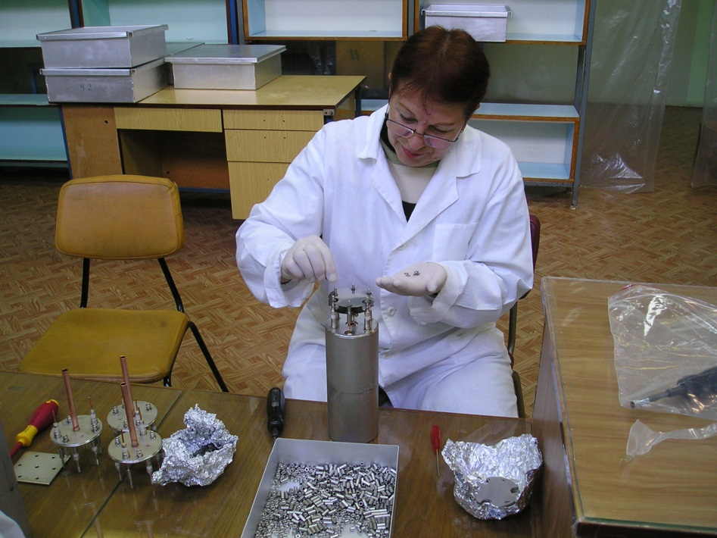
Some Stage of Manufactory at IHEP
ASSEMBLY

Slide 6
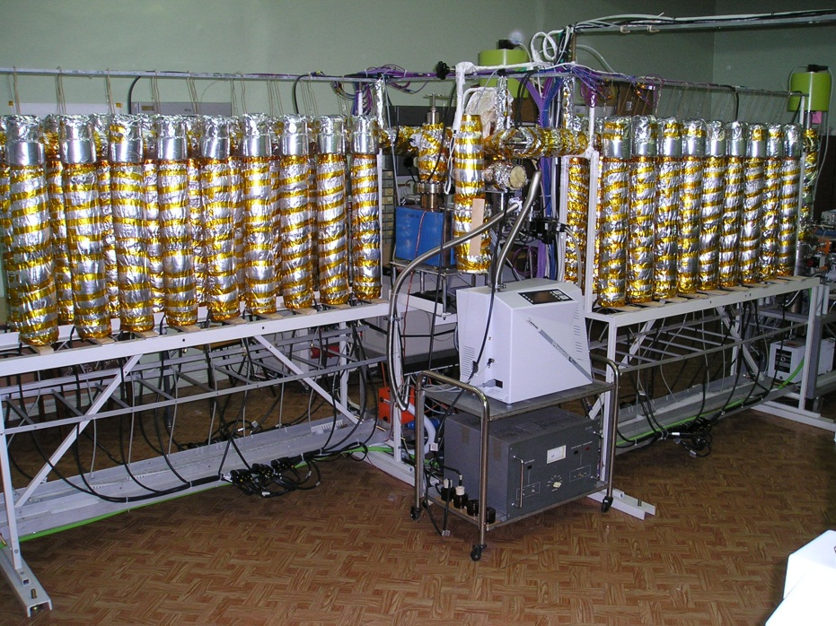
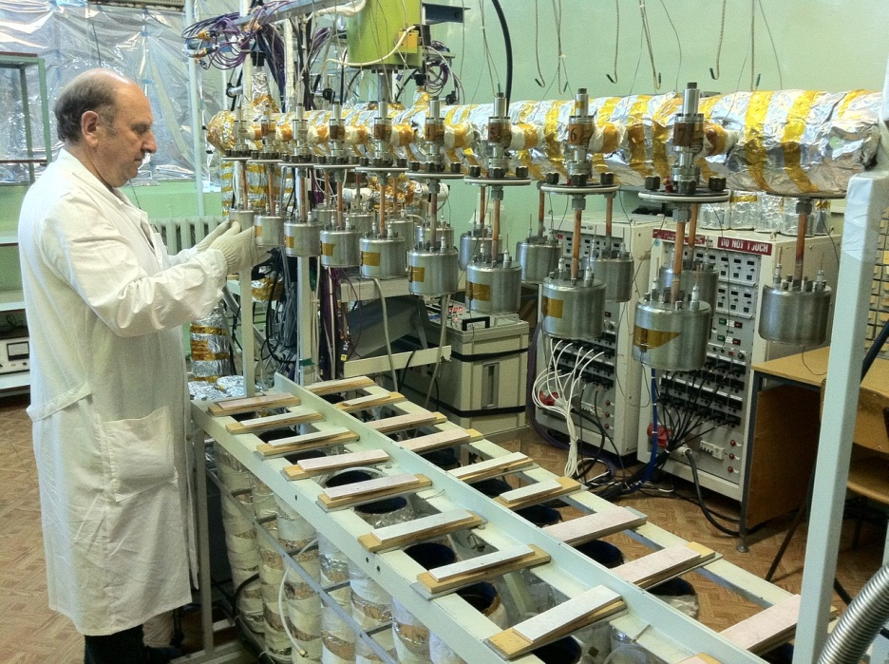
IHEP UHV production stand
for IC production (left) and LIC

Slide 7
Some Stage of Manufactory in IHEP
Cut off LIC
Soldering

Slide 8
Some Stage of Manufactory at IHEP
Electrical testing
IHEP Team

Slide 9
Summary of Manufactory at IHEP for CERN
2005—2011 years
IC -- 4100 st.
LIC– 315 st.
SEM—350 st.

Slide 10
Tests and Experience on varied beams of IHEP

Slide 11
The read out electronics consist of a Current to Frequency Converter that digitize the signals and integrates them.

Slide 12
Measurements of the integrated beam intensity per spill up to 5*10E10
Set up of the high luminosity test beam for ATLAS forward calorimeter. Different LHC luminosities have been simulated experimentally by varying the beam intensities at constant beam energy of 60 GeV using the bent crystal technique for beam extraction
Absolute calibration was done activated foils

Slide 13
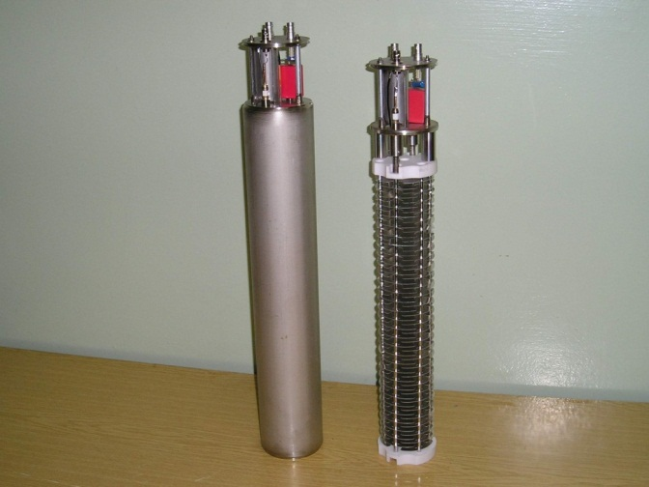
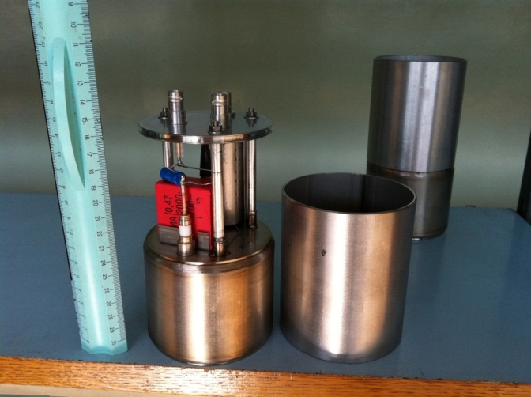
Comparison of Losses for IC and LIC
IC 1.5 l;N2; 1100mbar LIC 0.05l; N2; 400 mbar
ICC
Range of intensity: IC 10e6-5*10e10; LIC- up to 2*10e11 (data of CERN)

Slide 14
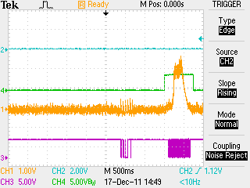
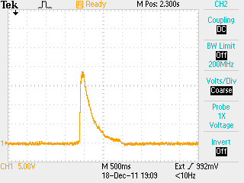
Comparison signals LIC and IC. Beam of ions C+6, 440 MeV/u, 10E9 C/s
LIC
IC/LIC~10

Slide 15
SEM for differ usage
IHEP SEM for measure of beam intensity IN/OUT windows have thin (0.2) walls.
SEM for LHC BLM

Slide 16
The Intensity Detector of the slowly extracted beam (10E11 -10E13 ppp)
IHEP SEM on proton 60 GeV beam
Signal of IHEP SEM

Slide 17
Long time stability of intensity protons on target (green-SEM) (Channel #21 for RF separation K mesons)

Slide 18
Protons and light ions for medical irradiation centre of IHEP (Protvino)
IHEP’s experts are currently working on the creation of a medical irradiation centre with beams of protons and carbon ions on the basis of IHEP acceleration complex. Already existing IHEP accelerators I-100 – U-1,5 – U-70 are forming a complete chain capable of accelerating not only protons, but also, light ions: deuterons and carbon.

Slide 19
Slow extraction Beam of Carbon from U-70 to 34 ss by means Septum

Slide 20
Bragg peak C+6 440 MeV/u L~ 300 mm

Slide 21
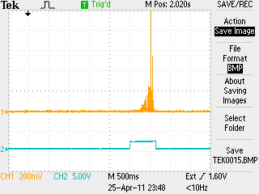
Si detector 3x3 cm2
We try used Si detector, but its had lifetime very small (several hours, D~100 Gy/s)
Signal of Si detector. Carbon I~ 10E8 Its will more useful used diamond.

Slide 22
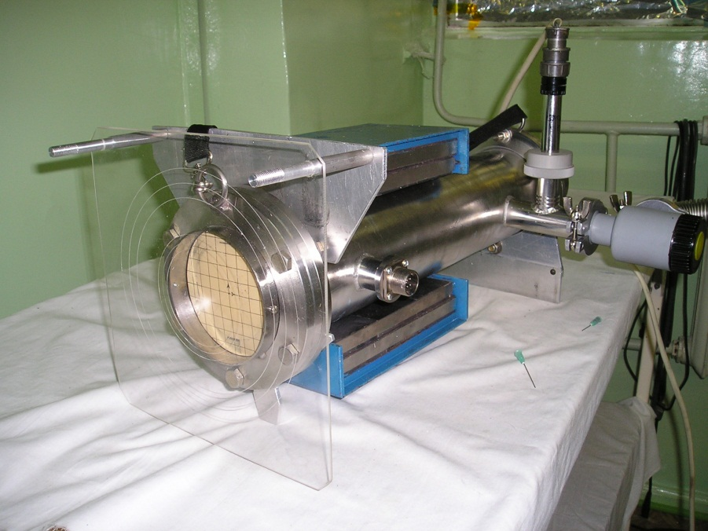
The Compact Faraday Cup for Radiobiological Researches in IHEP
Autonomic Faraday Cup (FC)
Manufacturing, clearing of details and tests of FC were spent in HUV stand IHEP
Vacuum inside the cylinder is 3*10-e3 torr FC has been tested for tightness with leak founder with sensitivity ~ 10e-12 l*mbar/s
The compact autonomic Faraday cup which works in atmospheric environment has been developed to measure currents in the accelerators beam. One of the important specificities of the device is ability to work without pumping out for a long time. FC kern (200 mm of carbon) has the property of absorbing various particles ( and energies) as was used for radiobiological researches in IHEP.
Additional application this FC is more easy change location.
<>

Slide 23
Thanks
B. Dehning, G. Ferioli ,
E.B. Holzer, I. Wevers,
and other collaborators
of the BI BLM Group

Slide 24
Conclusion
2oo5- 2011 years
IC ~ 4000; LIC ~ 320; SEM ~ 400.

Slide 25
Comparison wave integral LIC/SEM (Data of CERN)
SET UP 0,4bar LIC and SEM, 1500V
LIC/SEM Ratio of integrals increases

