Slide 1
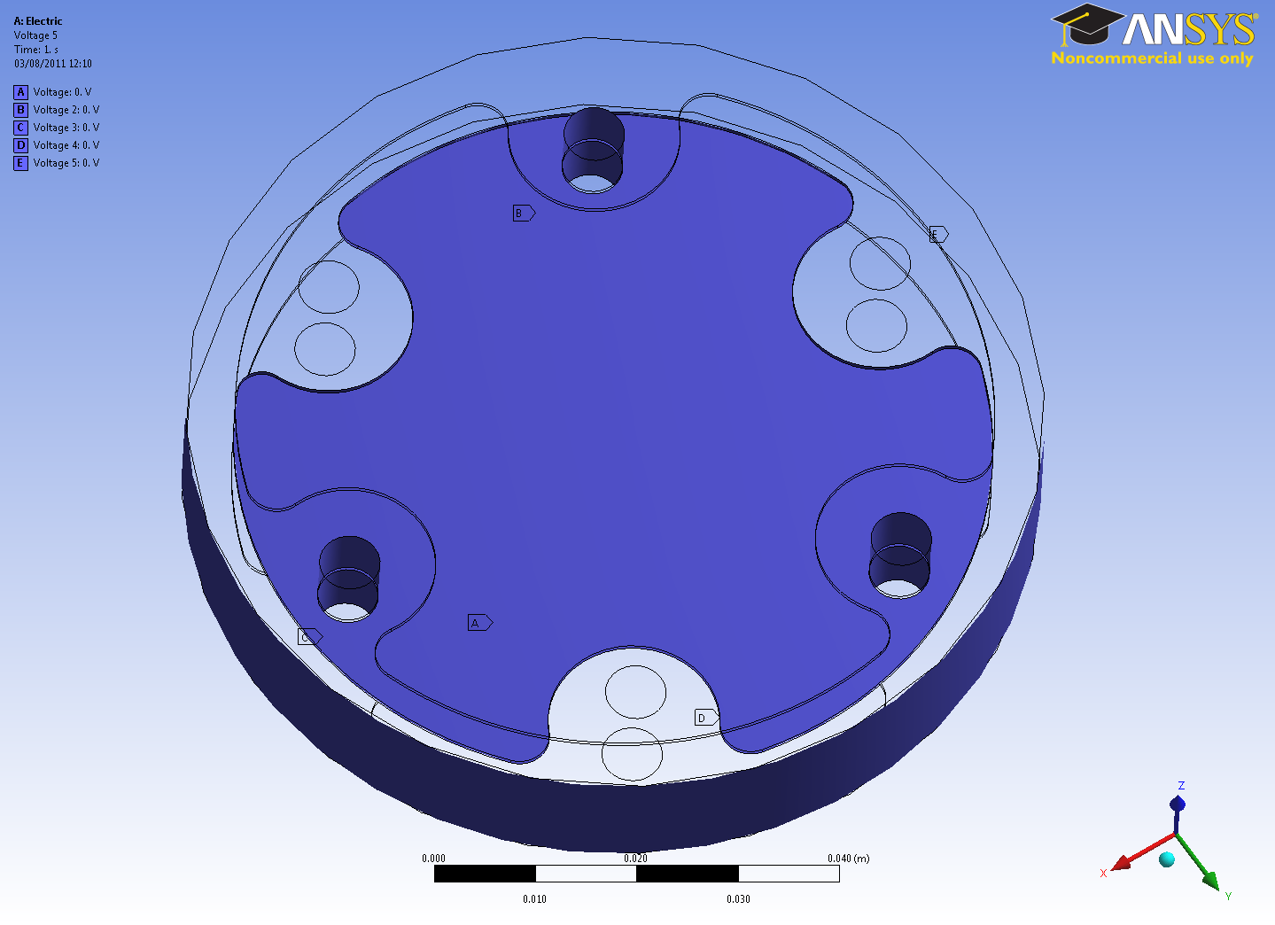
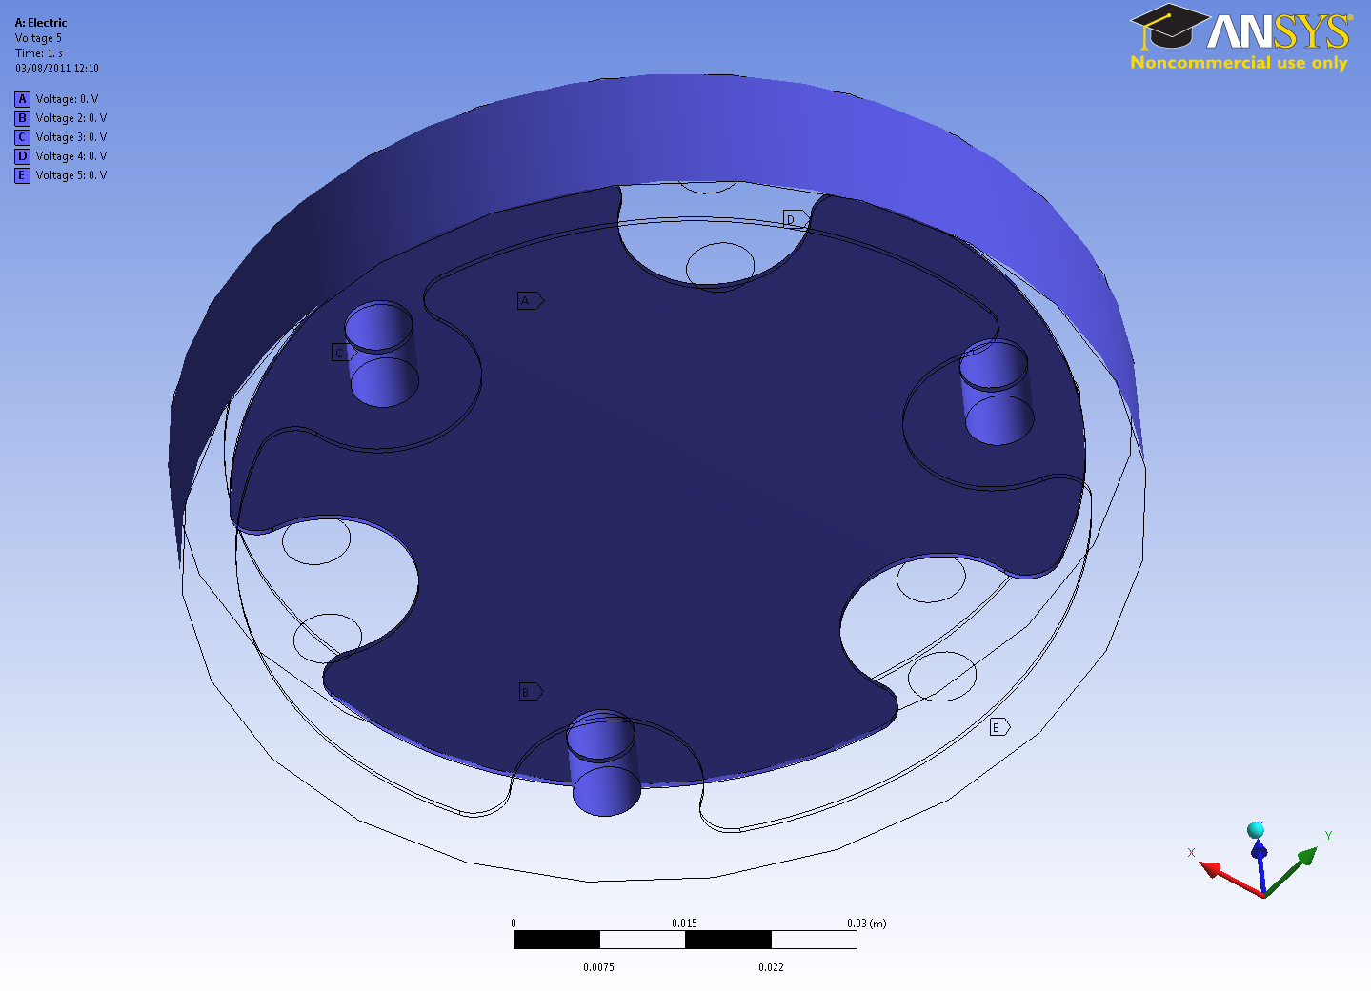
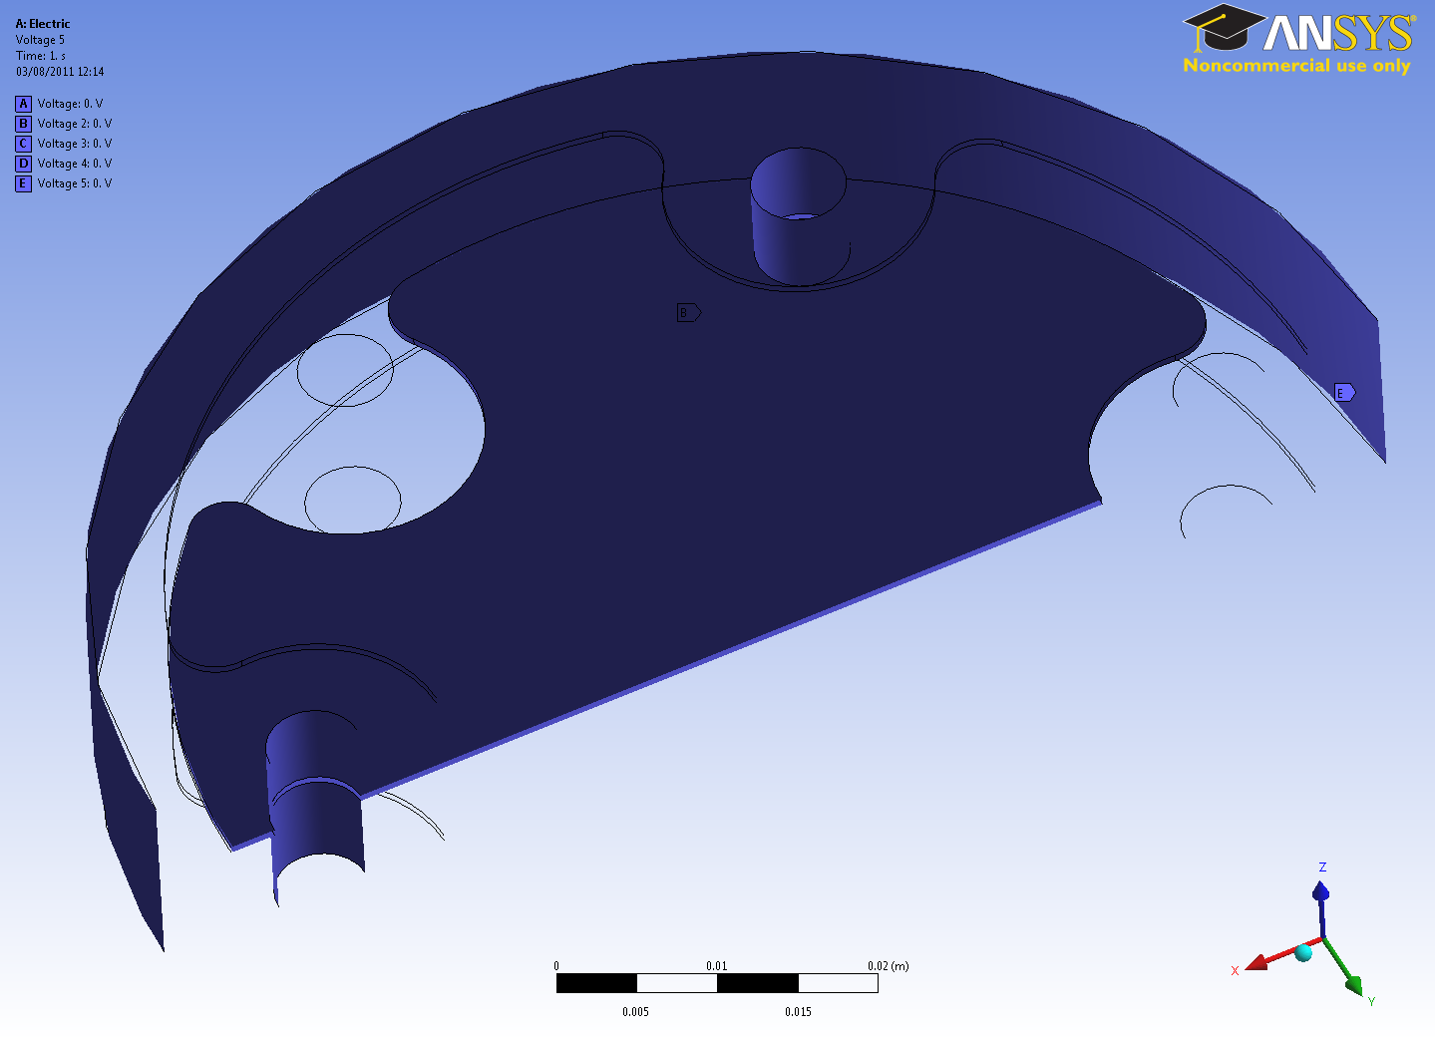
LICs Electric Field Lines Simulations
Boundary Conditions
DRAFT FOR DISCUSION
Boundary conditions for both models
LIC0 and LIC1
LIC0: as it is now
LIC1: central plate “arcs” diameter
25 mm instead of 17 mm
Material: Air, 2e16 ohm*m
0 V
0 V
0 V

Slide 2
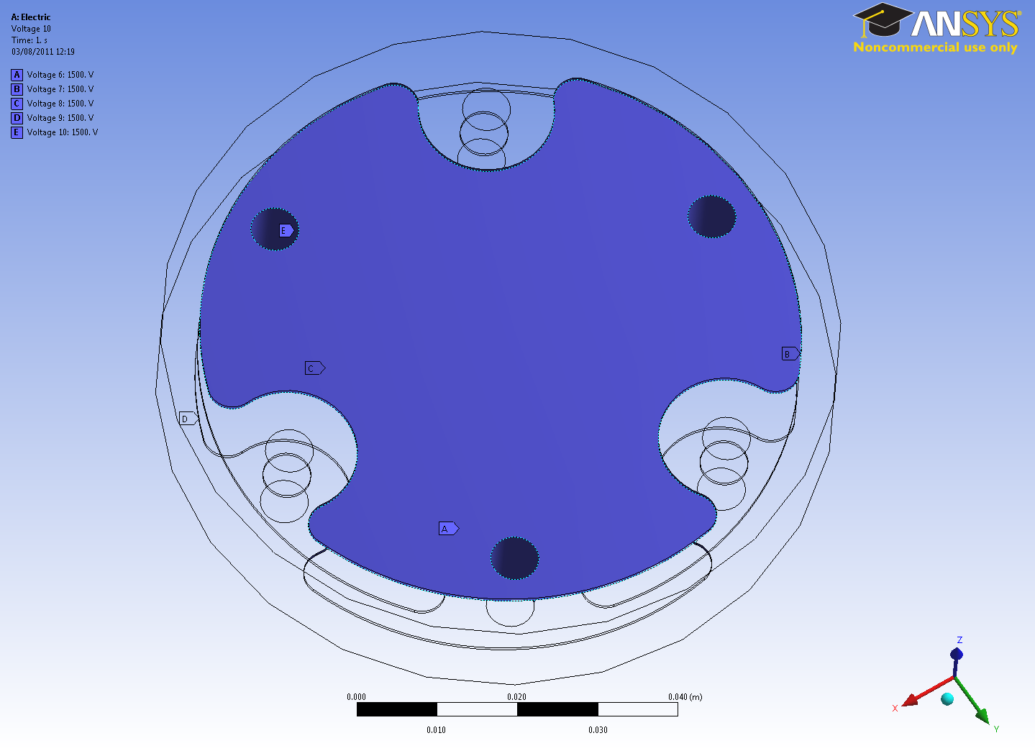
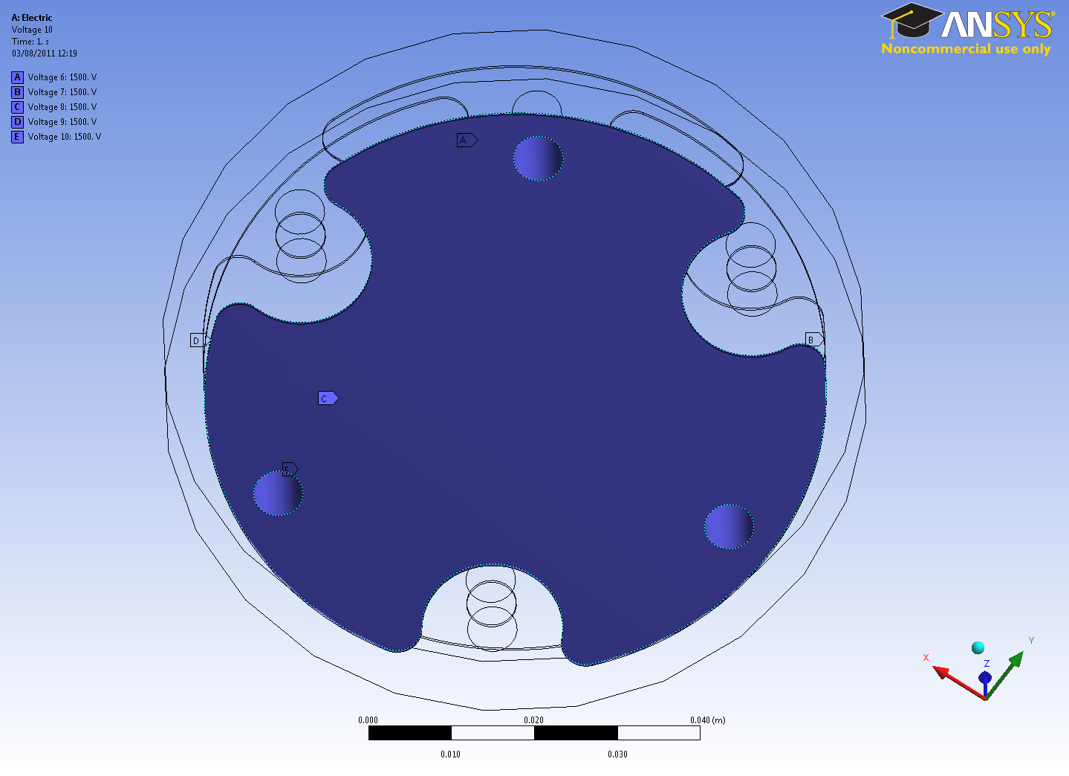
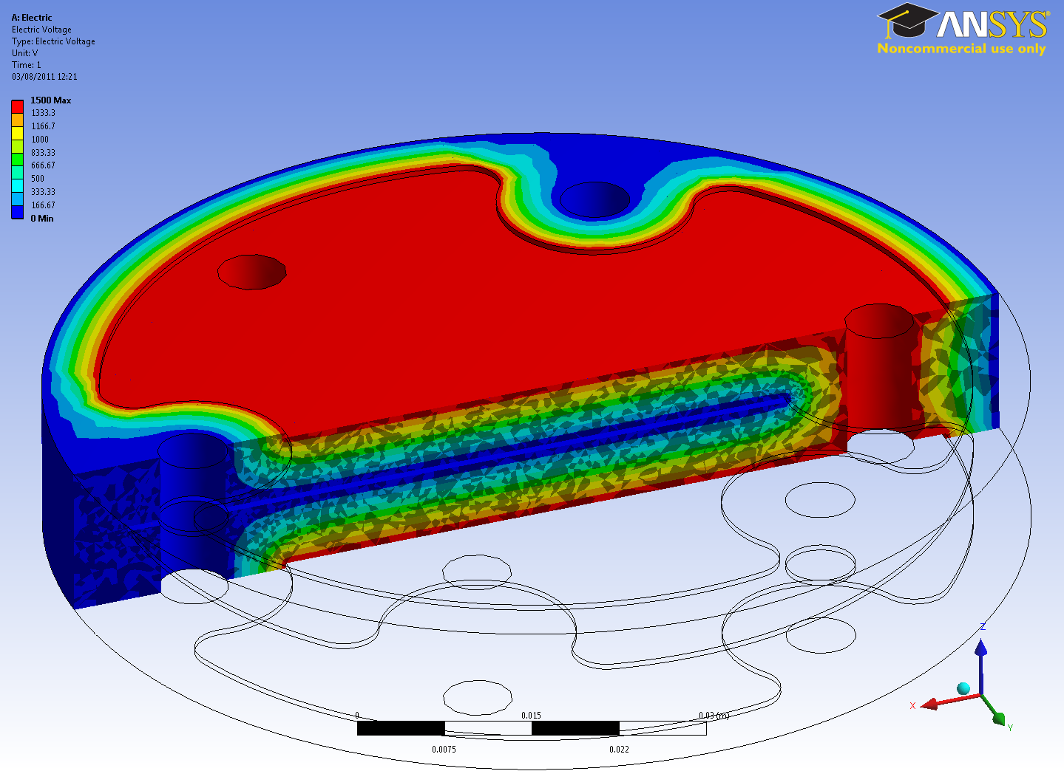
LICs Electric Field Lines Simulations
Boundary Conditions
DRAFT FOR DISCUSION
1.5 k V
1.5 k V
1.5 k V
0 V

Slide 3
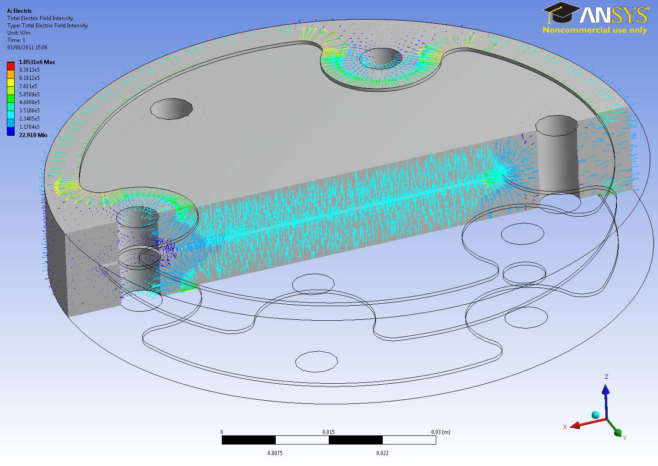
LICs Electric Field Lines Simulations
Results
DRAFT FOR DISCUSION
Model LIC0

Slide 4
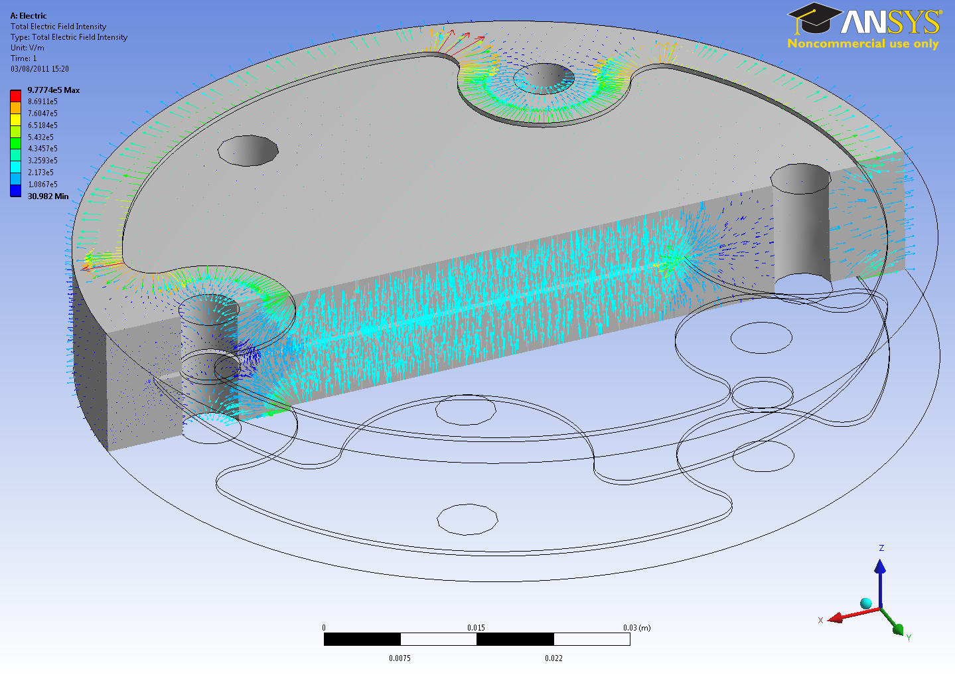
LICs Electric Field Lines Simulations
Results
DRAFT FOR DISCUSION
Model LIC1

Slide 5
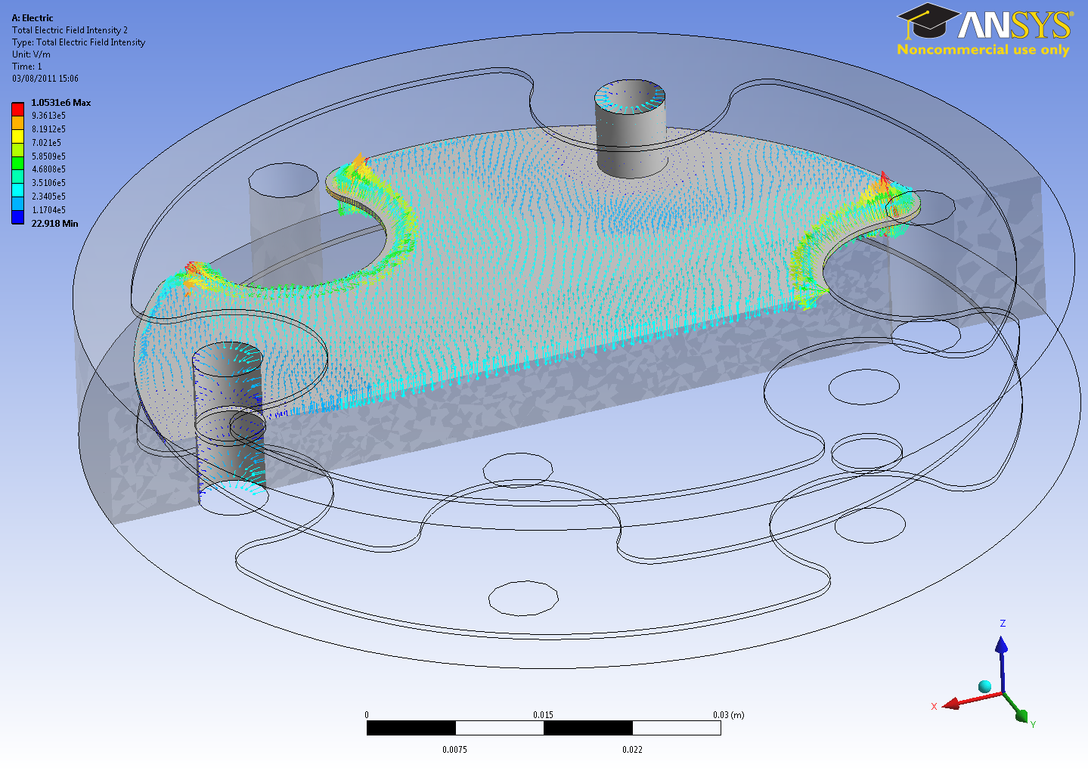
LICs Electric Field Lines Simulations
Results
DRAFT FOR DISCUSION
Model LIC0
Nodal field SUM = 1.16e9

Slide 6
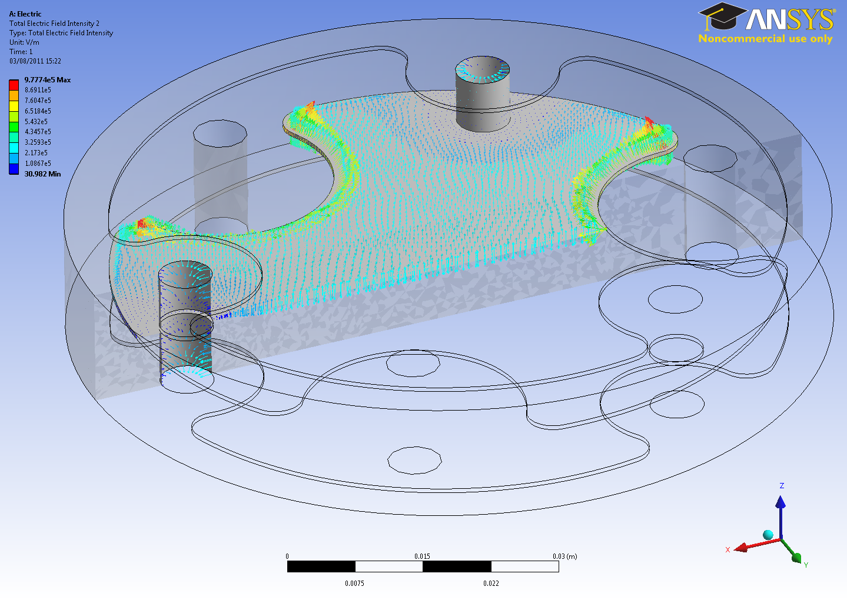
LICs Electric Field Lines Simulations
Results
DRAFT FOR DISCUSION
Model LIC1
Nodal field SUM = 1.04e9

Slide 7
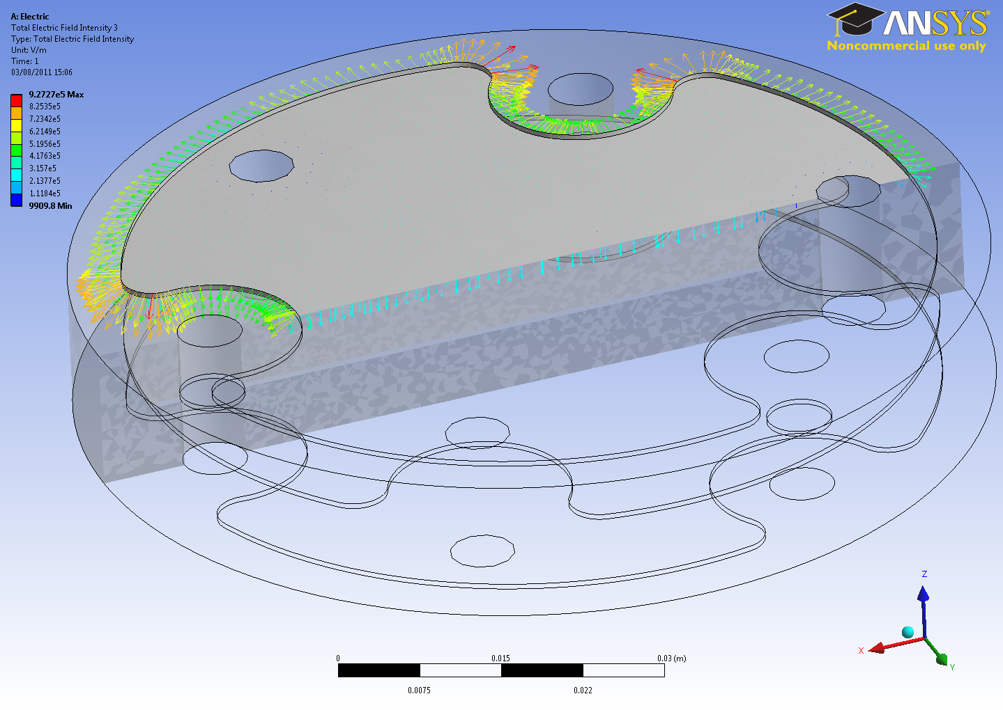
LICs Electric Field Lines Simulations
Results
DRAFT FOR DISCUSION
Model LIC0

Slide 8
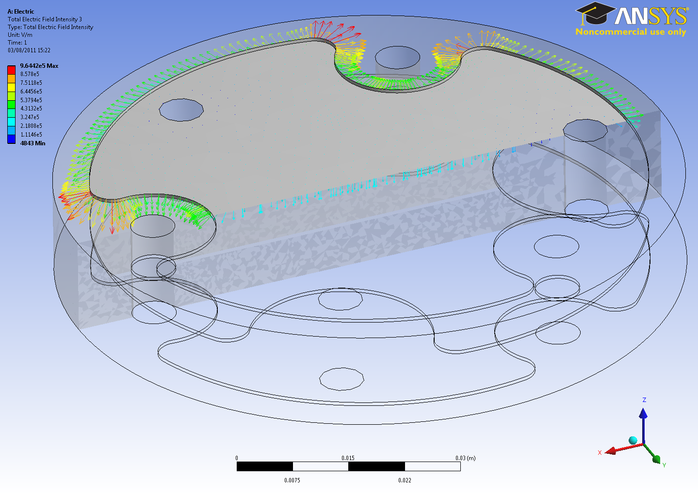
LICs Electric Field Lines Simulations
Results
DRAFT FOR DISCUSION
Model LIC1

Slide 9
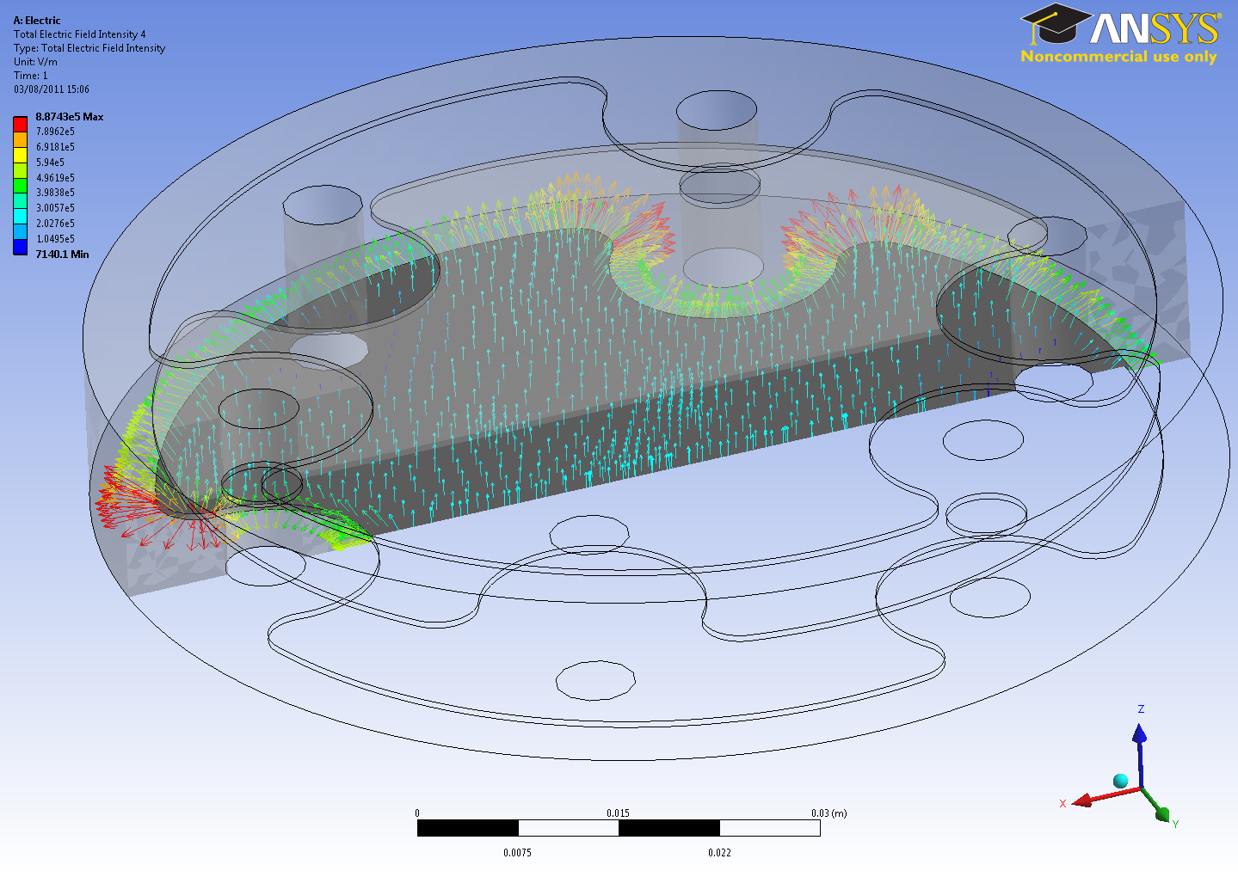
LICs Electric Field Lines Simulations
Results
DRAFT FOR DISCUSION
Model LIC0

Slide 10
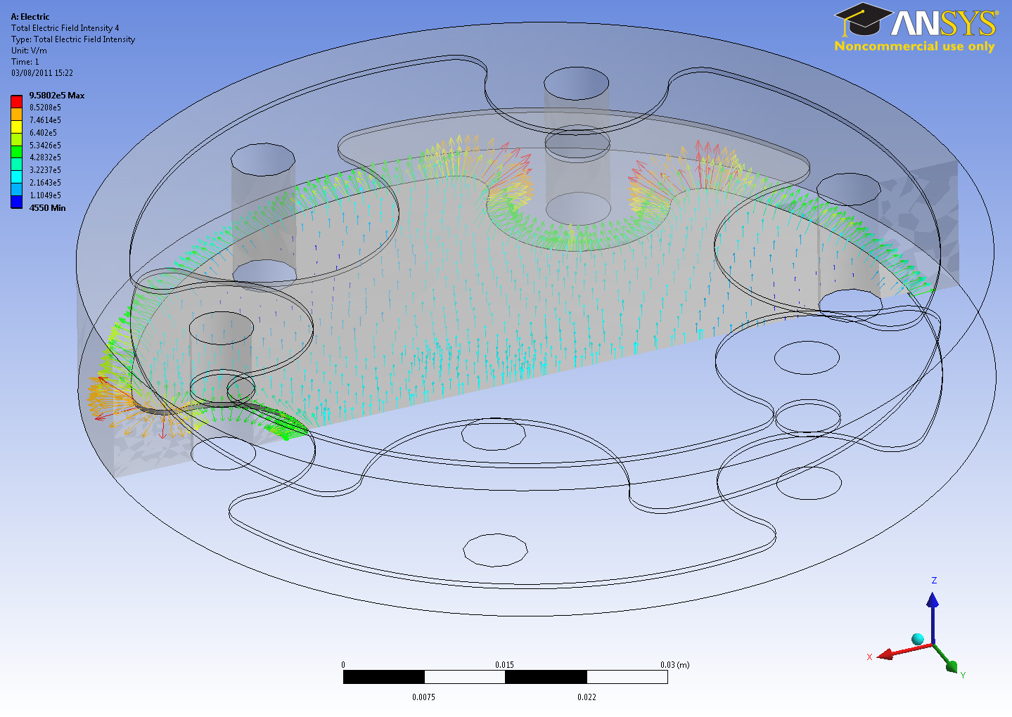
LICs Electric Field Lines Simulations
Results
DRAFT FOR DISCUSION
Model LIC1

Slide 11
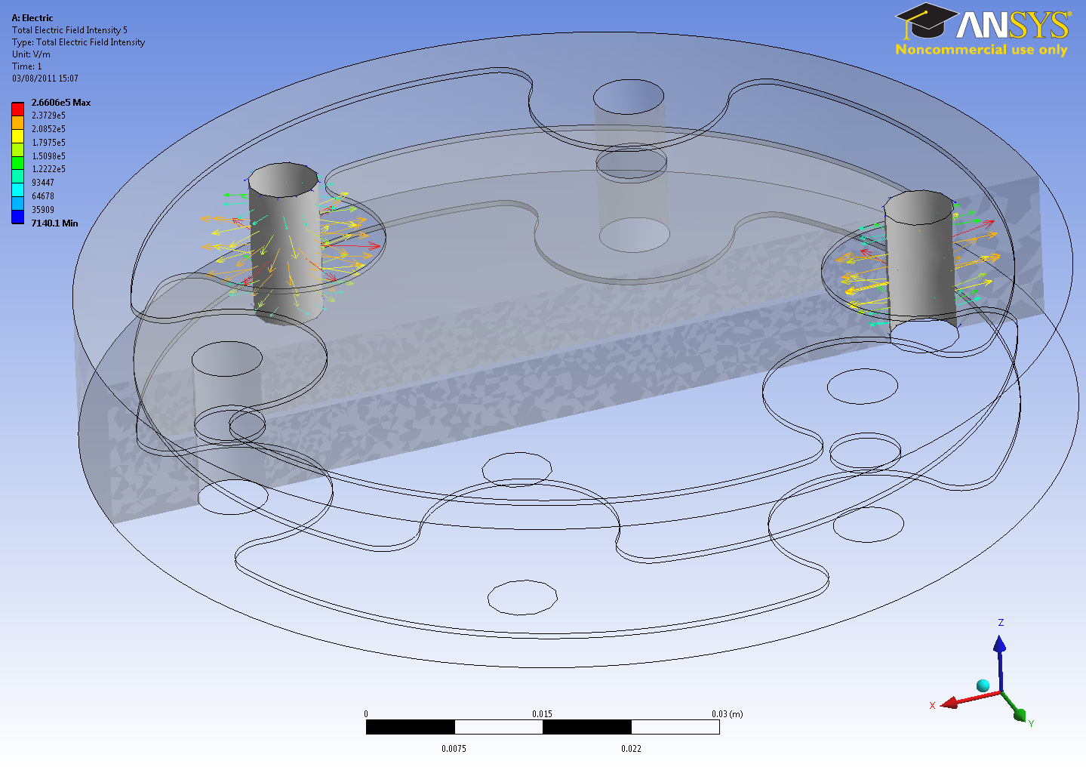
LICs Electric Field Lines Simulations
Results
DRAFT FOR DISCUSION
Model LIC0

Slide 12
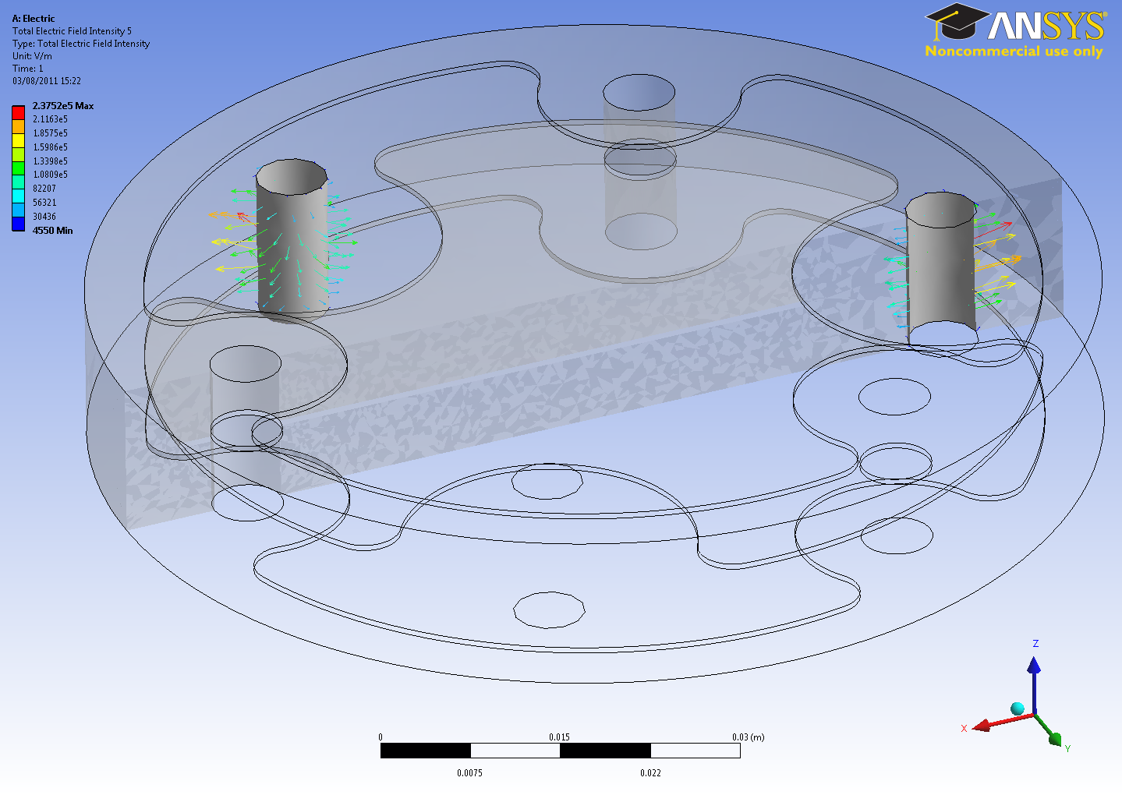
LICs Electric Field Lines Simulations
Results
DRAFT FOR DISCUSION
Model LIC1

Slide 13
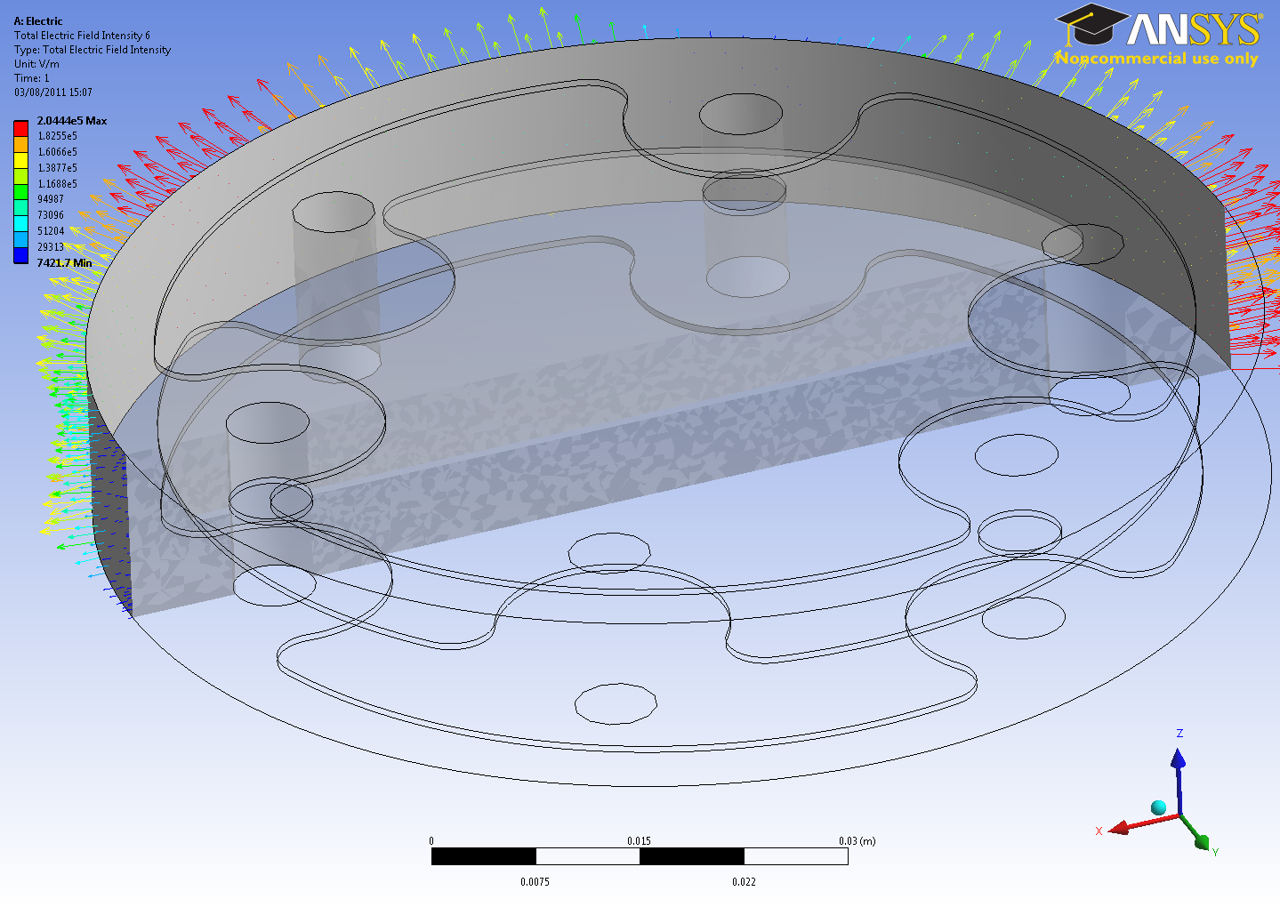
LICs Electric Field Lines Simulations
Results
DRAFT FOR DISCUSION
Model LIC0

Slide 14
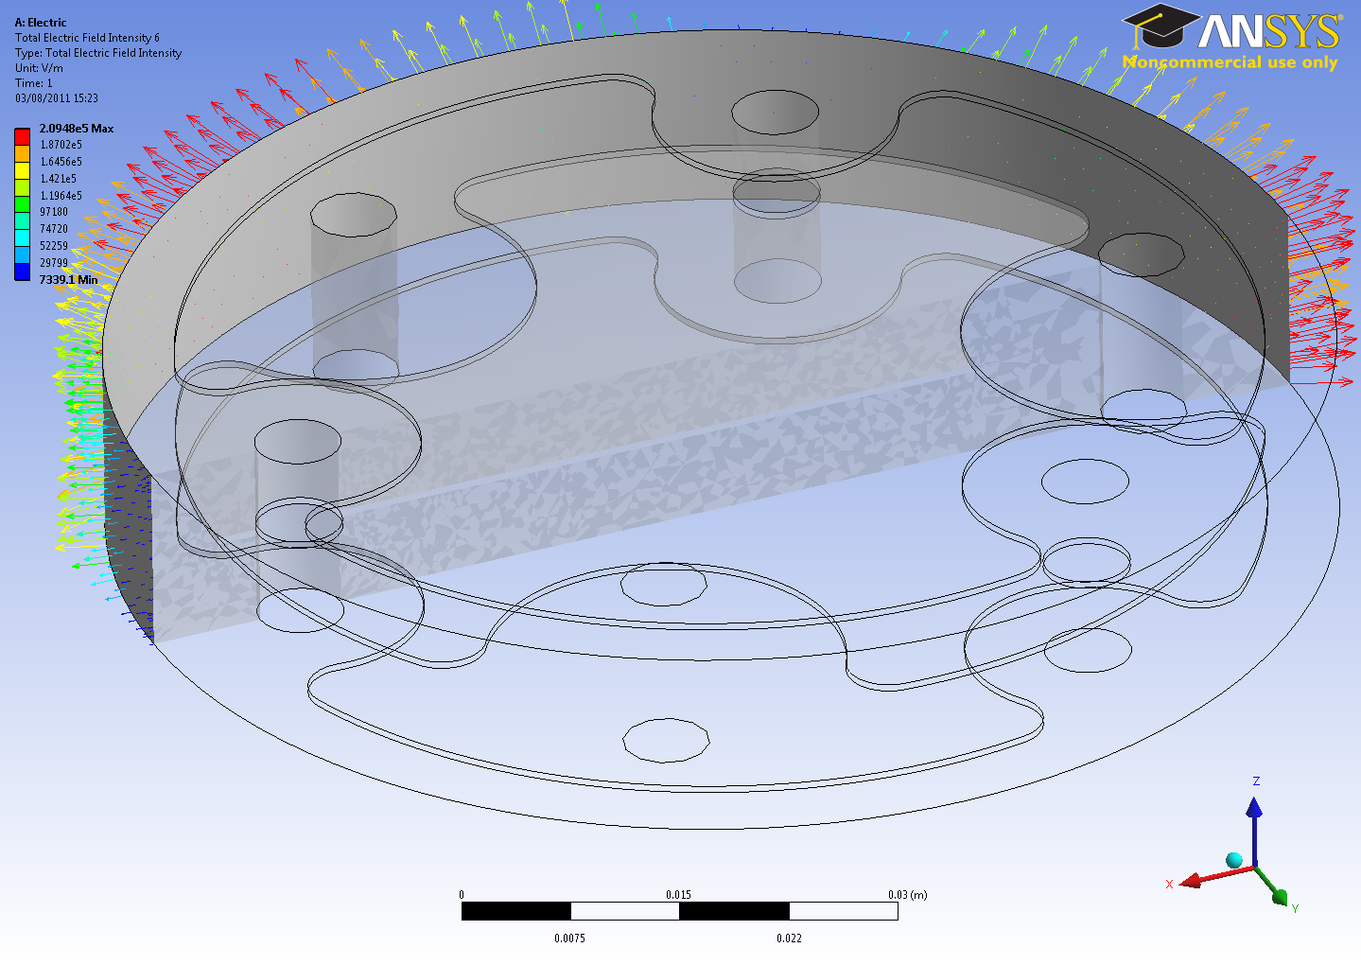
LICs Electric Field Lines Simulations
Results
DRAFT FOR DISCUSION
Model LIC1

Slide 15
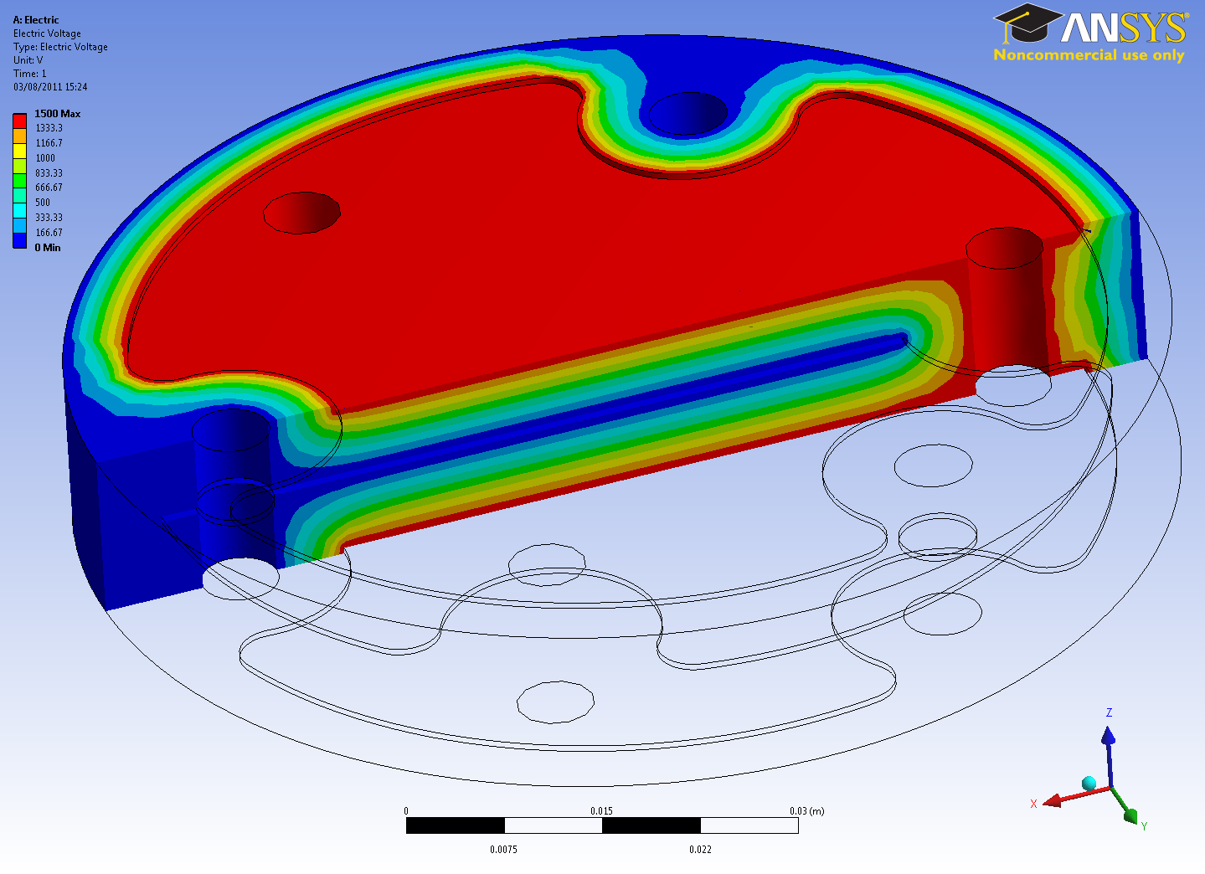
LICs Electric Field Lines Simulations
Results
DRAFT FOR DISCUSION
Model LIC0

Slide 16
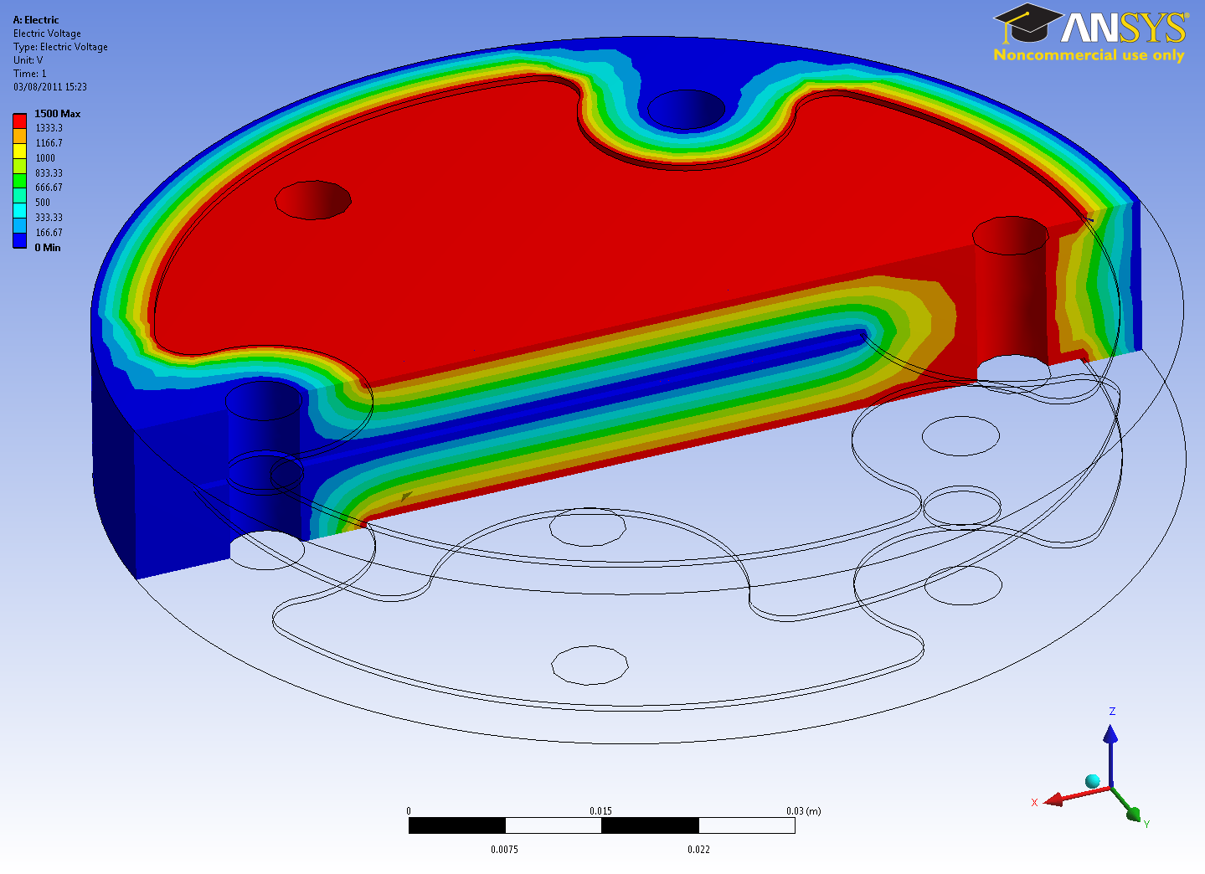
LICs Electric Field Lines Simulations
Results
DRAFT FOR DISCUSION
Model LIC1

