Slide 1
Slit electrode simulation using CST
20150115
20150121(modified)
Kenichirou Satou

Slide 2
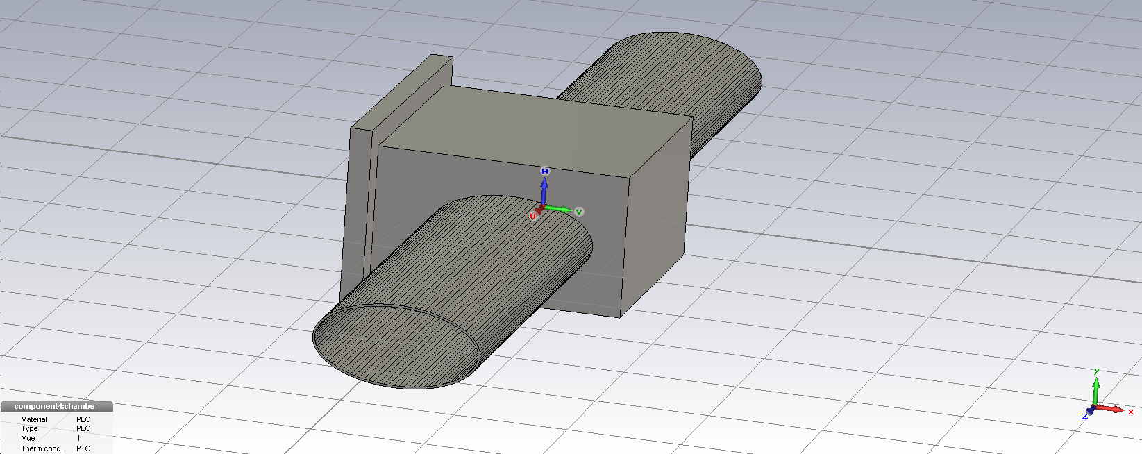
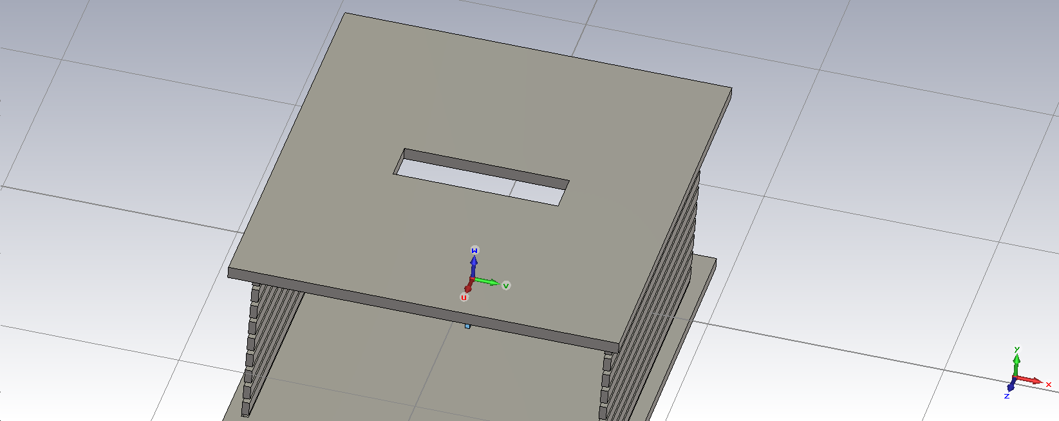
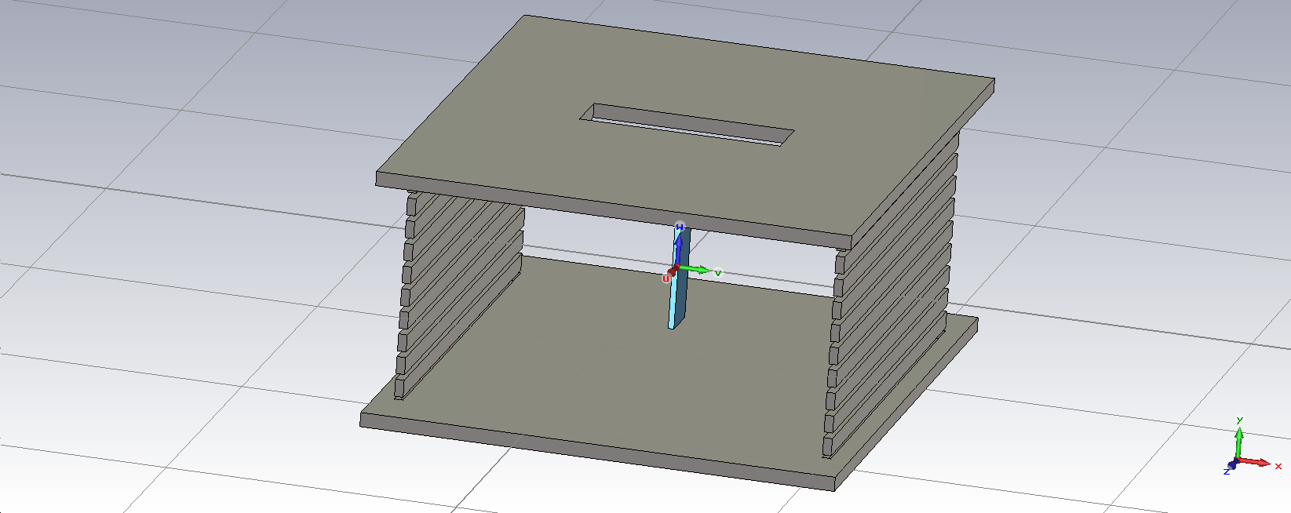
Model
70mm
20mm
70mm
146mm
Slit dimension
Slit
Chamber
HV:-20kV
RGP
Detector plate
Electrode

Slide 3
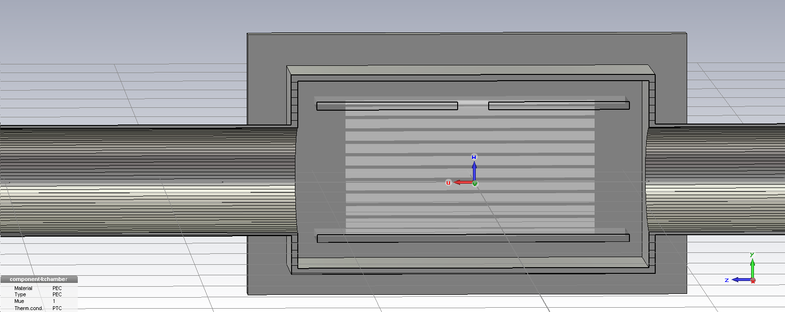
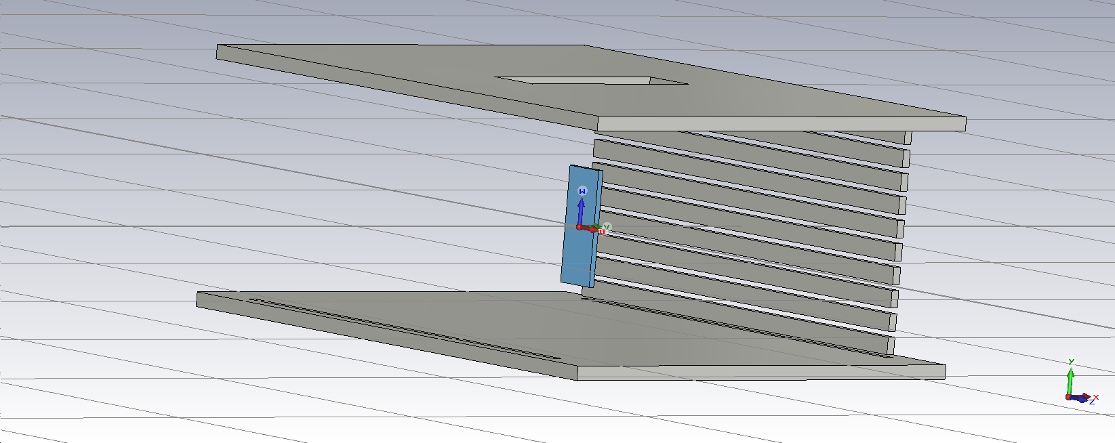
Model2
5mm
13.5
63.5
10mm
70mm
56.5
12.5
40mm
15mm
Electron source

Slide 4
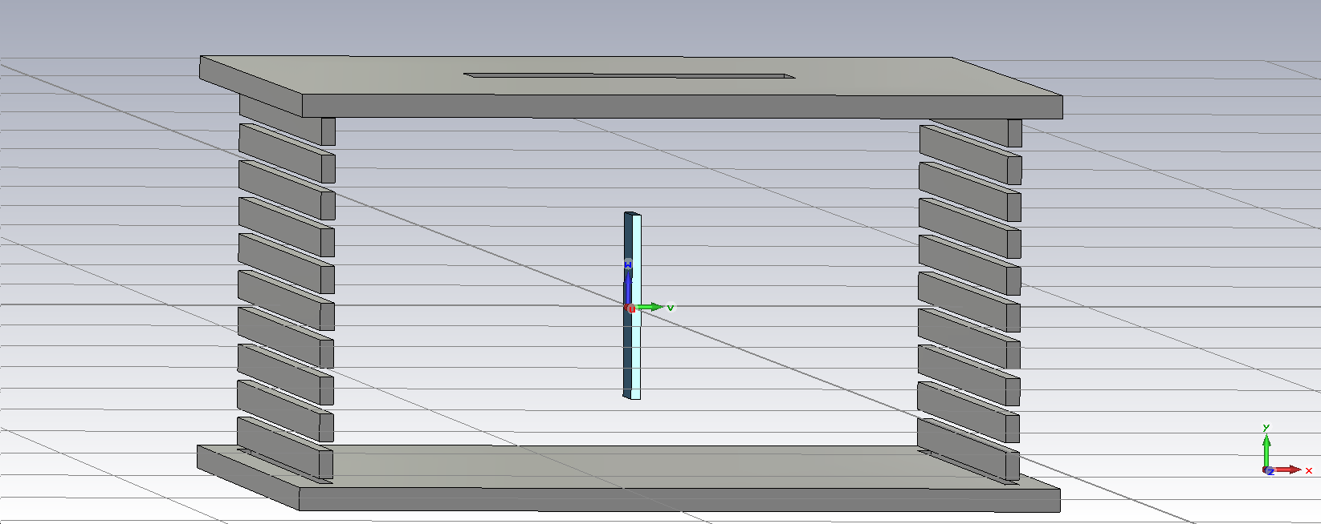
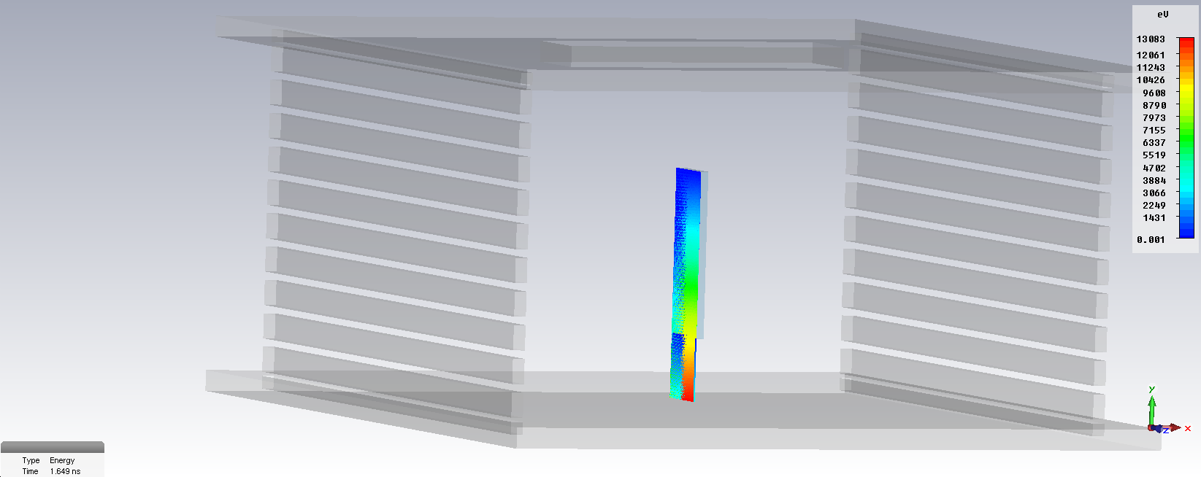
Electron emission model
y
x
s
Electron Initial Energy: Ei

Slide 5
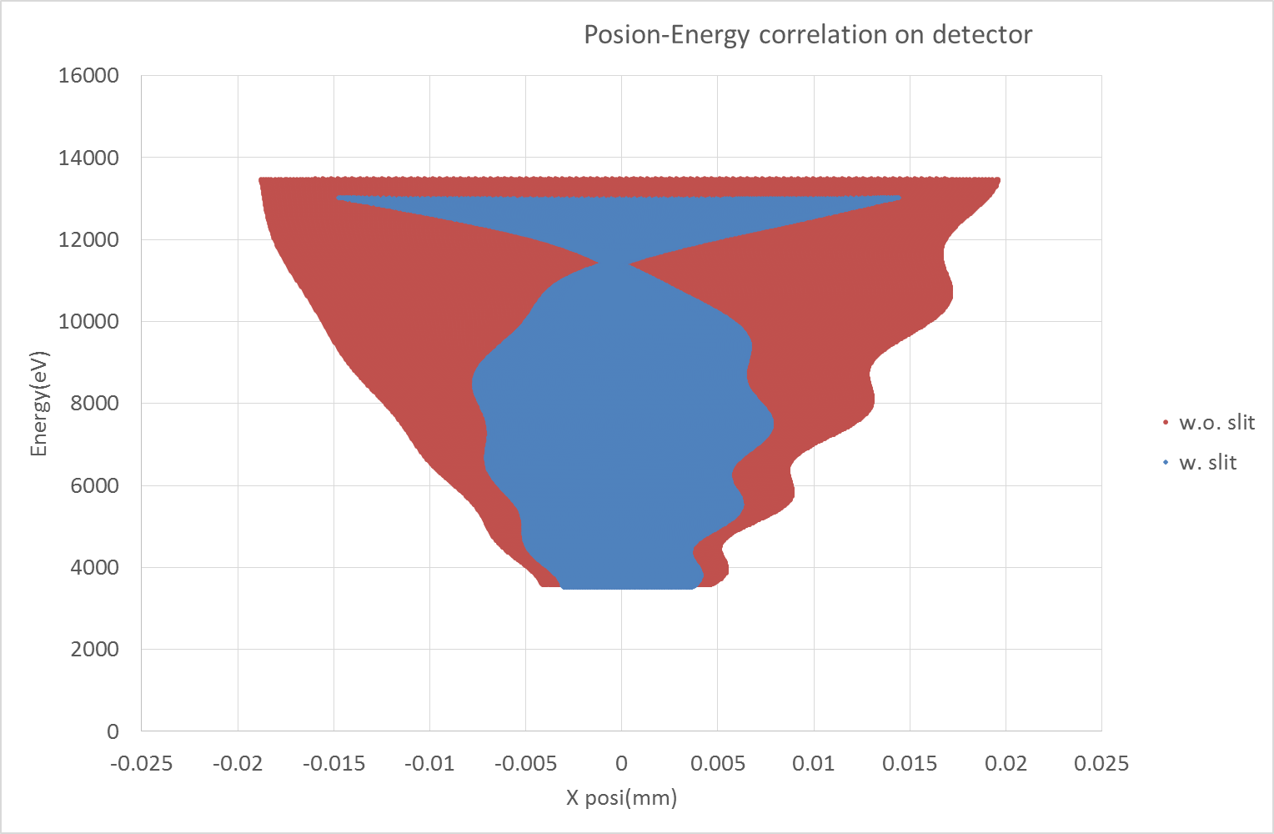
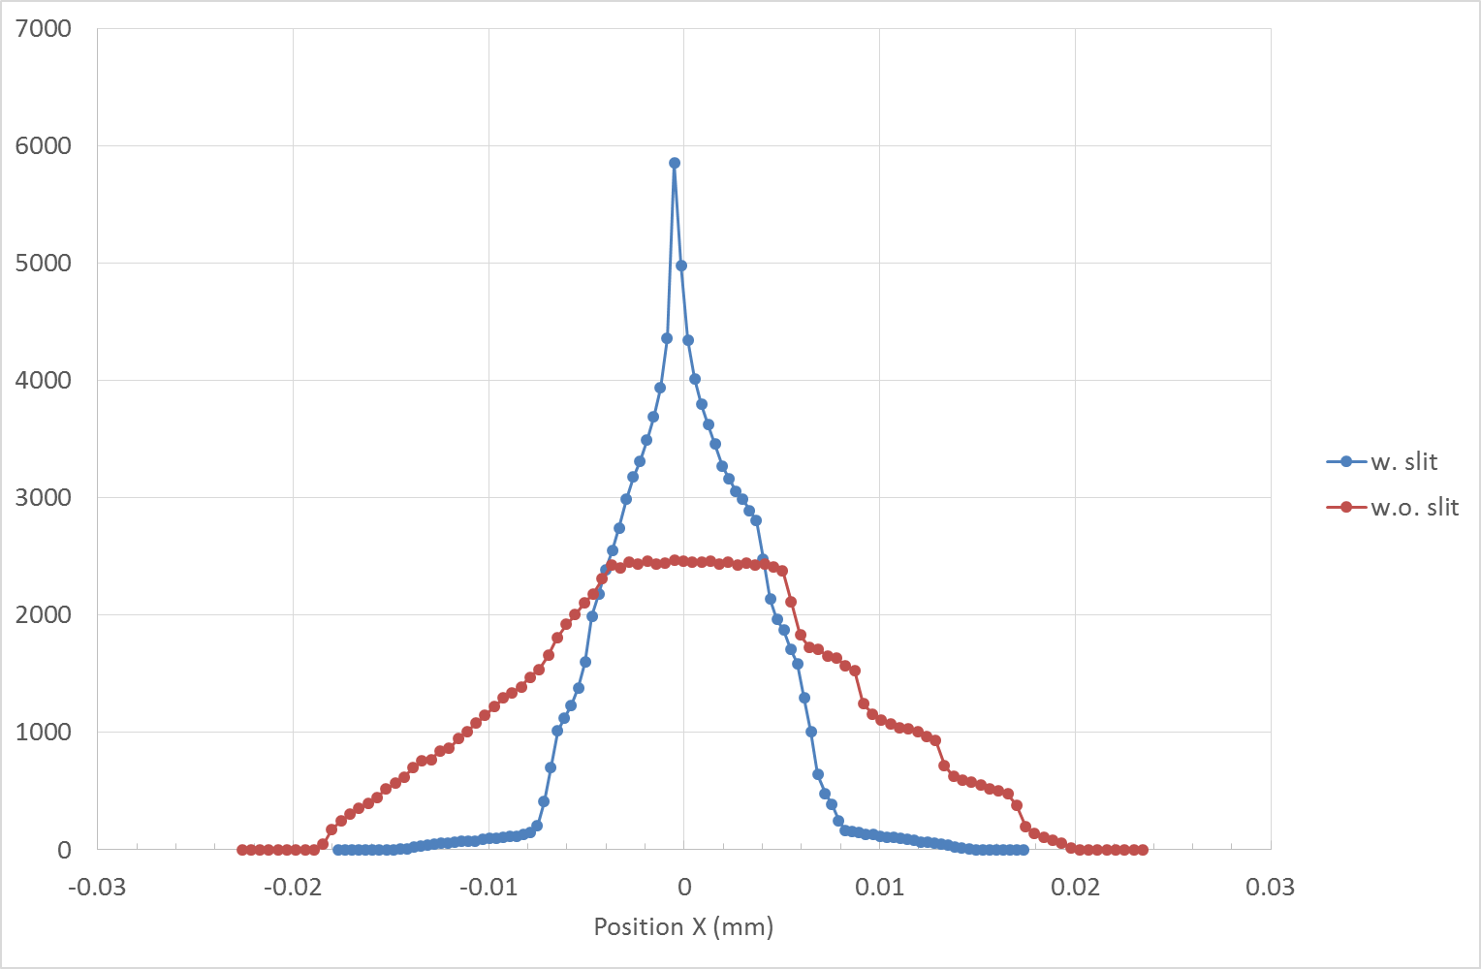
Electron tracking w./w.o. the slit
Assumption:
Ei set to 0.1 meV -> Gyration radius is negligible (0.17 µm)
Unit vector of the initial momentum is (-1, 0, 0) -> worst case
No beam space charge
By=0.2 T, Bx=Bz=0, set analytically
The Slit case is better than the non-slit case
as long as yi < 20 mm
yi=20mm electron
Energy corresponds to initial Y position (yi) of an electron
yi=0mm electron
yi=-20mm electron
10 µm

Slide 6
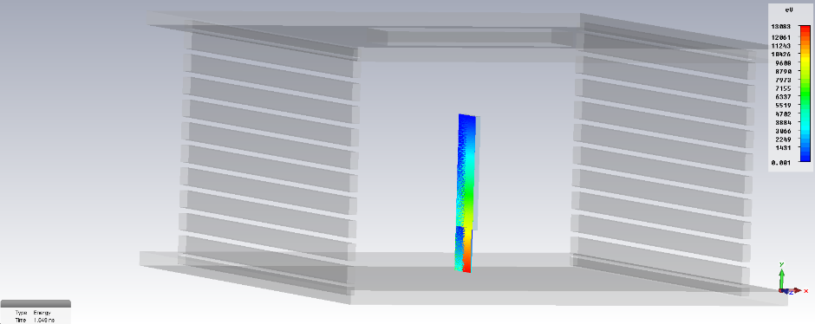
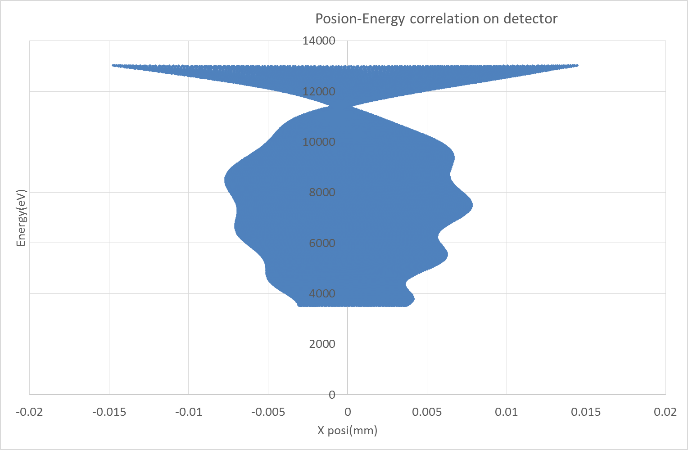
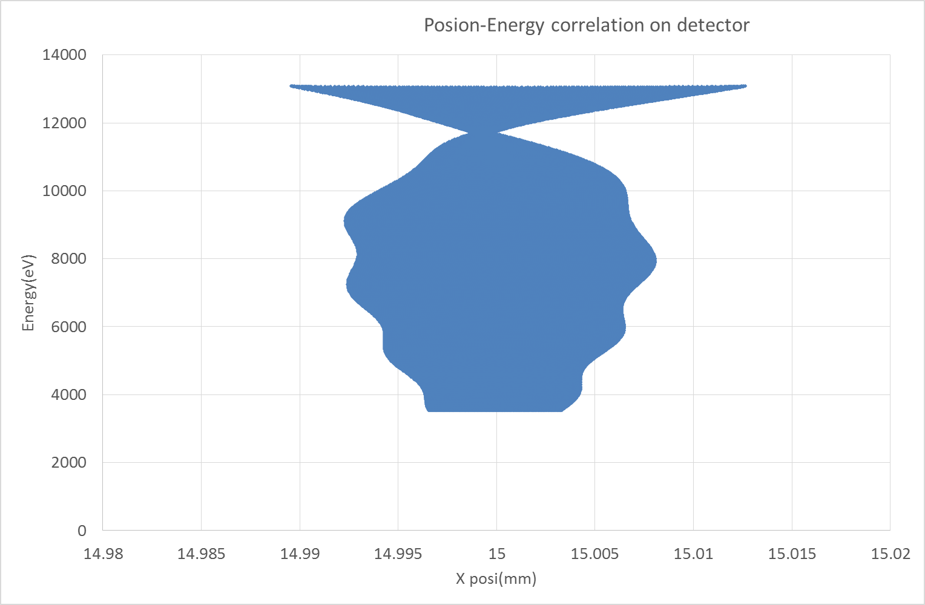
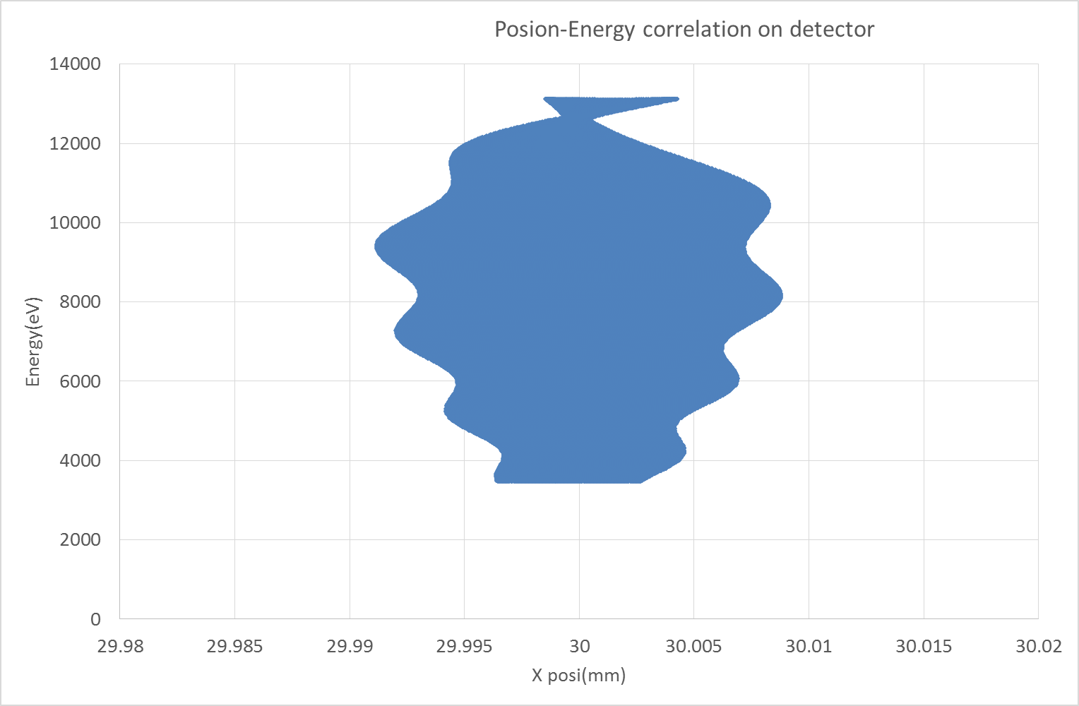
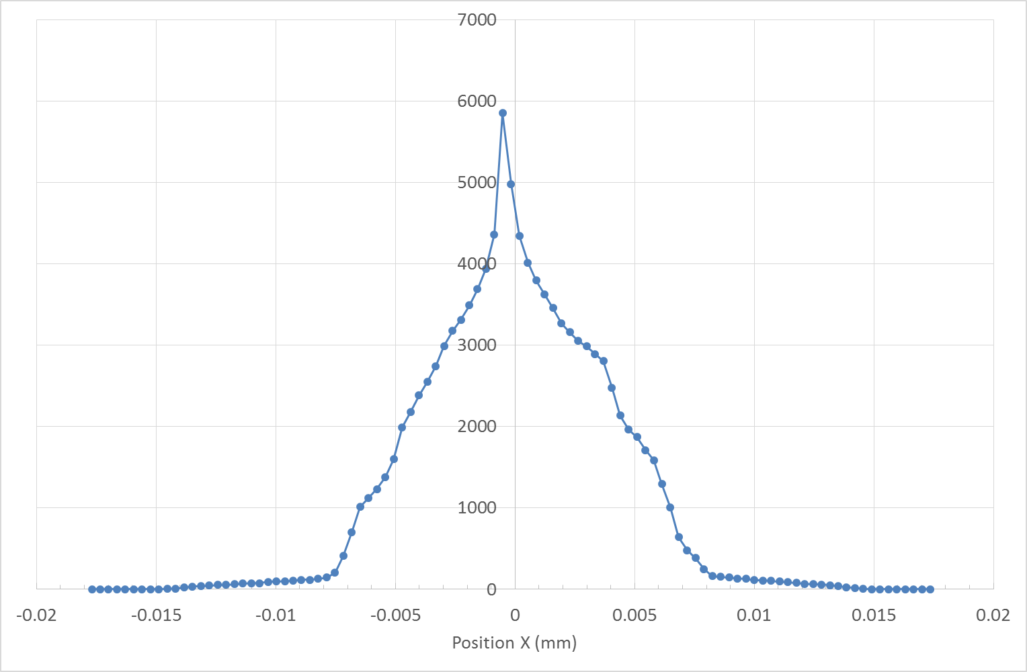
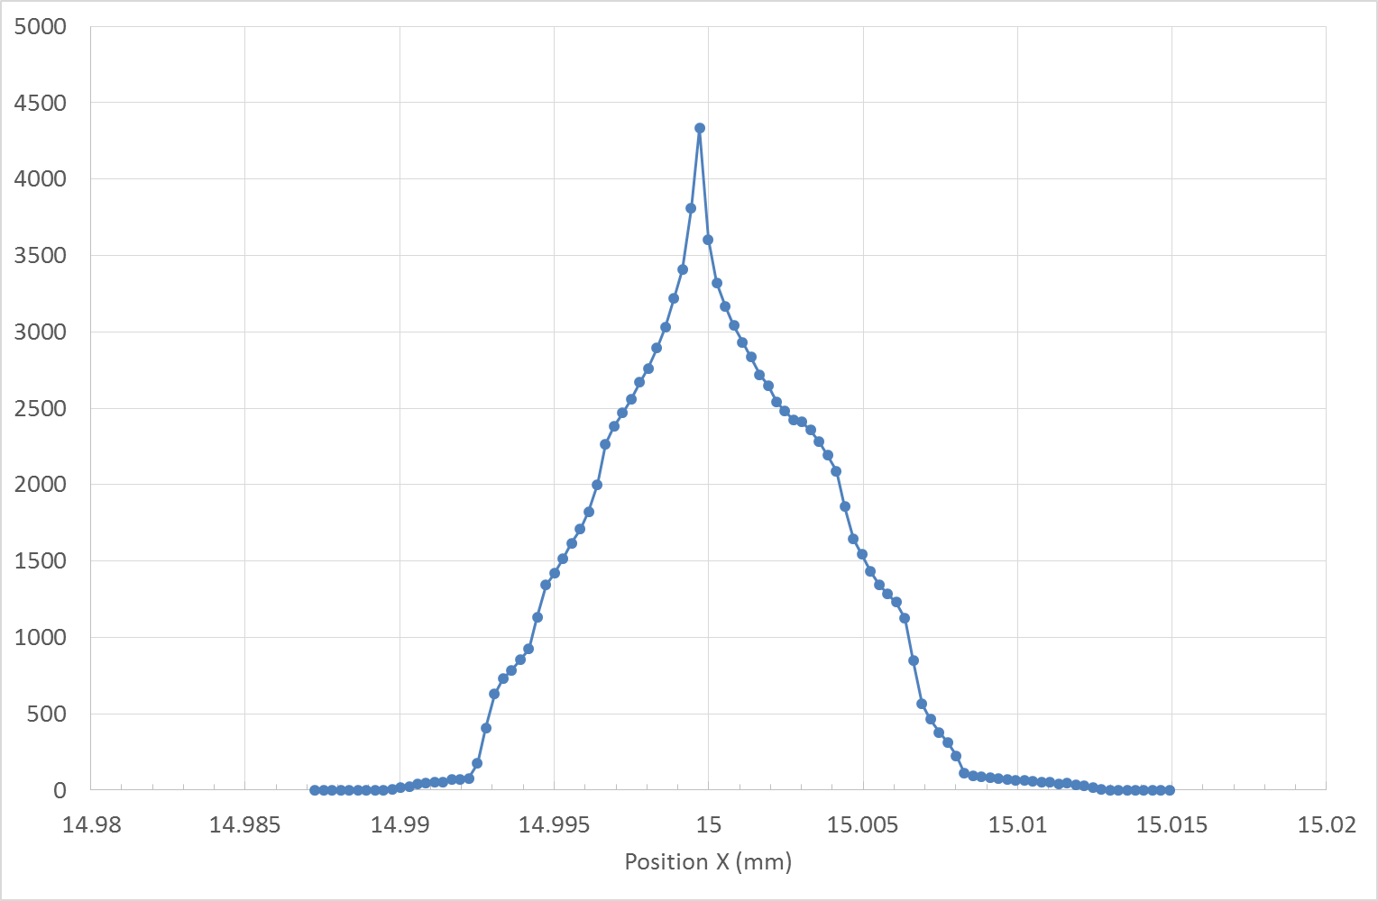
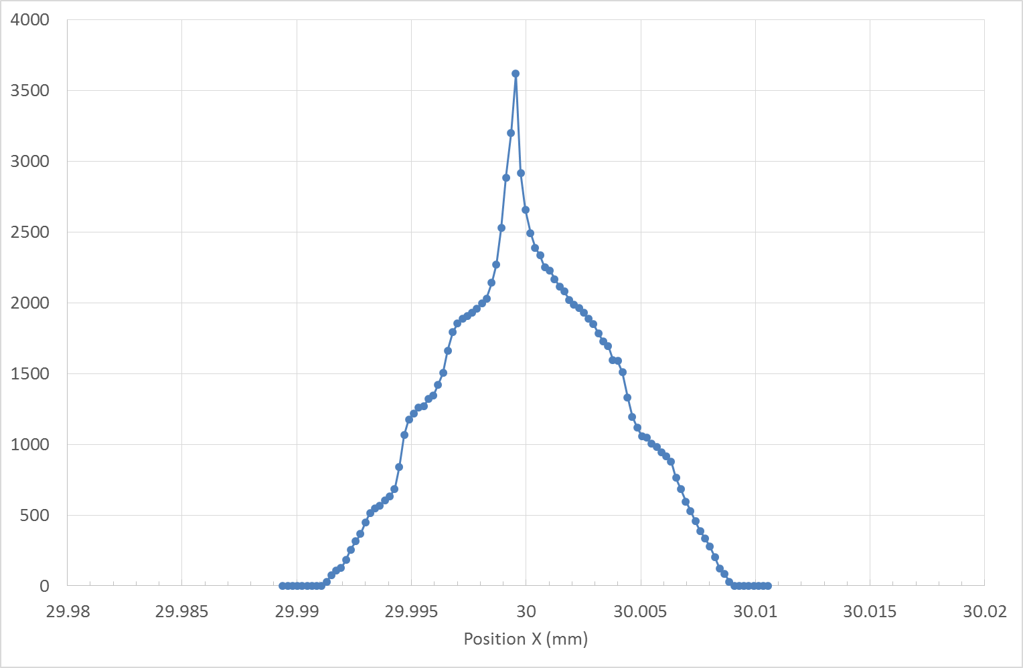
Electron tracking: Source position Xi
Assumption:
Ei set to 0.1 meV -> Gyration radius is negligible(0.17 µm)
Unit vector of the initial momentum is (-1, 0, 0) -> worst case
No beam space charge
By=0.2 T, Bx=Bz=0, set analytically
Source position Xi is set, 0, 15, 30 mm
Xi
0 mm
Xi
30 mm
Xi
15 mm
Xi=0mm
Xi=15mm
Xi=30mm
10 µm
10 µm
No tail

Slide 7
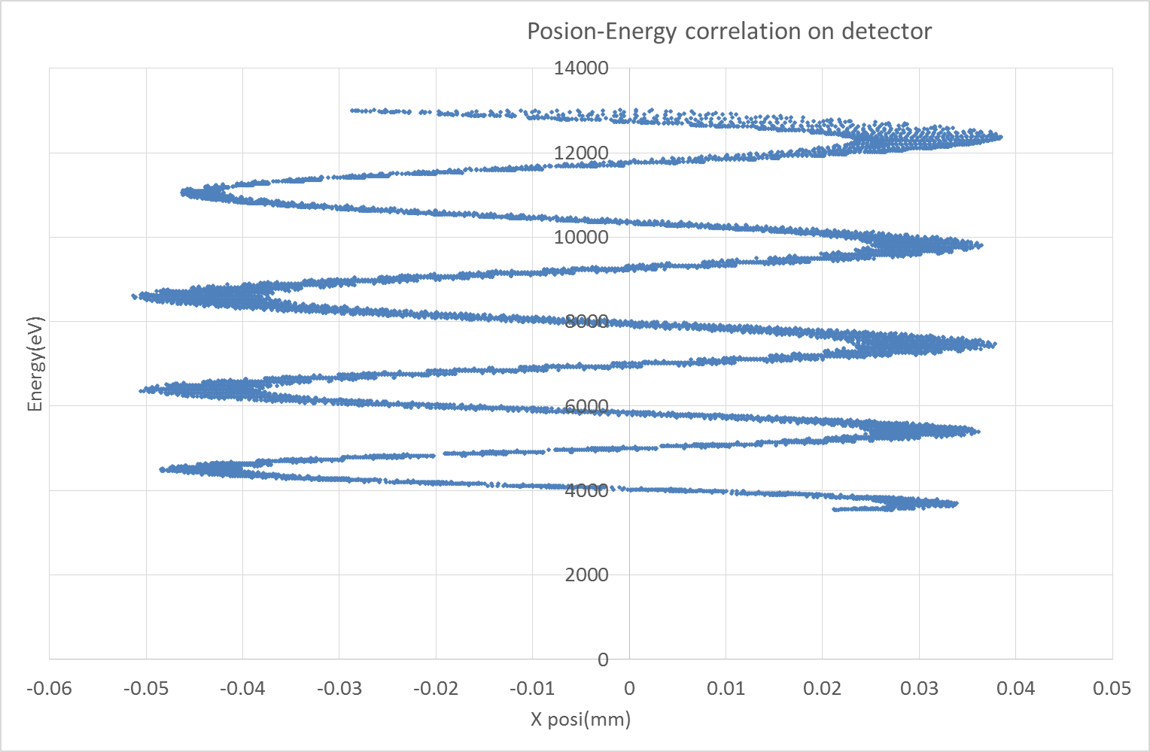
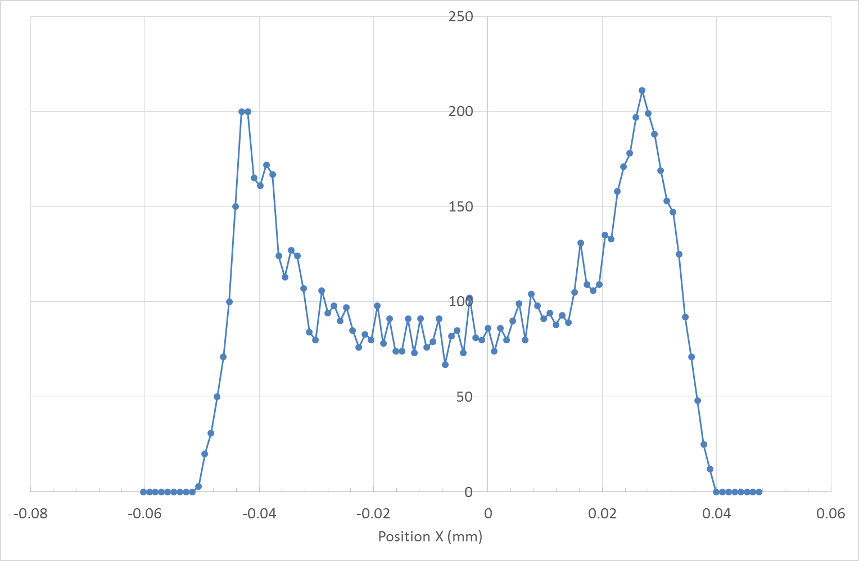
Electron tracking: Gyration motion
Assumption:
Ei set to 5 eV
Unit vector of the initial momentum is (-1, 0, 0) -> worst case
No beam space charge
By=0.2 T, Bx=Bz=0, set analytically
Xi = 0 mm
$$r_{B}=\frac{mv}{eB}=37.3μm$$
$$E_{i}=5 eV$$
$$B=0.2 T$$
75µm
The centre is shifted by 7.5µm

Slide 8
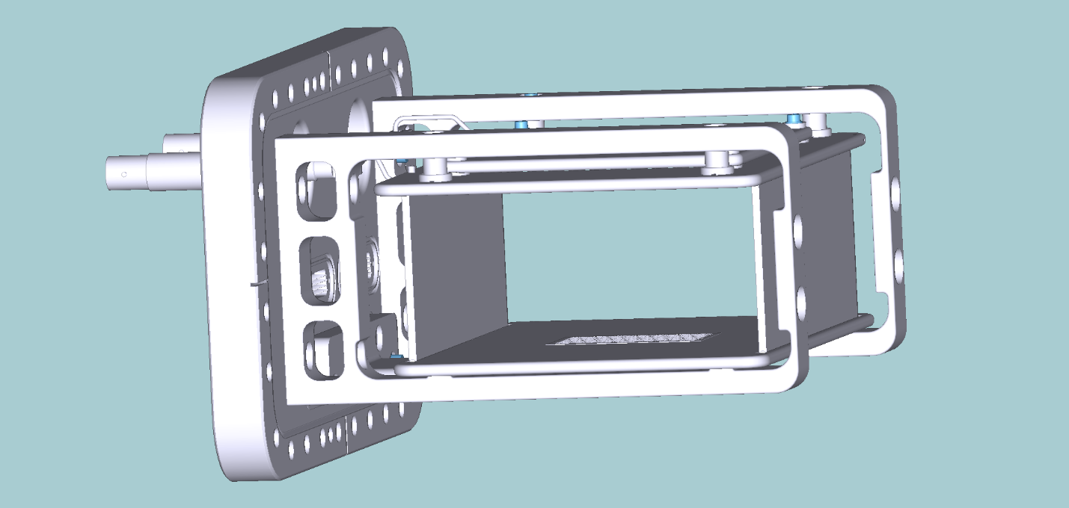
Interference with arms
85
No space between arm and slit plate
5mm
13.5
63.5
10mm
70mm
56.5
12.5

Slide 9
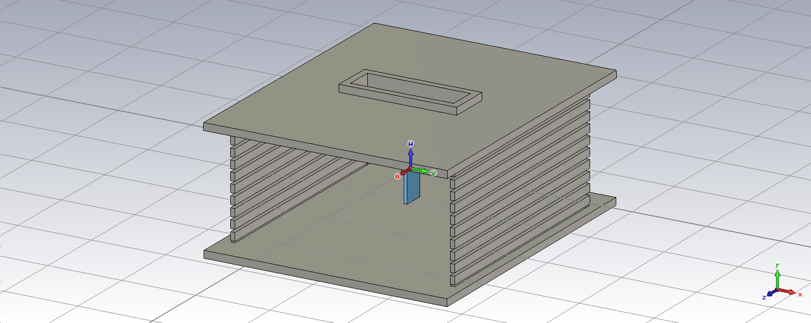
Modified model
The slit plate is moved to inside by 5mm
To keep uniformity of E field, sim is added
20
70
5
5
75
sim

Slide 10
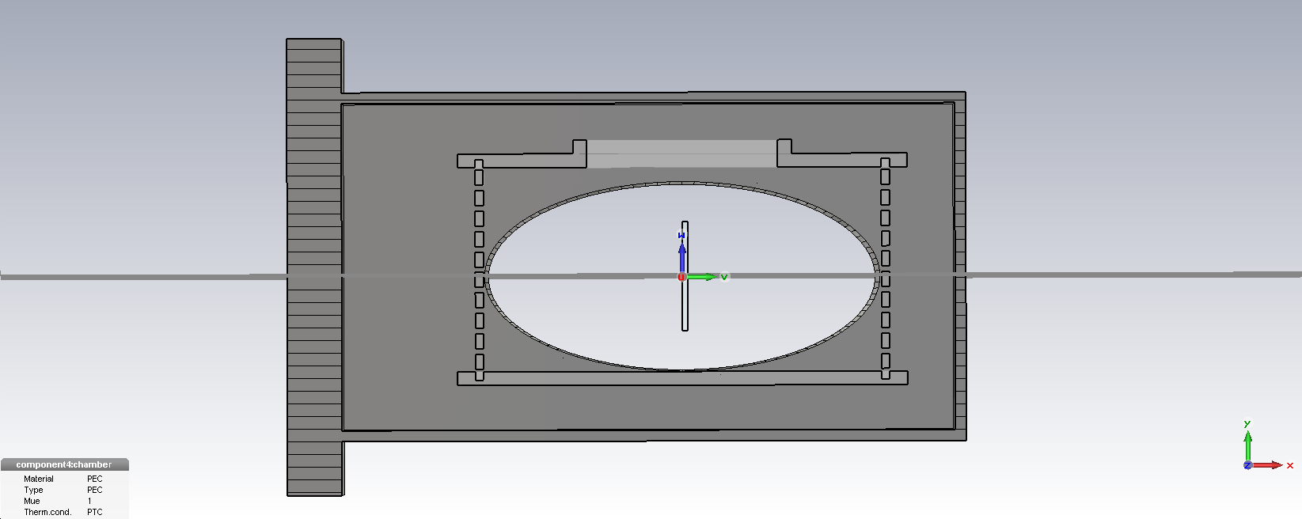
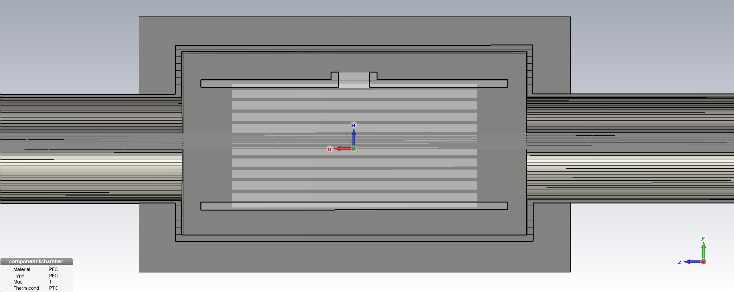
Modified model 2
18.5
5
10
70
40
35
Arm
5
5
10
23.5
20
40
Beam
35

Slide 11
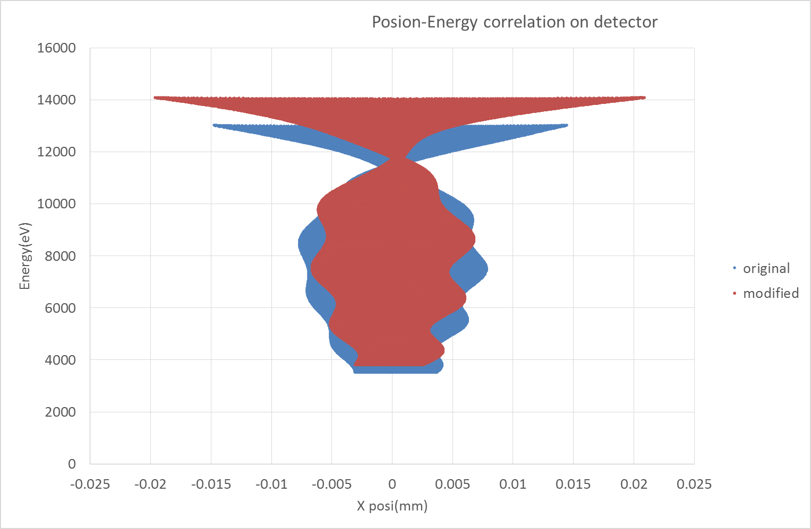
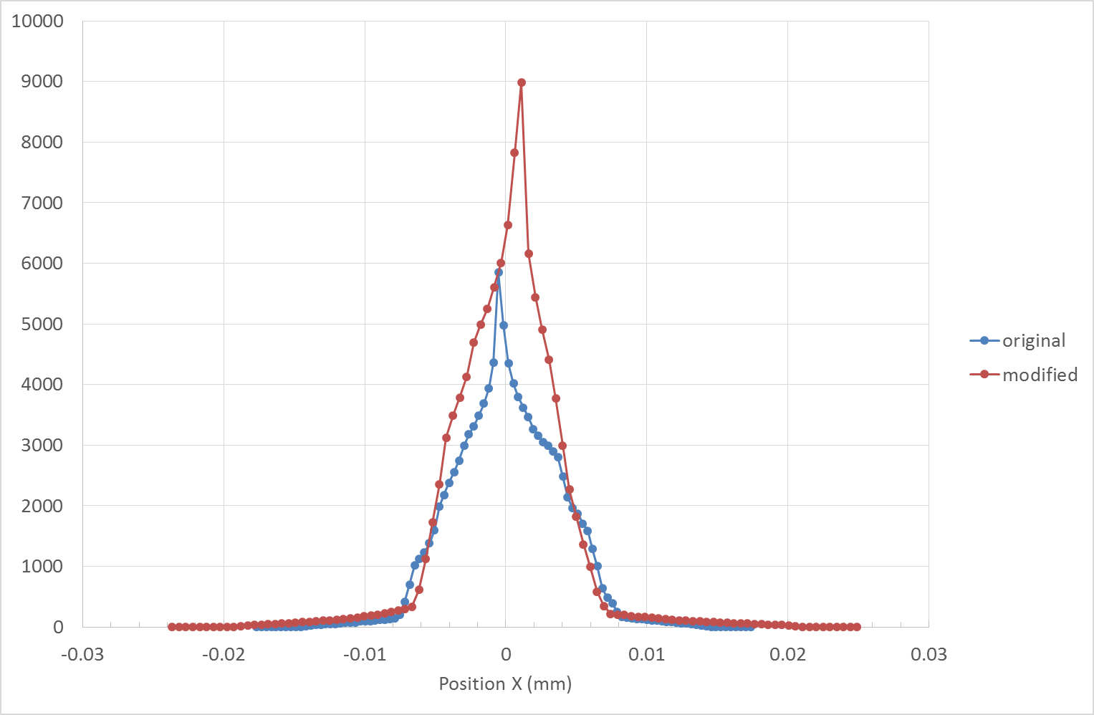
Electron tracking
Assumption:
Ei set to 0.1 meV -> Gyration radius is negligible(0.17 µm)
Unit vector of the initial momentum is (-1, 0, 0) -> worst case
No beam space charge
By=0.2 T, Bx=Bz=0, set analytically
Source position Xi is set to 0mm
The resolution of the new model is comparable to that of the original one

Slide 12
Slit
θ

Slide 13
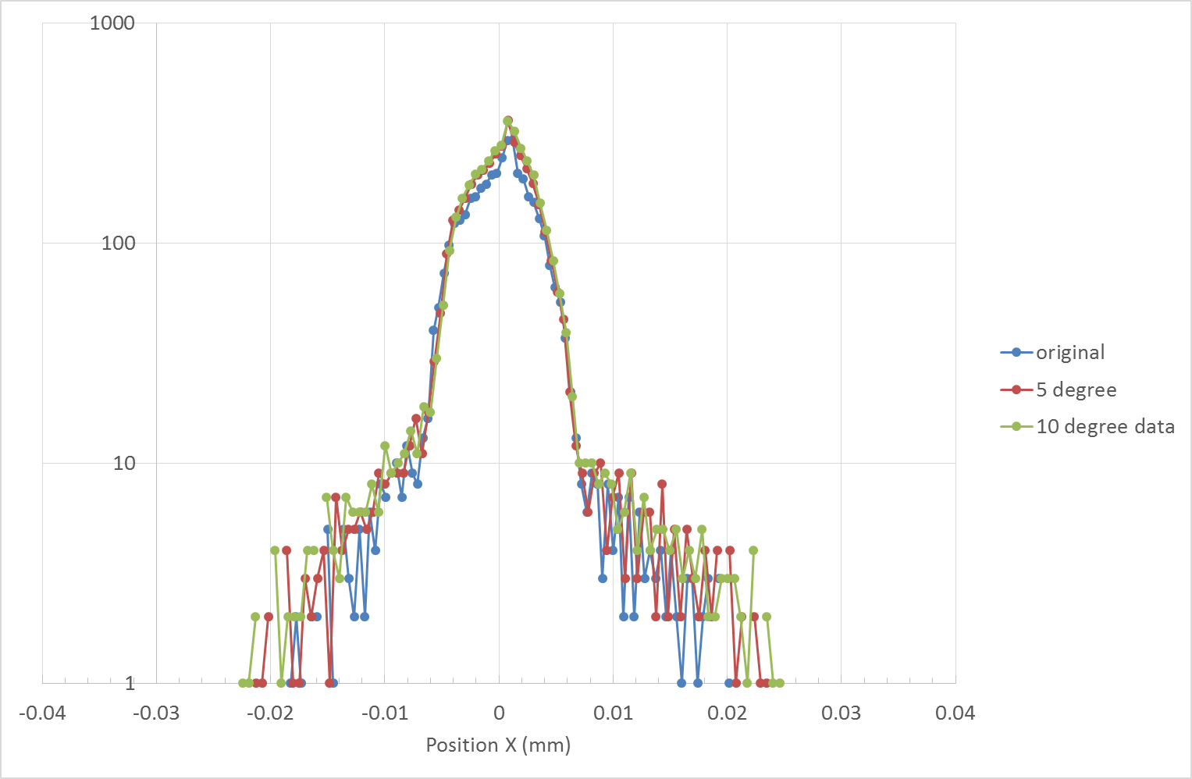
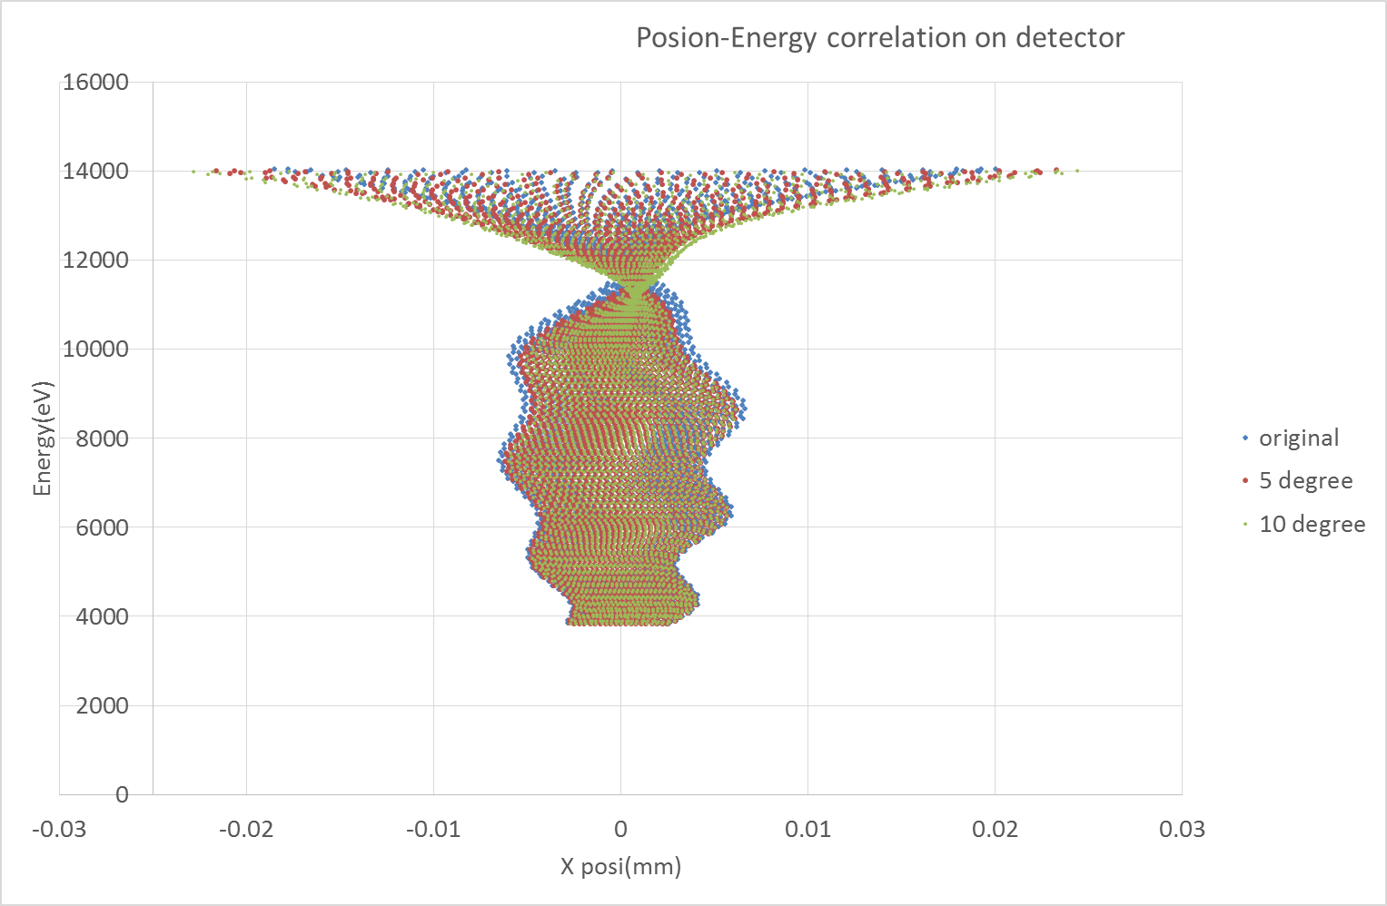
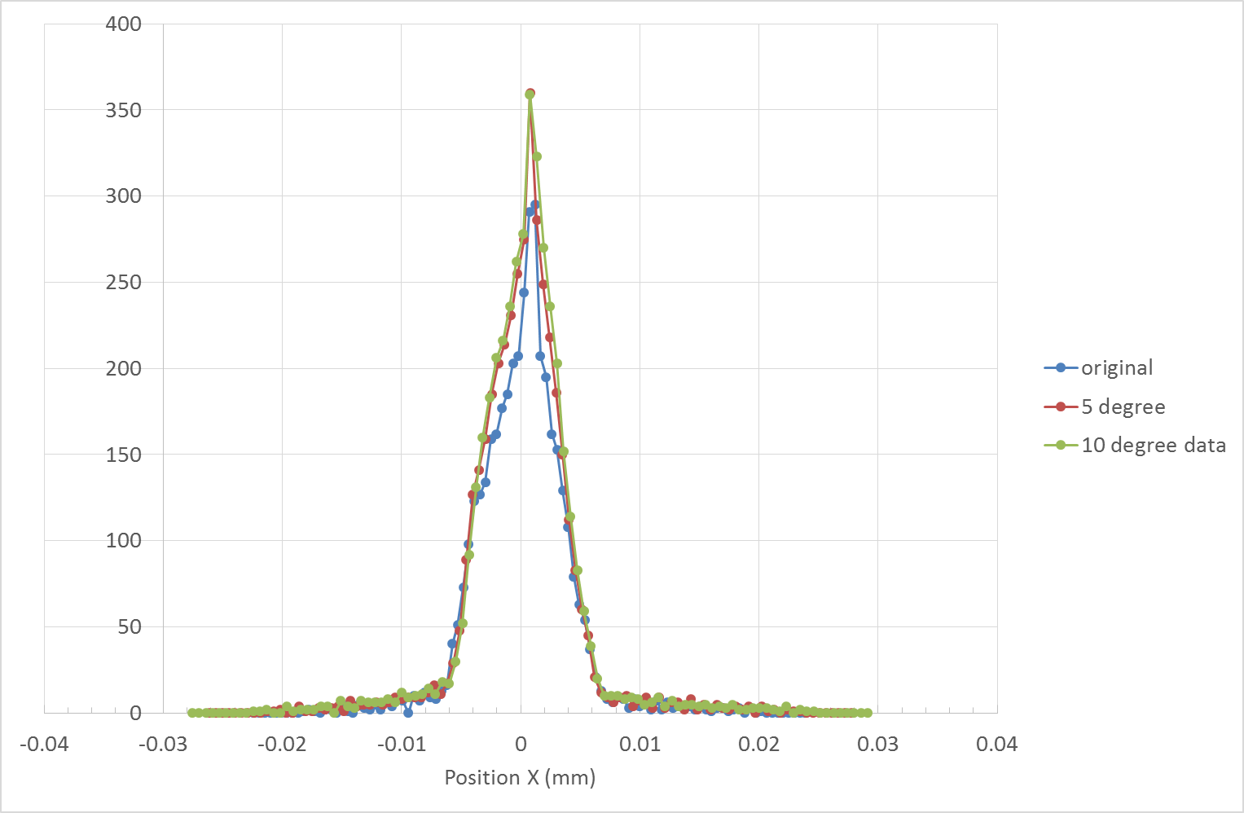
Electron tracking
Assumption:
Ei set to 0.1 meV -> Gyration radius is negligible(0.17 µm)
Unit vector of the initial momentum is (-1, 0, 0) -> worst case
No beam space charge
By=0.2 T, Bx=Bz=0, set analytically
Source position Xi is set to 0mm

Slide 15
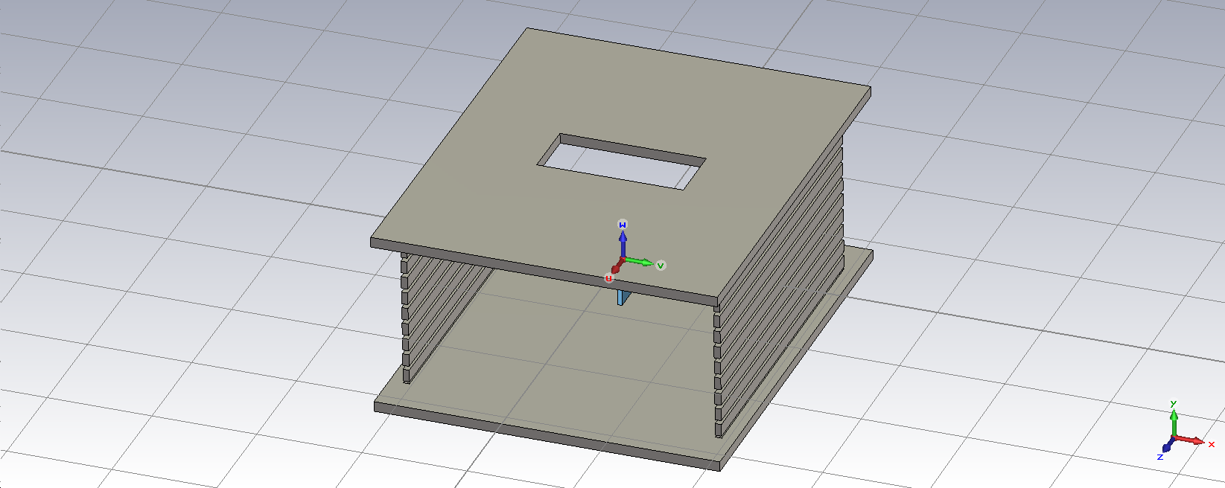
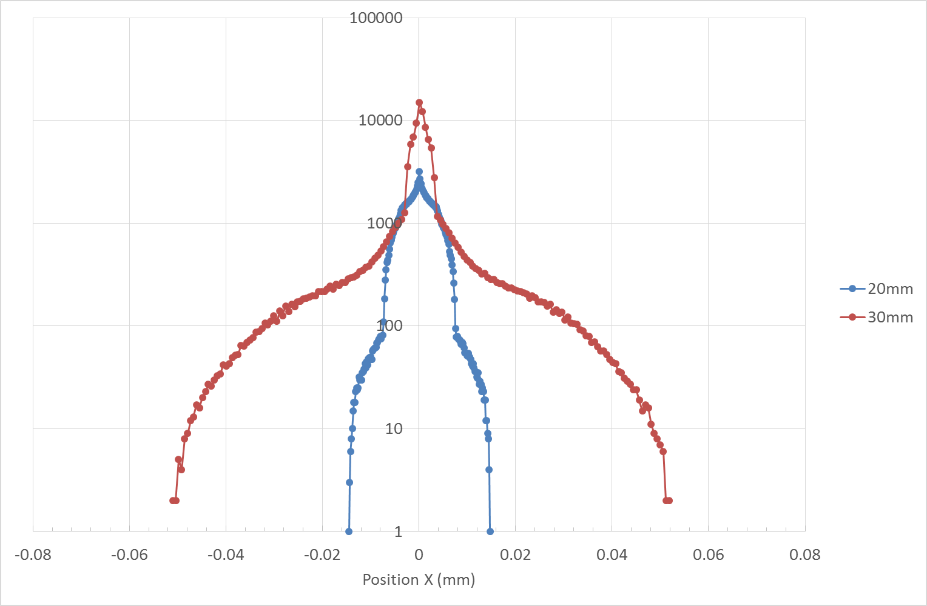
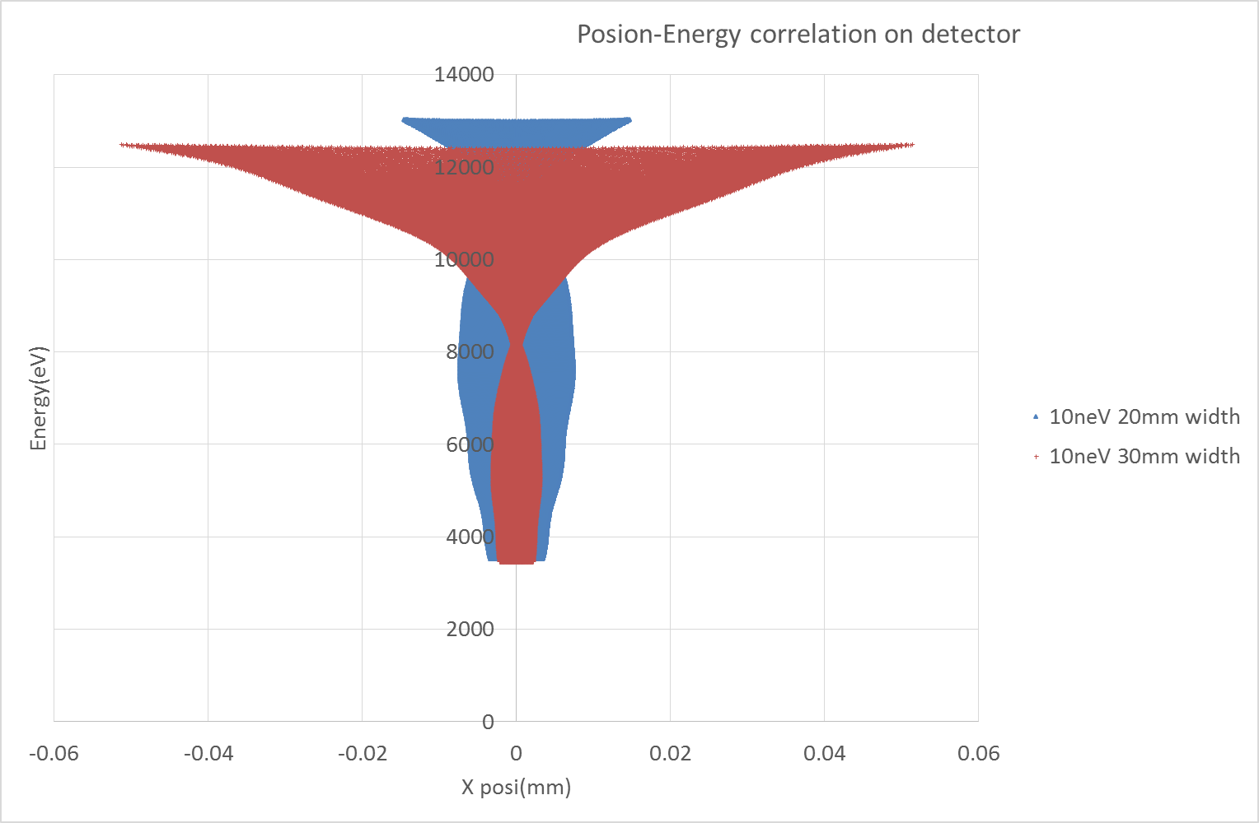
Slit modified
Assumption:
Ei set to 10 neV -> Gyration radius is negligible (1.7 nm)
Unit vector of the initial momentum is (-1, 0, 0) -> worst case
No beam space charge
By=0.2 T, Bx=Bz=0, set analytically
30 mm
70 mm
400 µm

Slide 16
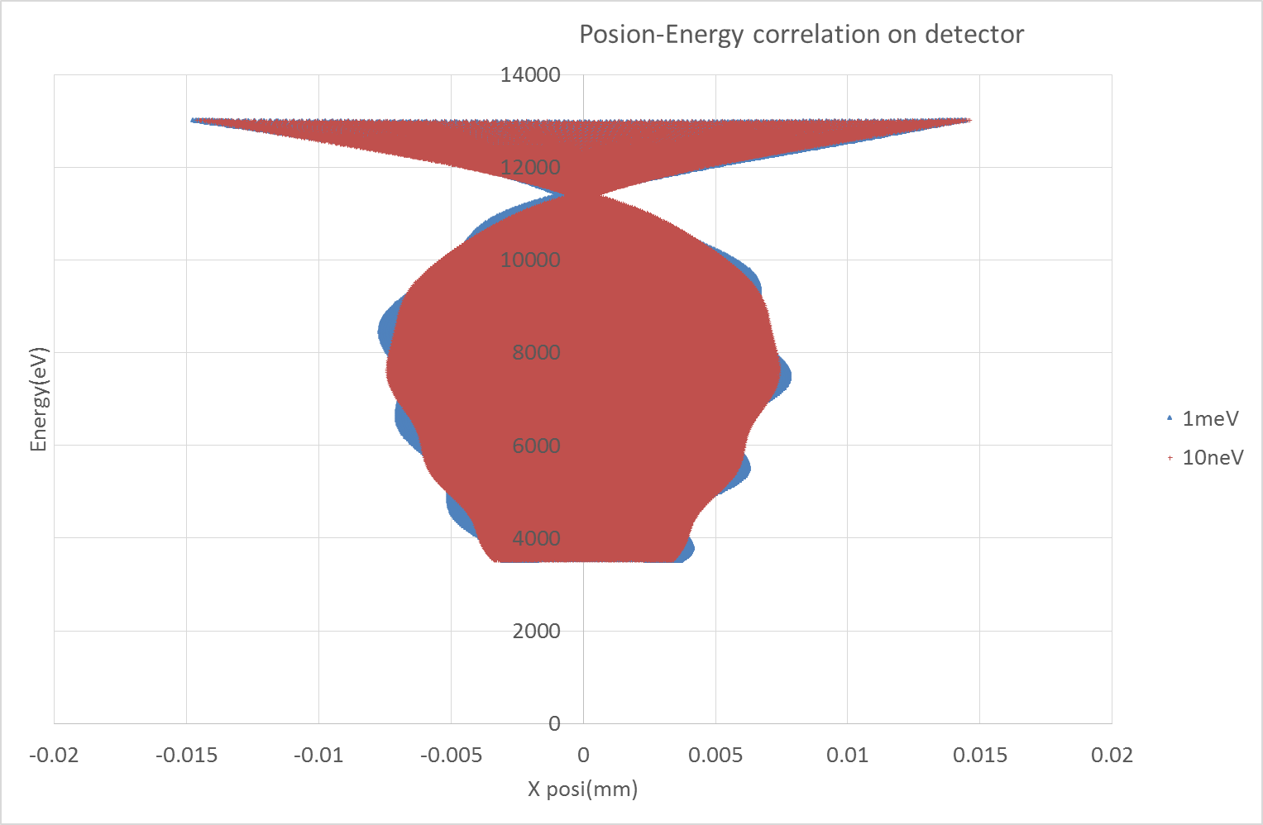
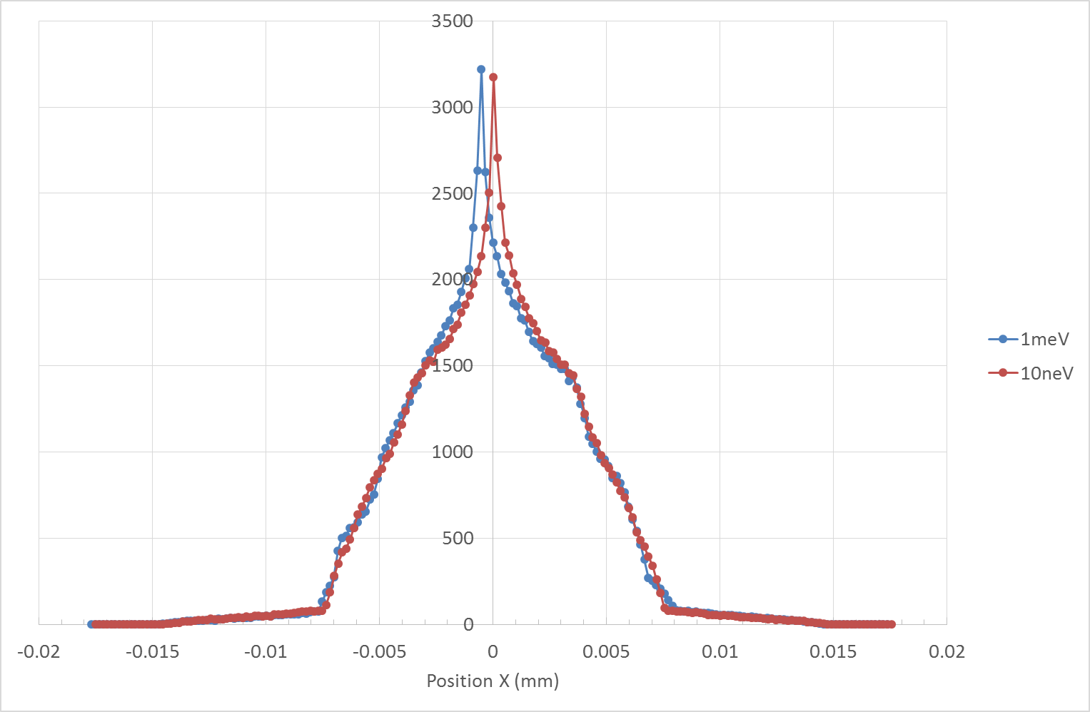
0.5µm

Slide 17
Beam space charge effect :
……………….

