Slide 1
Injection Region BLM changes
E.B. Holzer
MPP threshold WG 9.3.2011

Slide 2
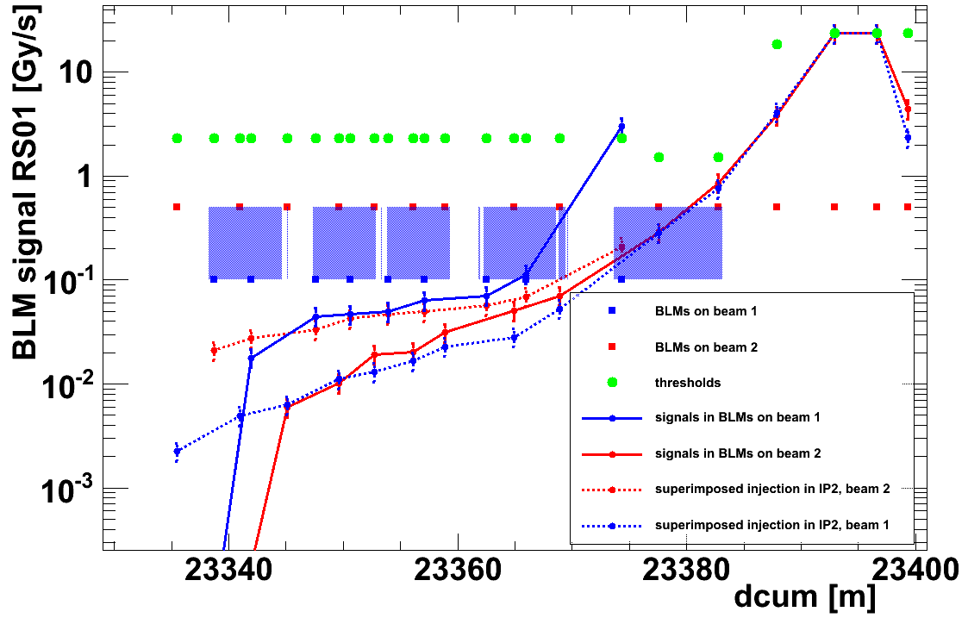
Triplet at Over-Injection
IP8 + mirrored signals from IP2
MQX
MQX
MQX
MQX
MBX
Chicane in IP8

Slide 3
Over-injection

Slide 4
BLMEI.04L2.B1E20_TDI.4L2.B1 (disconnect from BIS or change monitor location)
BLMEI.04L2.B1E10_MBXA (RC filter or disconnect from BIS)
BLMEI.04L2.B1E20_MBXA (increase 450 GeV thresholds)
BLMQI.03L2.B2I30_MQXA (increase 450 GeV thresholds)
BLMEI.04R8.B2E20_TDI.4R8.B2 (disconnect from BIS or change monitor location)
BLMEI.04R8.B2E10_MBXB (RC filter or disconnect from BIS)
BLMEI.04R8.B2E20_MBXB (increase 450 GeV thresholds)
BLMQI.03R8.B1I30_MQXA (RC filter)

Slide 5
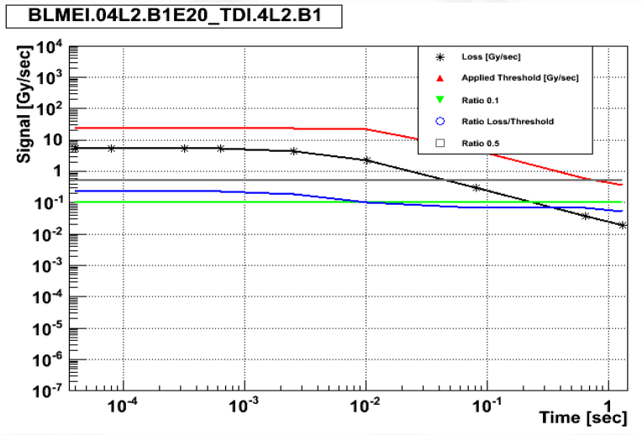
A. Nordt presentation on “BLM sunglasses LIB meeting 15.02.2011

Slide 6
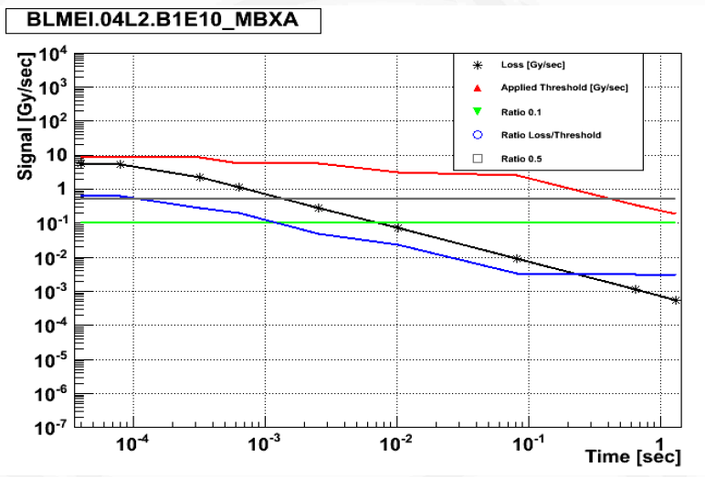
A. Nordt presentation on “BLM sunglasses LIB meeting 15.02.2011

Slide 7
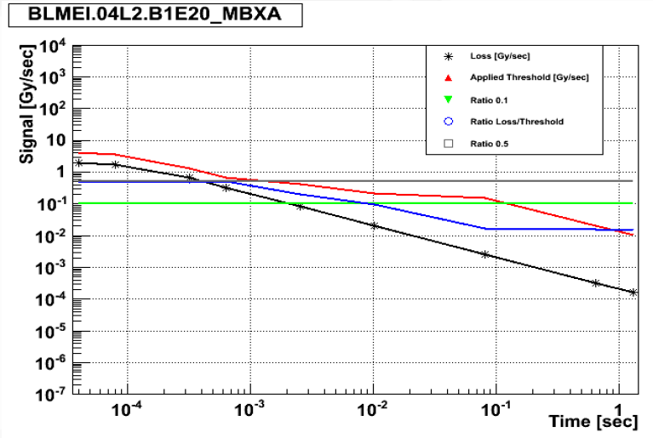
A. Nordt presentation on “BLM sunglasses LIB meeting 15.02.2011

Slide 8
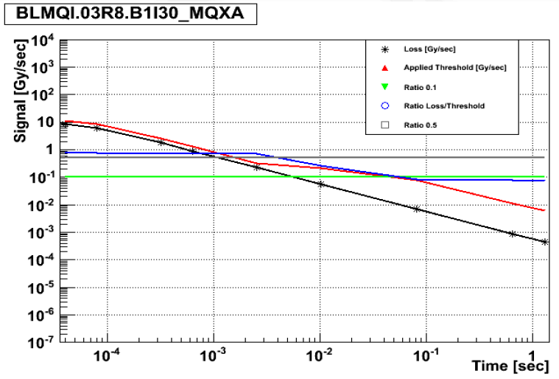
A. Nordt presentation on “BLM sunglasses LIB meeting 15.02.2011

Slide 9
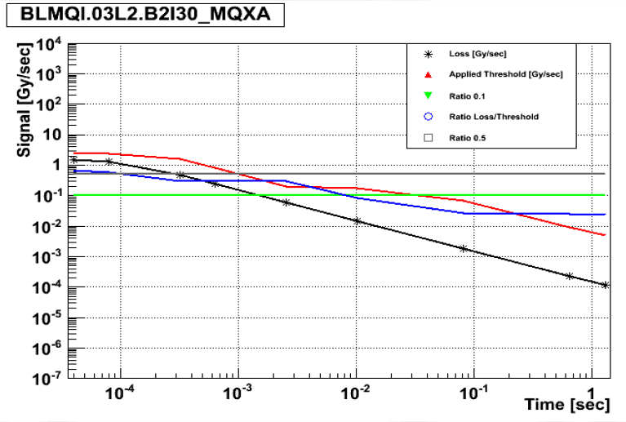
A. Nordt presentation on “BLM sunglasses LIB meeting 15.02.2011

Slide 10
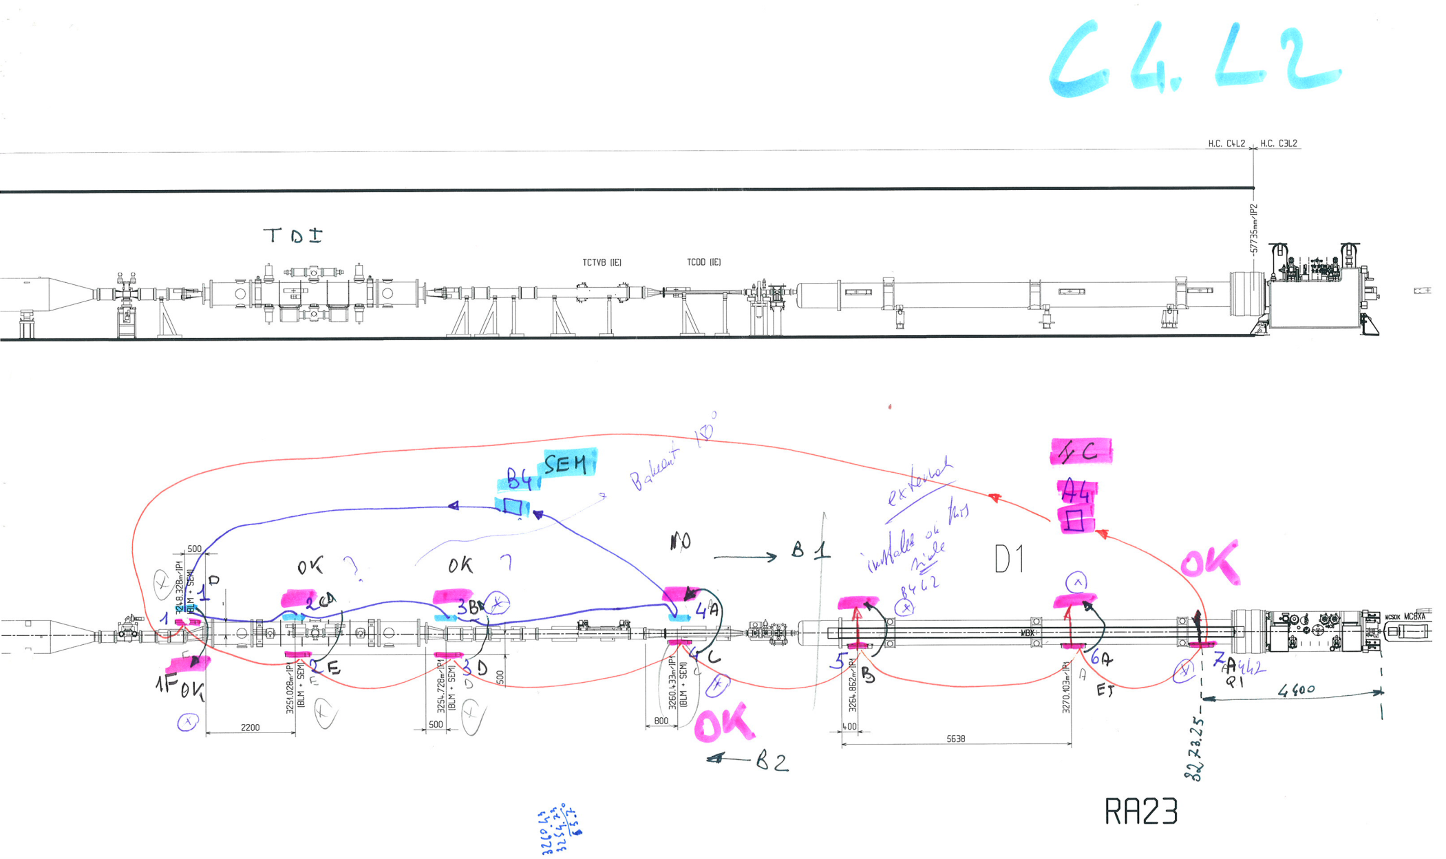

Slide 11
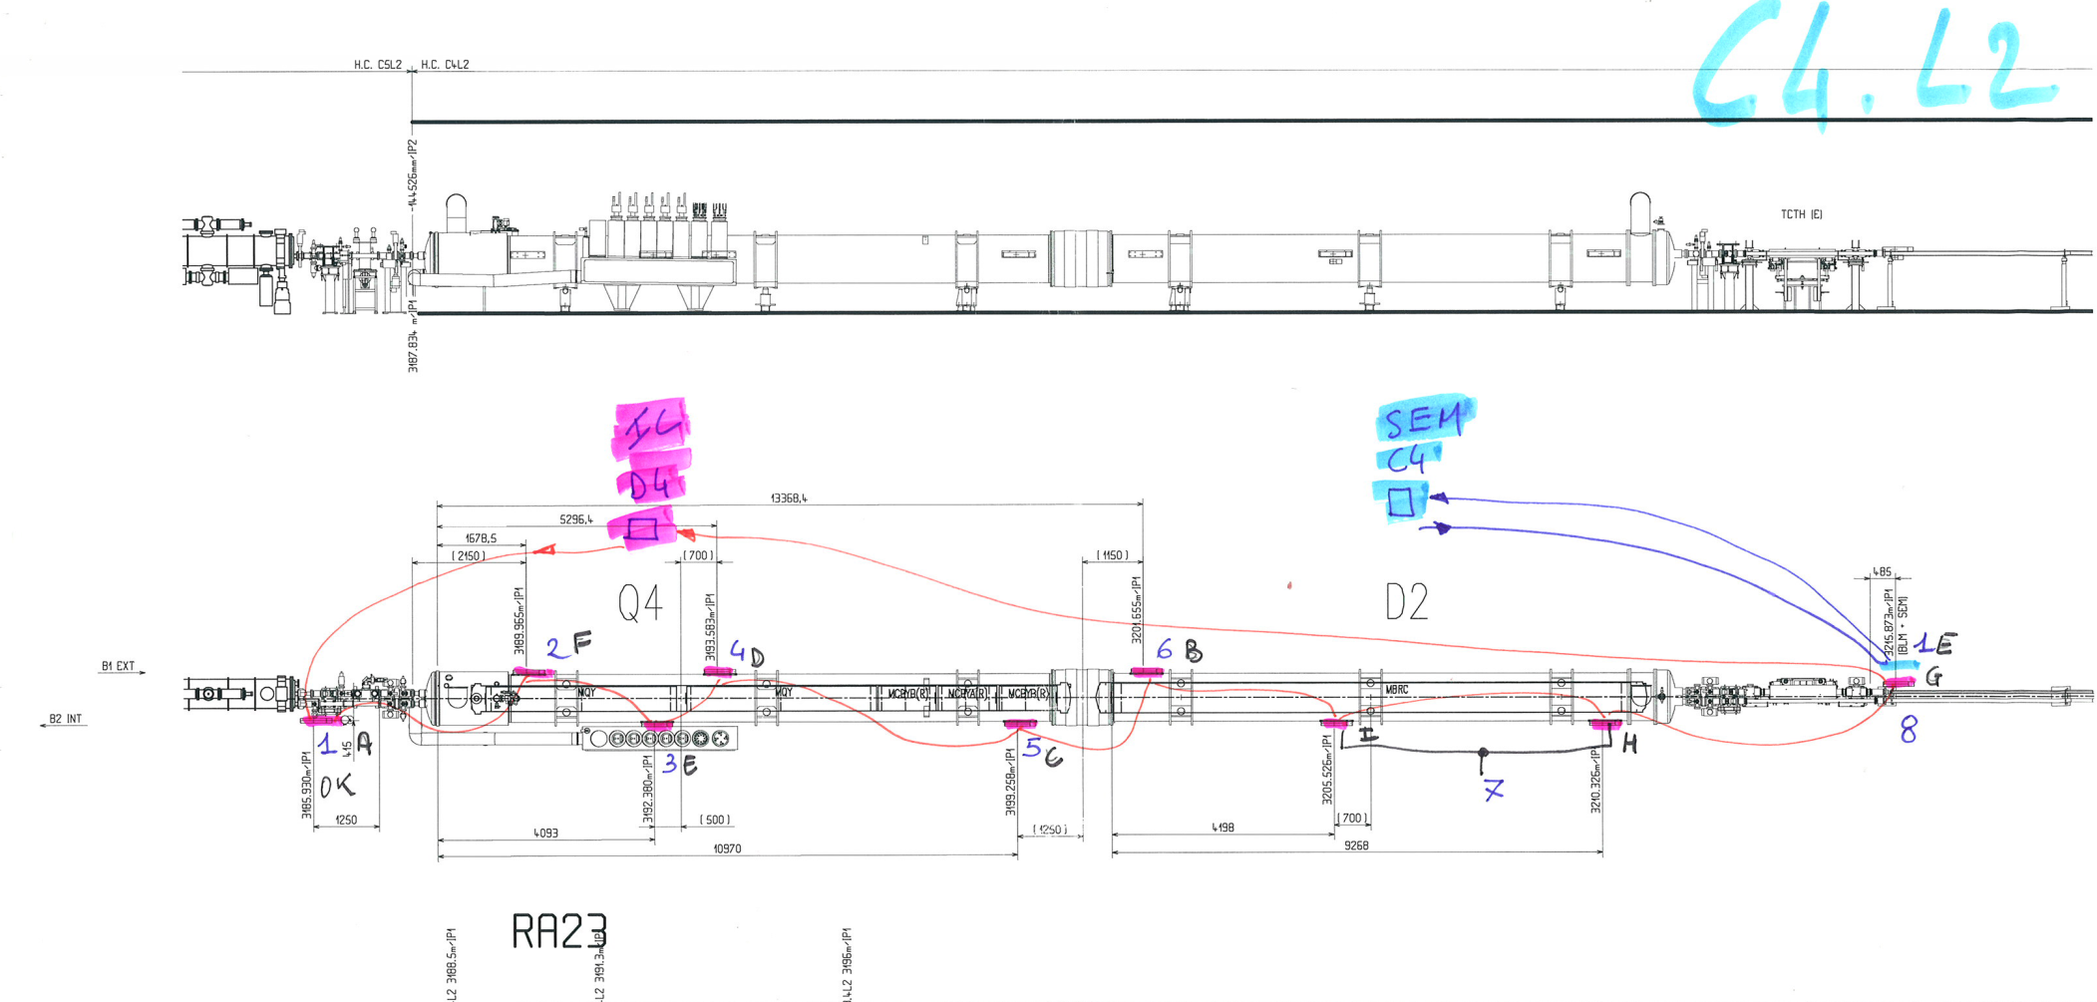

Slide 12
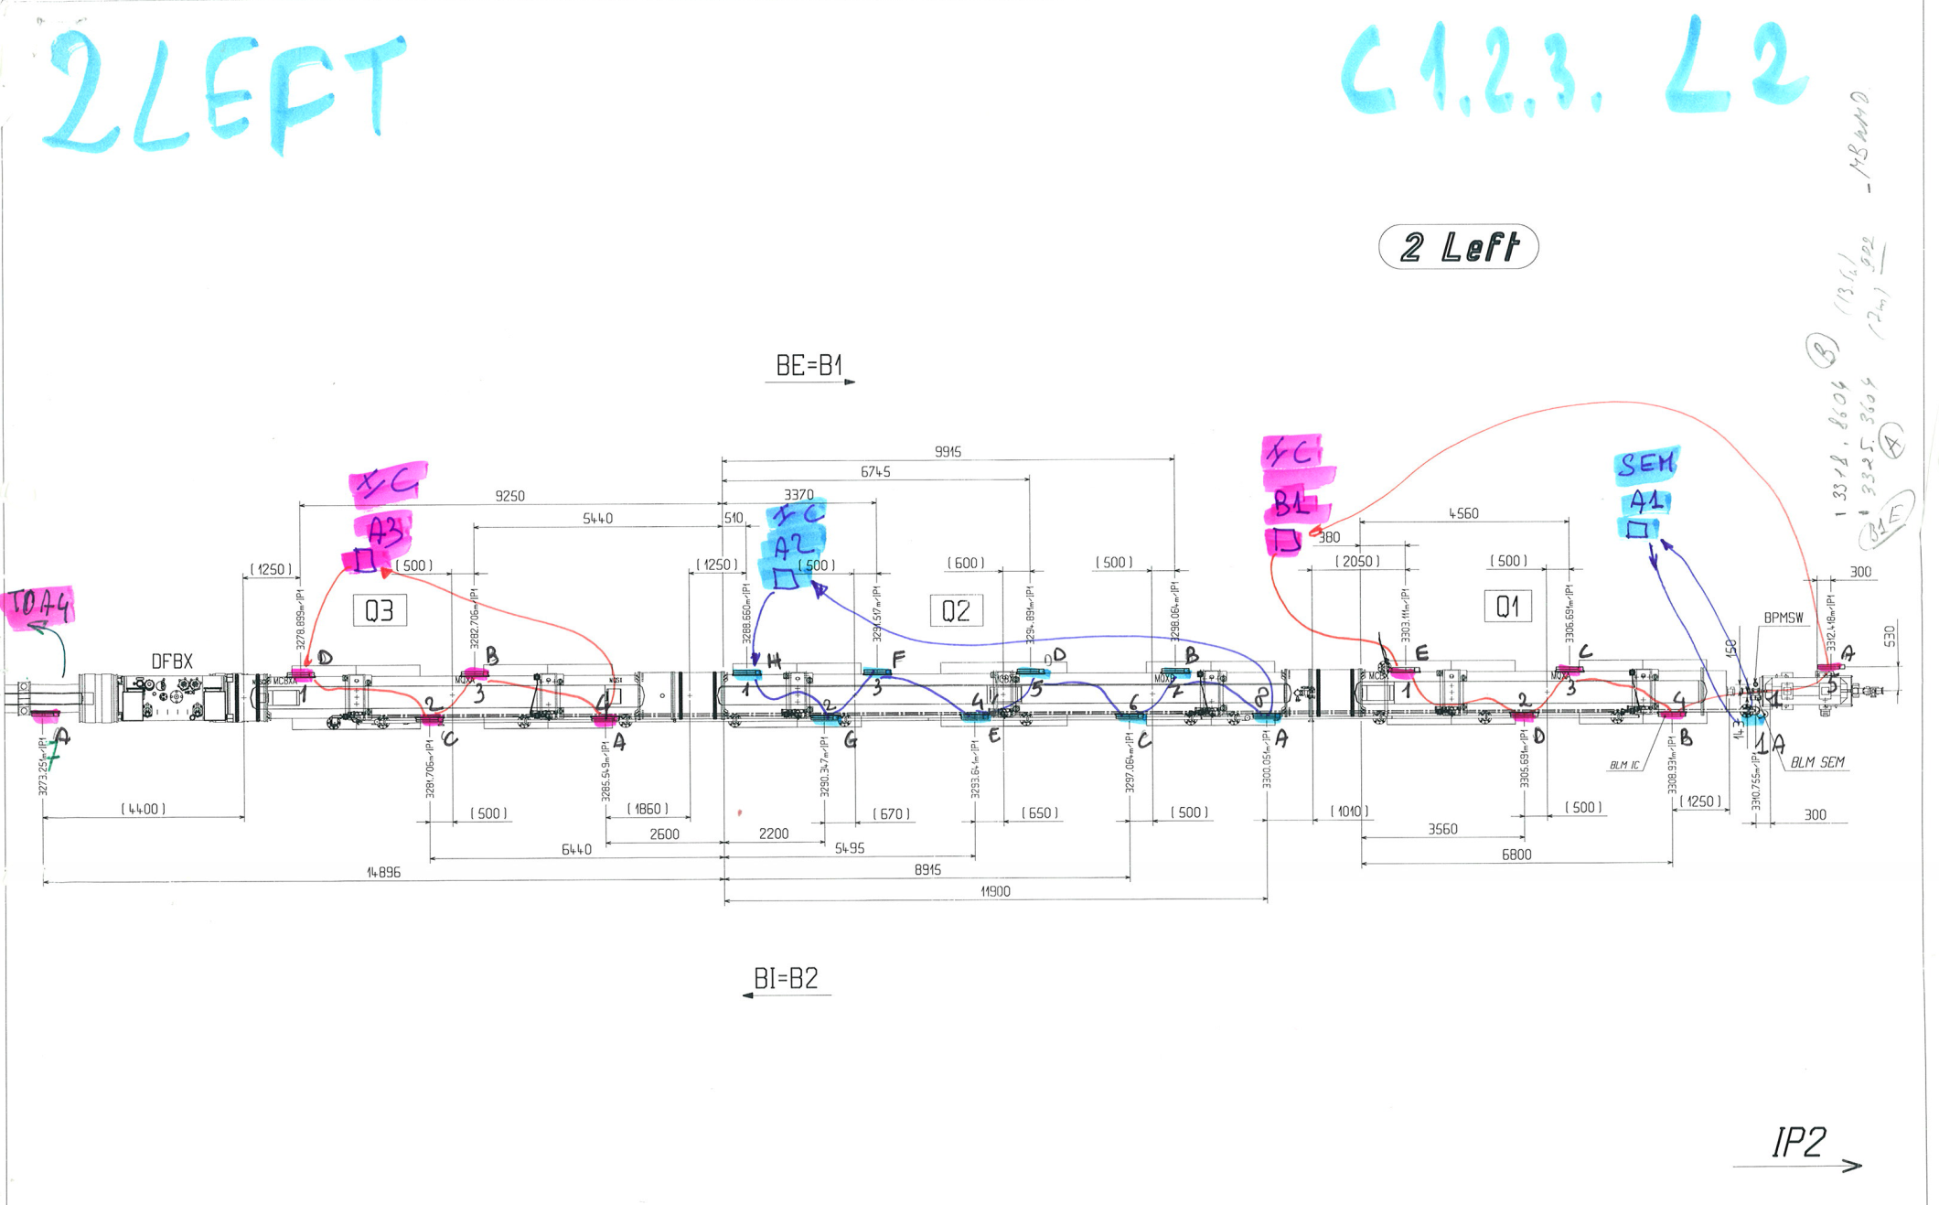

Slide 13
