Slide 1
BLM changes
HV software interlock (SIS)
TCTVB.4L8 monitor factor (MF) change
TCSG in IP7 master threshold change

Slide 2
HV interlock
HV BLM SIS interlock protects against:
power converter failure (1 redundant power supply per IP)
disconnection of power cable (several HV cables per crate)
If HV is disconnected the BLM system holds HV for minutes (at least)
BLM HV = 1500V: The BLM signal does not change significantly when the voltage drops to ~800V
Interlock chain:
HV drop of ≥10% detected by BLM hardware (tunnel) → error signal sent
FESA concentrates error signal, and if it lasts for 10 seconds (1 minute) → beam abort by SIS

Slide 3
IP7 and IP3 Central Crates
22.7. 23:00 BLM high voltage software interlock SIS: changed the delay time before beam dump from 10s to 1 minute for the two central crates in IP3 and IP7 → no more disabling when going into collision
Crates cfv-sr3-blmc and cfv-sr7-blmc: BLM of Collimators
Deployment of new FESA class
Not all monitors in LSS 3 and 7 have this longer delay time:
Crates cfv-sr7-blml and cfv-sr7-blmr (cfv-sr3-blml and cfv-sr3-blmr) also hold the quadrupoles in LSS (plus DS and arc magnets) – still on 10 s delay time

Slide 4
TCTVB.4L8: Vacuum activity left side of IP8
BLM monitor factor on BLMEI.04L8.B1E10_TCTVB.4L8 changed from 0.1 to 0.2 to allow for higher losses (vacuum activity - 2 dumps on 1.3 s integration time). The monitor factor for the adjacent BLMEI.04L8.B1E10_TCTH.4L8. B1 was already at 0.2
9.6.2011
UFOs at MKI
Injection losses + delay filter
14.10.2011
21.4.2011
‘LHCb lumi debris’
Vacuum activity
24.7.2011
9.6.2011
UFOs at MKI

Slide 5
TCSG IP7 threshold changes
25.7.2011: Change of BLM thresholds for monitors protecting TCSGs in IP7 in order to avoid beam dumps in the long running sums due to high beam losses.
Previously, all TCSGs were set to a factor 10 lower than TCPs for integration times 82ms and above.
Due to secondary particle showers from the TCPs the BLM signal on 5 (out of 11) TCSG per beam are very close to the TCP signals (within a range of approximately a factor of 2-3 above and below the highest TCP signals).
After the threshold change the TCSG BLMs give about the same limit to beam losses as the most limiting TCP BLMs (up to a factor of 2-3 higher or lower depending on loss details).

Slide 6
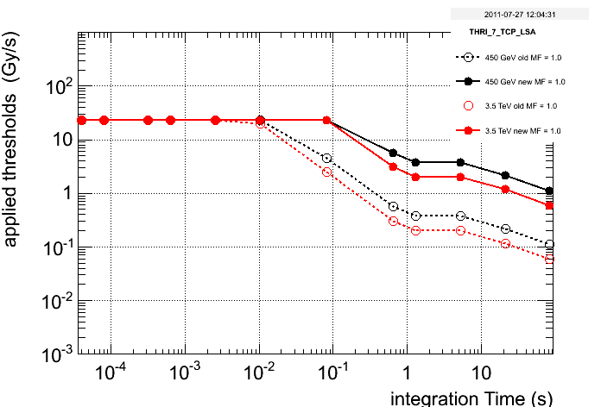
TCP and TCSG 450 GeV and 3.5 TeV thresholds [Gy/s] vs integration time [s]
450 GeV
450 GeV
3.5 TeV
3.5 TeV
6 TCSGs /beam
3 TCP + 5 TCSGs /beam
6 TCSGs /beam
3 TCP + 5 TCSGs /beam
Moved 5 TCSG per beam to TCP family
6 TCSG per beam stayed with previous thresholds

Slide 7
Names of the TSCGs moved
Skew
Horizontal
Skew
Skew
Skew
Skew
Skew
Skew
Horizontal
Skew

Slide 8
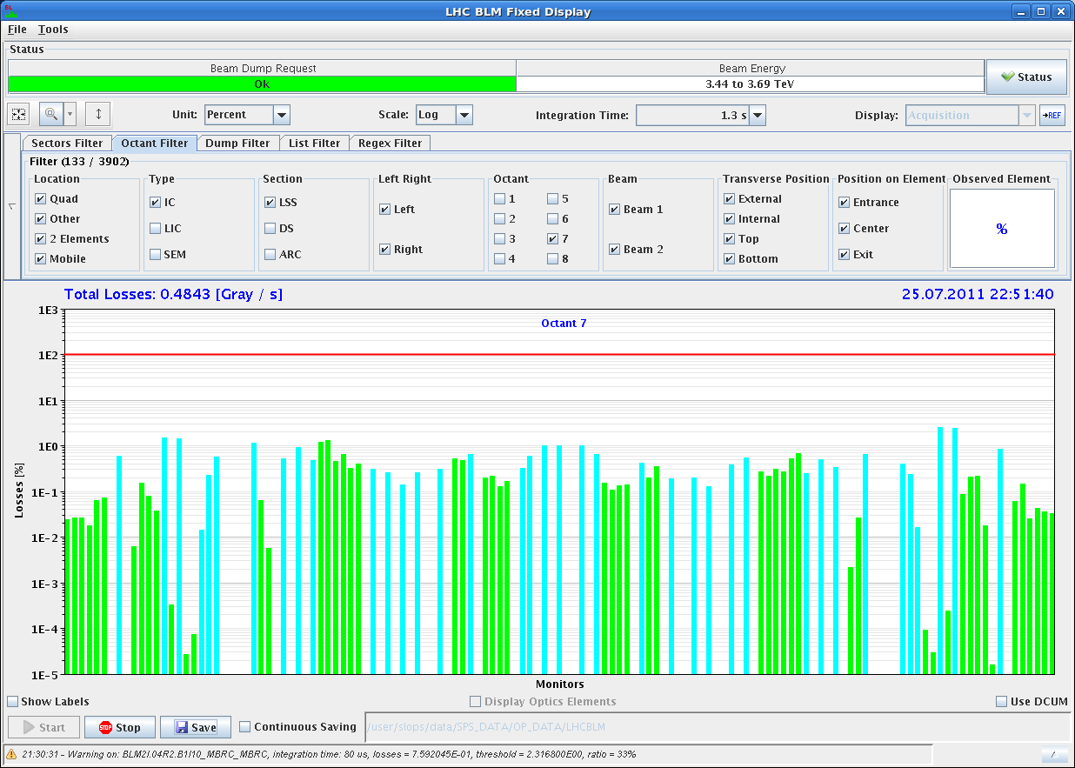
1.3 sec IP7 Signal / Threshold in Collision after Change
Green: Magnets: thresholds for local magnet protection
Light blue: Collimators: thresholds according to operation scenarios – mostly (far) below protection limit – on few TCLAs close/above local protection limit
6 TCPs
10 TCLA

Slide 9
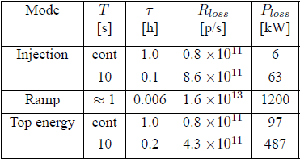
Collimator Thresholds IP7
Design values:
T … loss duration
τ … lifetime
Design Values |  |  | Current limits (measurements from MD) by thresholds on
Loss duration | Loss rate [p/s] | Power | Loss duration | TCP (approx.) | TCSG (approx.) | TCLA (approx.)
≈ 1 s | 2E12 (scaled 3.5TeV) | 1200 kW | 1.3 s | 330 kW | 330 kW | 170 kW
cont. | 1.6E11 (scaled 3.5TeV) | 97 kW | 84 s | 97 kW | 97 kW | 48 kW
10 s | 8.6E11 (scaled 3.5TeV) | 487 kW | 21 s | 194 kW | 194 kW | 97 kW

