Slide 1
LBDS Audit
Follow-up
Jan Uythoven
Thanks to:
Etienne Carlier and Brennan Goddard

Slide 2
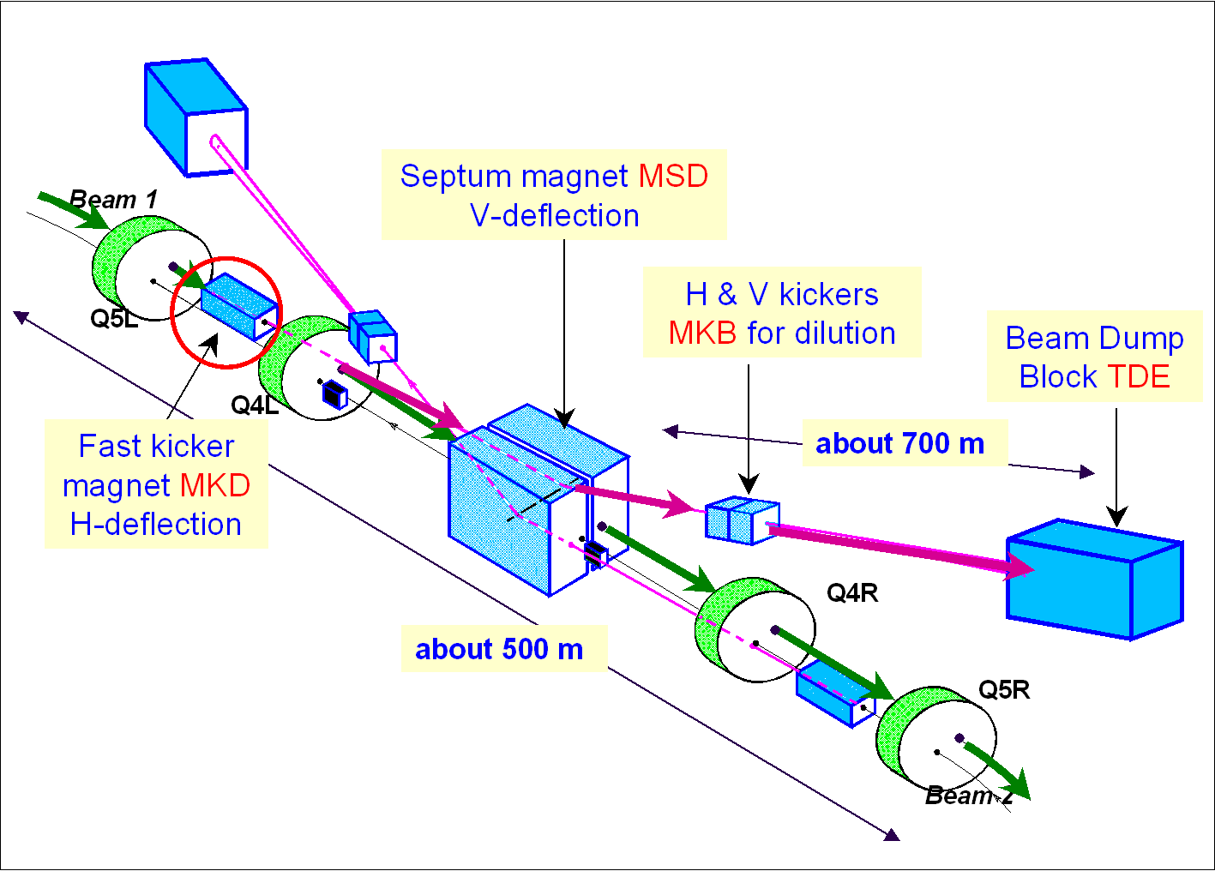
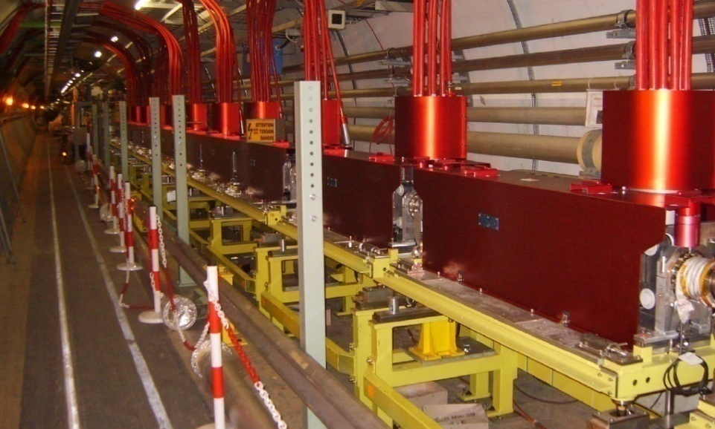
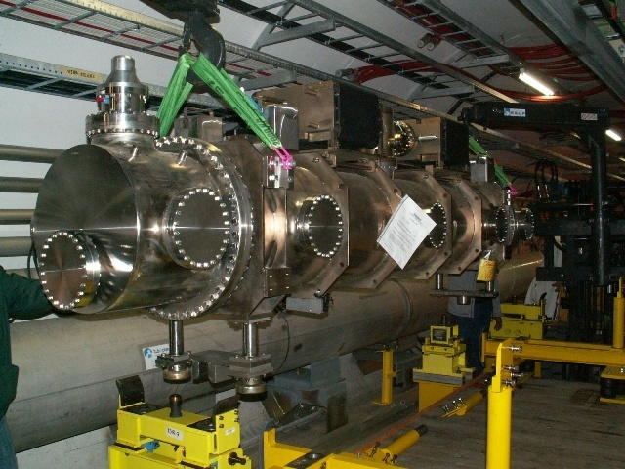
LHC Beam Dump System
MKD:
2 x 15 Systems
MKBH: 2 x 4 (4)
MKBV: 2 x 6 (4)
TCDQ
Magnet operates under vacuum
TCDS

Slide 3
LBDS Audit Follow-up
Audit held between January 28th and February 15th 2008
Outline:
  Quick overview of what we learned since the audit took place
  Point-by-point check of recommendations
  Conclusions

Slide 4
What we learned since the audit in 2008:
Reliability Run
Operation only below 5.5 TeV, due to MKB break down
Operation ‘with beam’ at injection energy
Beam 2
System pulses = 19 magnets
Beam 2
 | Beam 1 | Beam 2
# Pulses | 23’534 | 15’469
Time considered | 10.5 months | 9.1 months
Continuous running (p <13 h) | 2.7 months | 1.7 months
Data from 8/11/07 to 19/09/08

Slide 5
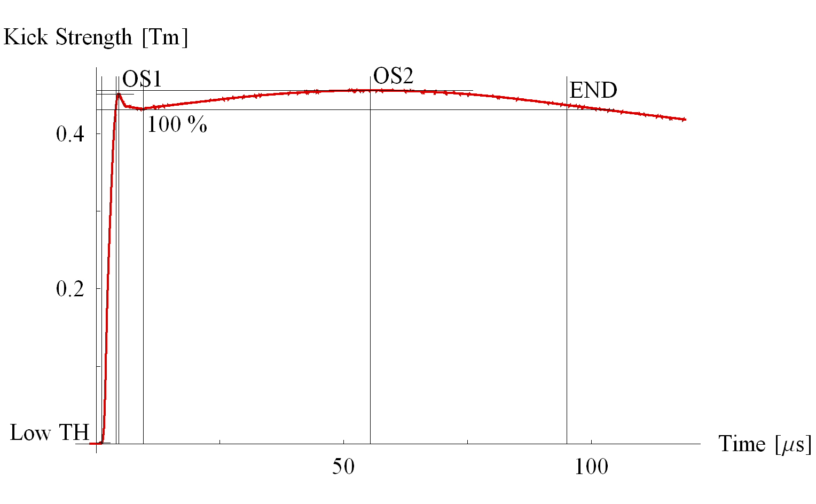
Reliability Run: Internal and External Post Operational Checks (IPOC / XPOC)
MKD pulse
741’057 Magnet Pulses Analysed with IPOC and XPOC Systems
  > 10 years of operation
Some hardware problems discovered →
No critical failures on the MKD system which would have resulted in a non-acceptable beam dump even if redundancy would not be there
No ‘asynchronous’ beam dumps were recorded (erratics). No missings.
However, unexpected MKB breakdown →

Slide 6
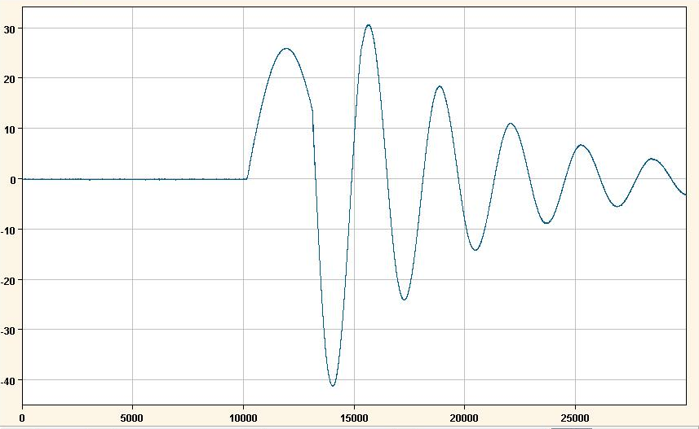
MKB failures
Unexpected common mode failure on the MKB system. Flashovers in 3 out of 4 magnets simultaneously after operation under bad vacuum: stopped operation above 5 TeV. Measures taken:
  Vacuum interlock was implemented but not yet tested
  Additional vacuum interlock: digital + analog
  HV insulators, identified as weak point, being changed for 2009
  Reduced conductance between adjacent MKB tanks by smaller aperture interconnects
I [kA]
Moment of break down
Measured MKB wave form
50 μs

Slide 7
MKD Issues Discovered
Four switch failures due to short circuit on one of the GTO discs
  Within limits of reliability calculation assumptions
  Would not have given an unacceptable beam dump but internal dump request resulting in synchronous dump
Problem with voltage distribution of GTO stacks: internal dump request
  All checked and redistributed for 2009
  Only affected availability, not safety
Re-soldering of trigger contacts on GTO stack
Decreasing value of compensation capacitors: capacitor changed on three systems
Re-optimisation of synchronisation and compensation voltages on 2 systems
Power trigger powering circuit units were under designed: refurbished for 2009
Two power converter failures
One ADC card for IPOC failed
Power trigger cables badly connected
All failures were detected by diagnostics, IPOC/XPOC !

Slide 8
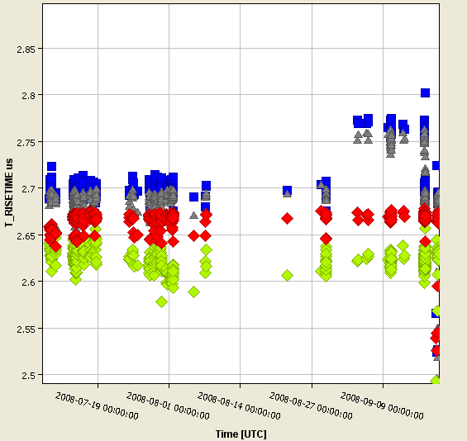
XPOC successfully used for detecting badly connected trigger cables
Rise time [µs]
Generators A and D give XPOC fault
50 ns
Fault on XPOC:
Rise time changed 50 ns, window ± 50 ns
Delay changed 100 ns, window ± 50 ns
Amplitude changed 0.9 %, window ± 1 % (fault on 1)
Access on 16/09/08:
showed on those two generators trigger cable badly connected, due to intervention on power trigger unit.

Slide 9
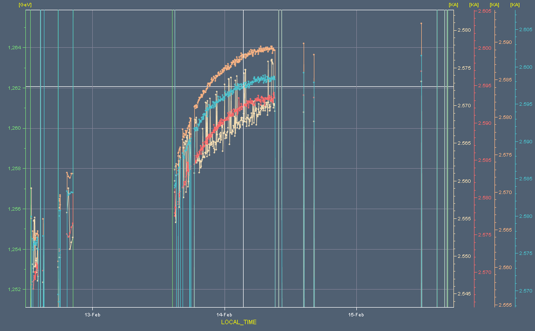
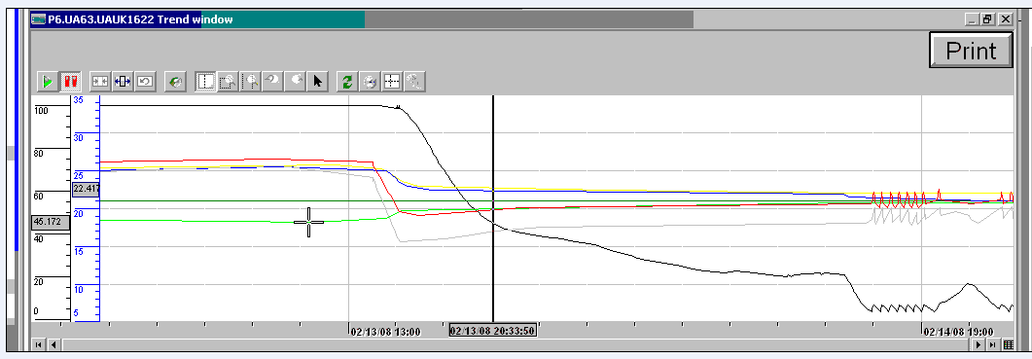
MKD Generator Temperature Effect
Measure kick currents at 1 TeV
Tunnel temperature down by 4 degrees, kick gone up by about 0.7 – 0.8 %,
Kick response appears to lag behind temperature change, which seems logical.
Series data start at 15:00, so in the middle of biggest drop in temp
24 hours
15:00
Yellow curve is tunnel temp.
dt = 4 degrees
Starting 13:00, biggest drop reached at 20:30
stable 24 hours later
6 hours

Slide 10
MKD Cooling
Peltier temperature regulation units installed on each of the 30 MKD generators
  Together with temperature isolation and ventilation
  Humidity sensor & interlock
Set regulation temperature at tunnel temperature = 23 degrees
  Interlock +/- 1 degree
  Synchronous Beam Dump if temperature gets out of regulation window
  Restart only possible when correct conditions are back
Some weeks of operational experience required before first beam

Slide 11
TCDQ Energy Interlock
TCDQ position is a function of energy, and gets triggered by a timing event (like collimators)
Sensitive to errors related to timing system and the transmission of the timing signal within the LBDS control system (from gateway to PLC)
For 2009 there will be an ‘independent’ check on the TCDQ position, taking the beam energy as input parameter
Dump the beam if the TCDQ is at the wrong position as expected relative to the beam energy
  For 2009 – 2010: software solution
  After 2010: hardware solution

Slide 12
Follow-up of Audit Recommendations
Section 4: General Impression:
“The auditors agree that the XPOC and IPOC tests and their connections to the connection to the Injection Inhibit are critical and must be able to cover most if not all of the failure modes. However, neither the XPOC nor the IPOC currently seem to be fully mature.
Areas of concern have been listed in Section 5.1.2. Although the inherent LBDS hardware does not show evidence for potentially correlated failure modes, the auditors are concerned about external “common mode” influences in particular due to Single Event Effects (SEEs; see Section 5.2.2.)”
The Reliability Run has shown that IPOC and XPOC work very reliable for IPOC and XPOC processes, see previous slides.
Single Events Upsets: R2E working group; Monitoring of Radiation; Slow increase of beam intensity (=radiation) covered by system redundancy.

Slide 13
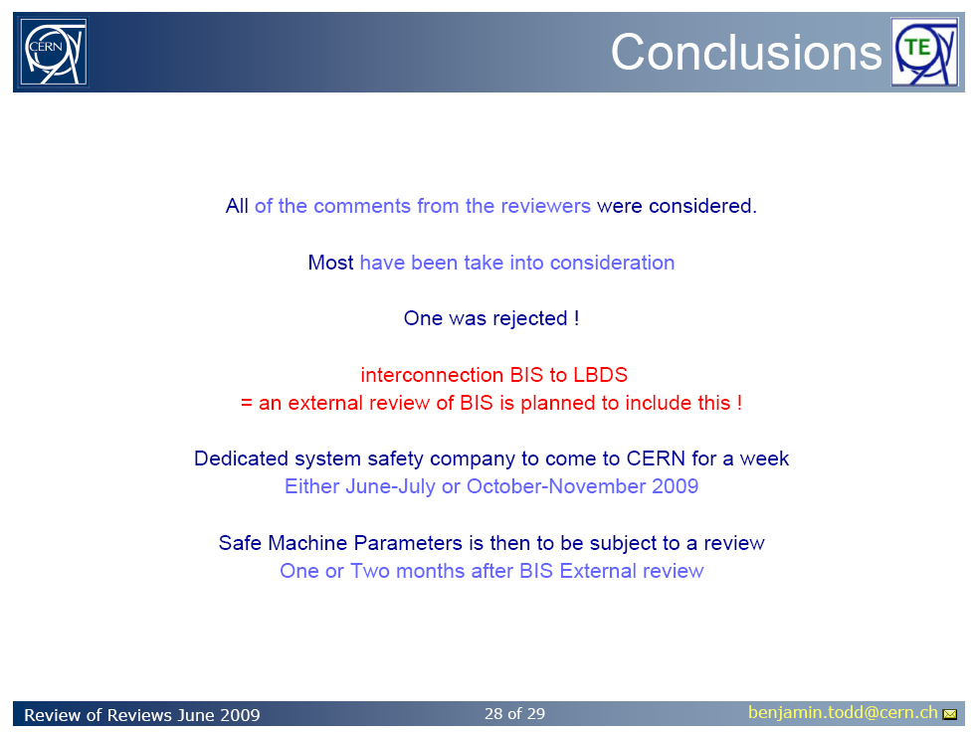
Section 5: Recommendations
1. Connection to the BIS
“The interfaces between the BIS and the LBDS are crucial for the overall safety
chain. Thus, these should be properly discussed, agreed upon, and documented.
The resulting solution should minimize the complexity of the overall, combined
system without deteriorating overall safety.”
Tests done in the SPS
Test procedure to check on all documented faults under discussion with BIS-people; should be done.
Slide Benjamin Todd

Slide 14
2. RF-Synchronisation
“Measures must be put in place to ensure that the LBDS is always synchronous
and in phase with the right and proper beam revolution frequency. This might
also require actions from experts of the RF system.”
Swapping Master RF B1 / B2 f_{rf}: Commissioning procedures; however weak point is swapping the fiber optics cables for B1/B2. Brought to the attention of the RF-Group: A.Butterworth / Ph. Baudrenghien.
If RF-Trip -> debunching: for higher beam intensities an RF-trip should dump the beam.
Beam should always follow the f_{rf}
Back-up by:
Abort Gap Monitor
Abort Gap Keeper during injection, independent of f_{rf}

Slide 15
3. MKD Kick Synchronisation
“Alternatives to compensate this additional delay should be discussed.”
To avoid having to use a individual trigger voltage defined as a function of energy.
Worked fine during the Reliability Run:
no XPOC fault

Slide 16
4. MKD Switch “Degradation”
“The first experience of the LBDS has shown a slight, but constant degradation of the kicker magnet switches, presently studies by the experts.
A deeper study must be conducted to understand this behaviour and alternative
solutions must be elaborated.”
Some capacitors found to be degrading: replaced and stable afterwards
Temperature stabilisation of the MKD generators
Redistribution of the GTO discs
Affects availability only
Long-term upgrade to 12 wafers being studied

Slide 17
5. MKD Rise Time is and Trigger Tolerance / Synchronisation is Tight
“Possibilities to increase this tight time window in order to add some safety
margin should be investigated.”
Adapting the LHC bunch filling to 4 µs instead of 3 µs is possible, but will reduce the machine luminosity (loose 72 bunches out of 2808).
Not critical straight away and can be adapted when required.

Slide 18
6. Redundancy
“Therefore, the redundancy and its correct and complete separation must be verified.
Means to ensure that external cables can not be swapped must be applied.
Furthermore, the consequences of the non-redundant signal paths on the PTM and
TFOT boards on the overall availability must be reviewed.”
That the present redundancy in the design is sufficient has been studied and found to be correct in the PhD thesis of R.Filippini.
At start-up several weeks have been spent to again check the redundancy of the signals
XPOC has proven to be able to detect the lack of redundancy due to small changes in the kick

Slide 19
7. UPS & Power Cut
“Adequate tests should be conducted to confirm that the system remains being capable of dumping the beam in case of simultaneous main and UPS power failures.”
Was tested in 2008, but ‘manual synchronisation of loosing UPS and mains
Test foreseen in 2009 to test power loss during same mains period.
UPS is also redundant.

Slide 20
8. ‘As Good As New’
“The respective procedures, still lacking in detail, should be carefully elaborated
and implemented together with the persons responsible for the RF and BIS
systems. Regular “toggle on/off”-tests prior to injection with cross-checks
against a central database might be able to find errors in the data chain, false
cabling, and wrong “inhibit”-switch settings. However, these tests should also
take into account cases of sabotage or simple vandalism.”
‘As Good As New’ of the LBDS equipment is guaranteed by the IPOC and XPOC.
XPOC interlock will this year have an interlock on the SIS.
Connection to BIS is tested during automatic arming procedures before every fill.
General procedures after interventions need to be worked on- need a ‘framework’.

Slide 21
9. Redundancy Tests
“Special and automated connectivity test procedures must be deployed in order to
detect bad or faulty cable connections.”
Manual testing during start-up
Redundancy tests are performed automatically in the IPOC process
  On HV pulsed output of power trigger under implementation
XPOC also detects the effect

Slide 22
10. Procedures for Maintenance and Inspection
“Additional procedures must be established for maintenance and inspection in order to detect degradation of the LBDS hardware, esp. of the kicker magnets.”
Test program was carried out during shutdown, some magnets were visually inspected
For EC section generator test procedures after shutdown are written down and used this re-start.
Additional explicit / formal procedures might be required
XPOC will check on degradation during operation

Slide 23
11. Procedures ‘Dry-Dumps’ and
‘Safe Beam Dumps’
“In particular it must be defined and documented when “dry dumps” and “safe beam dumps” are needed, and how this is enforced.”
Yes, on my list to do !
Important !

Slide 24
12. Failures not to be detected with Safe Beam
“Finally, an assessment must be conducted on how far the “safe beam dump”-tests
resembles operation with full beam, which failure modes this test is able to cover,
and which failures can not be detected by the “safe beam dump”-test.”
LBDS Machine Protection System tests have been detailed now.
Increase in intensity will be gradual
XPOC being extended to BTVDD, BLM, BPMDD, BCT

Slide 25
13. Second, independent FMECA study
“A second, independent analysis should be conducted to confirm and verify these initial results.”
Ongoing; but focusing on Timing Synchronisation Unit (TSU)
Results expected in October.

Slide 26
14. Review of Magnets and Switches
“Since the focus of this review was on the trigger electronics, an independent review of the magnet components should be organised.”
Not done
Results from Reliability Run
  MKB vacuum weakness
  Followed up

Slide 27
15. Sensitivity Analysis of applied failure rates in reliability study
“A sensitivity analysis should be conducted to estimate if the sources (Military
Handbook and the methods) are directly applicable and realistic to power systems.
For example, the value of 103 FIT for power converter failure (λps) was obtained
from the corresponding manufacturer.”
Included in Section 7.3.3 of the Reliability Study, p.137

Slide 28
16. Relative failure rates / accelerated testing
“A comparison of the estimated values (…failure rates…) and values derived by accelerated testing of specific components (components identified by the aforementioned sensitivity analysis) should be made.”
Not done explicitly
Reliability Run supports results of the Reliability Study.

Slide 29
17. Reliability Data Base
“It is equally vital that failures are tracked in order to ensure that the assumptions made in the FMECA thesis hold. Therefore, a “reliability database” should be set up in order to track failures and to accumulate “real life” statistics. This can be done in collaboration with other groups concerned (e.g. BIS, BLM, QPS).”
MTF system for LBDS description and follow-up of faults of components presently being developped
Specific for the LBDS, no collaboration BIS/BLM?QPS

Slide 30
18. Procedures after Failure
“Furthermore, it is crucial that failures which could potentially undermine the safety are fully understood. Procedures must be put in place to verify, after a failure, that no safety aspect has been compromised at a design level (see also Section 5.1.2).”
No standard procedures in place. Difficult for different type of failures.
Did follow-up for ‘faults’ which occurred in the RR:
  Interlock due to voltage distribution on MKD switch (availability)
  MKB vacuum

Slide 31
19. Fiber Links
“…it is not clear in how far bit error rates of all the fiber links have been included in this estimation. Eventually, the Manchester decoder can be made more robust by oversampling.”
Error check exists, some bits added after Audit.
BETS triggers dump in case of transmission error
OK during RR: no faults

Slide 32
20. EMC >
“During the planned EMC testing period, it is strongly recommended to verify
the impact of triggering the kicker magnets onto these crossing signal lines with respect to cross-talk and EMC. Eventually, additional shielding measures must be deployed.”
Done
But little feedback from other groups

Slide 33
21. EMC <
“All external cables (from one crate to another, e.g. via the re-trigger lines)
should be tested with burst tests to identify EMC potential susceptibility.”
Done for re-trigger lines (longest cables, from UA63-UA67)
Further tests can be done in 2009

Slide 34
22. – 27. Radiation
“Thus, it is recommended to quantify what risks, if any, are posed to the LBDS by radiation effects. The risks of SEEs and “aging” on the LBDS hardware must be understood and critical locations and components must be identified.
Simulations are advanced to determine the expected flux in UA63 and UA67;
A list of potentially susceptible LBDS components is created (e.g. all CMOS devices on the critical signal path);
An SEE expert coordinates irradiation experiments to identify failure modes and cross-sections of these components;
A Xilinx FAE is contacted in order to quantify the risks of FPGA mal-functio with the given flux;
An updated FMECA model is created, plotting safety versus flux to show the boundaries of the system operation.”
Followed up by R2E working group
Extrapolations from existing simulations giving expected flux rates have been studied
Additional radiation diagnostics installed
Radiation will go up slowly with beam intensity and energy
Any increase of failures will be monitored by IPOC and XPOC
Issue is likely to affect availability and not safety

Slide 35
28. Electronics
“It is recommended to use components with higher margins like a 25V rating.”
Some critical capacitors have been changed (4 or 5)

Slide 36
29. Infra Red Inspection
“An infra red inspection of all PCBs should be done in order to ensure the
current high reliability, to verify the power consumption of individual
components, and to detect bad components being mounted.”
Done: ok.

Slide 37
30. – 31. Power Soak Tests &
Thermal Aging
“In order to detect faulty components and boards, additional power soak tests should be conducted.
In addition, an accelerated thermal aging test of one system might be conducted as well, in order to check that the computed lifetime is not completely wrong.”
Not done
Reliability Run

Slide 38
32. Electrical Testing
“Therefore, electrical testing is preferable to visual inspection and, if properly implemented, even faster. Errors on that level are very cumbersome to find once a unit is fully assembled.
Electrical tests of all PCBs should be conducted. These are easily possible using standard automatic cable testers.”
Automatic testing of PCB not done, only basic tests during production
Full electrical testing of all cards is done before installation

Slide 39
33. Schematics
“ Design schematics should always be kept up-to-date.”
Errors brought to the attention during the Audit have been corrected

Slide 40
34. TSU
“The implementation of the TSU’s DTACK should be changed in the next
iteration of the design.”
Card has been modified accordingly.
Version V3 in preparation

Slide 41
35. Decoupling FPGA
“Hence the PCB design should consider a proper decoupling of the FGPA to
accommodate relatively high power consumption.”
Implemented on new cards, like the TSU

Slide 42
36. Flash ROMs
“The expected rate of errors in the FLASH ROMs used in the LBDS have to be verified with regard to these studies. If applicable, the use of EEPROMs instead of FLASH RAM (as e.g. done in the Safe Machine Parameters project) is strongly recommended.”
Tested on test bench
Found to be ok
Also no problem in SPS

Slide 43
37. VHDL Code
“A tighter collaboration on VHDL programming should be established by the
LBDS programmers and other VHDL experts at CERN. A peer-review parallel to the development of the LBDS code should be conducted.”
Done for new designs
No general review of VHDL code done
External TSU review includes VHDL code

Slide 44
38. – 42. VHDL Coding
“However, in some designs the remaining few asynchronous resets should also be modified into synchronous resets.
The “When others” clause is extensively used to make state machines safer, but at least left out on the BEC.
Furthermore, it is very important to clock in asynchronous signals by three consecutive flip-flops (at least) using the system clock before propagating them further. However, in the TSU FPGA this has been omitted and the revolution clock is fanned out to a number of blocks before being synchronized. This can give problems with metastability and, subsequently, incoherent states in the different blocks.
Proper documentation of the VHDL code inside a software repository like CVS is recommended.”
All done
“Extensive tests must be performed every time a re-design of the FPGA VHDL
code is conducted. This must include re-assessments if the VHDL compiler
changes or is upgraded. A robust framework and simulation test bench must be
put in place to assure that any upgrades are regression tested.”
Remains to be done; test bench in preparation for TSU

Slide 45
43 - 47. PLC code
“A tighter collaboration on PLC programming should be established by the LBDS programmers and other PLC experts at CERN (e.g. in AB/CO and IT/CO). A peer-review parallel to the development of the LBDS code should be conducted.
A high-level document describing the code, all programs and the data blocks, should be produced prior to the aforementioned peer-review”
Not done
“Appropriate commentary statements, currently widely missing, should be inserted into the different programs.
The operational blocks (OBs) 80, 81, 82, 83, 84, 85, 86, 121, 122 have been deployed which is very good since this avoids stopping the PLC is case of internal failure. However, appropriate programs should be added in order to transmit failures to the supervisory control system.”
Done
“Proper version management of the PLC code inside a software repository like CVS is
recommended. AB/CO is currently preparing guidelines for this. Methods must be
put in place to ensure that the right code is loaded in the right PLC.”
Waiting for AB/CO -> EN/ICE

Slide 46
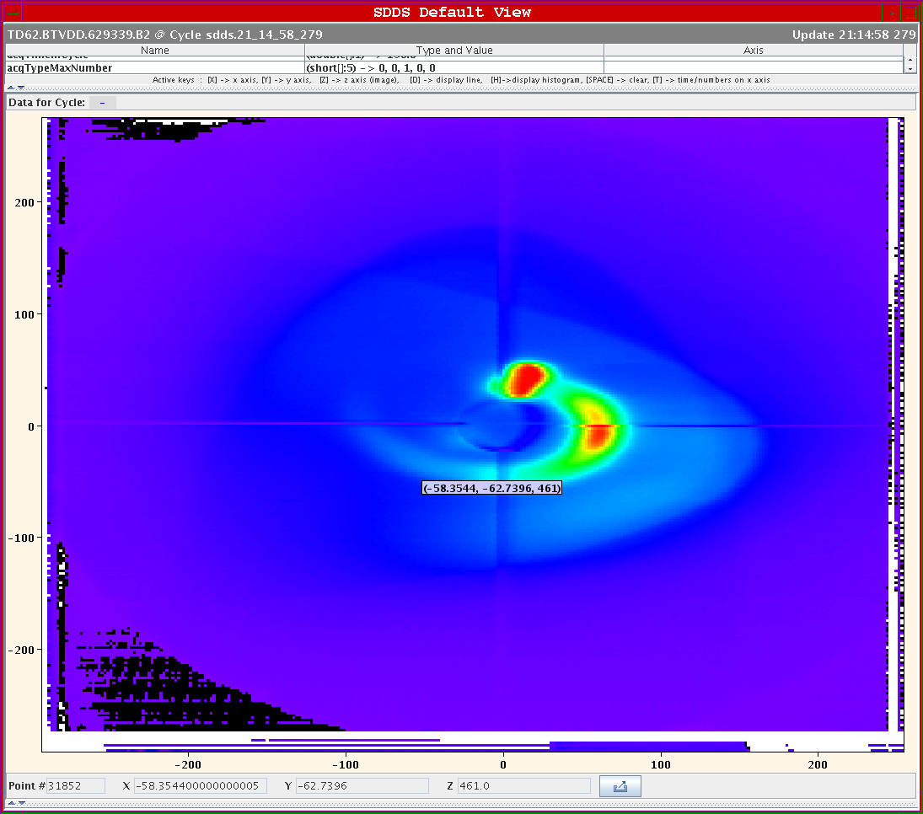
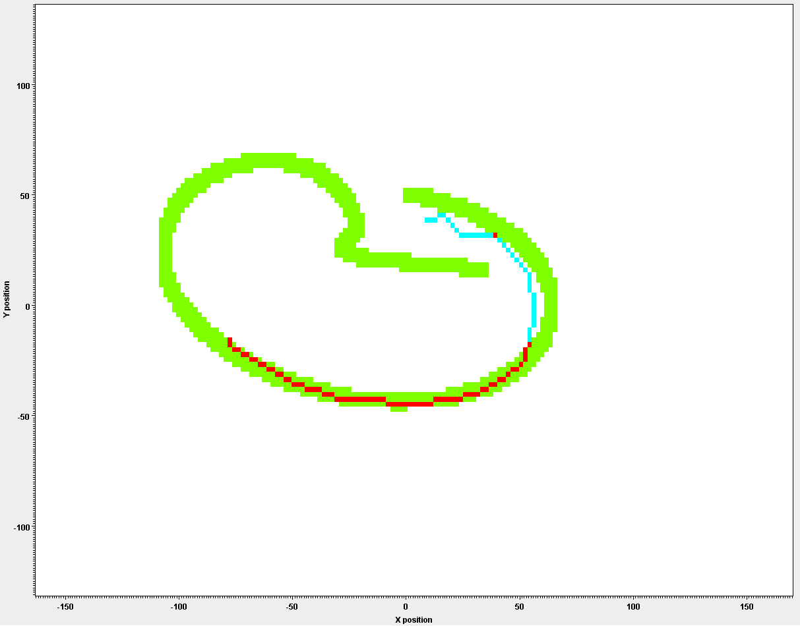
Conclusions
The Conclusions should be made by the Auditors
My Conclusions:
  Many things have been followed up, some not
    Indicates the usefulness of the Audit
  Some of them are in the process of being followed up
  Parallel to this, work has continued on the reliability and reliability testing of the system
  The Reliability Run has been very useful:
    Confirmed global reliability numbers
    Pointed towards some weaknesses which have been followed up as well
And there was beam:

