Slide 1
LS1@LHC BLM planning
28/01/2014

Slide 2
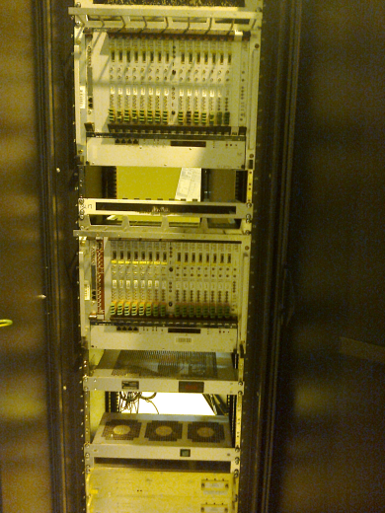
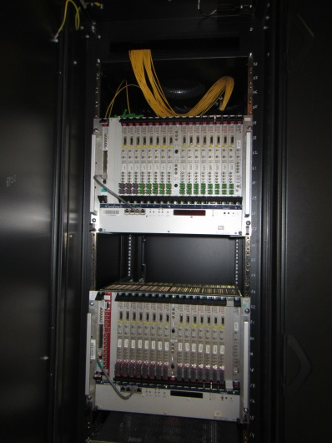
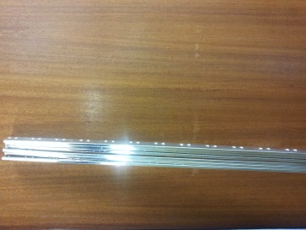
Surface racks
P2
P1, P2, P5, P6, P7, P8 (1/2) : done
(not complete…)
Pt3 : February
Pt4 : February, March (Bernd’s request) P6
6 Bars ( 2 for Pt8) - +
Cards

Slide 3
Tunnel racks and HV divider
Arc: All backplanes was exchange
Arc: all CFC cards removed
LSS: CFC cards removed
LSS: HV divider installation:
~60% HV dividers was installed in 6 LSS, but rest of cases are special ( as example R5 - presentation)
Pt6 , where 3 HV dividers was installed

Slide 4
BLM re-installation
New cables for dipole-dipole (DD) BLM installation was done in All Arc with the connectors, except sector 6-7 and L6 (no HV connectors)
L6 – BLMs re-installed in cells 7-21 with new DD support (except cell 8)
R6 – done from Q8-Q11 with connectors, except QBBI.8R6
R5 – done from Q7 to Q7 with connectors, except for 3 open ICs
LSS: Pt3 re-installed
LSS: R5 - prepared but not installed 4 and 5 cells
DD supports:
Germany: received 400 long supports ( for 400 DD)
CERN: received brides and int supports – 400 pcs (for 200 DD), next delivery – middle of February
Connectors : 24.01 arrival
1300 HV connectors
400 signal connectors
New installations (collimators, AFP, TOTEM, Alice – 2 old + new)
Put (overhead) the empty labels on old slot label for displacement to DD BLM
Scotch for new DD supports: 8 (10) rouleaus, 528 euro/rouleau

Slide 5
Divers
Slot Labels
Databases ( ~840 new expert names)
Test (electrical, battery)
Rad Source test ( 2 sources)
Label for new “short” cable (BJBDV - BJBAP)
ECR LHC-BLM-EC-0003 (BJBDV):
Samy “Is it possible to change the name form BJBCT (IC High Voltage Box with Capacitor) to BJBCP) and BJSCT (for SEM) to BJSCP?
LIC’s (list and GIF results) for installation
William’s request:
Booster IC Supports -> about 5 days
Booster Rack -> about 1 day
Linac4 Rack -> about 2 Days

