Slide 1
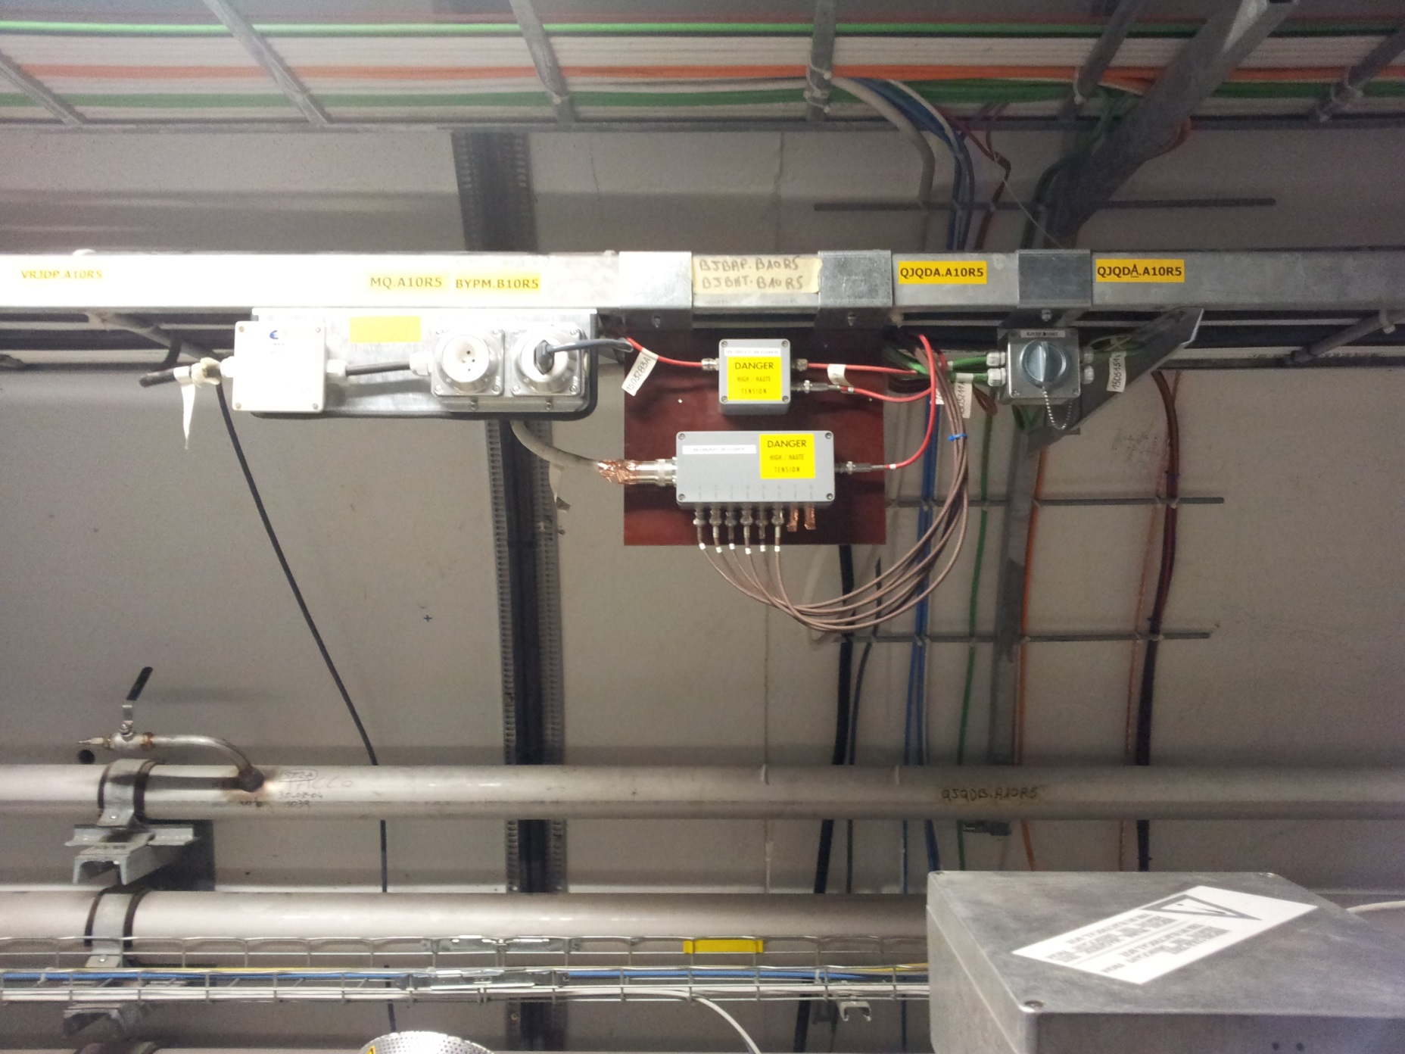
BJBAP.B10R5

Slide 2
BJBAP.B8R5

Slide 3
BJBAP.A6R5

Slide 4
BJSAP.A5R5

Slide 5
BJBHT_A4_B4R5 and BJSHT.A4R5

Slide 6
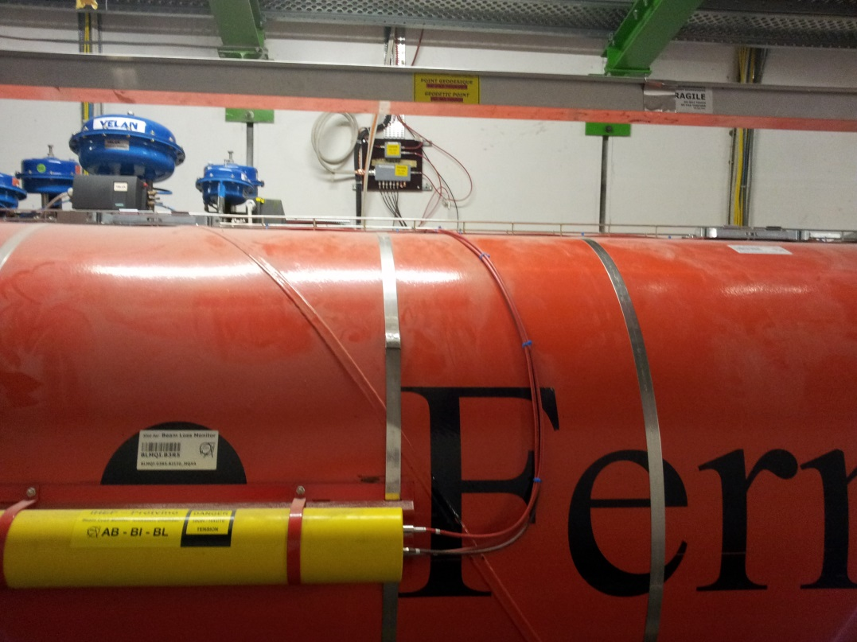
BJBAP.A3R5

Slide 7
BJBAP.A2R5

Slide 8
BJBAP.B1R5 and BJSAP.A1R5

