Slide 1
LS1@LHC BLM planning
24/02/2014

Slide 2
Surface racks
P1 -/+, P2 -/+, P5 -/+: change
P6 + , P7 +, P8 + : OK
Pt3 - dismounted
Pt4 : March (Bernd’s request)
From: Christos Zamantzas , Seghaier Ben Amor Subject: Rack configuration:
R L
I C
- ground metallic bar: >5 fixation

Slide 3
Tunnel racks and HV divider
HV divider installation:
L7 – standard cases + R6 – standard cases +
R7 and L6 –
Special cases –
L5: restoration of racks after He spill test
Racks – CFC cards : ready for installation ( Ion or Russian team)

Slide 4
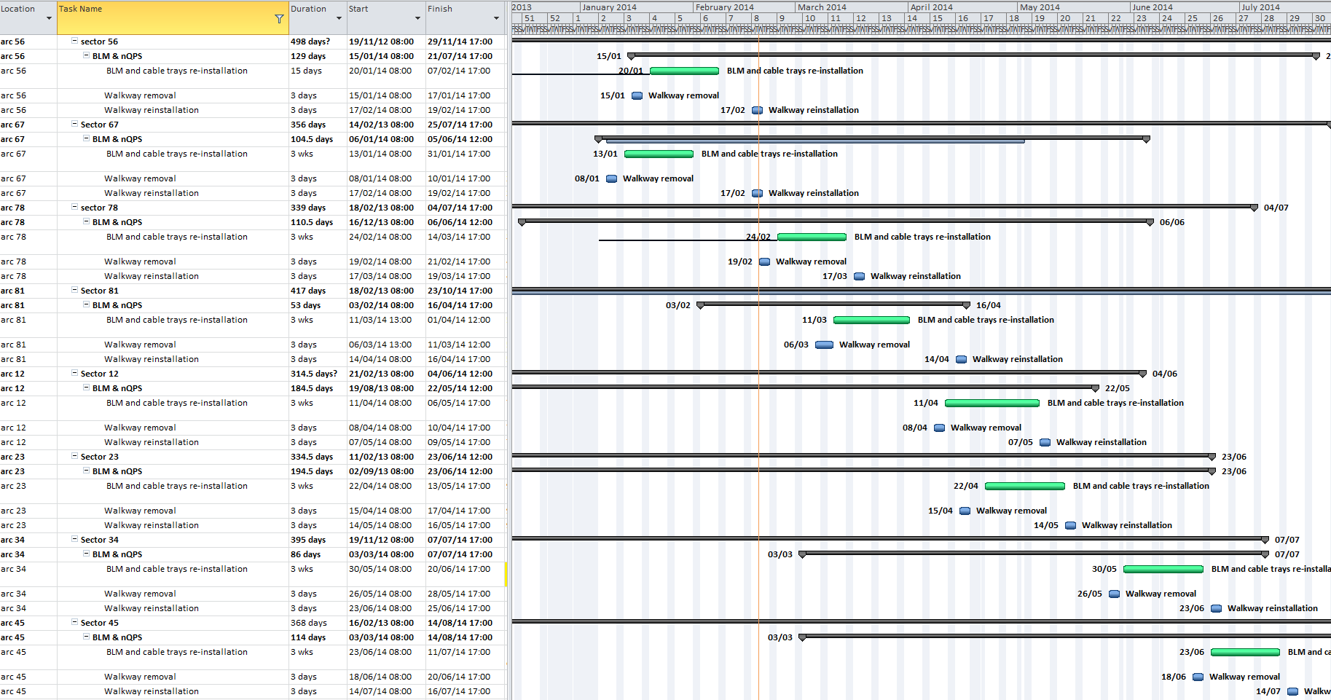
BLM and cable trays - Walkways

Slide 5
BLM re-installation
From: Marzia Bernardini Sent: 19 February 2014 15:20 To: Slava Grishin Cc: Ewald Effinger; Michel Arnaud Subject: RE: REMINDER- LHC LS1 coordination meeting TOMORROW - 20th Feb. - BLM schedule
Dear Slava,
I’ll move the installation in sector 81 of 1 week, on 18.03.
Concerning sector 23, we’ll see in the coming month.
Cheers,
Marzia
From: Slava Grishin Sent: 19 February 2014 15:14 To: Marzia Bernardini Cc: Ewald Effinger; Michel Arnaud Subject: RE: REMINDER- LHC LS1 coordination meeting TOMORROW - 20th Feb. - BLM schedule
Dear Marzia,
Could I look at the schedule of BLM installation and some remarks:
1)sector 7-8, start from 24/02 during 3 weeks and walkway removal-reinstallation – is OK.
2)sector 81, start from 11/03 – but it’ll be overlap in 1 week with sector 7-8. Could you move this sector for one week?
3) sector 12 – start from 11.04 during 3 weeks and walkway removal-reinstallation – is OK.
4)sector 2-3 – start from 22.04 – but it’ll ne overlap in 2 weeks with sector 1-2.
5&6) sector 3-4 and sector 4-5 are OK.

Slide 6
BLM re-installation
According to LS1 schedule and constrains for ARC+DS
Sector 6-7 - done
Sector 5-6 - done
Sector 7-8 – from today
LSS

Slide 7
General Information
Beam Vacuum Pumping in the LSS and Arcs before the start of the cool-down
All activities on the stand alone need to be completed before
Start week 13 for the sector 67

Slide 8
GLOBAL OVERVIEW: P test & cool down

Slide 9
Divers
Databases: changes on this week sector 5-6, 6-7
Slot Labels ( after changes of expert names)
Rad Source test ( 2 sources – when will be ready?)
Label for new “short” cable (BJBDV - BJBAP)
Addendum for 50 FICs and Amendment for 1 month* 4 persons prolongation – under signature at CERN ( this week)
LIC’s after GIF for installation – middle of March (?)
1 shielding + 1st refilling
1 shielding + 2nd refilling
2 shielding + 1st refilling
2 shielding + 2nd refilling
*sagana leaks during the refilling

