Slide 1
LS1 BLM@LHC status
24/03/2014

Slide 2
Surface racks
P2 -/+, to change the configuration
P1, P3, P5, P6 , P7, P8
Pt4 - dismounted:
- 4 extensions in hall of P4
- 1 door from P3 - bld 283
- ventilators are in Christos’s office
- BL electronics - Seghaier for cleaning
Rack configuration:
R L
I C

Slide 3
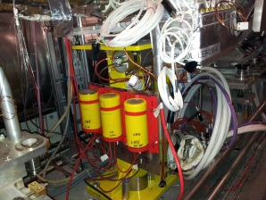
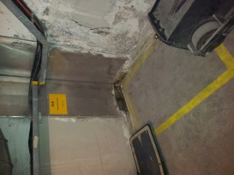
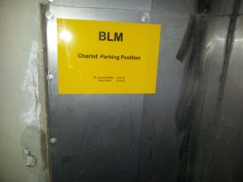
BLM re-installation (1)
Current status of DS+ARC installation:
Sector 6-7 - done
Sector 5-6 – done
April 2nd – Russian Team exchange ( to 30.06)
Sector 7-8 - done
Requested SEMs was dismounted in L8
Sector 8-1: start at R8
Requested SEMs was dismounted in R8 as well as LICs at R7
-New Installation ( +LHCb)
-Ion’s Request for new installation
From: John Jowett
Sent: 21 March 2014 16:16
Subject: RE: RE: BLMs for heavy ion losses
IR2, both left and right, where we seem to be missing coverage is in the connection cryostat next to the Q11. Can we have some BLMs there even though they are not “shielded” by a magnet cold-mass ?
IR1 and IR5: similarly for the connection cryostat.
In general, if “coupling” the BLMs means not knowing which of two BLMs has the higher loss, then we should avoid doing so.
- Barbara’s request to dismount SEMs and install LICs in P6 ( mail form 13.03.2014).
- BLMQI.01L8.B1E30)MQXA(BPMSW) - change of expert name ( Christos question from 10.03)
List what we need to be work before RSM:
Installation, surface rack, tunnel rack, DB, …
Request to move the source on surface – Procedure
LSS installation (MKI,MKD)

Slide 4
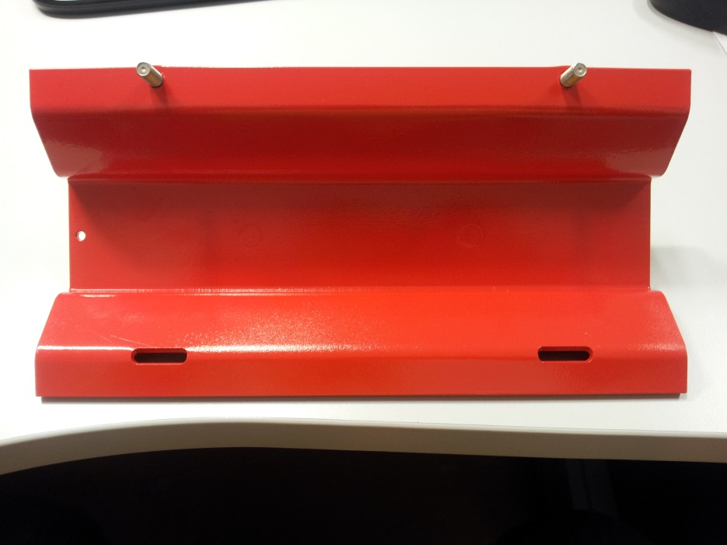
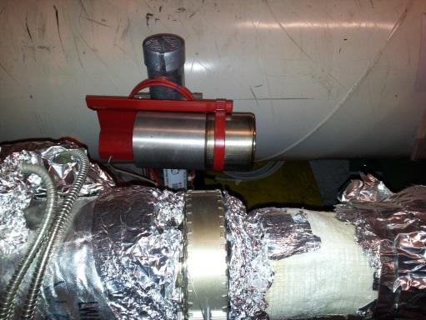
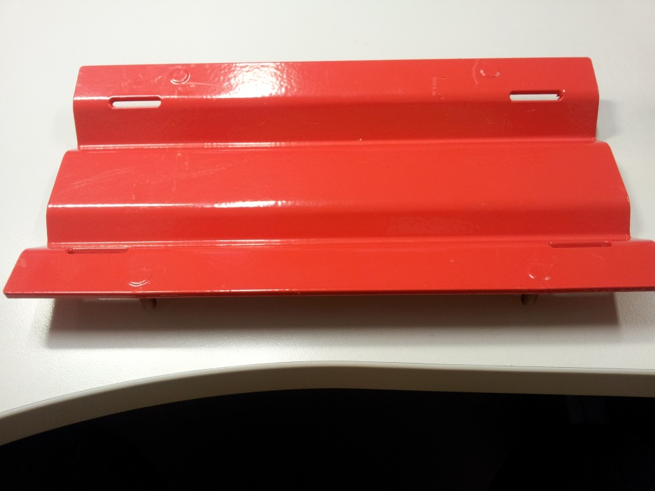
BLM re-installation (2)
LIC: installation and fixation
On Support : Exchange to this type
On cryostat : Fit to LIC

Slide 5
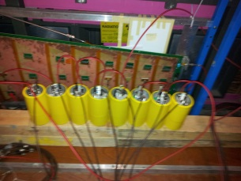
Divers
Slot Labels for 4 sectors ( after changes of expert names) – beginning of April (2nd Rteam)
Label for new “short” cable (BJBDV - BJBAP), ECR for HV divider is released
Coating of rest of supports and brides to outside of CERN, RAL3020 + schedule?
Plastic boxes and old supports from tunnel to SPS storage bld (Remo?) – beginning of April , 2nd team will take it from 4 sectors
Order the additional materials for installation:
1000 m(HV) and 3000 m(BNC) cables; 35 bobins (*45 m in each) of metallic strips.
Rad Source test ( 2 sources ) ready to end of July
LIC’s tests and shrinking at GIF is done
FIC production :
Materials to send: resistors ordered but 1 month delivery
List of materials, cost and amount of IC new production ( Q4,2013-Q1,2014)

Slide 6
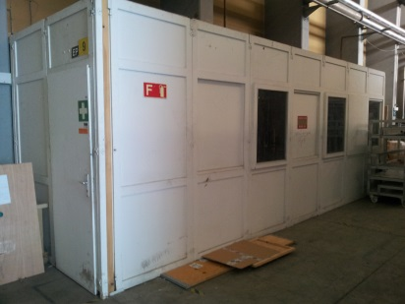
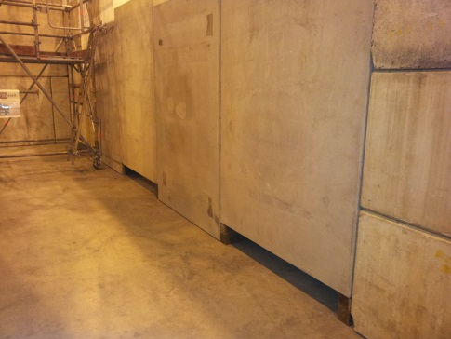
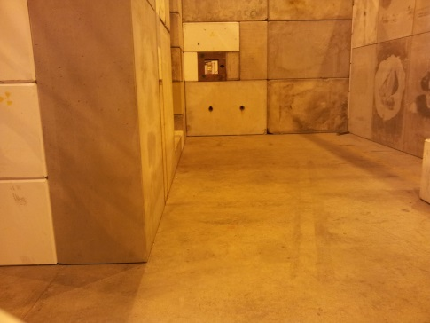
GIF and GIF++
GIF and GIF++ status:
GIF will operate up to Middle of August, 2013 (FIC tests in July, 2013)
GIF++ will operate from Middle of January, 2014 (IC tests in February,2014)
GIF: May 2013-remove the barrack
shrinking machine to …?
GIF++: install the cables in May 2013(? Insulated patch panels)
New EDH access to bunker

Slide 7
Tunnel racks and HV divider
HV divider installation:
Installed in all “standard” locations in all Points, except L6
In “special cases” – not installed,
but long cables was ordered ( Remo) - ?
L5: restoration of racks after He spill test
Racks – CFC cards : ready for installation ( Ion or Russian team)

