Slide 1
LS1 BLM@LHC status
07/04/2014

Slide 2
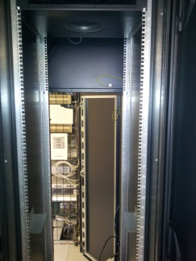
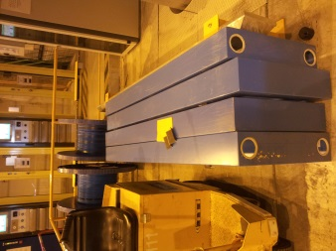
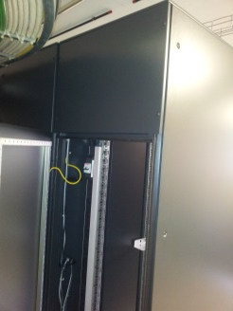
Surface racks
P2 + corrected the configuration
P4 + installed but p.s. should be below row 31 ( currently 34).
+ 4 extensions in hall of P4
Rack configuration:
R L
I C
 | SR1|3|5|6 & SX4 |  |  |  |  |  |  |  |  |  |  |  |  |  |  |  |  |  |  |  |  |  | SR1|3|5|6 & SX4
 | Rack: BLMLHC BY01 |  |  |  |  |  |  |  |  |  |  |  |  |  |  |  |  |  |  |  |  |  | Rack: BLMLHC BY02
 | Empty |  |  |  |  |  |  |  |  |  |  |  |  |  |  |  |  |  |  |  |  |  | Empty
 | OPTICAL CABLE STORAGE |  |  |  |  |  |  |  |  |  |  |  |  |  |  |  |  |  |  |  |  |  | OPTICAL CABLE STORAGE
 | OPTICAL CABLE SUPPORT |  |  |  |  |  |  |  |  |  |  |  |  |  |  |  |  |  |  |  |  |  | OPTICAL CABLE SUPPORT
 | 1 |  |  | 1 | 2 | 3 | 4 | 5 | 6 | 7 | 8 | BOBR | 9 | 10 | 11 | 12 | 13 | 14 | 15 |  | BLECS |  | 1 |  |  | 1 | 2 | 3 | 4 | 5 | 6 | 7 | 8 | BOBR | 9 | 10 | 11 | 12 | 13 | 14 | 15 |  | BLECS
 |  |  |  | 1 |  | D | S |  | S | S |  |  |  | D | S |  | S | S |  |  |  |  |  |  |  | 1 |  | D | S |  | S | S |  |  |  | D | S |  | S | S
 | C |  |  | 2 |  | A | R | C |  |  |  |  |  | A | R | C |  |  |  |  |  |  | C |  |  | 2 |  | A | r | c |  |  |  |  |  | A | r | c
 | P |  |  | 3 |  |  |  |  |  |  |  |  |  |  |  |  |  |  |  |  |  |  | P |  |  | 3
 | U |  |  | 4 |  | L | e | f | t |  |  |  |  | L | e | f | t |  |  |  |  |  | U |  |  | 4 |  | L | e | f | t |  |  |  |  | L | e | f | t
 |  |  | SN: |  |  |  |  |  |  |  |  |  |  |  |  |  |  |  |  |  |  |  |  |  | SN:
 | 1 | 2 | 3 | 4 | 5 | 6 | 7 | 8 | 9 | 10 | 11 | 12 | 13 | 14 | 15 | 16 | 17 | 18 | 19 | 20 | 21 |  | 1 | 2 | 3 | 4 | 5 | 6 | 7 | 8 | 9 | 10 | 11 | 12 | 13 | 14 | 15 | 16 | 17 | 18 | 19 | 20 | 21
 | CFVM-SR1-BLML |  |  |  |  |  | Fan VME |  |  |  |  |  |  |  |  | SN: 71300130 |  |  |  |  |  |  | CFVM-SR2-BLMC |  |  |  |  |  | Fan VME |  |  |  |  |  |  |  |  | SN: 71300217
 | AIR DEFLECTOR |  |  |  |  |  |  |  |  |  |  |  |  |  |  |  |  |  |  |  |  |  | AIR DEFLECTOR
 | Empty |  |  |  |  |  |  |  |  |  |  |  |  |  |  |  |  |  |  |  |  |  | OPTICAL CABLE STORAGE
 |  |  |  |  |  |  |  |  |  |  |  |  |  |  |  |  |  |  |  |  |  |  | OPTICAL CABLE SUPPORT
 |  |  |  |  |  |  |  |  |  |  |  |  |  |  |  |  |  |  |  |  |  |  | 2 |  |  | 1 | 2 | 3 | 4 | 5 | 6 | 7 |  | BOBR | 9 | 10 | 11 | 12 | 13 | 14 | 15 |  | BLECS
 |  |  |  |  |  |  |  |  |  |  |  |  |  |  |  |  |  |  |  |  |  |  |  | C |  | 1
 |  |  |  |  |  |  |  |  |  |  |  |  |  |  |  |  |  |  |  |  |  |  | C | I |  | 2 |  | A | R | C |  |  |  |  |  |  | A | R | C
 |  |  |  |  |  |  |  |  |  |  |  |  |  |  |  |  |  |  |  |  |  |  | P | S |  | 3 |  | L | e | f | t |  |  |  |  |  | R | I | g | h | t
 |  |  |  |  |  |  |  |  |  |  |  |  |  |  |  |  |  |  |  |  |  |  | U | V |  | 4
 |  |  |  |  |  |  |  |  |  |  |  |  |  |  |  |  |  |  |  |  |  |  |  |  | SN:
 |  |  |  |  |  |  |  |  |  |  |  |  |  |  |  |  |  |  |  |  |  |  | 1 | 2 | 3 | 4 | 5 | 6 | 7 | 8 | 9 | 10 | 11 | 12 | 13 | 14 | 15 | 16 | 17 | 18 | 19 | 20 | 21
 |  |  |  |  |  |  |  |  |  |  |  |  |  |  |  |  |  |  |  |  |  |  | CFVM-SR2-BLMR |  |  |  |  |  | Fan VME |  |  |  |  |  |  |  |  | SN: 71300216
 |  |  |  |  |  |  |  |  |  |  |  |  |  |  |  |  |  |  |  |  |  |  | AIR DEFLECTOR
 | Rack Control |  |  |  |  |  |  |  |  |  |  |  |  |  |  |  |  |  |  |  |  |  | Rack Control
 | Empty |  |  |  |  |  |  |  |  |  |  |  |  |  |  |  |  |  |  |  |  |  | Empty
 |  |  |  |  |  |  |  |  |  |  |  |  |  |  |  |  |  |  |  |  |  |  | HV Power Supply
 |  |  |  |  |  |  |  |  |  |  |  |  |  |  |  |  |  |  |  |  |  |  | F A N
 |  |  |  |  |  |  |  |  |  |  |  |  |  |  |  |  |  |  |  |  |  |  | AIR DEFLECTOR
 |  |  |  |  |  |  |  |  |  |  |  |  |  |  |  |  |  |  |  |  |  |  | BIC "UNMASKABLE"
 |  |  |  |  |  |  |  |  |  |  |  |  |  |  |  |  |  |  |  |  |  |  | HCCIBUS-ID000xxx
 |  |  |  |  |  |  |  |  |  |  |  |  |  |  |  |  |  |  |  |  |  |  | BIC "MASKABLE"
 |  |  |  |  |  |  |  |  |  |  |  |  |  |  |  |  |  |  |  |  |  |  | HCCIBUS-ID000xxx
 | Internet |  |  |  |  |  |  |  |  |  |  |  |  |  |  |  |  |  |  |  |  |  | Internet

Slide 3
BLM tunnel
BLM re-installation:
Sector 8-1: R8 done, L1 – not yet finish (20L1->33L1, 2-3 working days)
Sector 1-2 : from 07.04
* Re-install BLM in open Ics ( sector 6-7 first)
LSS
Coating of rest of supports and brides outside of CERN, RAL3020 + schedule : the sample?
2nd Russian team – + 02/04 – 30/06 ; -3rd team 30/06(24/06?) – 30.09 (23.09)
– the possible prolongation of Russian team: 30.09(23.09) – 12.12.2014
SEM->LIC
New Installation
HV divider
Last, April 2014, BLM related schedule ( 2 pdf files)

