Slide 1
LS1 BLM@LHC status
28/04/2014

Slide 2
BLM re-installation
Current status of DS+ARC the monitors re-installation ( according to LS1 schedule):
Sector 5-6 – done
Sector 6-7 - done: 8 LICs for P6 are in tunnel, but not yet installed
Sector 7-8 - done
Sector 8-1 - done : 12 LICs was installed in R8, SEMs are in tunnel
Sector 1-2 - will be done this week
Sector 6-7 - ready for cool down from May 7th : All monitors, all HV dividexr, R6 CFC card (Ewald), the plastic boxes on surface
Small items to do: --- Dump line HV dividers ; --- L7 CFC cards
Next sector for cool down is Sector 8-1 to June 13th : we’ll plan to complete this sector on W24.
ALICE:
Mid of May – new cables ( for 1 new and 1 shifted ICs) from tunnel side to Alice hole
August –installation: 1 IC on old place, 1 new IC and 1 IC will shifted at 5 m
Ion losses - new installation:
New installation: DCUM, installation's drawings
Current installation: check DCUM to Note 402 and IPs 1,2,5
LSS installation:
MKD@R6 in W19?
Mobile monitors at MK@L2 – already standard ( why in BLMM list?)
L7 – done, except the diamond and ACEM
New collimators
Expert names for re-location monitors:
52 new names ( for L8 E20) – 10 or 20 – according to increasing of DCUM (ECR) or 20-10 to IP form Left and Right ( Christos)
GIF++: in May there should be installation of new cables
New supports for re-located IC: waiting the delivery from Germany at the beginning of May

Slide 3
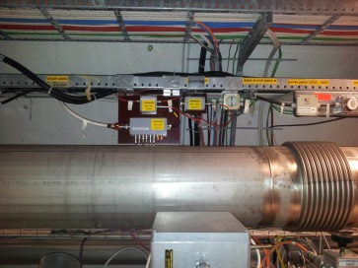
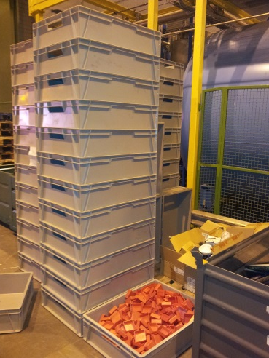
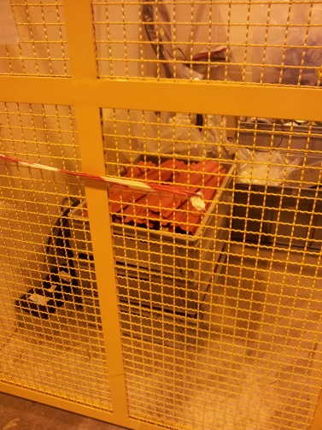
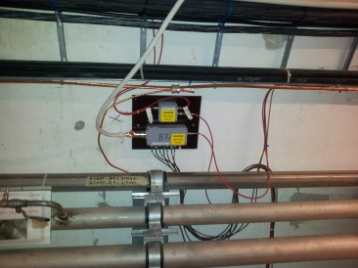
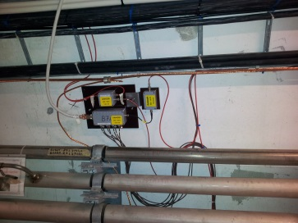
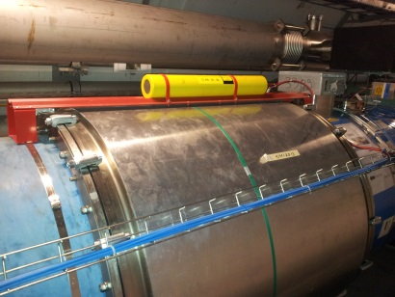
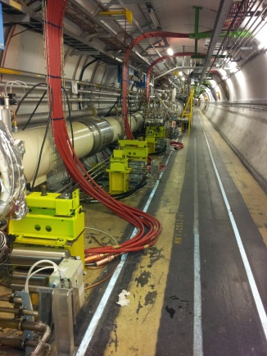
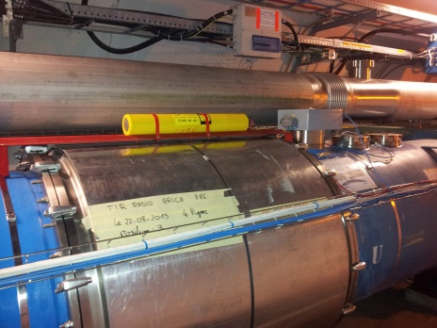
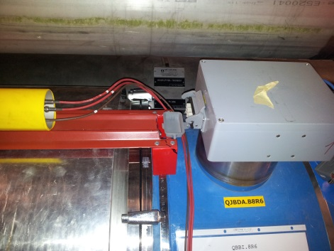
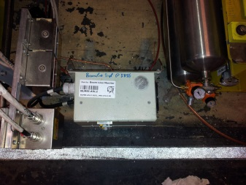
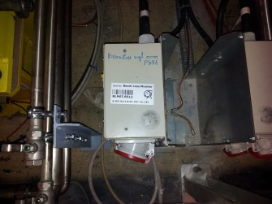
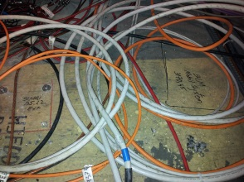
P6: sector 6-7
Standard HV divider
B7L7 HV divider
Standard UFO IC
MKI@L2 and BLMM
R6 UFO IC

Slide 4
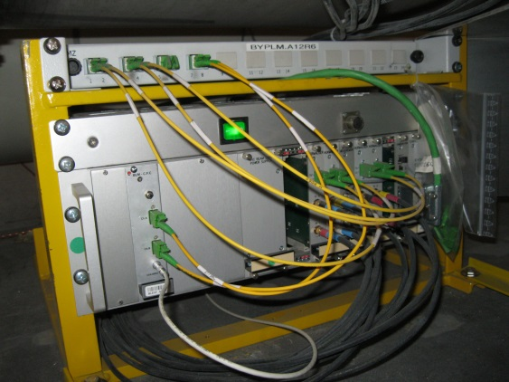
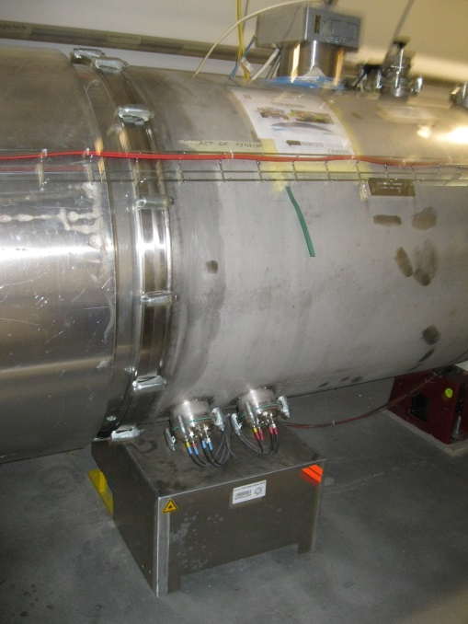
BYPLM.A12R6
Ewald and Slava
 | MTF
Slot Identifier: BYPLM.A12R6=R682
Other Identifier: BYPLM.12R6
Description: DEMI RACK BLM+BPM Demi-cellule 12
BYPLM_A12R6_A .JPG (2 Mb)
BYPLM_A12R6_C .JPG (2 Mb)
ID | 126020
Machine | LHC Ring
Type | BYPLM (Type ID : 118872, naming convention : HC)
Description | Half Rack BLM+BPM (Beam Instrumentation)
Layout Name | BYPLM.12R6
Links to other databases | BYPLM.A12R6=R682 in MTF
Positioned by Template | BYPLM IN ARC (Template ID : 2186607)

Slide 5
Ewald:
 |  | Re-installed |  |  | HV Threshold |  | Electronic |  |  | Test
Cell | Position | IC | SEM | LIC | HV Divider | Back plane | CFC | Laser | Function | Battery | Source | Comments
33 | BJBHT.A33L1 | 6
32 | BJBHT.A32L1 | 6
31 | BJBHT.A31L1 | 6
30 | BJBHT.A30L1 | 6
29 | BJBHT.A29L1 | 6
28 | BJBHT.A28L1 | 6
27 | BJBHT.A27L1 | 6
26 | BJBHT.A26L1 | 6
25 | BJBHT.A25L1 | 6
24 | BJBHT.A24L1 | 6
23 | BJBHT.A23L1 | 6
22 | BJBHT.A22L1 | 6
21 | BJBHT.A21L1 | 6
20 | BJBHT.A20L1 | 6
19 | BJBHT.A19L1 | 6
18 | BJBHT.A18L1 | 6
17 | BJBHT.A17L1 | 6
16 | BJBHT.A16L1 | 6
15 | BJBHT.A15L1 | 6
14 | BJBHT.A14L1 | 6
13 | BJBHT.A13L1 | 8
12 | BJBHT.A12L1 | 6
LSS:Slava and Julie
16505.54818 | BLMED.A4L6 | BLMED.04L6.B2I10_TCSG.4L6.B2 | 4L6 | A4L6 | No | week 23
16505.54818 | BLMEI.T4L6 | BLMEI.04L6.B2I10_TCSG.4L6.B2 | 4L6 | A4L6 | No | on support - week 23
16505.54818 | BLMES.T4L6 | BLMES.04L6.B2I10_TCSG.4L6.B2 | 4L6 | A4L6 | No | on support - week 23
16505.55818 | BLMEI.V4L6 | BLMEI.04L6.B2I11_TCSG.4L6.B2 | 4L6 | A4L6 | No | week 23
16508.93618 | BLMEI.S4L6 | BLMEI.04L6.B2I10_TCDQA.B4L6.B2 | 4L6 | A4L6 | No | on the TCDQ moving table - week 23
16508.93618 | BLMES.S4L6 | BLMES.04L6.B2I10_TCDQA.B4L6.B2 | 4L6 | A4L6 | No | on the TCDQ moving table - week 23
16512.48618 | BLMEI.R4L6 | BLMEI.04L6.B2I10_TCDQA.A4L6.B2 | 4L6 | A4L6 | No | on the TCDQ moving table - week 23
16512.48618 | BLMES.R4L6 | BLMES.04L6.B2I10_TCDQA.A4L6.B2 | 4L6 | A4L6 | No | on the TCDQ moving table - week 23
16621.02718 | BLMEI.Q4L6 | BLMEI.04L6.B1E10_TCDSA.4L6.B1 | 4L6 | IP6 | No | on support
16621.02718 | BLMES.Q4L6 | BLMES.04L6.B1E10_TCDSA.4L6.B1 | 4L6 | IP6 | No | SEM have to be changed to LIC
16624.56918 | BLMEI.P4L6 | BLMEI.04L6.B1E10_TCDSB.4L6.B1 | 4L6 | IP6 | No | on support
16624.56918 | BLMES.P4L6 | BLMES.04L6.B1E10_TCDSB.4L6.B1 | 4L6 | IP6 | No | SEM have to be changed to LIC
16626.12818 | BLMEI.O4L6 | BLMEI.04L6.B1E10_MSDA.E4L6.B1 | 4L6 | IP6 | Yes | stripped on the MSD
16626.12818 | BLMES.O4L6 | BLMES.04L6.B1E10_MSDA.E4L6.B1 | 4L6 | IP6 | Yes | SEM have to be changed to LIC

