Slide 1
LS1 BLM@LHC status
12/05/2014

Slide 2
BLM re-installation
Current status of DS+ARC the monitors re-installation ( according to LS1 schedule):
Sector 5-6 – done
Sector 6-7 - done: 8 LICs for P6 are in tunnel, but not yet installed – COOL DOWN
Sector 7-8 - done
Sector 8-1 - done : 12 LICs was installed in R8, SEMs are in tunnel
Sector 1-2 - done: L2 without new supports
Sector 2-3: will be done on this week, but without new supports
HV divider: R2 – 4 “special” cases, L2 will be go
Next sector for cool down is Sector 8-1 to June 13th : we’ll plan to complete this sector on W24.
Problem in R7 ( next slide)
ALICE:
Mid of May – new cables ( for 1 new and 1 shifted ICs) from tunnel side to Alice hole - done
August –installation: 1 IC on old place, 1 new IC and 1 IC will shifted at 5 m
Ion losses - new installation:
New installation: DCUM, installation's drawings
LSS installation
TOTEM
Expert names for re-location monitors:
52 new names ( for L8 E20) – 10 or 20 – according to increasing of DCUM (ECR) or 20-10 to IP form Left and Right ( Christos) – waiting
For sector 6-7 will be the 1st and should be during 1-2 weeks
GIF++: in May there should be installation of new cables – new schedule
New supports for re-located IC: delivery ( next slide)

Slide 3
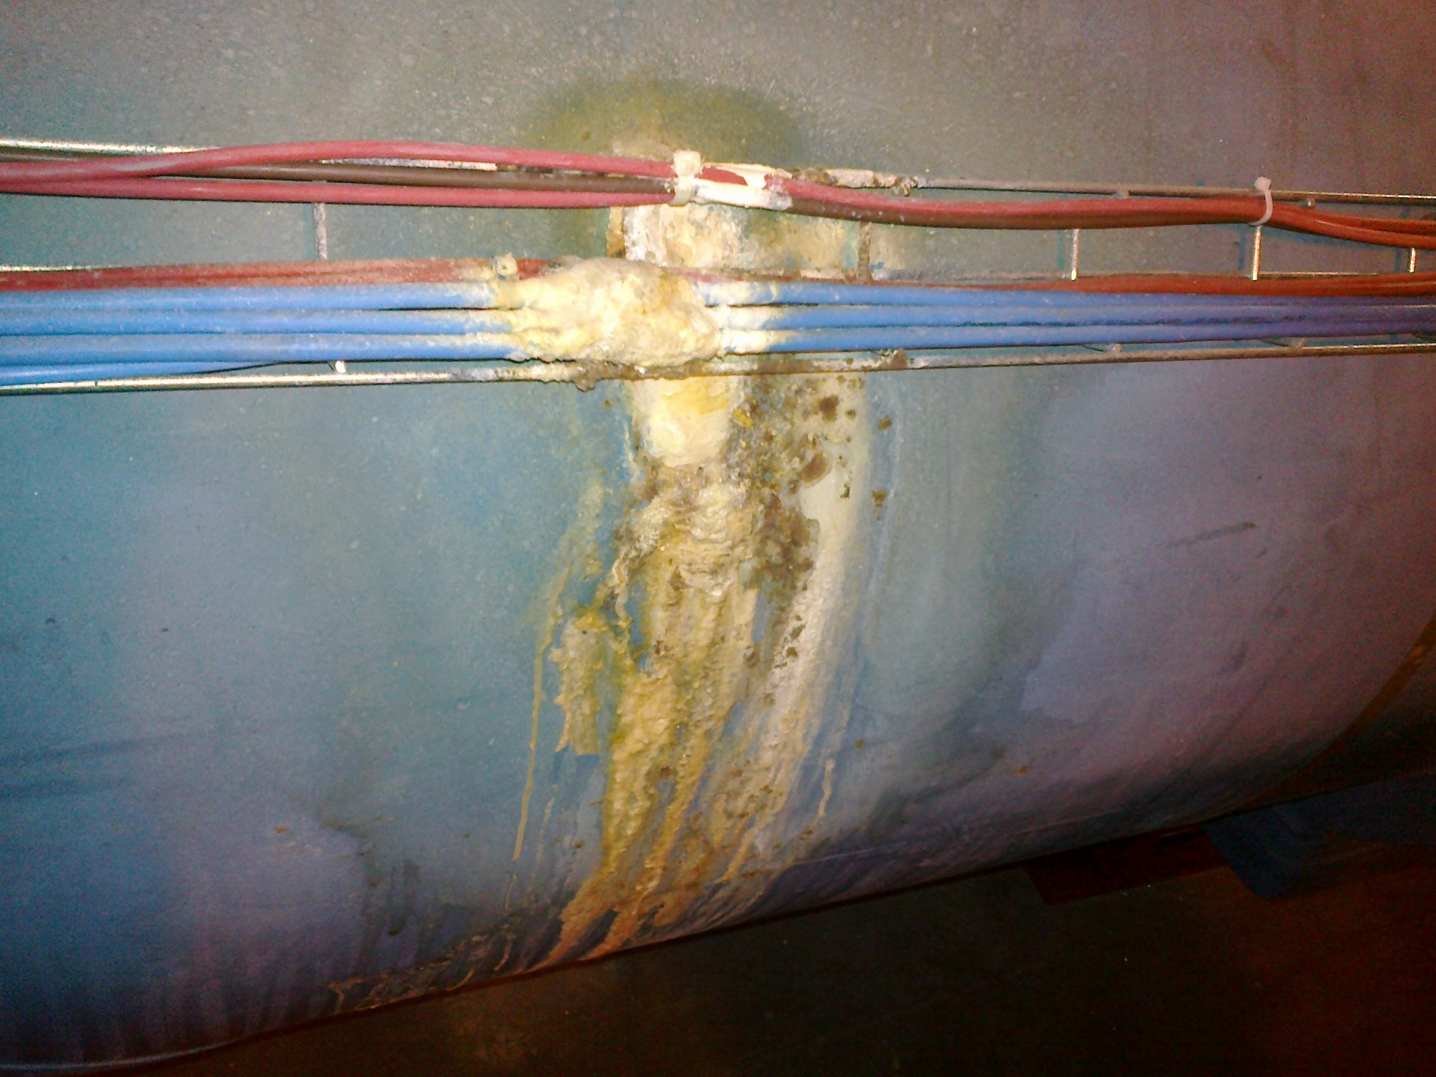

Slide 4
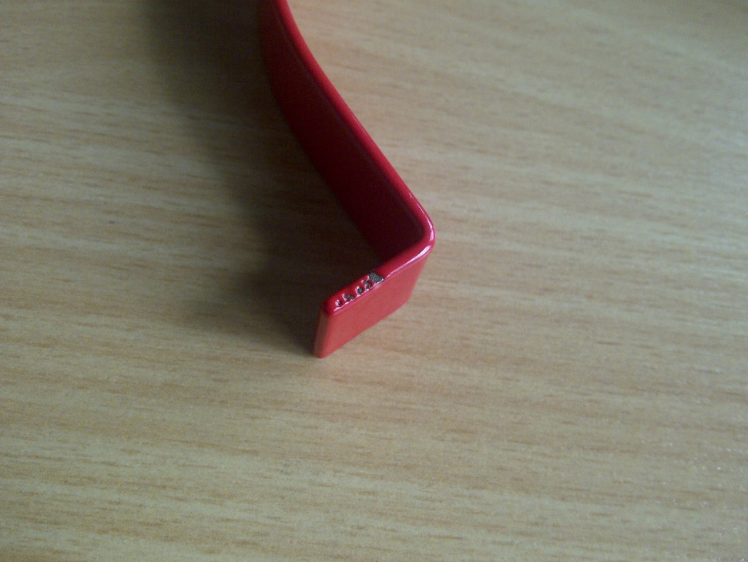
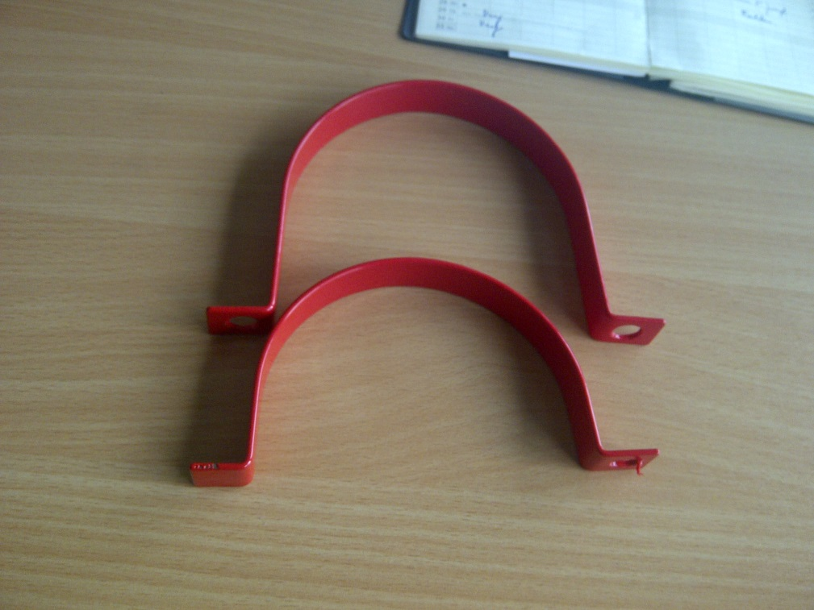
New supports and Rislan
1) Van: Raf Van Os
Verzonden: vrijdag 9 mei 2014 17:45
Aan: 'phlippe.frichot@cern.ch'
Onderwerp: Rilsan
Monsieur Frichot,
Les pièces urgentes sont prêtes. Si vous venez les enlever début de la semaine prochaine, informez-nous pour que l' on puisse faire la facture pro forma pour la Suisse.
2)

