Slide 1
LS1 BLM@LHC status
6/06/2014

Slide 2
BLM re-installation
ARC
Sector 3-4 – in work, will be done to 10.06
Sector 4-5 – from 30(23).06 – 11.07
Sector for Cool Down
Sector 8-1 – from 16.06 due to cool down will start June 23
HV divider installation – P4 done, except 2 cases ( next slide)
+Old short supports, red small boxes – RP measurement, removal and transfer (Remo) to bat 283
___________________________________________________________________________________________________________________
LSS
L4 – installed except 05L4 on week 25 ( next slide)
___________________________________________________________________________________________________________________
RSM
Have to update the documents; Meeting on week 26 with RP (doc’s, loan, procedure)+ Marzia (planning, sector to sector transfer, ARC-LSS)
___________________________________________________________________________________________________________________
Russian team
2nd team - up to 30.06, 3rd team – from June 24
P109/A4/A2 – for prolongation up to November 30 is under signature at CERN
___________________________________________________________________________________________________________________
GIF – GIF++
From: Martin Richard Jaekel , Sent: 03 June 2014 11:58
Cleanup of 190 - Side Gas Area - in the next 2 weeks
Adrian Fabich: it might be the best solution to move to a temporary place in EHN1 for the moment, until definitive space is allocated.
Aboubakr Ebn Rahmoun: Meeting 10 June 2014 09:30-10:30
______________________________________________________________________________________________________________
DB
Expert names for re-location monitors
Expert names : BLMBx and BLMTx
______________________________________________________________________________________________________________
FIC
During weeks we’ll send the materials

Slide 3
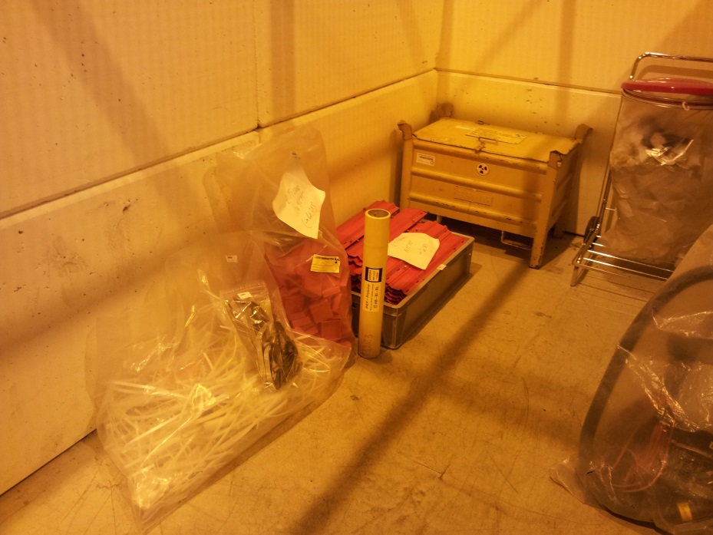

Slide 4
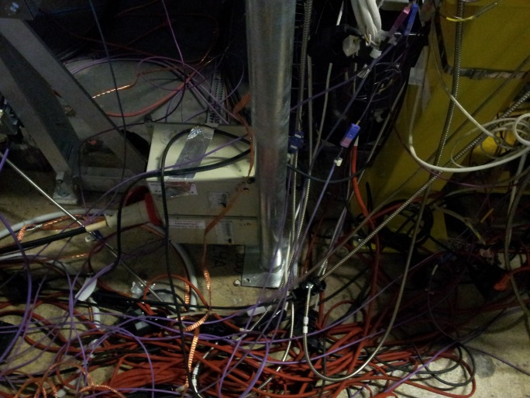
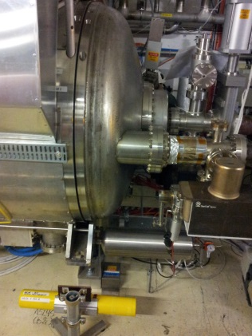
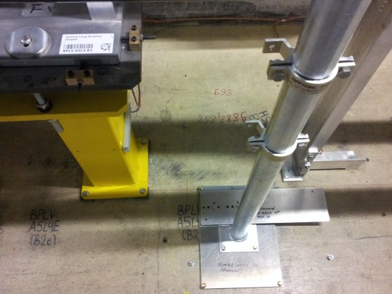
From: Julie Coupard Sent: 03 June 2014 12:40 First wait for the bake-equipment to be dismounted (contact N. Zelko) and
then, please ask Y. Muttoni for this non-conformity of installation
DCUM RING START | FUNCTIONAL POSITION NAME | EXPERT NAME | CELL | VACSEC | Mounted | NOTE
9822.4292 | BLMQI.A7L4 | BLMQI.06L4.B2E30_MQY | 7L4 | A7L4 | Yes
9826.3572 | BLMQI.F6L4 | BLMQI.06L4.B1I10_MQY | 6L4 | B6L4 | Yes
9826.9612 | BLMQI.E6L4 | BLMQI.06L4.B2E20_MQY | 6L4 | B6L4 | Yes
9828.1612 | BLMQI.D6L4 | BLMQI.06L4.B1I20_MQY | 6L4 | B6L4 | Yes
9829.9882 | BLMQI.C6L4 | BLMQI.06L4.B2E10_MQY | 6L4 | B6L4 | Yes
9833.1432 | BLMQI.B6L4 | BLMQI.06L4.B1I30_MQY | 6L4 | A6L4 | Yes
9859.4292 | BLMQI.A6L4 | BLMQI.05L4.B2E30_MQY | 6L4 | A6L4 | Yes | Support not fixed, w23-w24
9863.3572 | BLMQI.E5L4 | BLMQI.05L4.B1I10_MQY | 5L4 | F5L4 | Yes
9863.9612 | BLMQI.D5L4 | BLMQI.05L4.B2E20_MQY | 5L4 | F5L4 | Yes
9865.1612 | BLMQI.C5L4 | BLMQI.05L4.B1I20_MQY | 5L4 | F5L4 | Yes
9866.6972 | BLMQI.B5L4 | BLMQI.05L4.B2E10_MQY | 5L4 | F5L4 | Yes
9869.0522 | BLMQI.A5L4 | BLMQI.05L4.B1I30_MQY | 5L4 | F5L4 | Yes
9872.7972 | BLMEI.D5L4 | BLMEI.05L4.B2E20_MBRB | 5L4 | F5L4 | Yes
9877.8672 | BLMEI.C5L4 | BLMEI.05L4.B2E10_MBRB | 5L4 | F5L4 | Yes
9920.6512 | BLMEI.E5L4 | BLMEI.05L4.B2E10_BSRTM | 5L4 | D5L4 | No | Week 25 (JC) (picture)
9936 | BLMED.A5L4 | BLMED.05L4.B1C10_BGI | 5L4 | D5L4 | No | Week 25 (JC) ,Diamond, Ewald
9937.43 | BLMEI.F5L4 | BLMEI.05L4.B1I10_BGI | 5L4 | D5L4 | No | Week 25 (JC) Can not to install on old place ( picture)
9944.6982 | BLMEI.B5L4 | BLMEI.05L4.B2E20_MBRS | 5L4 | C5L4 | Yes
9949.4212 | BLMEI.A5L4 | BLMEI.05L4.B2E10_MBRS | 5L4 | C5L4 | No | ready to install w23-w24, no signal cable connector?
9985.0342 | BLMEI.G5L4 | BLMEI.05L4.B1I10_ACSGA.5L4.B1 | 5L4 | A5L4 | Yes
9996.864 | BLMEI.H5L4 | BLMEI.05L4.B1I20_ACSGA.5L4.B1 | 5L4 | A5L4 | Yes | Installed but not connected,W24

Slide 5
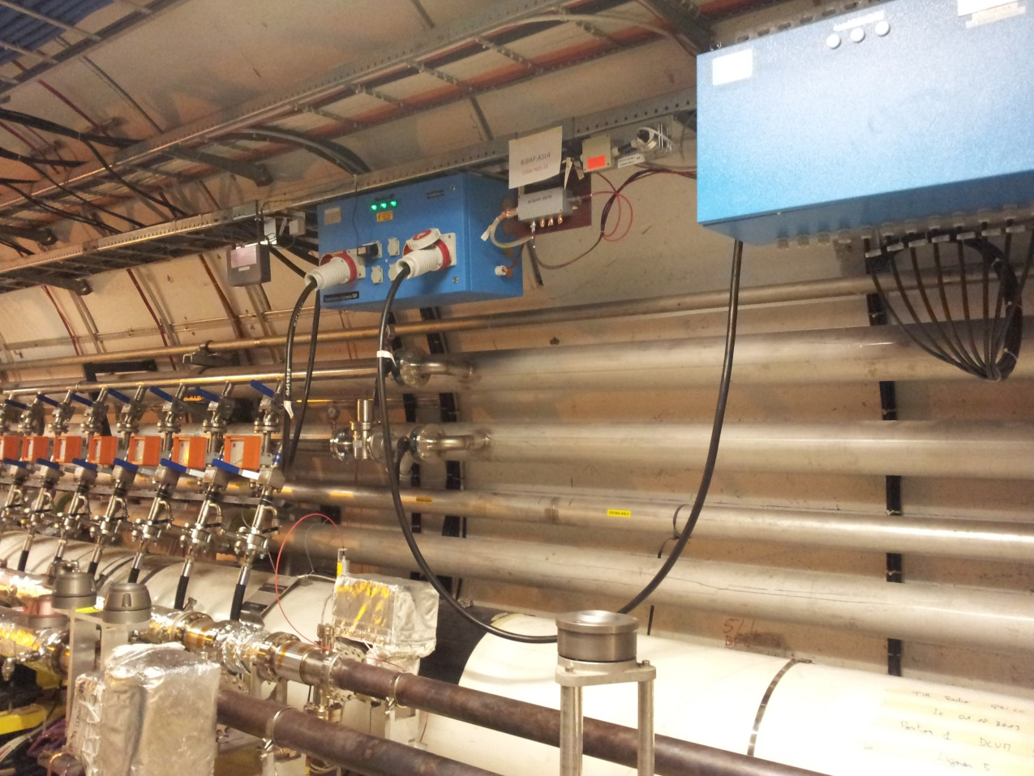
From: Julie Coupard Sent: 03 June 2014 12:40 2 possibilities : - Check with E. Paulat if the special scale we have in EN-MEF could help - Ask for a scaffolding to G. Canale.

