Slide 1
LS1 BLM@LHC status
30/06/2014

Slide 2
ARC
Sector 4-5 – up to ~ 11.07
Sector 1-2 – the complete re –installation before cool down : w29 (tbc)
Half of LHC - HV divider installation checking, plastic boxes removal, old short supports, red small boxes
________________________________________________________________________________________________________________
Basement 865 - cleaned
___________________________________________________________________________________________________________________
LSS
Installation drawings
From ~11.07 to 28.07 ( start of RSM) – final installation : access, schedule – Julie; team with Slava (? ), Ewald
___________________________________________________________________________________________________________________
RSM
From 28.07 (?)
today’s Meeting with Marzia – schedule, ARC+LSS
RP – doc’s are ready, today’s meeting with Abderrahim Errahhaoui
Wednesday – training for tractor driver license
__________________________________________________________________________________________________________________
Russian team
3rd team – OK
P109/A4/A2 – for prolongation up to November 30 : signed at CERN, in Protvino
___________________________________________________________________________________________________________________
GIF – GIF++
GIF++ meeting at 11 July
GIF++ cables – mid of August
Adrian Fabich: place for shrinking device in NH
Aboubakr Ebn Rahmoun: before beam the removal of wood ( barrack) in NH
GIF : cleaning of white barrack (?)
______________________________________________________________________________________________________________
DB
________________________________________________________________________________
FIC
Shipping of the materials
IC
The addendum under the signature at CERN, order of the materials

Slide 3
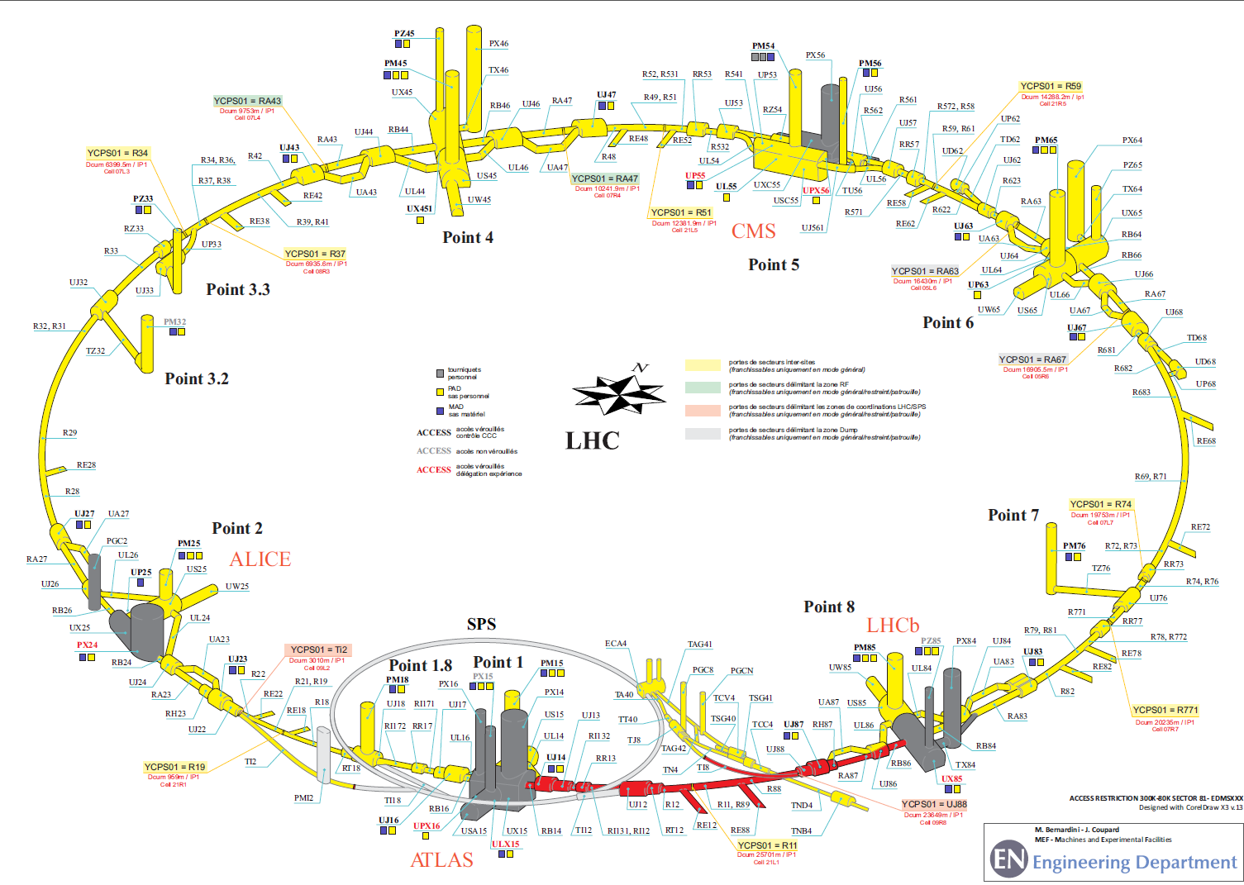
Since June 26th COOL DOWN START in Sector 81 → NO ACCESS

