Slide 1
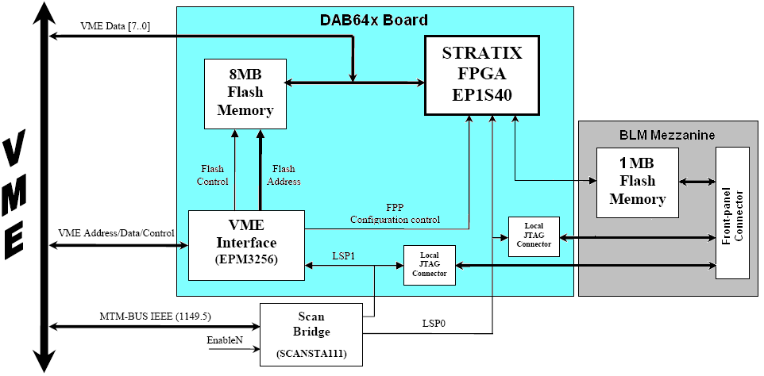
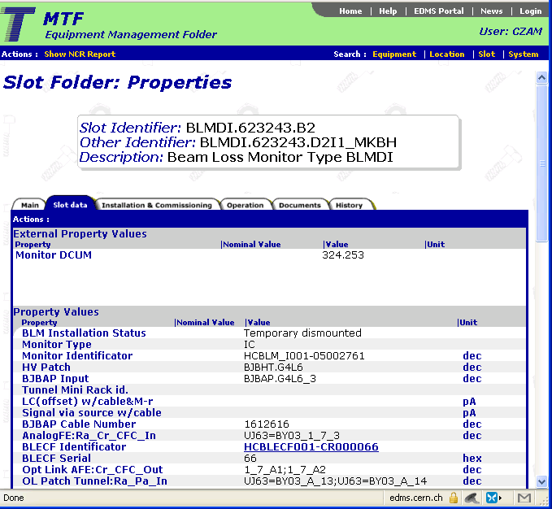
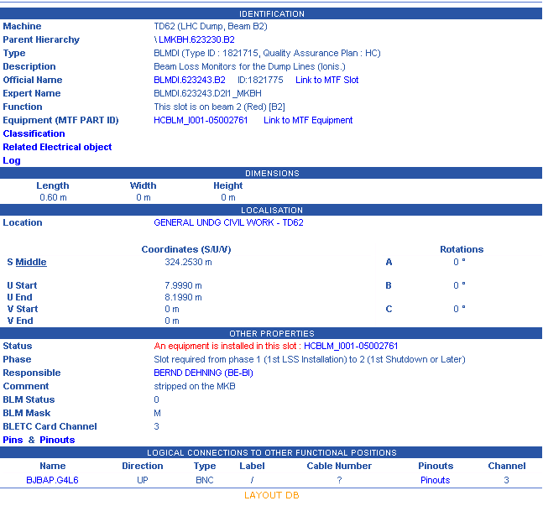
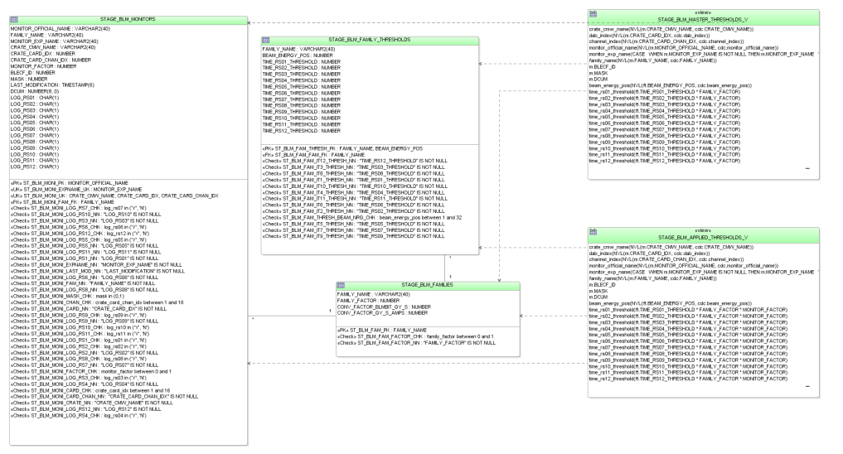
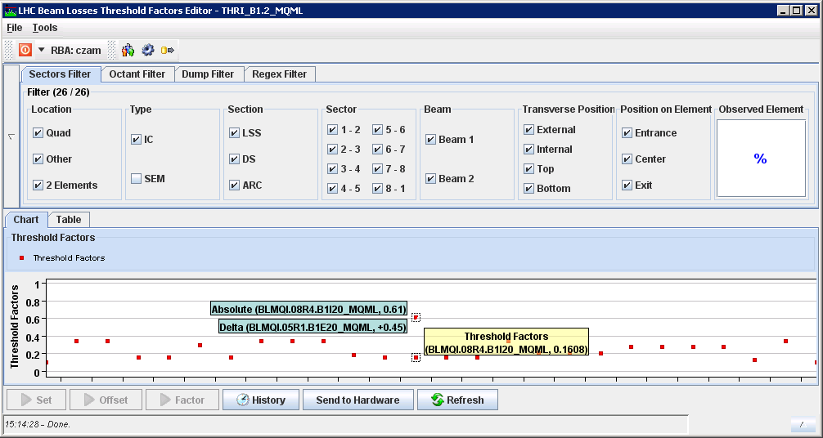
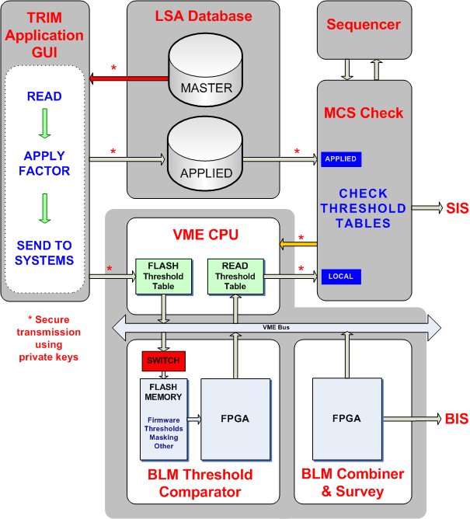
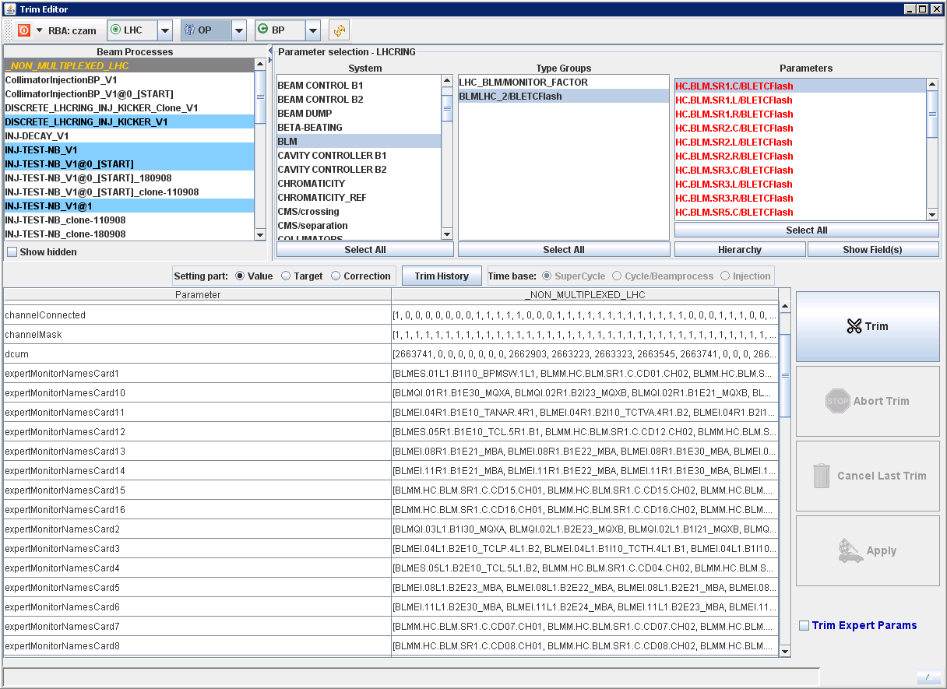
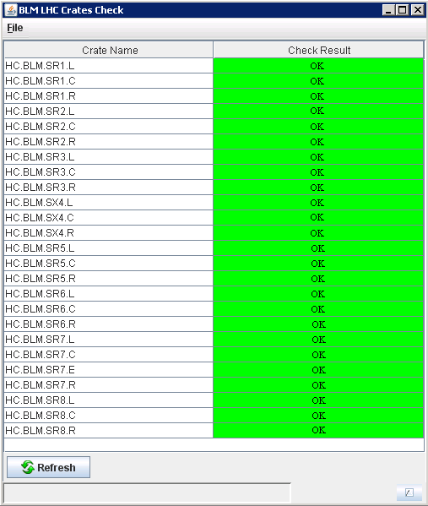
Configuration and Validation of the LHC Beam Loss Monitoring System. C. Zamantzas, B. Dehning, J. Emery, J. Fitzek, F. Follin, S. Jackson, V. Kain, G. Kruk, M. Misiowiec, C. Roderick, M. Sapinski
Abstract: The LHC Beam Loss Monitoring (BLM) system is one of the most complex instrumentation systems deployed in the LHC. As well as protecting the machine, the system is also used as a means of diagnosing machine faults, and providing feedback of losses to the control room and several systems such as the Collimation, the Beam Dump and the Post-Mortem. The system has to transmit and process signals from over 4’000 monitors, and has approaching 3 million configurable parameters.
This paper describes the types of configuration data needed, the means used to store and deploy all the parameters in such a distributed system and how operators are able to alter the operating parameters of the system, particularly with regard to the loss threshold values. The various security mechanisms put in place, both at the hardware and software level, to avoid accidental or malicious modification of these BLM parameters are also shown for each case.
Configuration of BLETC Module
Storage of Parameters
The FPGA firmware can be loaded either:
Initially the data are imported in MTF and are copied and linked together after scrutinous verification to the Layout DB. The latter provides hierarchical views of the system as well as information on the position in the tunnel and with respect to all other elements of the LHC.
Remotely via the Front-End Computer and the VME bus,
Locally via the JTAG connection in the front panel
Set as auto-configurable by utilising the on-board memory.
MTF DB
LAYOUT DB
The complete dataset can be one-way synchronised to LSA where it is split into tables to hold information for each monitor, crate or sector.
LSA DB
Parameters are stored in the configuration memory.
After the initialisation of the module the FPGA makes a local copy in its embedded memory.
The stored parameters can be updated remotely, but if safety reasons require it, only local updates can be enforced by an on-board switch.
sd
System Parameters Validation
The TRIM application GUI triggered by the operators reads the MASTER table, applies unique per monitor threshold coefficients, which are always < 1, and saves the new table as the APPLIED table.
The Management of Critical Settings (MCS) Online Check requests from the FEC to read all the currently used parameters (by incrementing the energy levels and recording the used threshold values).
It subsequently transmits them to the MCS Online Check for comparison. Both the FEC and the Software Interlock System (SIS) receive the PASS/FAIL result.
The APPLIED table is sent to the system and its correctness is verified.
In that way, operators and domain experts can readjust by scaling down the individual threshold values of each monitor, if this is found necessary, without impairing the protection characteristics of the system.
Drive of settings can be performed only when the accelerator status permits, i.e. offline.
Presented at the 9th European Workshop on Beam Diagnostics and Instrumentation for Particle Accelerators (DIPAC09), Basel, May 25-27 2009

