Slide 1
BLM – MPP review
Hardware nonconformities and safety
  Equipment failures
  IP 3 signal cross talk
  IP 2 sanity check failures
  SEM signal
Maximum of Acquisition Range
Monitors with Filter
Thresholds
  Global view
  Generation
  LSA developments
MPP test remaining
Audit

Slide 2
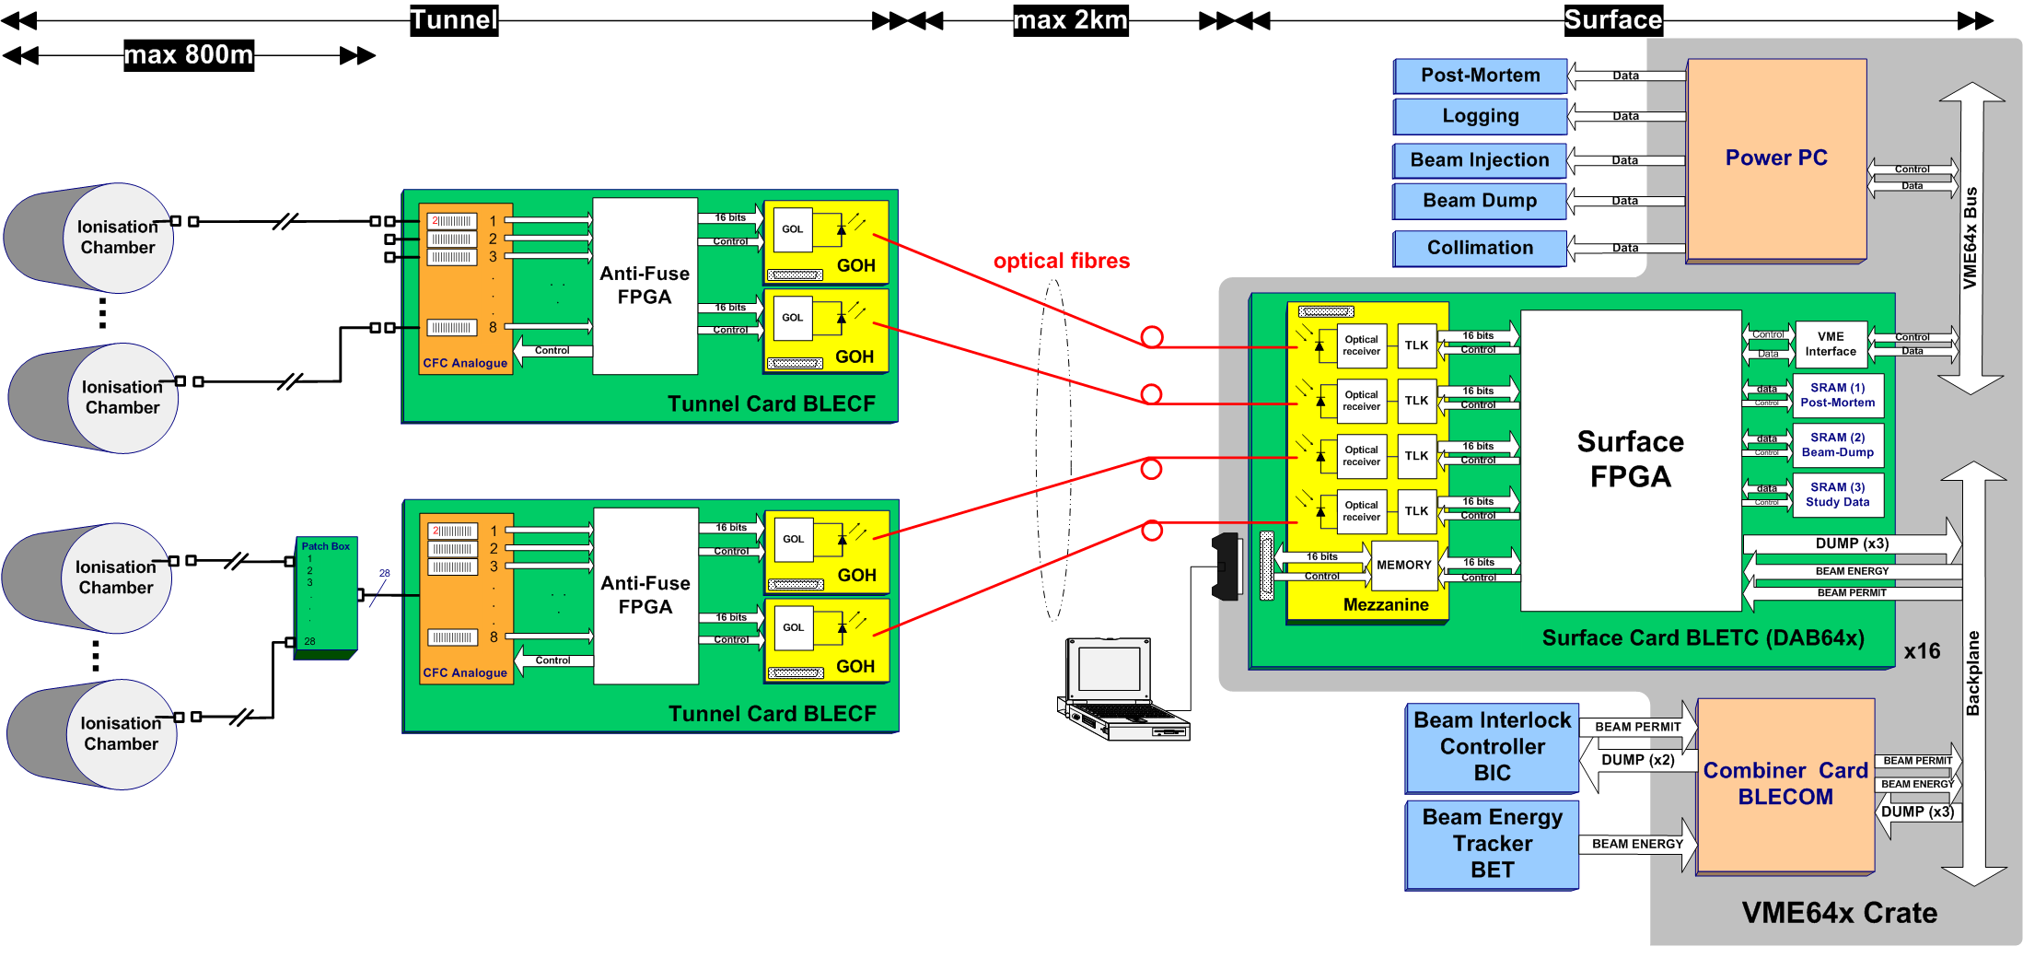
Overview of failures (since Feb. 2010)
9 IC with bad soldering
9 GOH with low power
1 damaged connector
1 x SRAM failed
6 CFC with noisy components
2 cards with bad soldering
6x optical receivers

Slide 3
System degradation analysis (I)
System Component & Action:
Criticality:
Ionisation Chambers
  Sanity checks [once daily + 200 dur. tech. stop]
  Check of all spares [ opening ~300 monitors]
Current-to-Frequency Converter
  Noise & Offset [technical stop]
Optical links
  Statuses & Errors [daily + weekly]
Degradation in between of sanity checks: fast losses cannot correctly detected
[reliability]
High noise/offset can give false dump requests [availability]
Lost packets provoke spurious dump requests [availability]

Slide 4
System degradation analysis (II)
Future Actions (increase availability):
Improve the analysis tools to achieve:
  Better combination of results
  Better display of results
  Automation
  Historical comparisons
Large scale test of Optical Links:
  Measure optical power of all links a few times
  Understand if there is degradation over time
  Understand if there is correlation with temperature

Slide 5
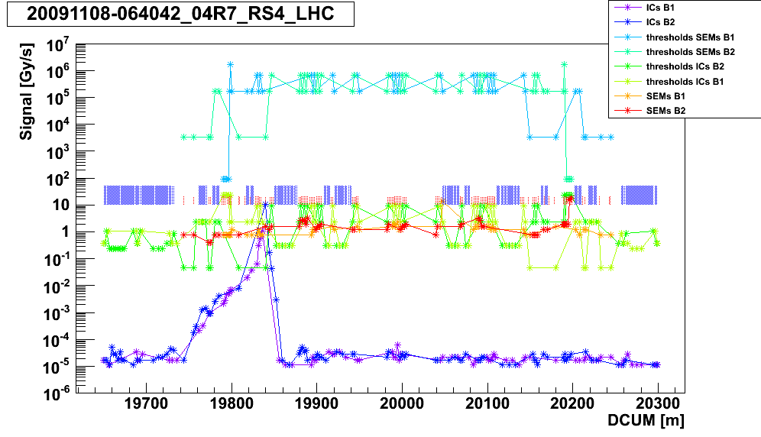
Comparison of BLM Monitor Behaviour between IR 3 and IR 7 (I)
Shooting on TCLA in IR 7

Slide 6
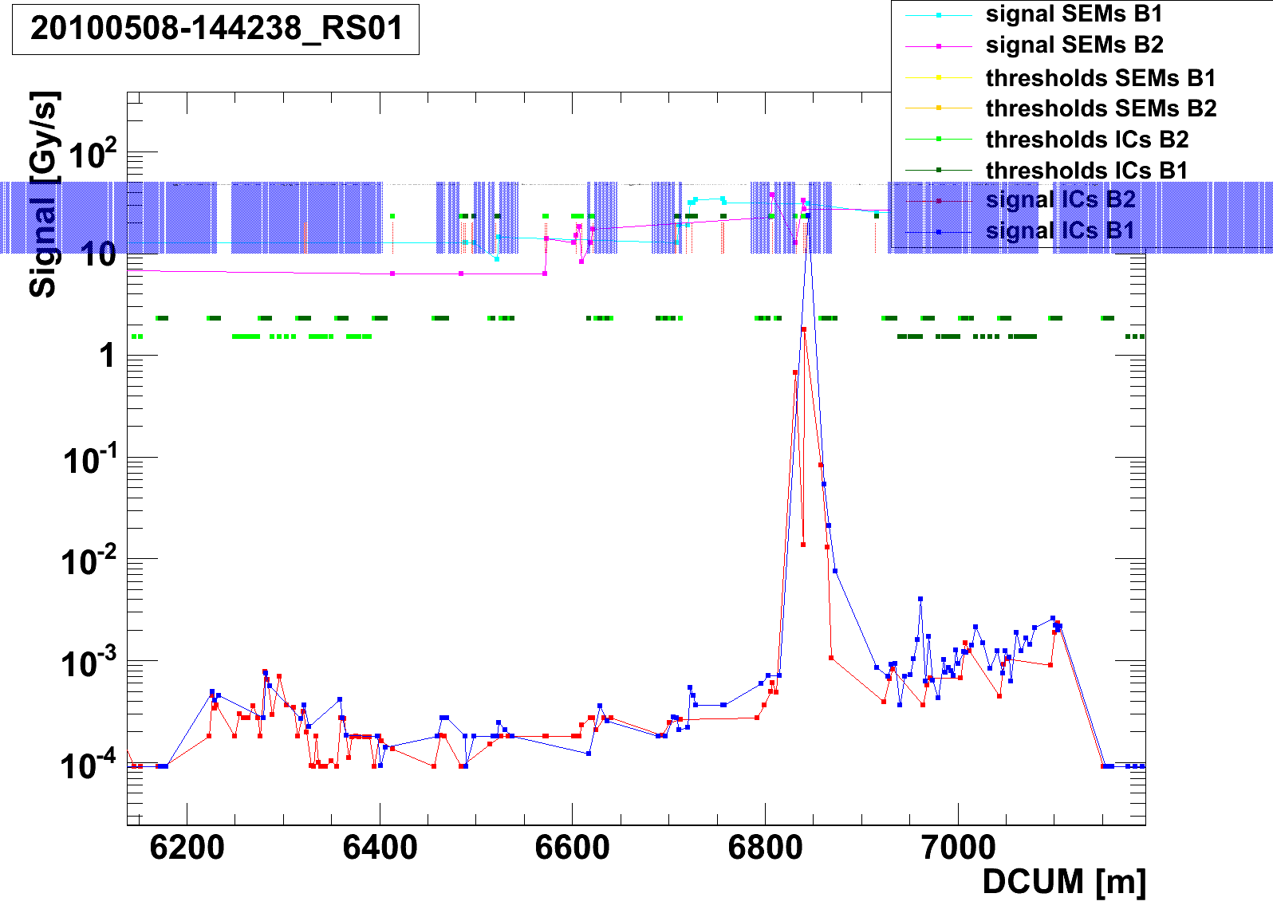
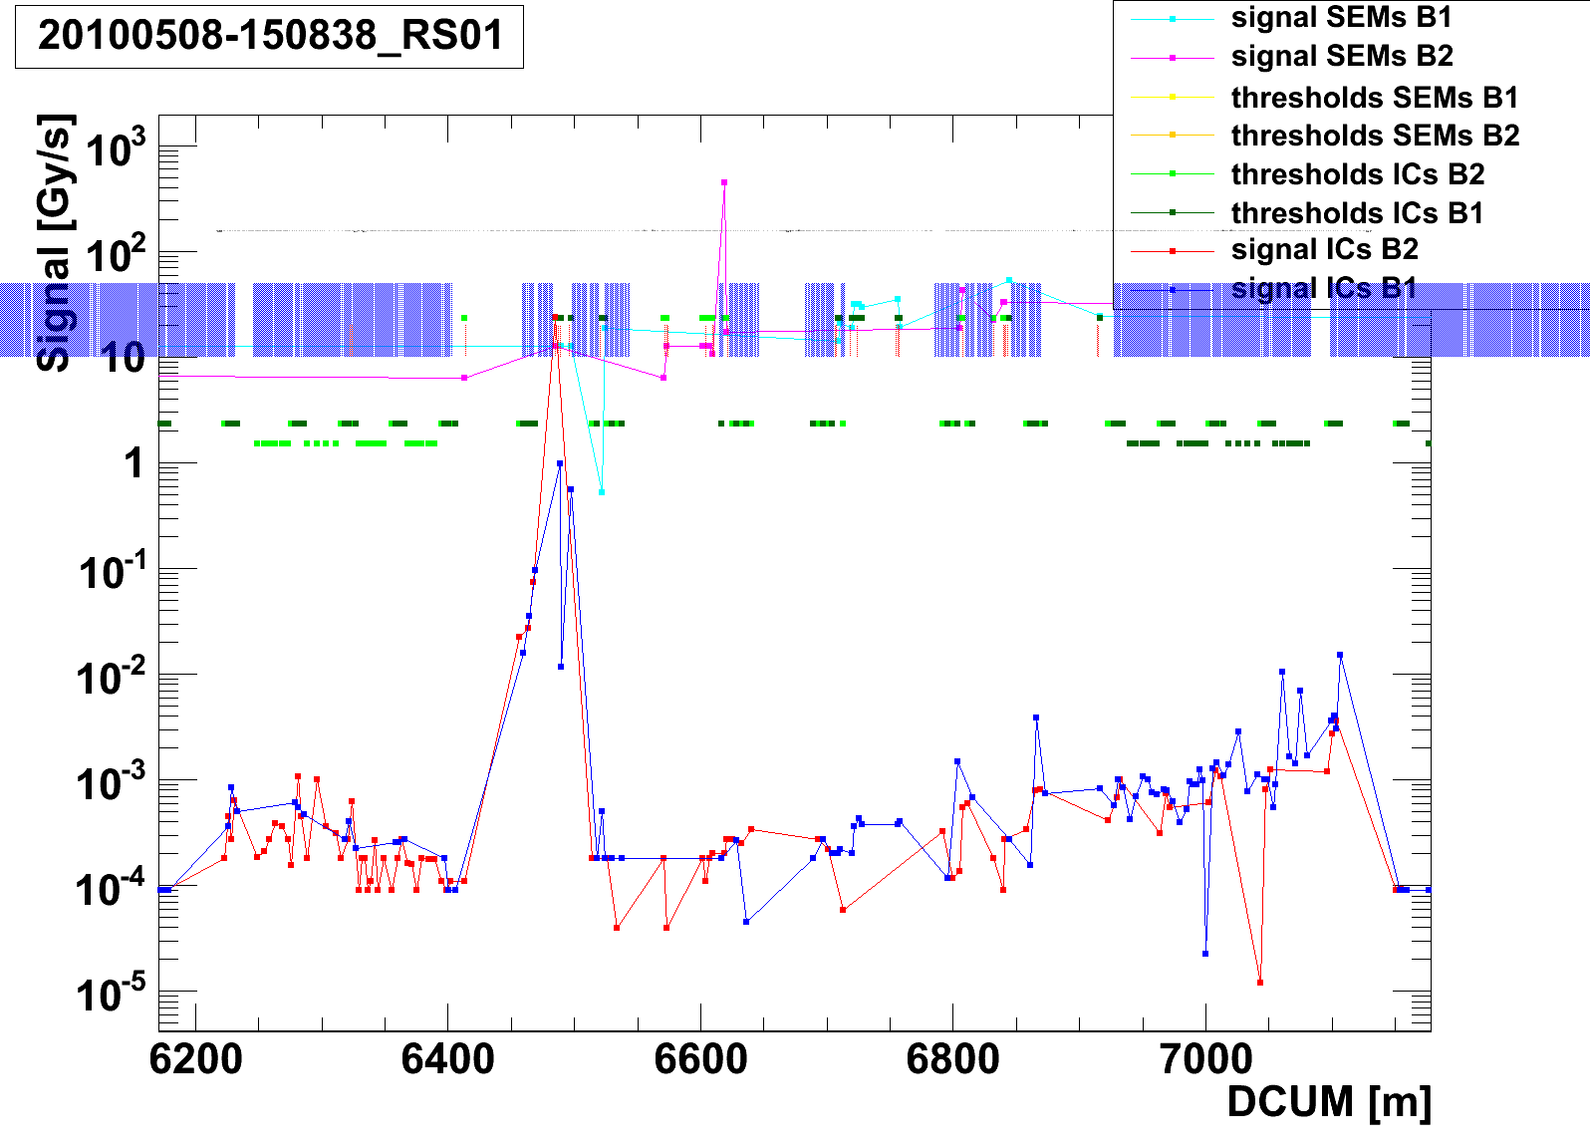
Comparison of BLM Monitor Behaviour between IR 3 and IR 7 (II)
Shooting on TCLA in IR 3 (beam 1 and beam 2)
The measured losses are equal in IP3 and in IP7 and they are equal
for Left and Right side in IP3
→ Functionality of the system is given and protection can be assured

Slide 7
Comparison of BLM Monitor Behavior between IR 3 and IR 7 (III)
Actions being taken so far:
Checked network structure
HV on the front ends is stable, variation < 50 V (Unom=1.5kV)
It can be not excluded that the effects come from signal cables
Expected non-conformity in HV distribution
Investigations and analysis ongoing, need more detailed studies
Additional installations being done in order to investigate noise
1) Installation of batteries on spare channels:
BJBAP.A6R3 Channel 7: connected battery with 1.5μA
BJBAP.A8R3 Channel 7: connected battery with 1.5μA
BJBAP.B8R3 Channel 7: connected battery with 1.5μA
2) Installation of cable + T splitters + HV resistors on spare channels:
BJBAP.A6R3 Channel 8: HV via 100Mohm 15μA
BJBAP.A8R3 Channel 8: HV via 100Mohm 15μA
BJBAP.B8R3 Channel 8: HV via 100Mohm 15μA
Beam tests and analysis pending

Slide 8
IP2 Sanity Check Nonconformity
Observation: sequencer initiated sanity check does not start
Consequence: timer reset is not done, no beam permit given
Beam permit generation is independent of sequencer
Non conformity is not safety critical

Slide 9
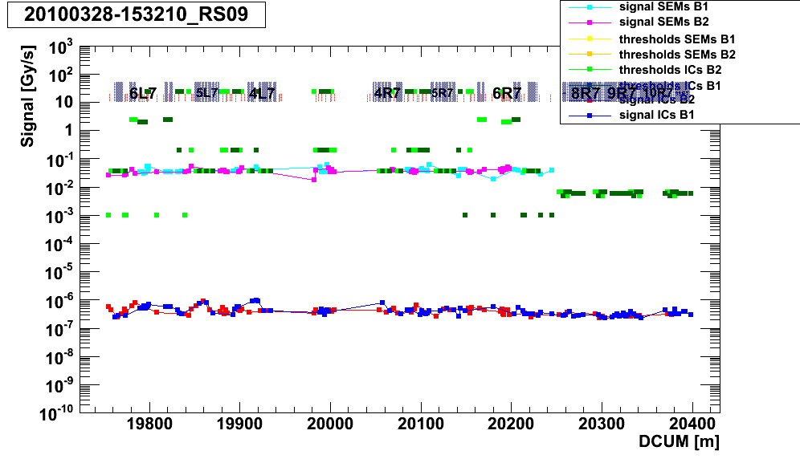
Resonance Crossing – SEM signal
No signal from SEM expected: probable due to ionization in air, more investigations needed

Slide 10
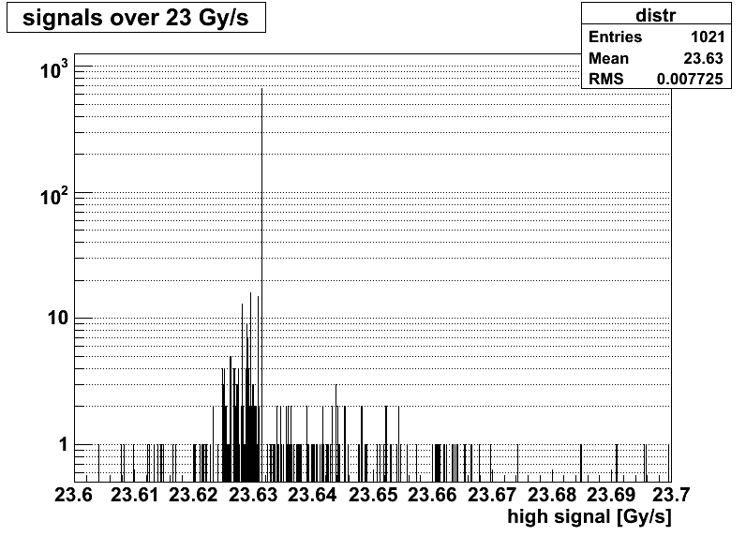
Maximum Values in the BLMs during Operation in 40 μs
Calibration: 1mA = 200 counts * 1024 = 204800 BITS
The counter is able to count up to: 255 counts * 1024 = 261120 BITS = 23.631 Gy/sec
Absolut maximum (including ADC): 255 counts * 1024 + 1023 = 262143 BITS = 23.724 Gy/sec
Restriction on LSA level (max. thresholds): 250 counts * 1024 = 256000 BITS = 23.168 Gy/sec
Mostly 23.631 Gy/sec are measured

Slide 11
Filter Monitors
Max @ 300 us
Checking performance and behavior:
Check with beam that filters are installed at the
defined channels (done)
2) Determination of rise time (time needed to collect 100%
of the charges (use PM data) (missing for IP6)
3) Determination of ratio filter/non-filter amplitude,
i.e. height of signal (partially done)
Tau = 10ms

Slide 12
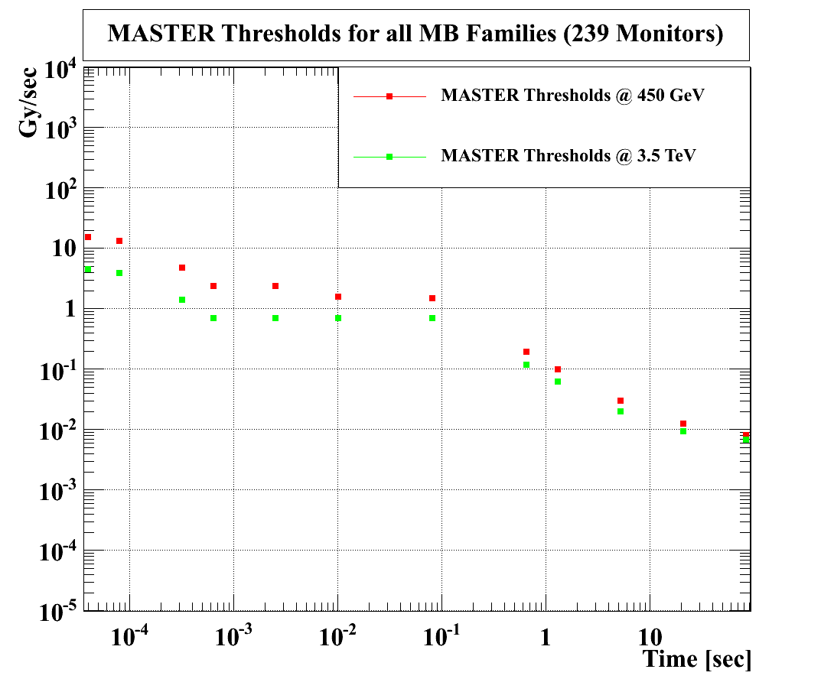
Thresholds for MB Monitors
239 MBB and MBA monitors (5 families according to position)
All monitors have the same thresholds, no difference for positions 1,2,3
Monitor factor = 0.1

Slide 13
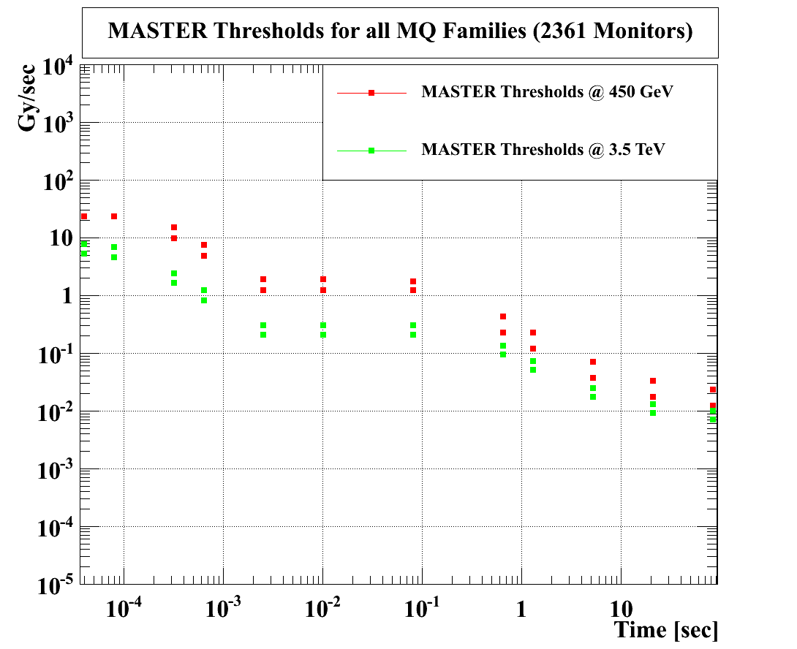
Thresholds for MQ Monitors
2361 MQ monitors (18 families according to position 1,2,3 in LSS, DS, ARC)
Monitors in position 2,3 have the same thresholds and are ~ 30% smaller than for position 1
No difference for LSS, DS, ARC
Monitor factor = 0.1

Slide 14
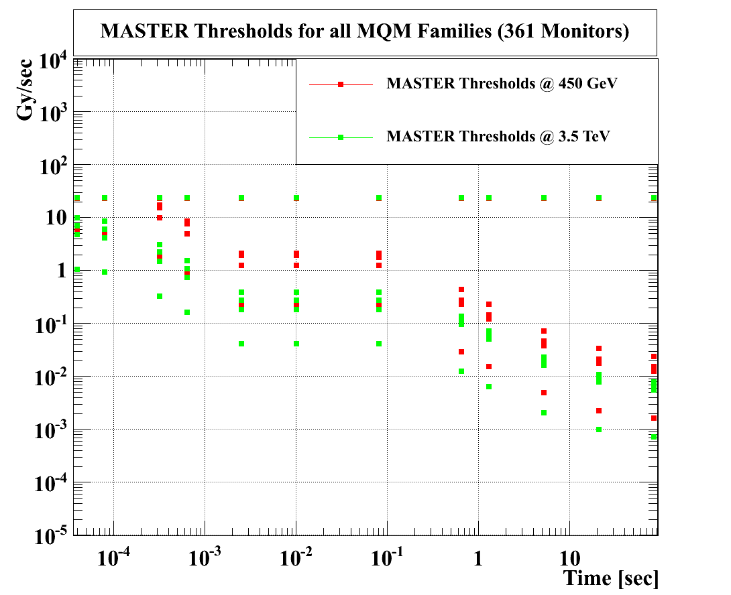
Thresholds for MQM Monitors
361 MQM monitors (12 families according to position 1,2,3 in LSS, DS)
Thresholds in LSS: pos. 1 > pos. 2 (~90% smaller) , pos. 3 at maximum
Thresholds in DS : pos. 1 > pos. 2 (~30% smaller) , pos. 3 same thresholds as in pos. 2
LSS pos.1 > DS pos.1 (~50% smaller)
Monitor factor = 0.1

Slide 15
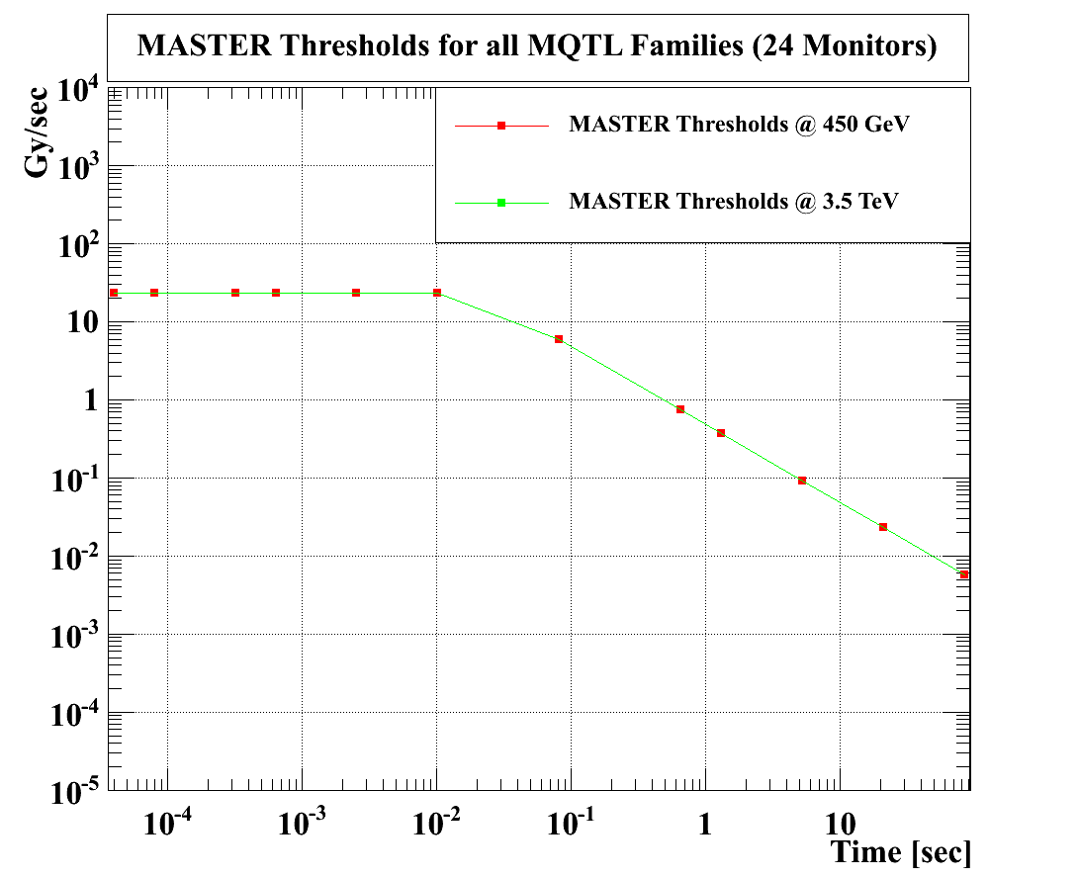
Thresholds for MQTL Monitors
24 MQTLH monitors (6 families according to position 1,2,3)
No difference for position, non-linear energy dependence (change only above 3.5 TeV)
Monitor factor = 0.1
Thresholds need to be reviewed and recalculated

Slide 16
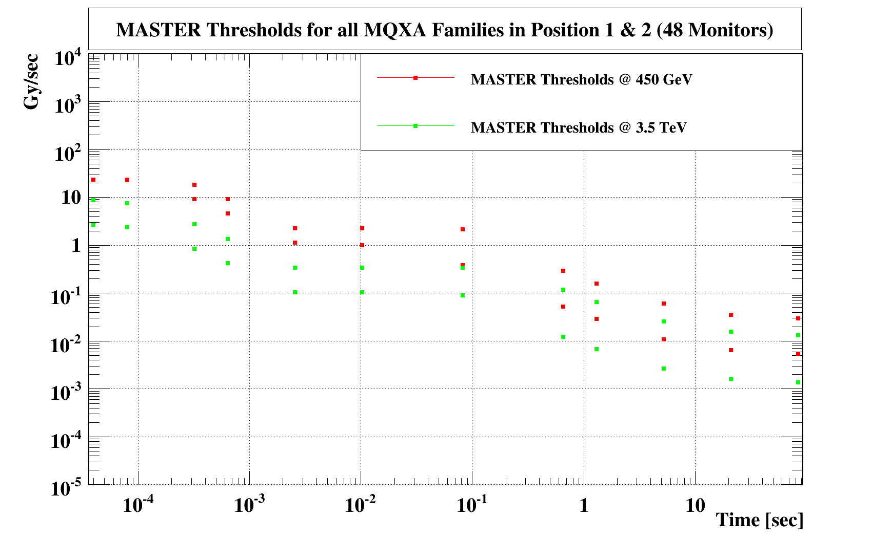
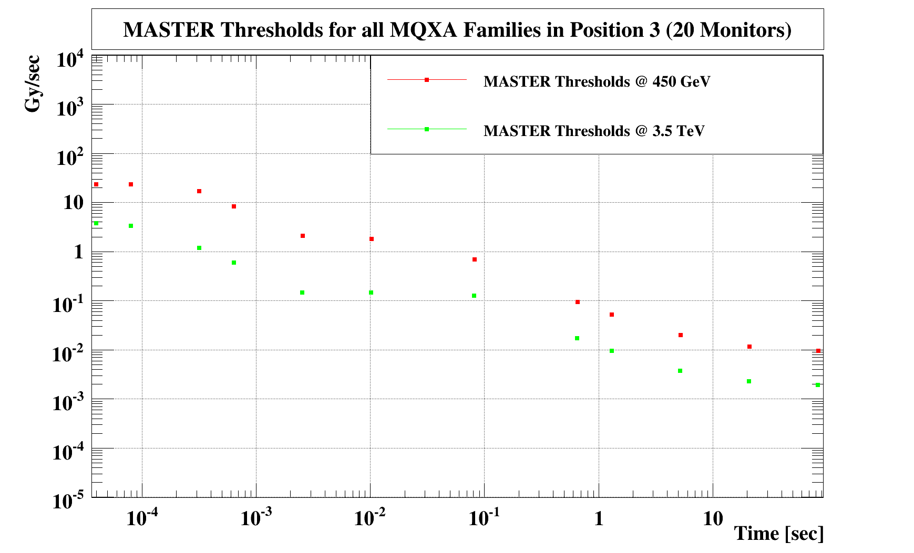
Thresholds for MQXA Monitors
80 MQXA monitors (8 families according to position 1,2,3 and special positions)
Thresholds in pos. 1 > pos. 2 (~70 % smaller) < pos. 3 (~25% higher)
Thresholds in special positions are at maximum
Monitor factor = 0.1

Slide 17
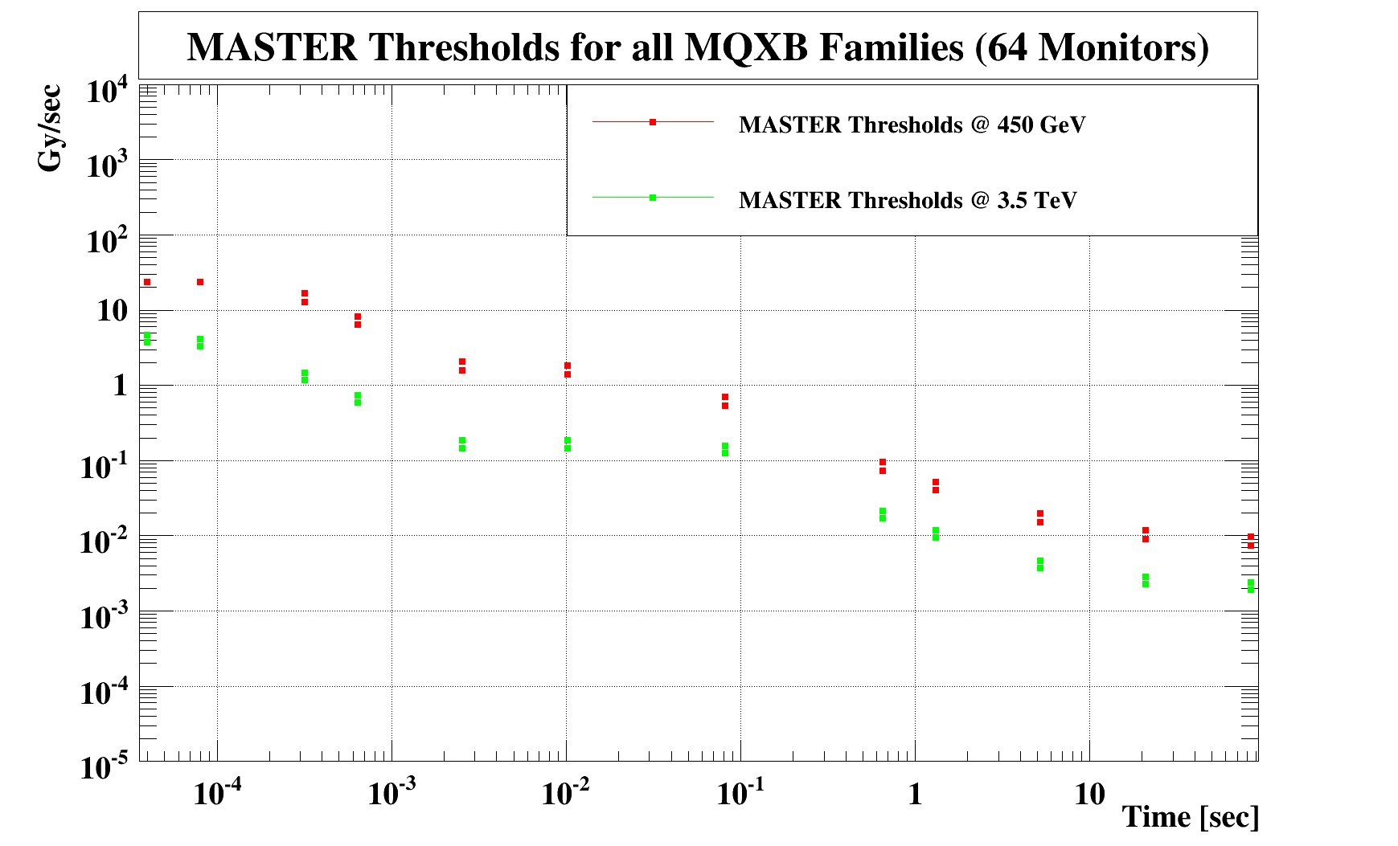
Thresholds for MQXB Monitors
64 MQXB monitors (4 families according to position 2,3)
Thresholds in pos. 2 < pos. 3 (~25 % higher)
Monitor factor = 0.1

Slide 18
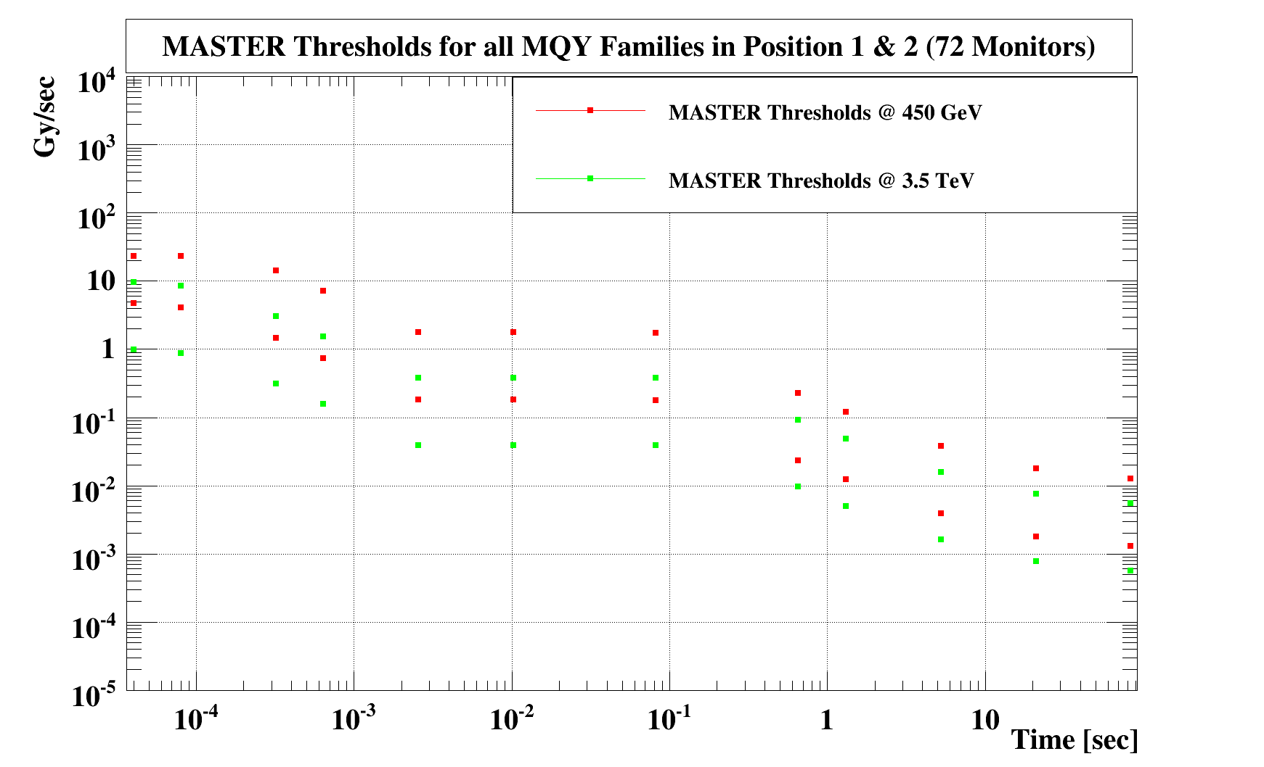
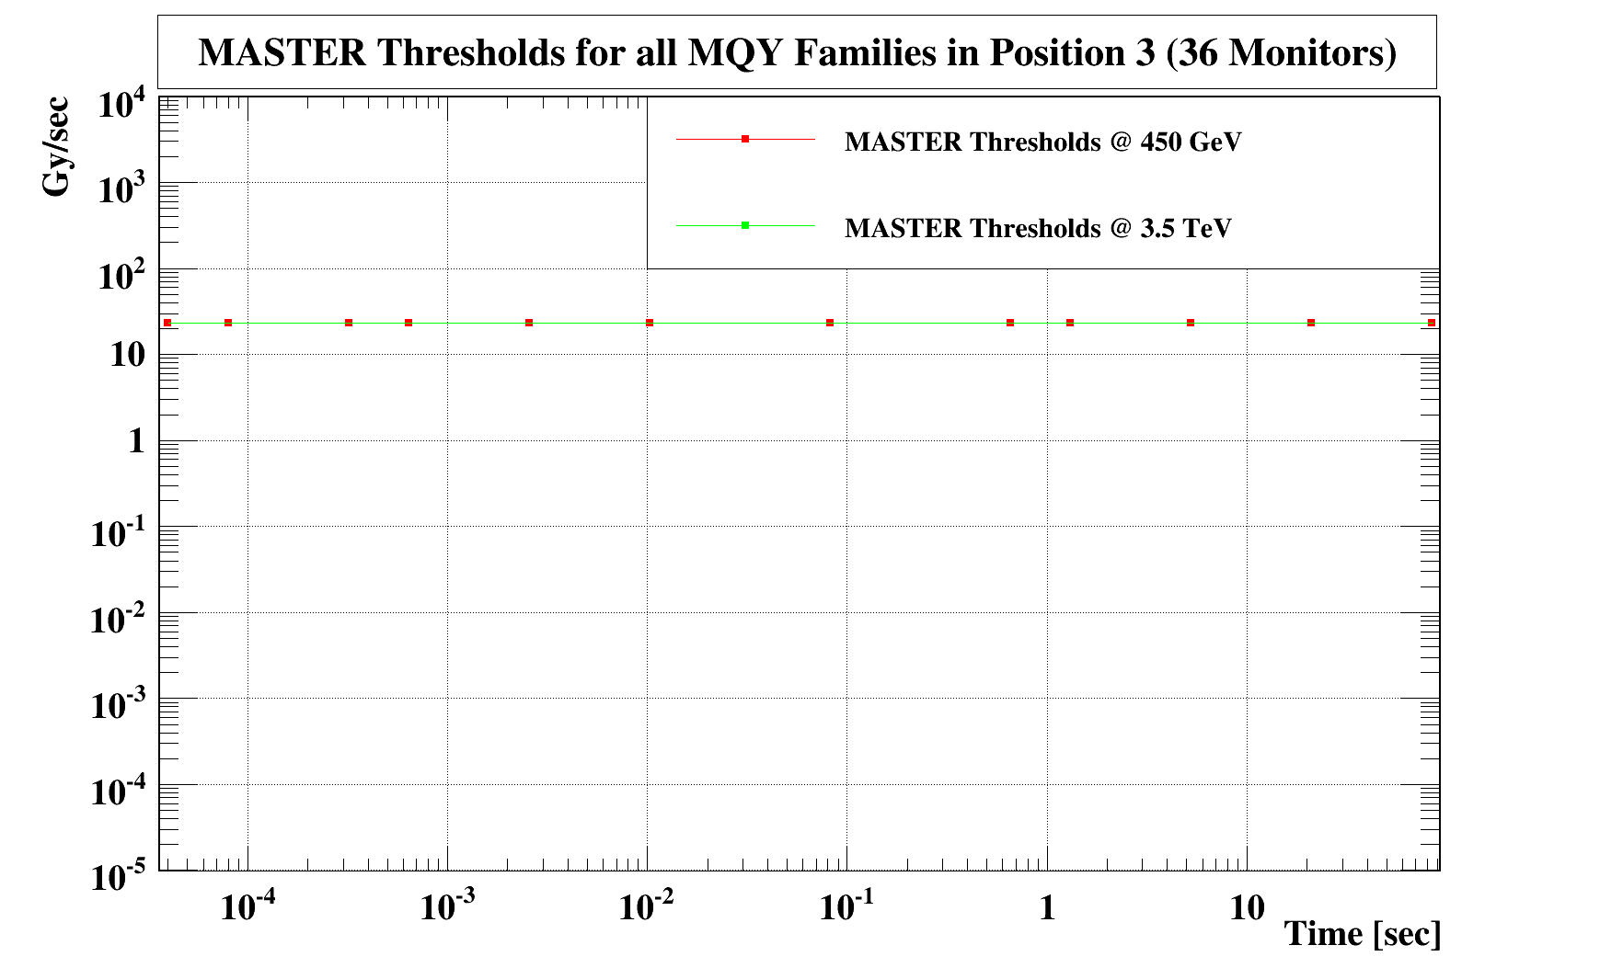
Thresholds for MQY Monitors
108 MQY monitors (6 families according to position 1,2,3 in LSS)
Thresholds in pos. 1 > pos. 2 (~90 % smaller), pos.3 at maximum
Monitor factor = 0.1

Slide 19
Status of Threshold Settings
Nr | Elements | Thresholds
1 | MB | Detailed Geant4 and FLUKA simulations, Quench tests on LHC
2 | MQ | Detailed Geant4 simulations.
3 | MQXA, MQXB (triplets) | Detailed FLUKA simulations (at 7 TeV only)
4 | B1.3B_MQXA B2.3B_MQXA | Max. thresholds New simulations are done – to be revised
5 | MQY | Quench Levels rescaled from MQ simulations, new Geant4 simulations and loss maps may be needed, monitors in position 3 have max. thresholds. Data analysis standalone magnet needed.
6 | MQM, MQML, MQM at 4.5 K | Quench Levels rescaled from MQ simulations, analysis loss maps needed (as for MQY), Monitors in position 3 have max. thresholds
7 | MQTLH | Quench Levels rescaled from MQ simulations (a setting error spotted, to be corrected asap)
8 | MBRB, MBRC | Basic simulations for loss pattern generated by Wire Scanner, but thresholds are rescaled from MB
9 | MBX | Quench Levels rescaled from MB + ECR's for over-injection issues More detailed analysis for over-injection needed
10 | Collimators | EDMS 995569 + ECRs, systematic study of signal per lost proton needed
Good knowledge
To be checked with data
More simulation
Will be changed next
Disconnected from BIS

Slide 20
11 | TDI | Thresholds based on input from Brennan + analysis results Detailed simulations have been started (but no results yet)
12 | TCD | Max. thresholds Need info from experts (who?)
13 | MSI/D | Damage conditions agreed with Jan + Geant4 simulations (being revised now)
14 | MKI/D | Max. thresholds Need info from experts
15 | Dump line | Disabled ,i.e. disconnected from BIS Analysis needed in order to determine thresholds
16 | MQW | The same thresholds as for MSI/D
17 | MBW | Max. thresholds (can they be re-scaled (BLM signal due to geometry) from MSI?)
18 | TAN | Max. thresholds Need info from experts
19 | Roman pots (XRP) | Like TCT,TCLA thresholds + FLUKA simulations for BLM signal
20 | On missing magnet in DS (LYRA) | FLUKA simulations
21 | DFB | The same thresholds as for MB
Good knowledge
To be checked with data
More simulation
Will be changed next
Disconnected from BIS

Slide 21
22 | TCSM + TCHS + TCAPA | Disabled ,i.e. disconnected from BIS, since element not installed
23 | All SEM | Disabled ,i.e. disconnected from BIS Analysis needed
24 | BSRTM +BGI | Thresholds as for MSI/D
25 | MBWMD | Max. thresholds Need info from experts
Good knowledge
To be checked with data
More simulation
Will be changed next
Disconnected from BIS

Slide 22
Threshold Generation
Current:
- Code written in C (object oriented source code, Macros to create thresholds)
- Code needs to be debugged in detail and needs to be improved
- For each family we use one specific Macro
- Source code, macros and threshold files are stored in SVN with given version
- Automatic versioning needs to be implemented
- Documentation of all changes (stored in SVN): automatization needed
- ECR for each change that needs to be signed by the responsible persons (needs
further improvement)
Planned:
- Change to fully object oriented threshold code (C++ or python)
- Implementing algorithms and parametrization on LSA level,
thresholds generation directly in LSA
Checks:
- Maximum BITS (code, application, LSA level)
- Decrease with energy and with integration time
- Need more automatic procedures to keep human failures as small as possible

Slide 23
LSA Developments
Internal LSA DB Constraints [improvement]
  Most of them already reviewed
  Need to add more complex/powerful constraints
Internal LSA DB Check for disabled channels [available]
  Based on monitor criticality and adjacent disabled channels
  Each monitor is being tagged on its criticality
  Current version blocks commits on rules violation
  Needs review of the monitor tags (e.g. collimator monitors can be disabled atm)
Roll-Back of commits
  Complete :: using DB Retention functionality [available]
    Currently available max 24h after commit has been made
    Only by DB expert (i.e. CO/DM)
  Partial :: using history tables [under development]
    Flags (masking, connection_to_BIS, …)
    Family (threshold values)
    Monitor (classification to family, other settings)

Slide 24
Predefined Procedures (Audits) - what is not done
MPS Aspects of the Beam Loss Monitor System Commissioning
Management Procedure of the LM System Settings
Procedure/Implementation for generation of thresholds
Direct dump not tested, high intensity needed (electrically done)
Update of thresholds – two person procedure executed in the control room, enforced by program (will be implemted)

Slide 25
MPS checks
Beam Commissioning Tests (only those still pending)
Interface of direct BLMs with the LBDS
  Reduce the voltage setting of the abort threshold.
  Dump the injected beam on the collimator TCDQ and TCSG (with local bump)
  2 hours and 2 accesses
Provoked quench for transient losses
  ‘recovering quench’ detected with the nQPS
  The losses are recorded and compared to the expected quench level
  1 hour/magnet type = 4 hours
Provoked quench for steady-state losses
  ‘recovering quench’ detected with the temperature sensors
  The losses are recorded and compared to the expected quench level
  1 hour/magnet type = 4 hours
  More info: https://espace.cern.ch/LHC-Machine-Protection/

Slide 26
External Audit
Review will seek to:
assess the adequacy of the overall BLM system design with a focus on the programmable parts
identify possible weaknesses in the programmable parts of the mission-critical BLM
suggest activities that could increase the level of confidence that the programmable parts of BLM system performs as intended
suggest potential improvements of the BLM
provide a general comparison of the BLM with approaches in industrial systems.
Date | Responsible | Deliverable
16th August 2010 | CERN | Delivery of project documentation
6th September 2010 | CSL/CERN | Finalization of site-visit agenda
13th to 16th September 2010 | CSL/CERN | On-Site visit - 4 full days
18th October 2010 | CSL | Delivery of written report

