Slide 1
Experience with BLMs
B. Dehning
CERN BE/BI

Slide 2
Content
Specification
Concept
Hardware failures
System tests
  Firmware
  With beam (delays)
  Online (Sanity Check)
Post mortem data
Logging data

Slide 3
Beam Loss Monitor Specification
5. USE OF THE BLM’S FOR MACHINE PROTECTION
The strategy for machine protection impacts on the BLM design in two ways, its time response and the reliability.
Protection of the machine from beam losses has two aspects:
• protection against beam losses that could lead to damage of equipment,
• protection against beam losses that could lead to a quench of a magnet.
Since a repair of superconducting magnets would take several weeks, the protection against damage has highest priority and damages should be strictly avoided (SIL 3, 1E-8 to 1E-7 1/h).
In case of a quench, the quench protection system would prevent equipment damage. However, the beam would be lost and re-establishing operation would take several hours. Therefore the number of quenches should be minimized.

Slide 4
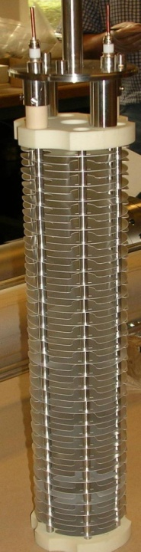
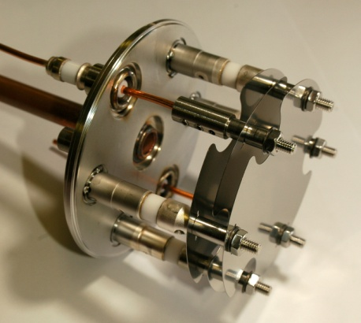
Beam Loss Measurement System Layouts
Ionisation chamber
  Function: observation and interlock
  3700 installed
  Over 90 % connected to interlock/dump system
Secondary emission detector
  Function: observation
  300 installed

Slide 5
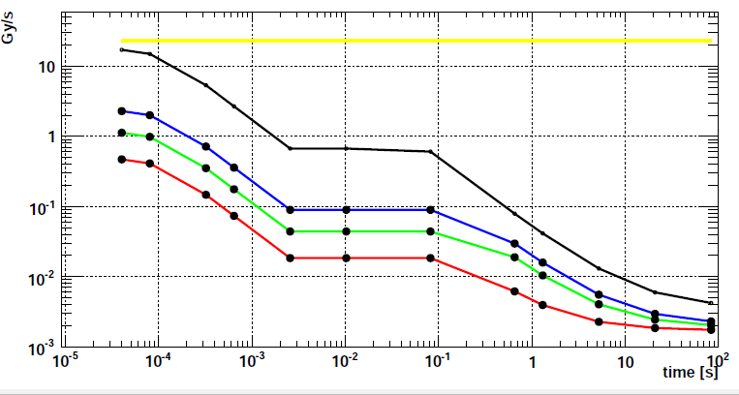

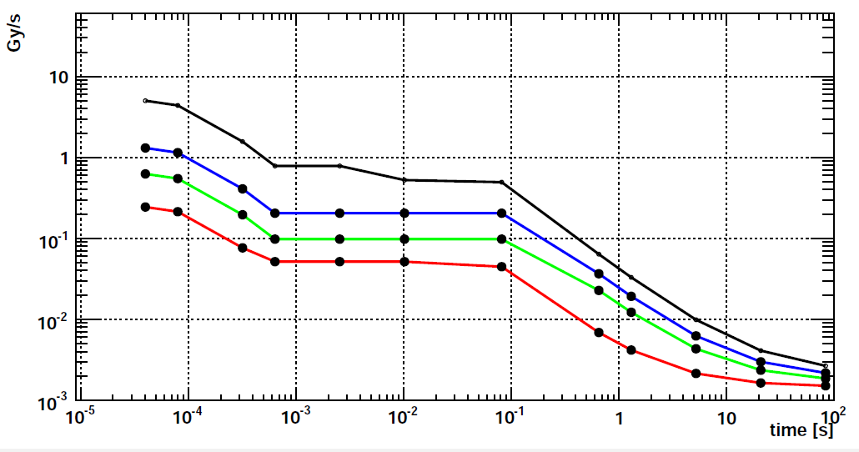
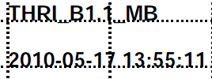
Quench and Damage Levels
Quadrupole and bending magnet thresholds
Specifications
  Time resolution ½ turn, 40 us
  Average calculation loss:
    12 values, 40 us to 83 s
  Max amplitude 23 Gy/s
  Min amplitude
    1E-4 Gy/s @ 40 us
    3E-7 Gy/s @ 1.3 s
  Dynamic
    2E5 @ 40 us
    ~ 1E8 @ 1.3 s
  Damage level
    2000 Gy/s @ 1 ms
  All channels could be connected to the interlock system
  Thresholds
    Loss duration dependent, 12 values
    Energy dependent, 32 values
    About 1.5 E6 thresholds
450 GeV
3.5 TeV
5.0 TeV
7.0 TeV

Slide 6
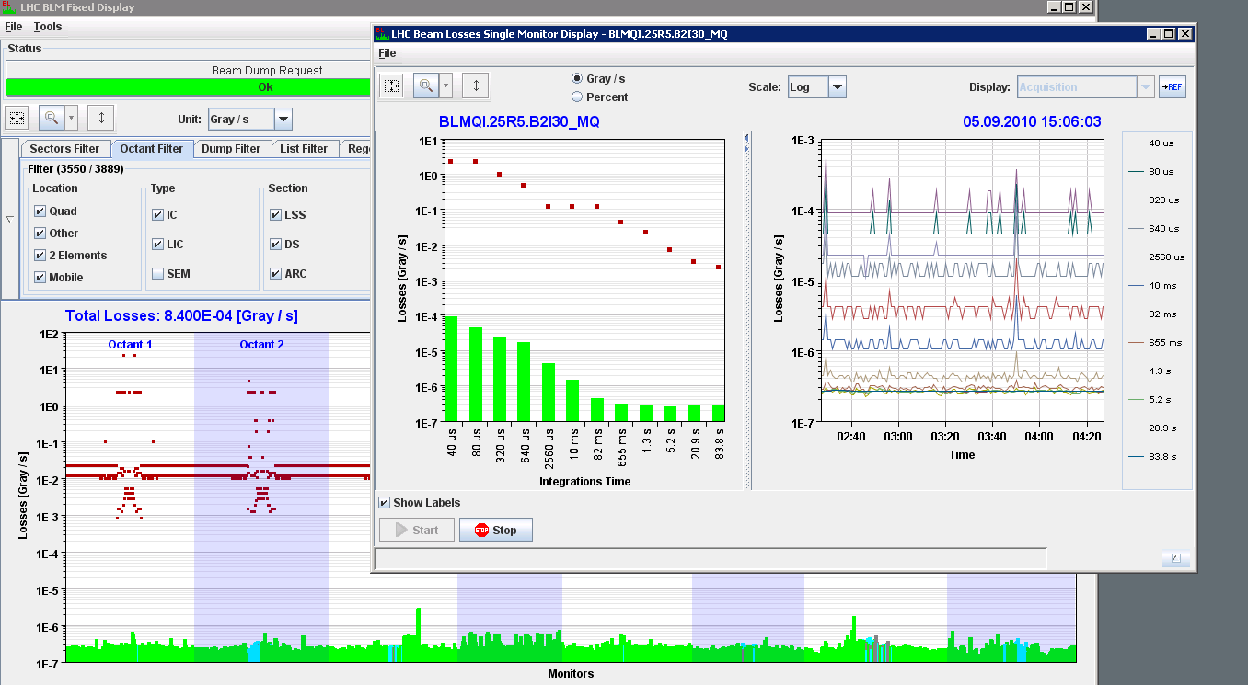
BLM Online Display
LHC @ 450 GeV
ATLAS
ALICE
Offset to check connectivity

Slide 7
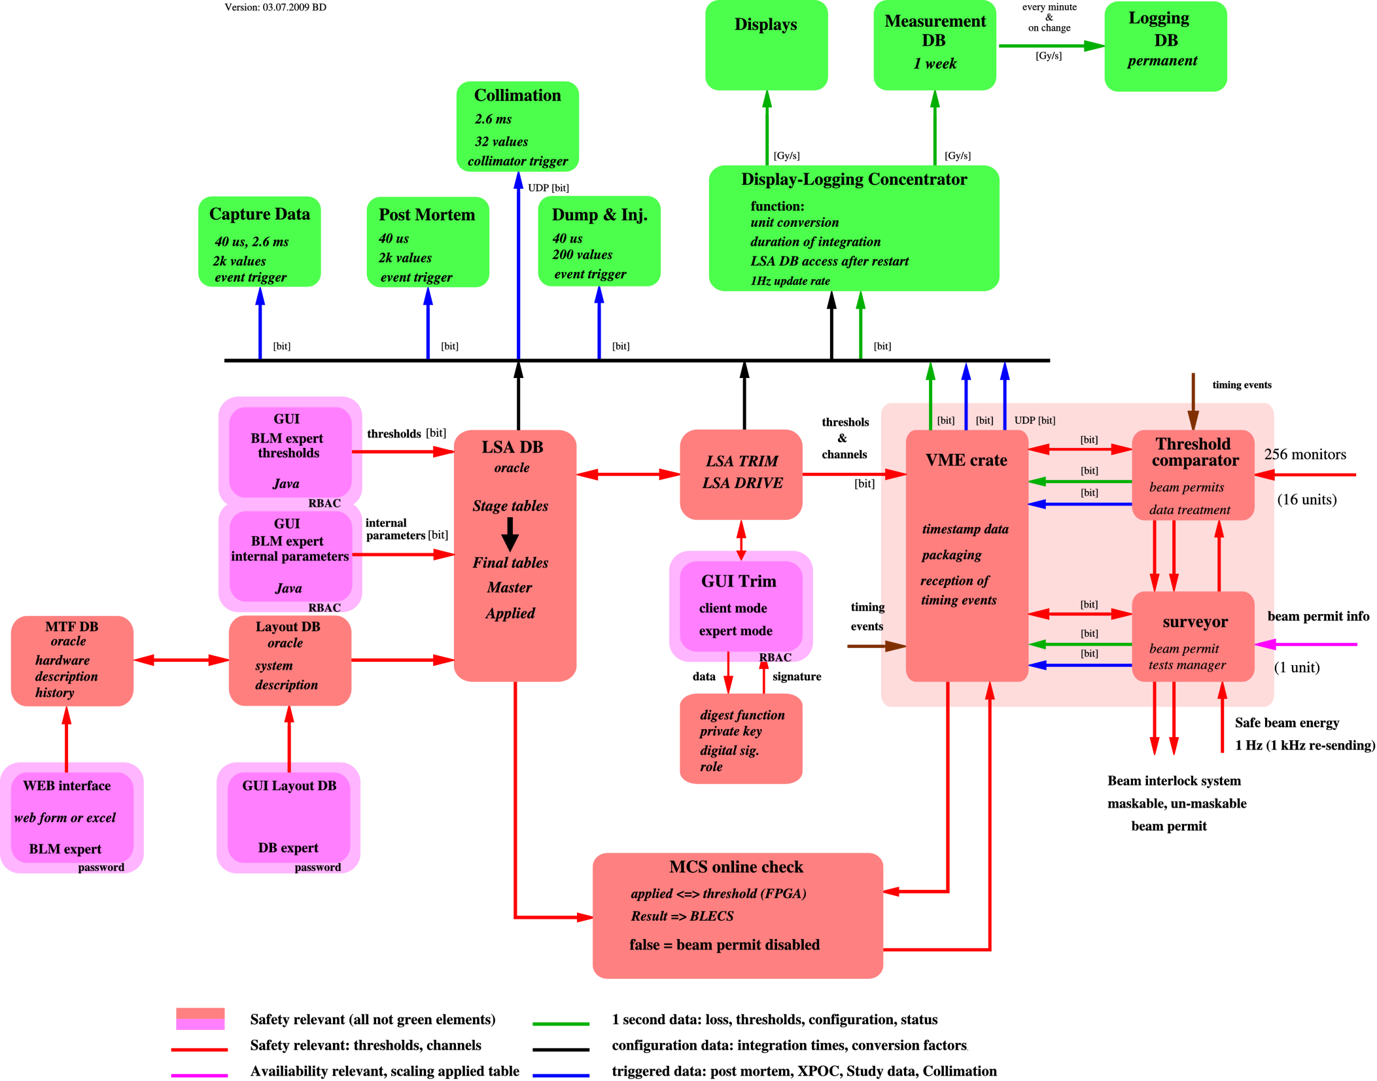
System settings
& data flow
Beam permit
signal flow

Slide 8
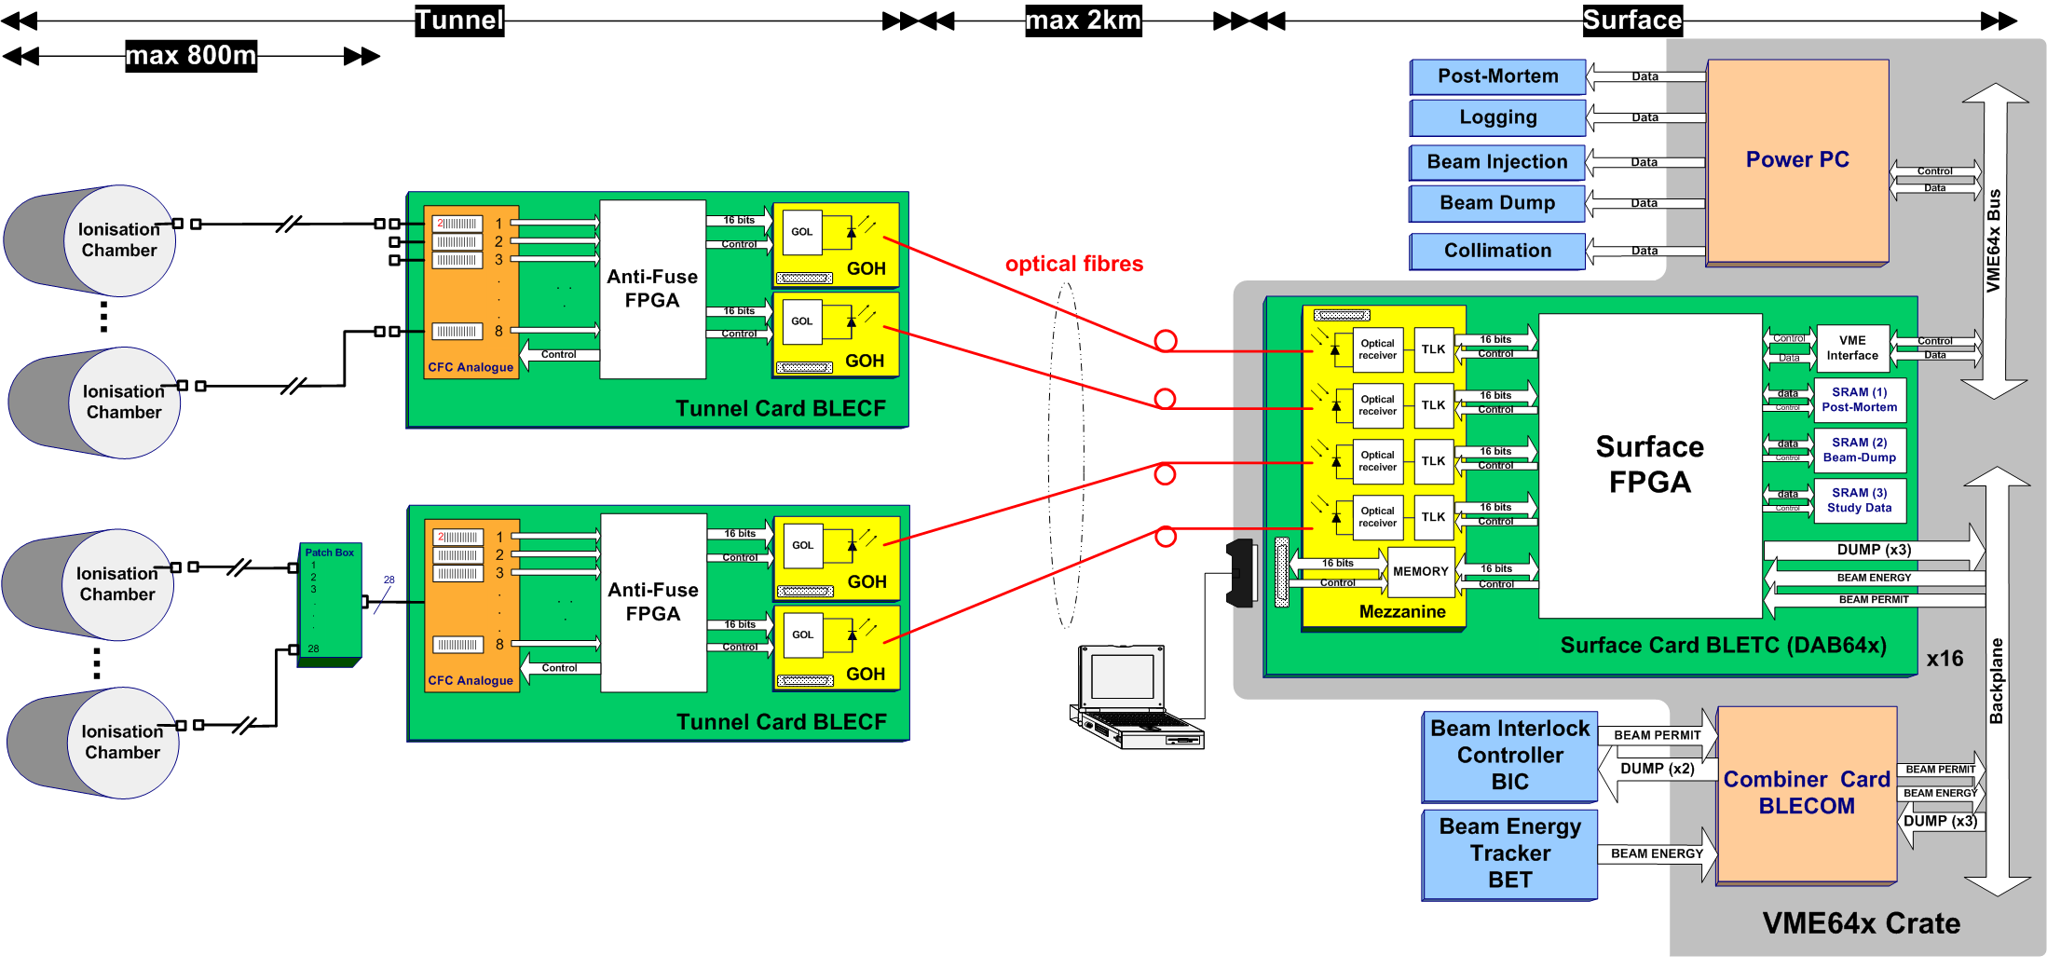
Overview of H/W Failures (since Feb. 2010)
9 GOH with low power
1 damaged connector
out of 1500
9 IC with bad soldering
(out of 3700)
2 failed CPU RIO3
out of 25
2 with failed SRAM
out of 350
7 CFC with ‘noisy’ components
2 cards with bad soldering
out of 359
7 with ‘weak’ receivers
out of 1500
1 VME Power Supply, out of 25
Number of failures regarded as manageable

Slide 9
Functional Tests Overview PhD thesis G. Guaglio
Detector
Tunnel electronics
Surface electronics
Combiner
Functional tests before installation
Barcode check
Current source test
Radioactive source test
HV modulation test
Beam inhibit lines tests
Threshold table data base comparison
Offset to check connectivity (10 pA test)
Double optical line comparison
System component identity check
Inspection frequency:
Reception Installation and yearly maintenance Before (each) fill Parallel with beam

Slide 10
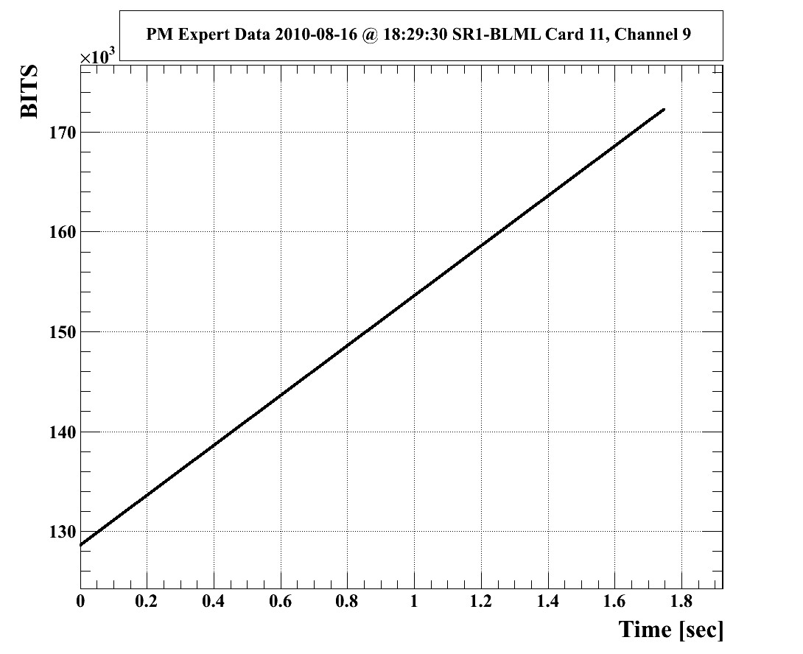
System Verification Tests
Surface Electronics Firmware Tests
Automatic on Vertical Slice Test system (before releasing new firmware)
Using front-end electronics emulator
  Lab tests
    Exhaustive Threshold triggering tests [also in LHC done]
    Optical Link Reception and Status tests
    Linearity, impulse, and some predefined patterns of input signals check
  Beam tests
    injected low intensity beams (pilot), debunched them and dumped with the operator switch.
    closed one of the collimator jaw of a TCP at point 3 and injected 3 times pilot beam 1.

Slide 11
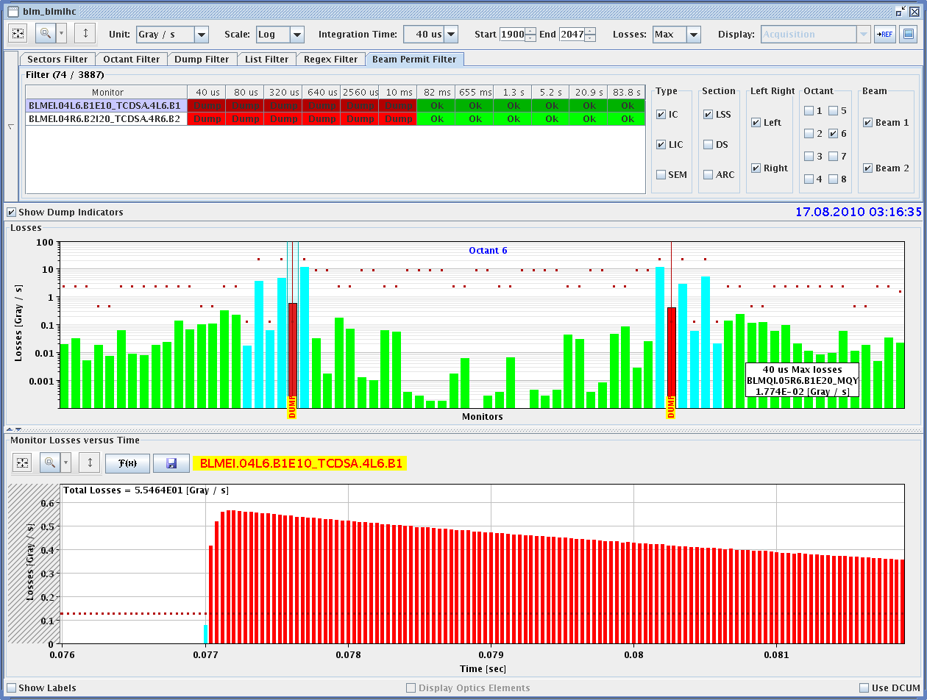
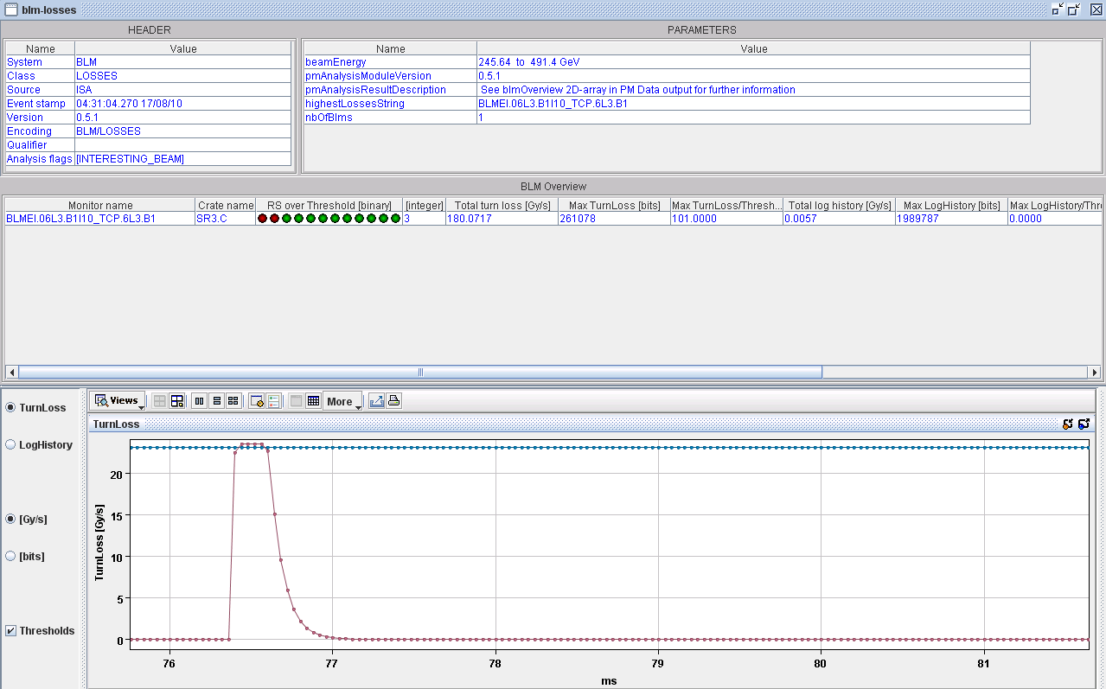
System Verification Tests
Surface Electronics Firmware Tests
Automatic on Vertical Slice Test system (before releasing new firmware)
Using front-end electronics emulator
  Lab tests
    Exhaustive Threshold triggering tests [also in LHC]
    Optical Link Reception and Status tests
    Linearity, impulse, and some predefined patterns of input signals check
  Beam tests
    injected low intensity beams (pilot), debunched them and dumped with the operator switch.
    closed one of the collimator jaw of a TCP at point 3 and injected 3 times pilot beam 1.
Detector with filter,
B. Holzer

Slide 12
System latency (2009 – 02/2010)
Analysed several Beam Dumps in detail.
Difference in time between the bunch at injection kicker magnet and the break of the beam permit loop (by the BLMS) recorded at the BIC was always between 100 and 130 μs.
Time of flight:
  MKI => monitor = 10 μs
  monitor => acq. electronics (0.5 km cable) = 3 μs
  Acq. => processing electronics (1 km fibre) = 3 μs
Detection of change in frequency in the daisy-chain = 5 μs
Integration in the acquisition electronics = 40 μs.
Decision at the BLETC (for fast losses) is taken every 40 μs.
Processing of data to decide < 1 μs.

Slide 13
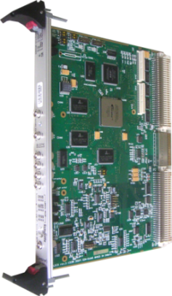
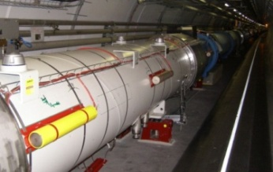
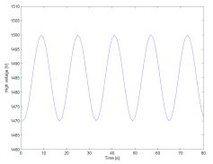
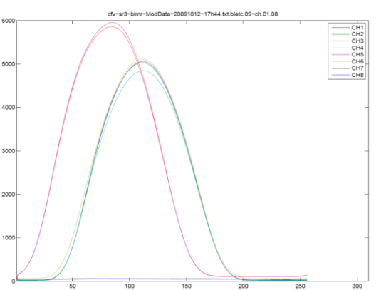
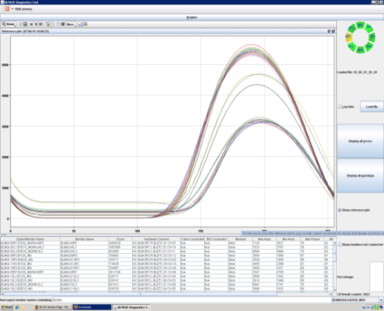
System Tests == Sanity Checks
Initiative - own ideas, responsibility & autonomous work
BLECS
Decision of pass or fail in surface electronics FPGA (combiner)
Every 24 h required, (beam permit inhibit if time limit exceeded
Tests
  Comparison between data base and backend electronics (MCS)
  Internal beam permit line test (VME crate)
  Connectivity check (modulation of chamber HV voltage supply
  amplitude an phase limit checks
  Duration of test: about 7 minutes
Beam loss monitors in the tunnel
Modulated High Voltage
BLM acquisition chain
BLM Diagnostic application
Capacitor missing
or disconnected
Normal behavior
Digital signal processing and decision
inside the FPGA
Amplitude [RS09_Bit]
Samples ( from 1Hz logging => 15Hz )

Slide 14
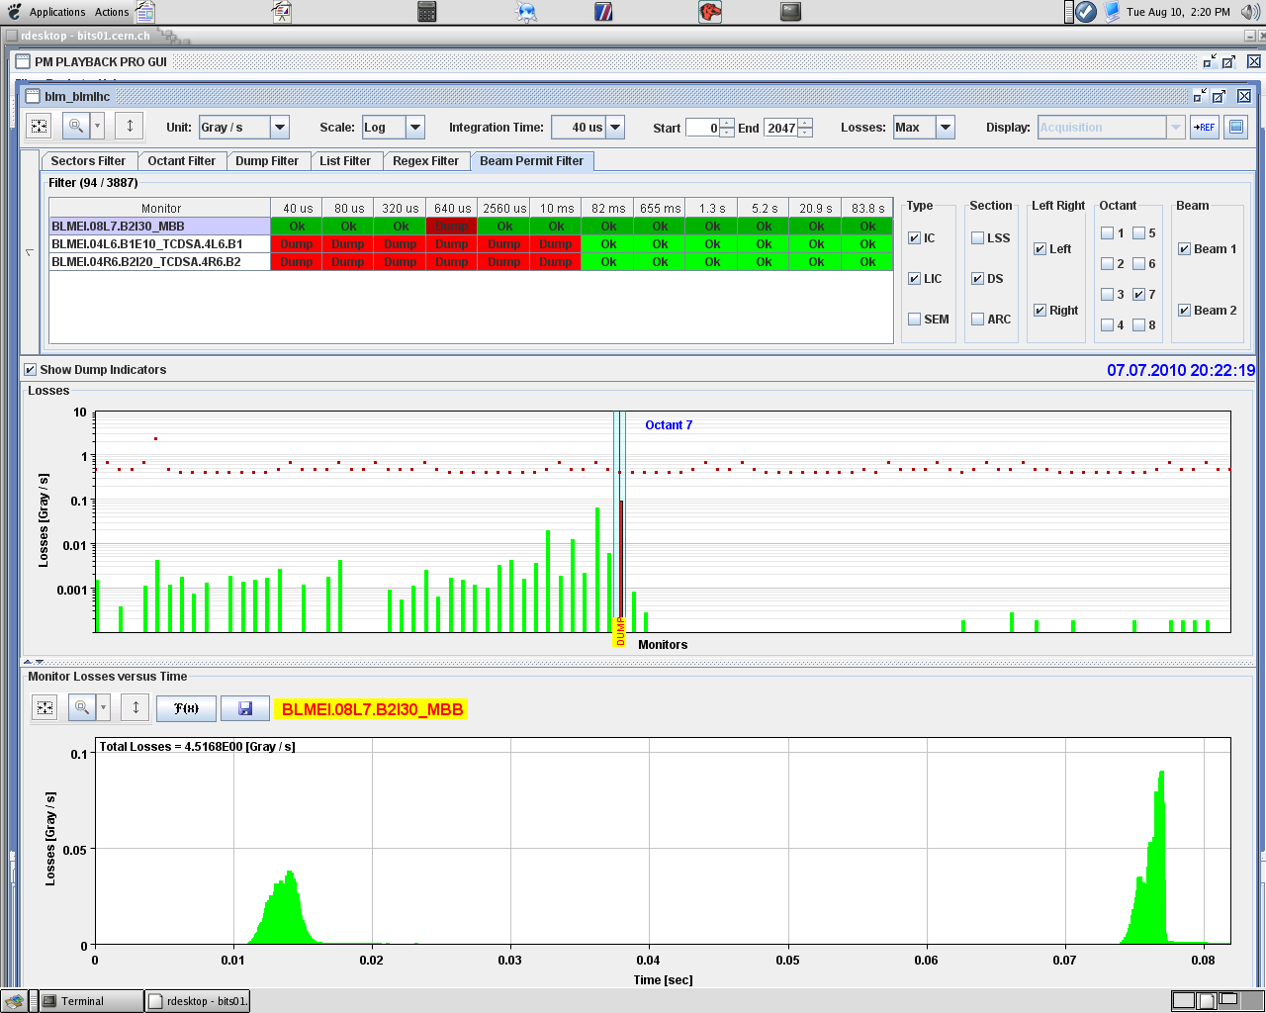
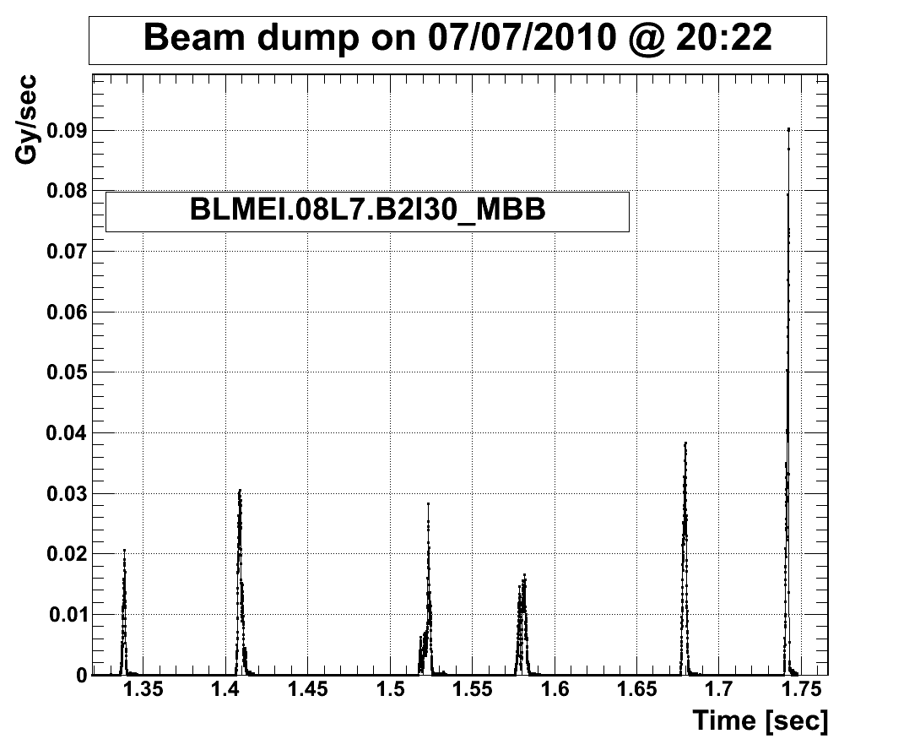
Post Mortem Data (some examples)
Loss in a bending magnet
PM application: BLM data of 0.082 sec
online available
Longer PM buffer: BLM data of 1.72 sec
offine available
43000 values (40 us)
Monitors
2000 values (40 us)
Time

Slide 15
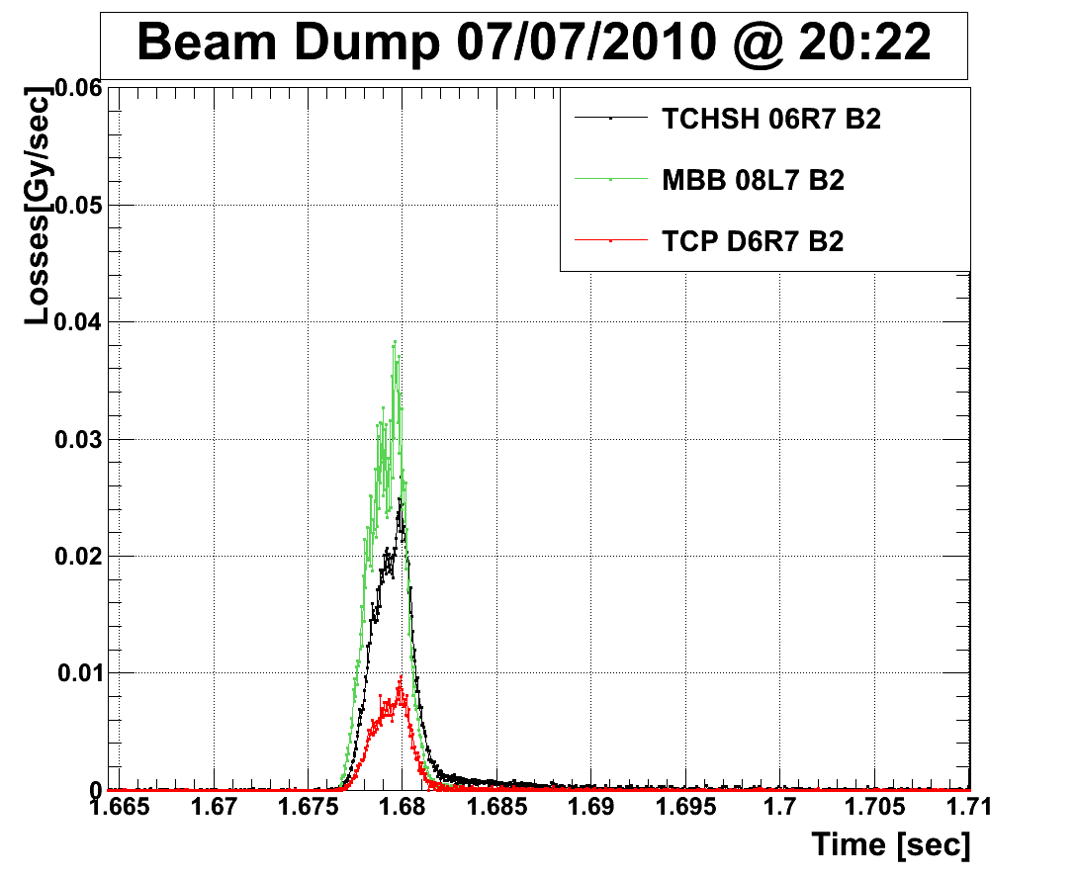
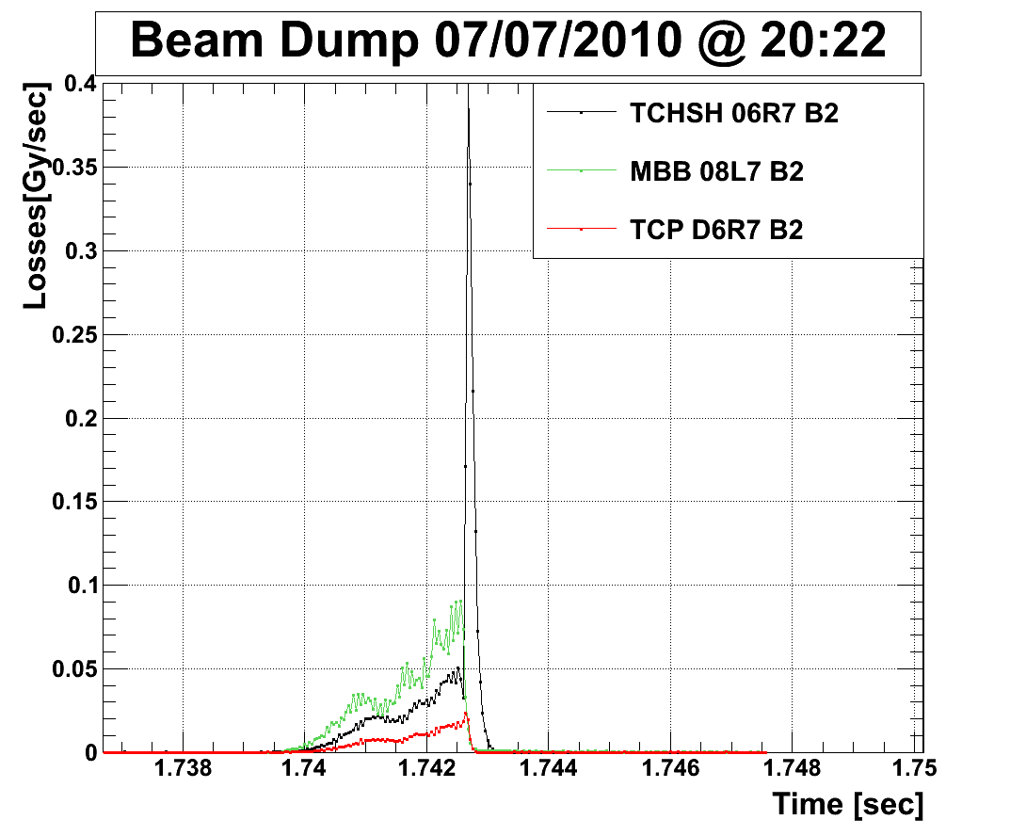
Post Mortem Data (some examples), Zoom
Loss from primary event
+
dump system loss

Slide 16
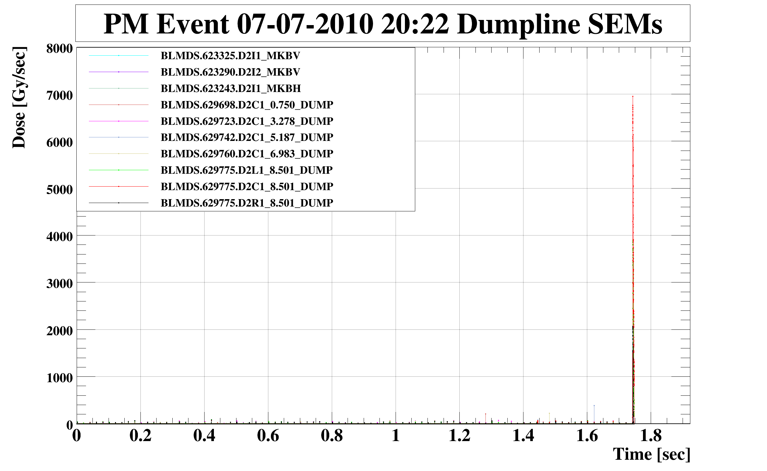
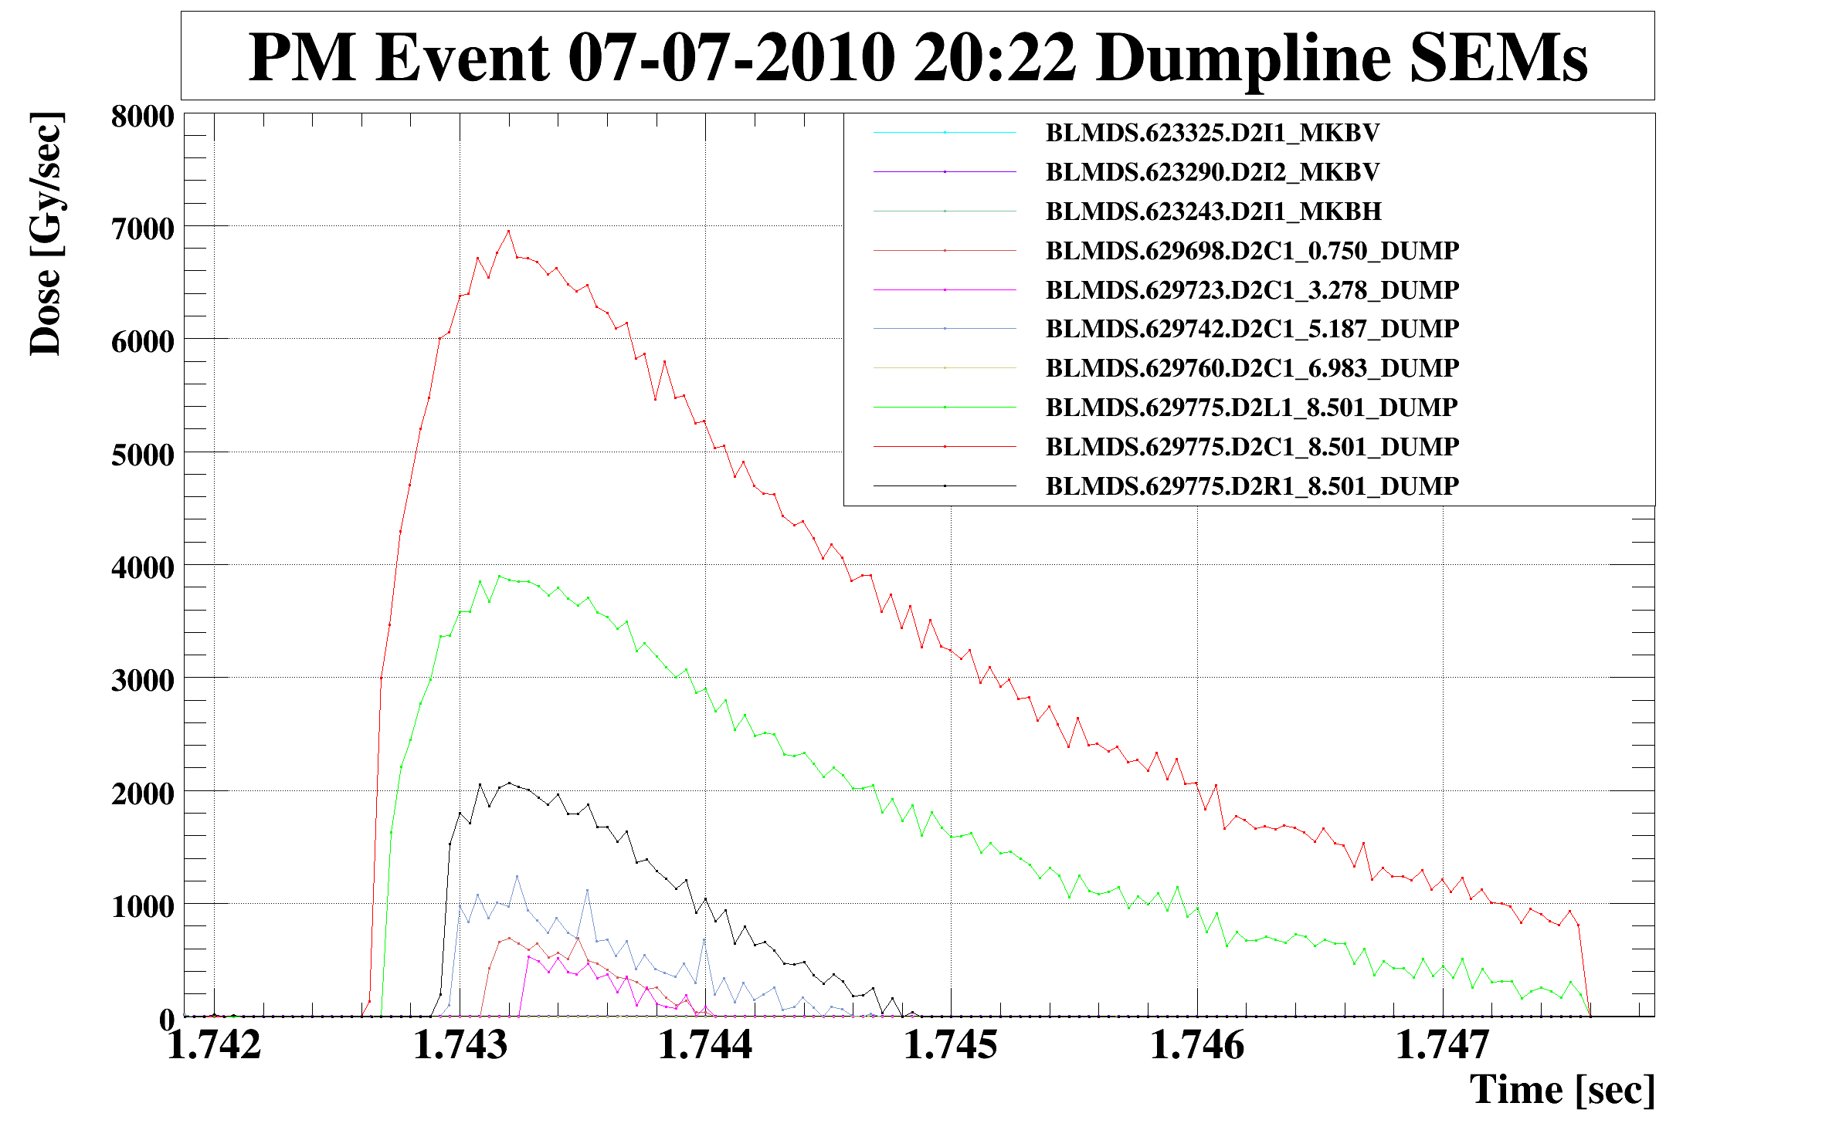
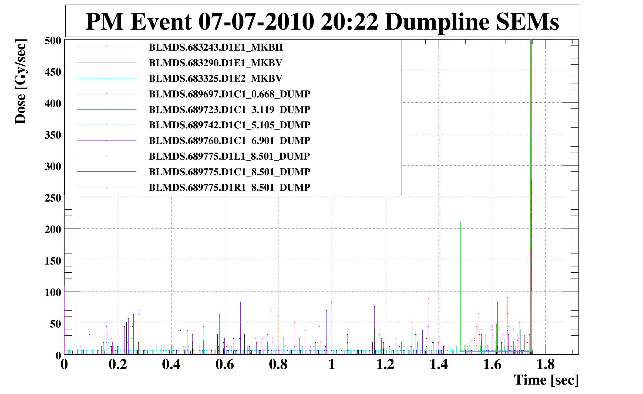
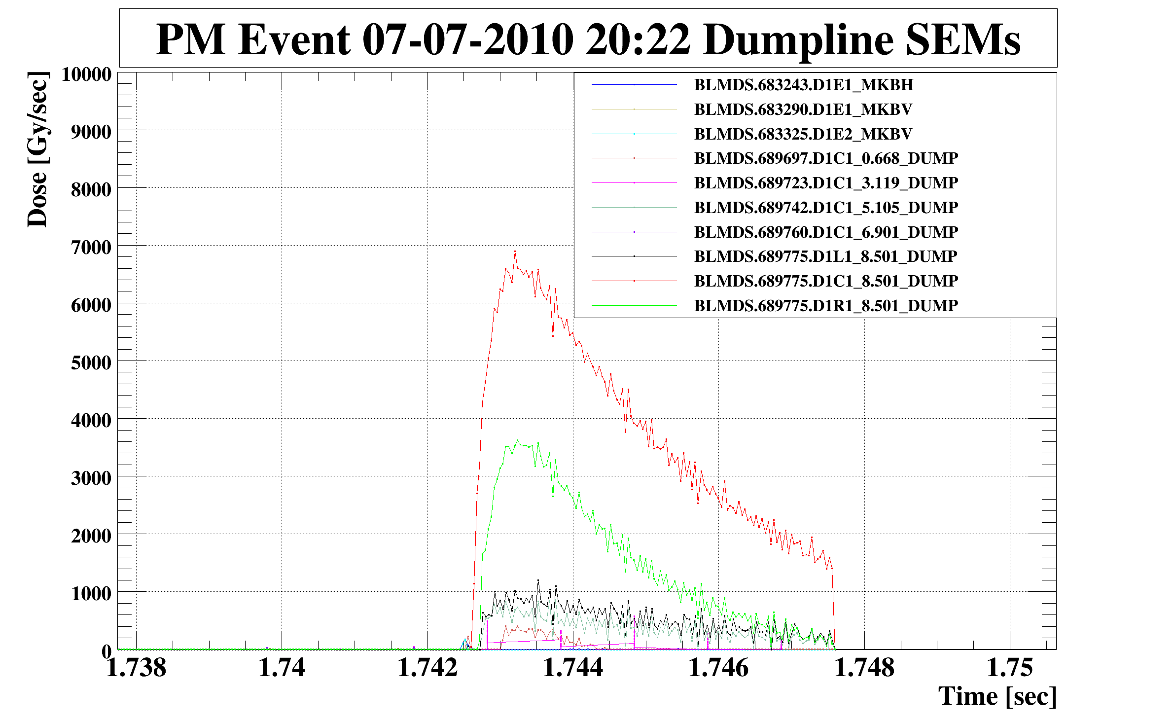
Post Mortem Losses in Dump Line and Dump, Secondary Emmission Monitors

Slide 17
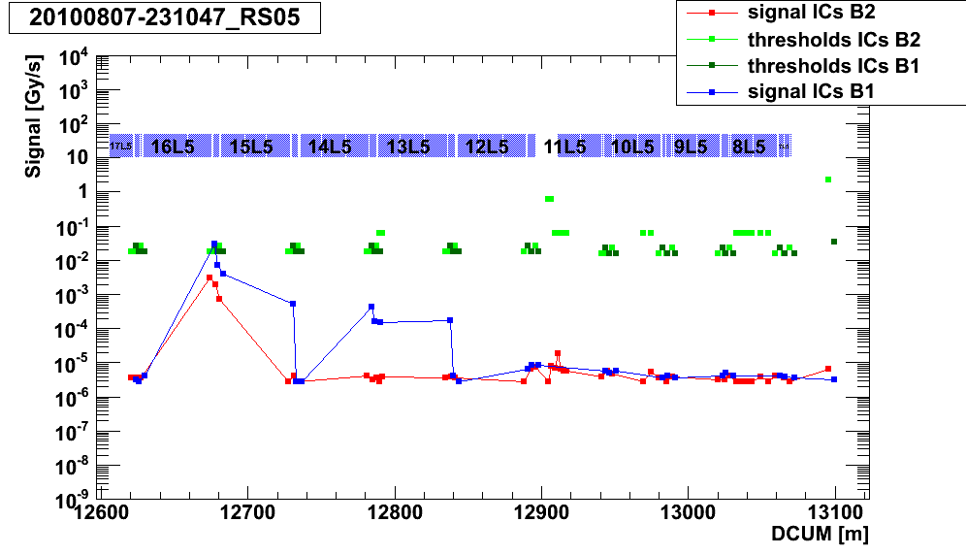
Logging Data Base Data (fast event)
Beam 1 loss (from left to right)
Loss monitor of B1 at MQ 15 over threshold
Beam 2 monitors measure about 5 times lower loss
Shown average value over 2.5 ms (maximum in 1.3 s)

Slide 18
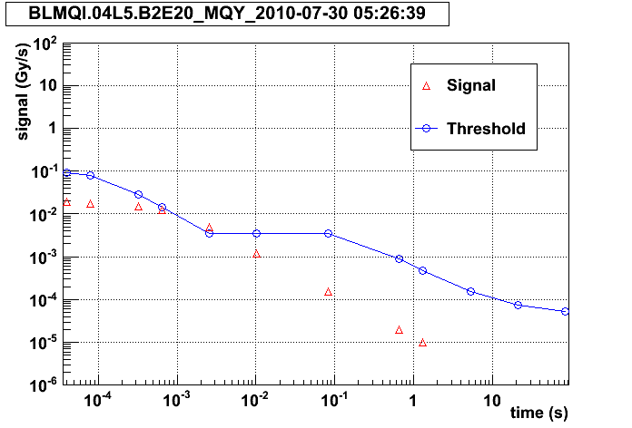
Threshold and Loss Data versus Averaging Duration
Online Display and Logging data base Storage
Data reduction in surface electronics
  Averages from 40 us to 660 ms == every 1.3 second max value in last 1.3 s
  Average 1.3 s directly stored
  Average 83 s every minute
  Logging 40 GByte / day
Reconstruction of duration of events possible by max value shapes (identification of kink)

Slide 19
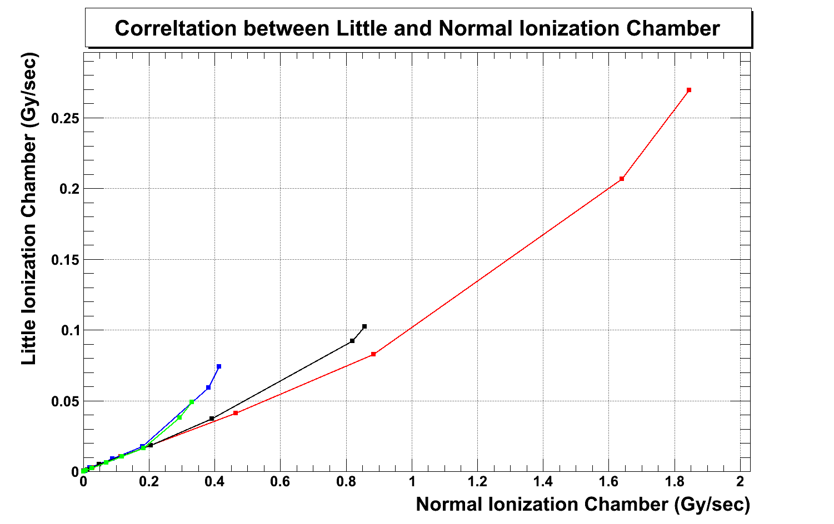
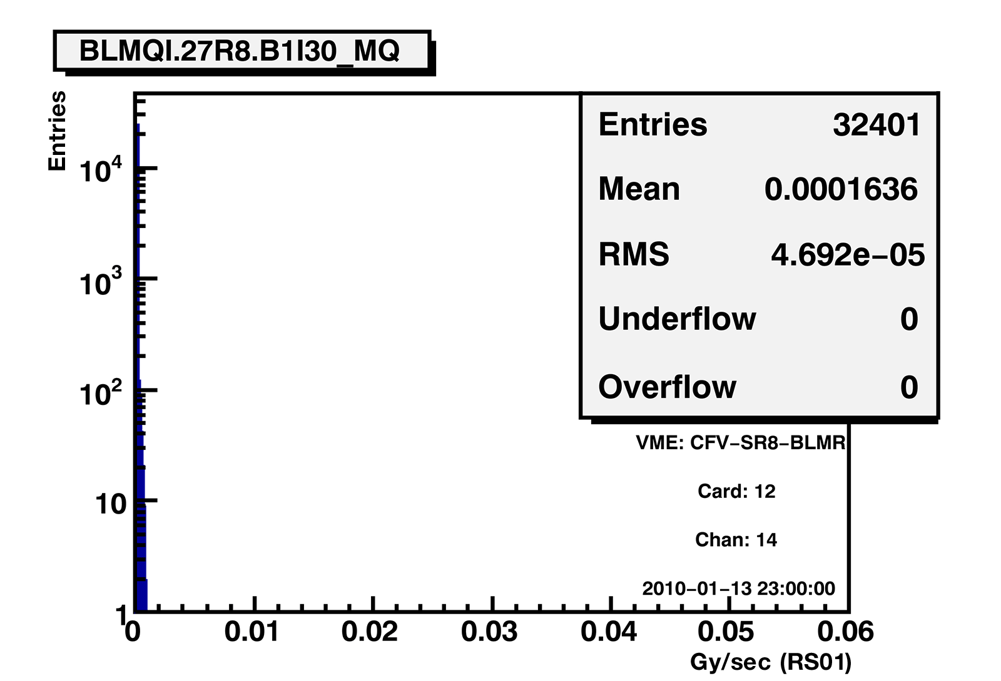
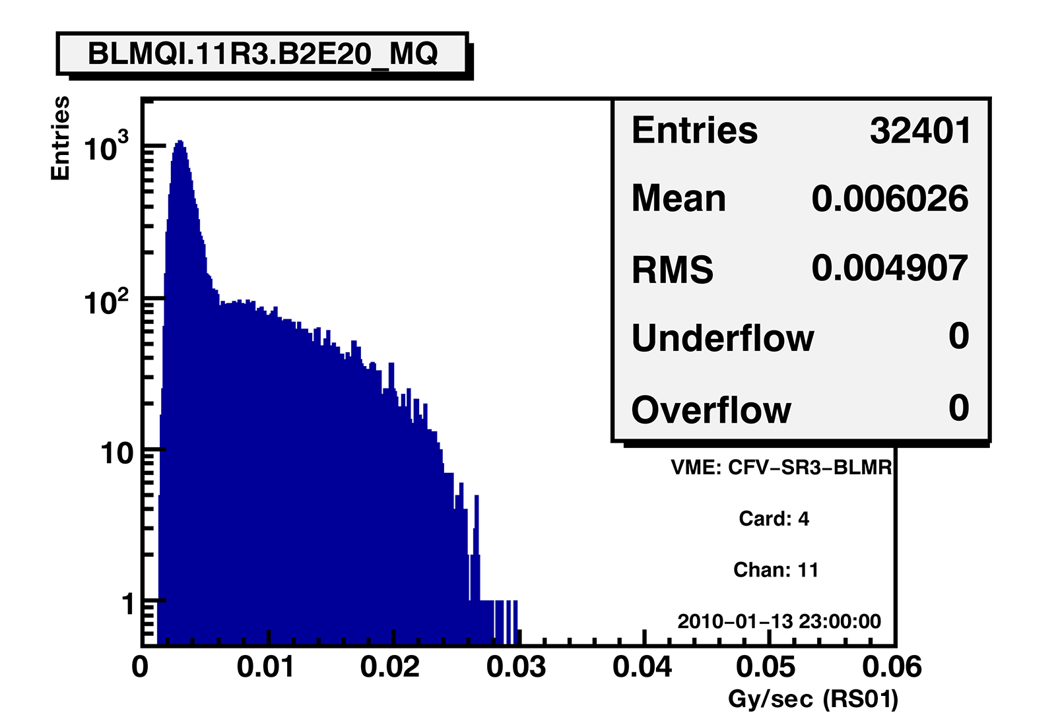
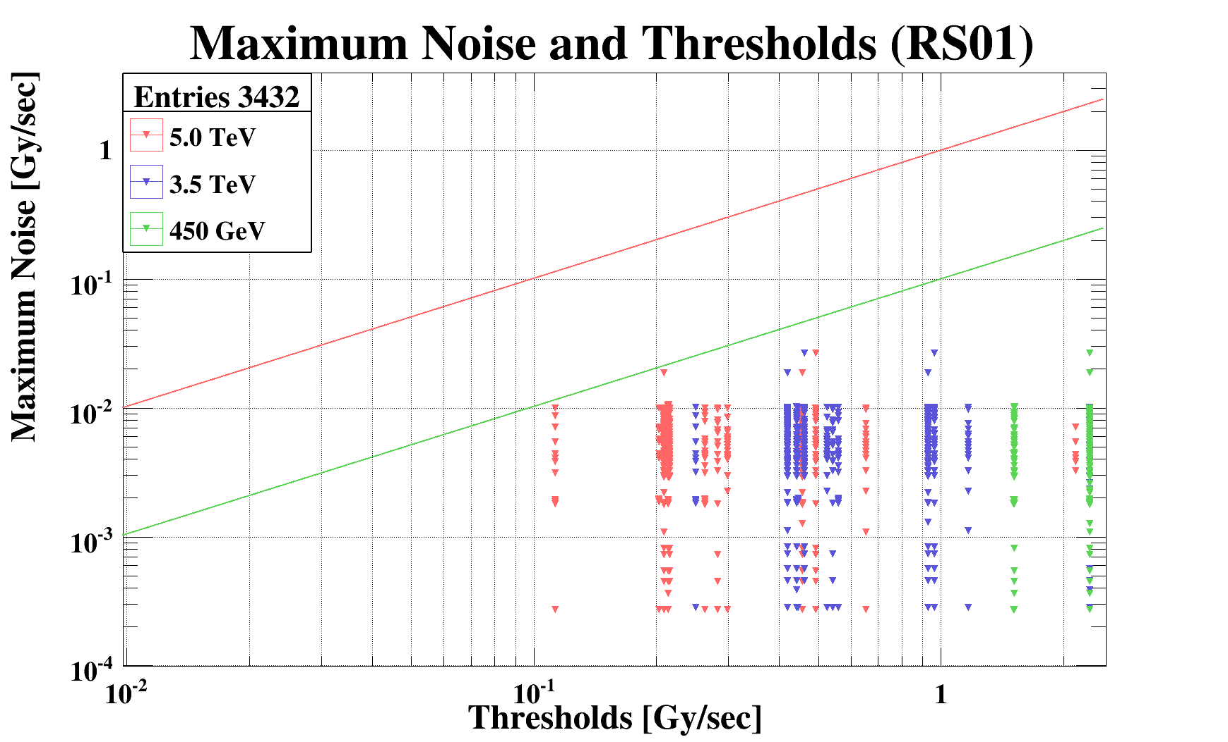
BLM System Upgrades
Online program predicting loss characteristics and likely loss origin, PhD
Long cable issue in IP3
Development of an Detector with intermediate measurement range
New cables for noise channels (7 TeV operation)
Ratio new / standart
proto type 8, aim 100
Data set: 8.1.2010-15.1.2010

Slide 20
Summary
No evidence has been found that a single beam loss event has been missed
  The initial threshold settings have to be sufficiently conservative in order not to damage the LHC magnets. During the initial runs of the LHC, they must then be iteratively adjusted. (Audit report 2008)
The hardware failures never caused a degradation of the reliability of the system
False dumps
  The number of hardware failures are as expected (reliability and safety study, PhD. G. Guaglio)
  No noise events

Slide 21
Spare Slides

Slide 22
Gain Variation of SPS Chambers
30 years of operation
Measurements done with installed electronic
Relative accuracy
  Δσ/σ < 0.01 (for ring BLMs)
  Δσ/σ < 0.05 (for Extr., inj. BLMs)
Gain variation only observed in high radiation areas
Consequences for LHC:
  No gain variation expected in the straight section and ARC of LHC
  Variation of gain in collimation possible for ionisation chambers
Test with Cs137
Total received dose:
  ring 0.1 to 1 kGy/year
  extr 0.1 to 10 MGy/year

Slide 23
Thresholds Test with 3 corrector orbit bump measurements
3 corrector bump already used during threshold tests
Top: BLM signal at trigger level vs dcum
Bottom: BLM signal vs bump size
Beam position reproducibility is estimated to 150 μm peak to peak, max BLM signal variation 50 %

Slide 24
Fault Tree Analysis
Almost 160 Failure Modes have been defined for the BLMS using the FMD-97 standard.
Three Ends Effects:
1. Damage Risk: probability not to be ready in case of dangerous loss.
2. False Alarm: probability to generate a false alarm.
3. Warning: probability to generate a maintenance request following a failure of a redundant component.
The probability to have an Failure Mode A, Pr{A}, is calculated per each Failure Modes of the FMECA, given the hazard rate, the repair rate and the inspection period .
False Alarm
Damage
by
Risk
transmission
OR Gate
AND Gate
OR Gate
AND Gate
Optical
Optical
Blind
Blind
line
1
line
2
FEE
BEE
EVENT
1
EVENT
2
EVENT
1
EVENT
2
EVENT
1
EVENT
2
EVENT
1
EVENT
2

Slide 25
Fault Trees Results
The probabilities to fail (unavailability) for the BLMS have been calculated.
Per each End Effects, the major contributors to such probabilities have been pointed out too.
 | Consequences per year | Weakest components | Notes
Damage Risk | 5·10⁻⁴ (100 dangerous losses) | Detector (88%) Analogue electronics (11%) | Detector likely overestimated (60% CL of no failure after 1.5 10⁶ h).
False Alarm | 13 ± 4 | Tunnel power supplies (57%) VME fans (28%) | Tunnel power supplies likely underestimated (see sensitivity example).
Warning | 35 ± 6 | Optical line (98%) VME PS ( 1%) | LASER hazard rate likely overestimated by MIL.

