Slide 1
LHC Beam Loss Monitoring System LHC Beam Commissioning Workshop 19-20 January 2010
Christos Zamantzas for the BLM team
Bernd Dehning, Claudine Chery, Ewald Effinger, Jonathan Emery, Csaba Jr Hajdu, Eva Barbara Holzer, Christoph Kurfuerst, Aurelien Marsili, Annika Nordt, Mariusz Sapinski, Raymond Tissier, Giuseppe Guido Venturini

Slide 2
Contents
Acquisition
Threshold Values
Processing
Applications & Databases
Reliability

Slide 3
Acquisition
Section 1:

Slide 4
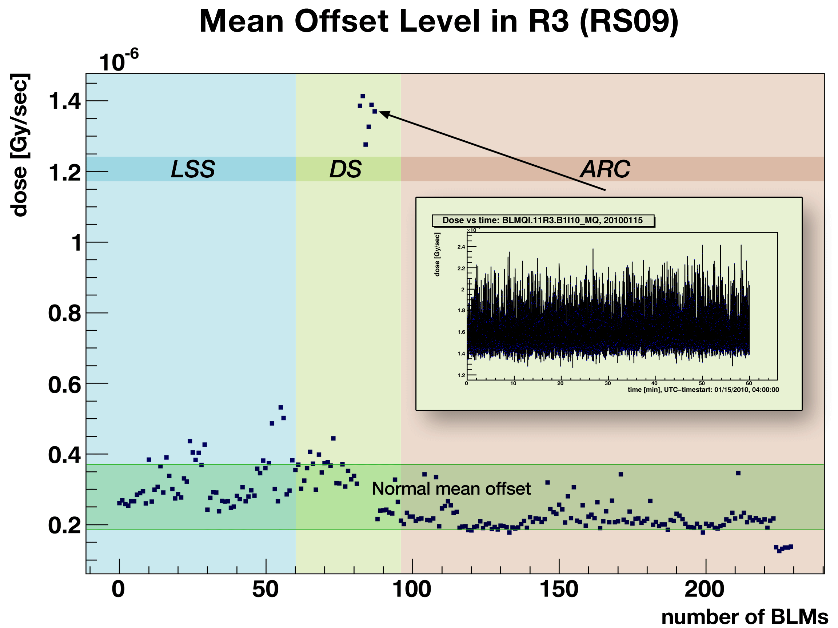
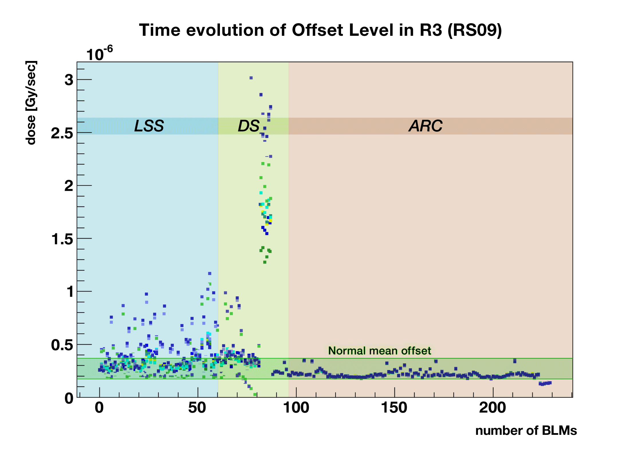
Offset Level
Relevant for:
Minimum detectable signal or Sensitivity of loss measurements
False triggers – LHC availability
Mean offset values for all IC monitors 1 hours of data – 18/12/2009
Offset [pA] | % of total | Comments
1-8 | 6.91% | Too low (problem has been identified)
10-20 | 77.71% | Very good
20-30 | 6.83% | Good
30-80 | 3.28% | High (DAC reset needed)
>80 | 5.00% | Problematic
=0 | 0.28% | no data (faulty cards/connections)
18.12.2009
18.12.2009 - 01.01.2010

Slide 5
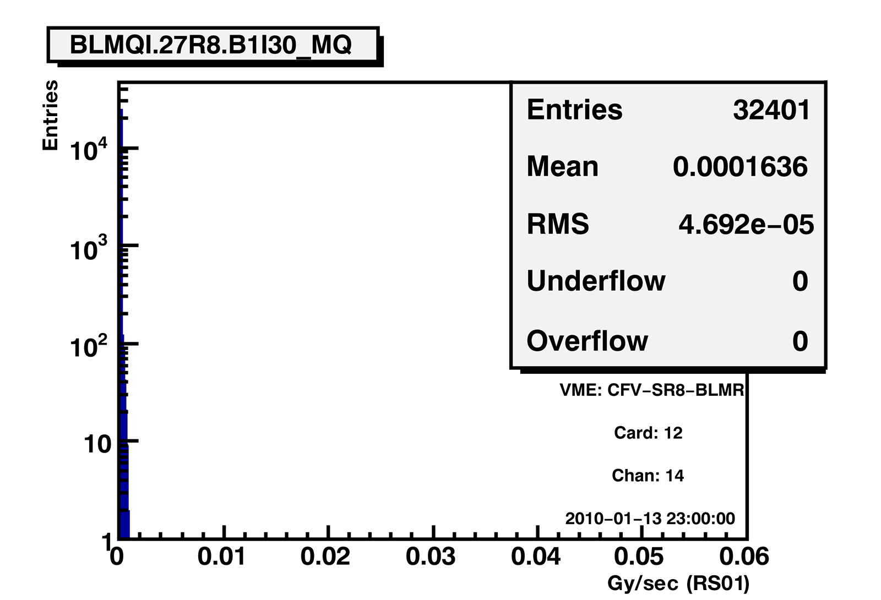
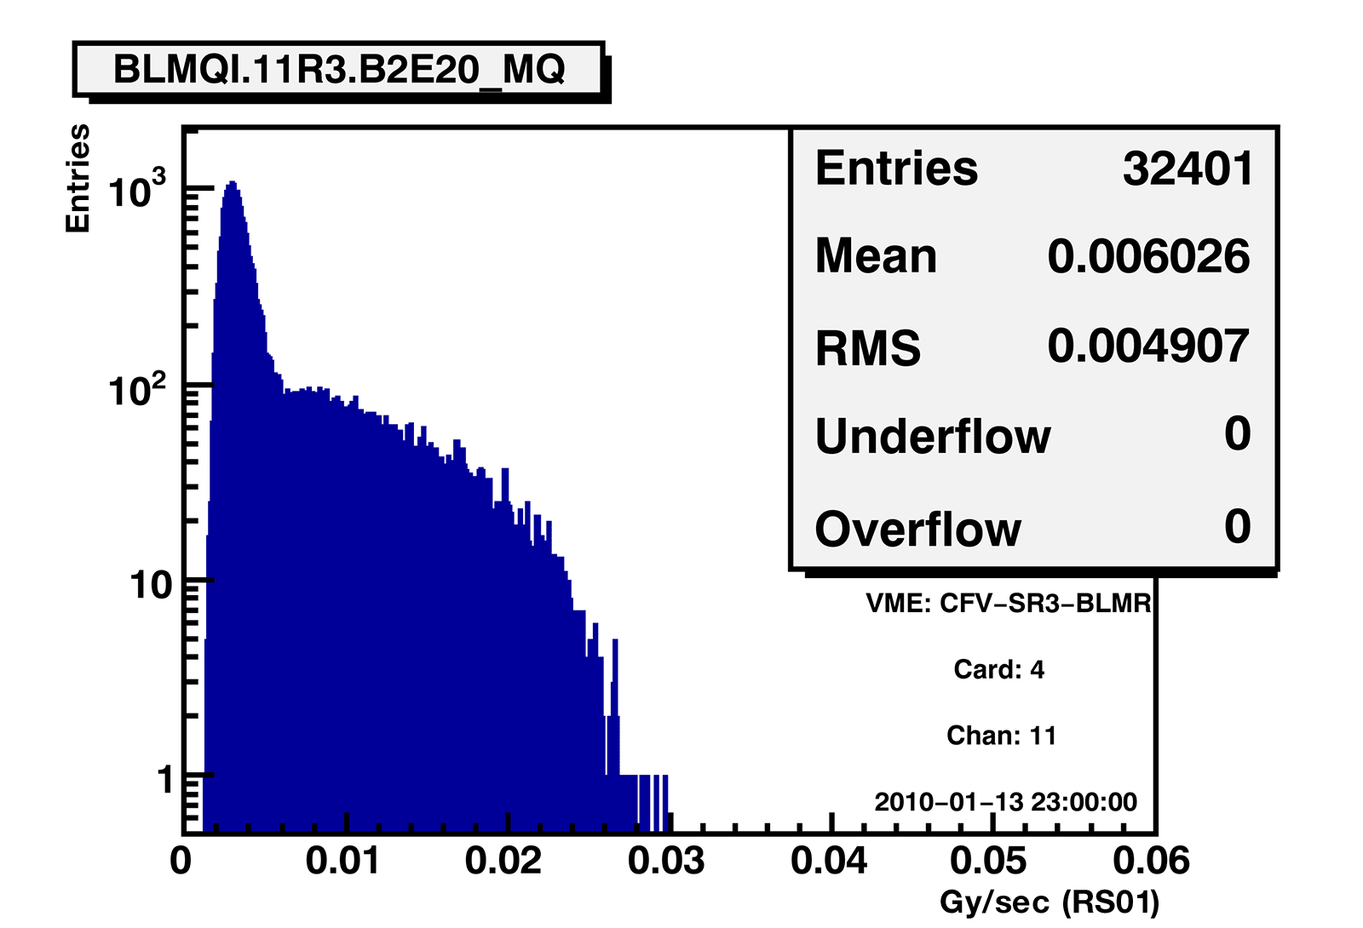
Noise Level
Single channel frequency distribution:
Noise on short cable (RS01)
Noise in RS01 for all IC monitors
9 hours of data; maximum values – 13/01/2010
Noise [BITS] | Monitors | % of total | Comments
1-30 | 1083 | 30.1% | very good
30-100 | 1646 | 45.7% | good
100-200 | 600 | 16.7% | ok
200-300 | 201 | 5.6% | candidates for problematic channels
> 300 | 54 | 1.5% | critical noise (channels to be repaired)
= 0 | 18 | 0.5% | no data from 3 cards
Several cables have been exchanged
some of them 800m long
Installation consists of 3 batches from different manufacturers
Expected noise reduction
Standard cables is factor 2
New cables is > factor 5 (single pair shielded)
Mid-term plan use new type of cables
Noise on long cable (RS01)

Slide 6
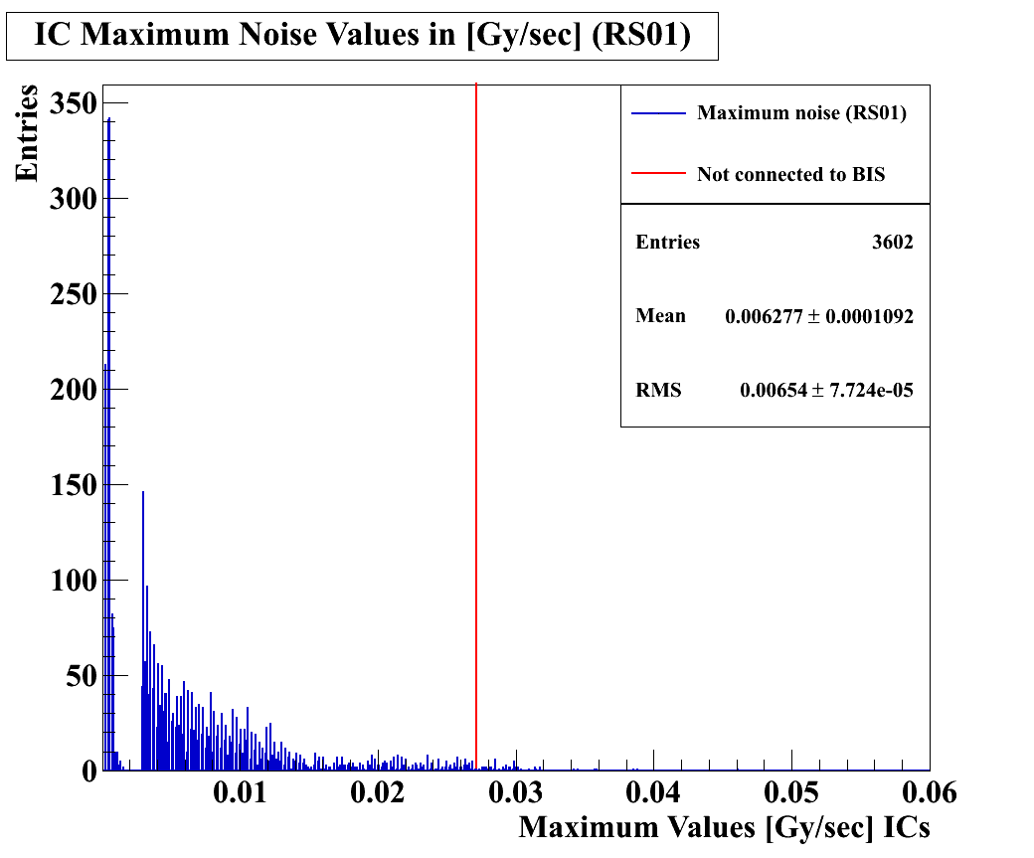
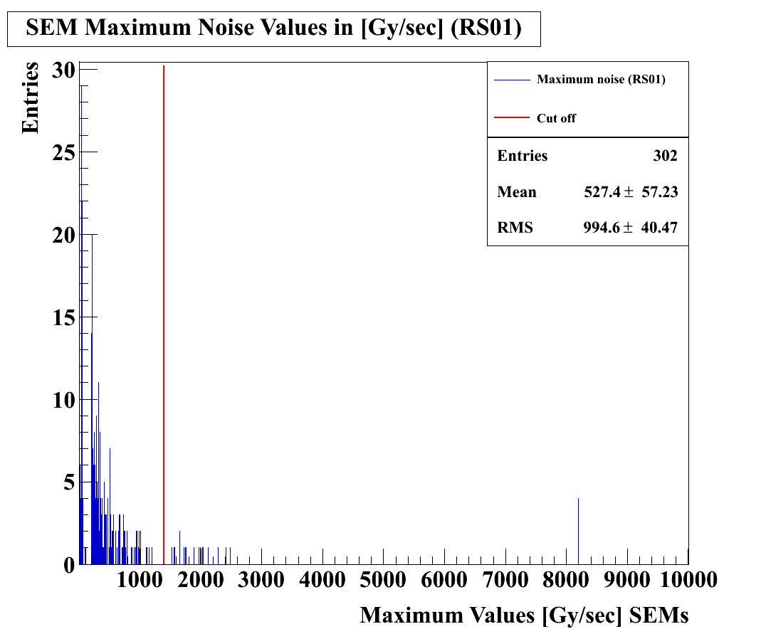
Noise Level
Max. noise value frequency distribution:
Ionisation Chambers (3602)
Noise in RS01 for all IC monitors
9 hours of data; maximum values – 13/01/2010
Noise [BITS] | Monitors | % of total | Comments
1-30 | 1083 | 30.1% | very good
30-100 | 1646 | 45.7% | good
100-200 | 600 | 16.7% | ok
200-300 | 201 | 5.6% | candidates for problematic channels
> 300 | 54 | 1.5% | critical noise (channels to be repaired)
= 0 | 18 | 0.5% | no data from 3 cards
Installation consists of 3 batches from different manufacturers
Several cables have been exchanged
some of them 800m long
Expected noise reduction
Standard cables is factor 2
New cables is > factor 5 (single pair shielded)
Mid-term plan use new type of cables
Secondary Emission Monitors (302)

Slide 7
Ongoing Modifications
Some acquisition cards need to be exchanged
Cards affected ~ 4%
Too low offset current
Interconnection boxes
Ionisation of the air inside the box measured
Adding better isolation to all SEM
Global reset of cards not reliable
Cards affected ~ 5%
Expected to get some improvement with WorldFIP; uncertain on WorldFIP reliability under radiation
Currently only point 6 has been connected.

Slide 8
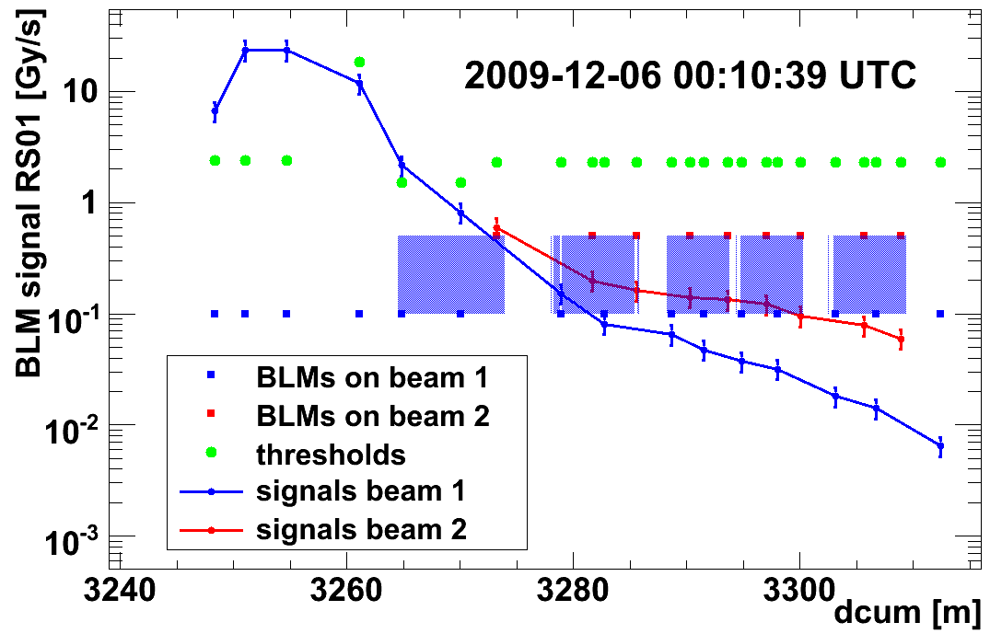
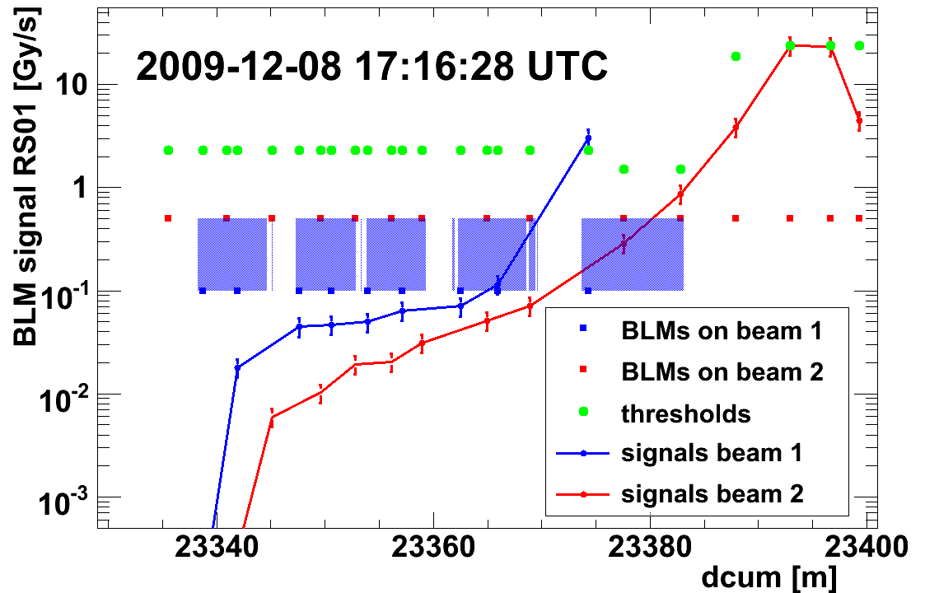
Over-Injection problem
BLMQI.03L2.B2I30_MQXA
BLMQI.03R8.B1I30_MQXA
Problem consists of losses at the LHC TDI and exceeding thresholds at the MQXA
Some small difference between injected beams
Installation has been verified to be correct.

Slide 9
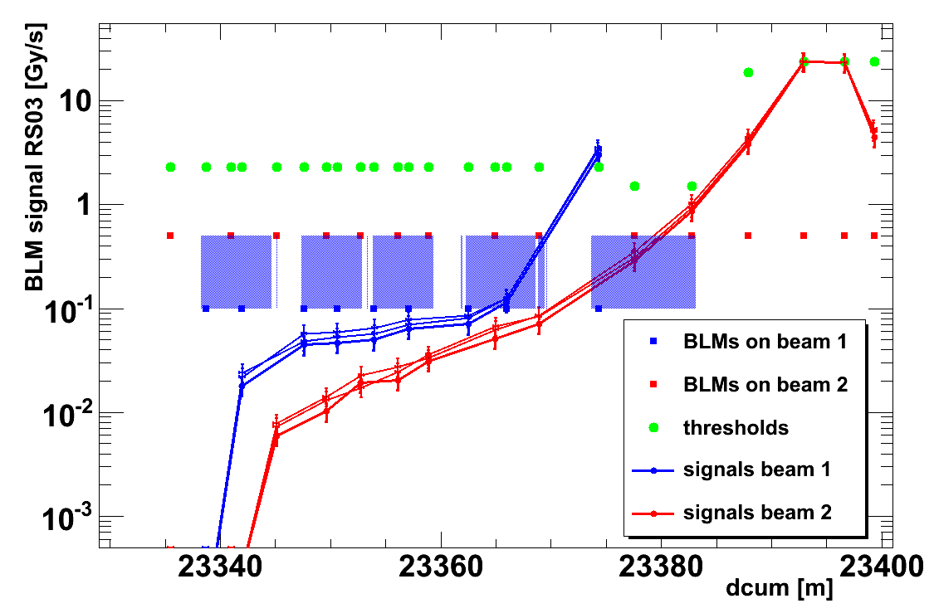
Over-Injection tests
Extensive tests done (with beam 2):
Over-injection, TDI open, 2e9 proton
Injection on closed TDI (+- 3mm), kicker off
Injection on closed TDI (+- 3mm) and TCTV (upper jaw -6 mm, down jaw -12 mm)‏
No significant difference observed
Most probably losses come from outside the cryostat

Slide 10
Over-Injection Solutions
Spread the signal by hardware means
installation of an additional capacitor
Add shielding
most favourable
needs simulations
Last year's test with threshold values set over the maximum allowed limit is not a safe solution.

Slide 11
Threshold values
Section 2:

Slide 12
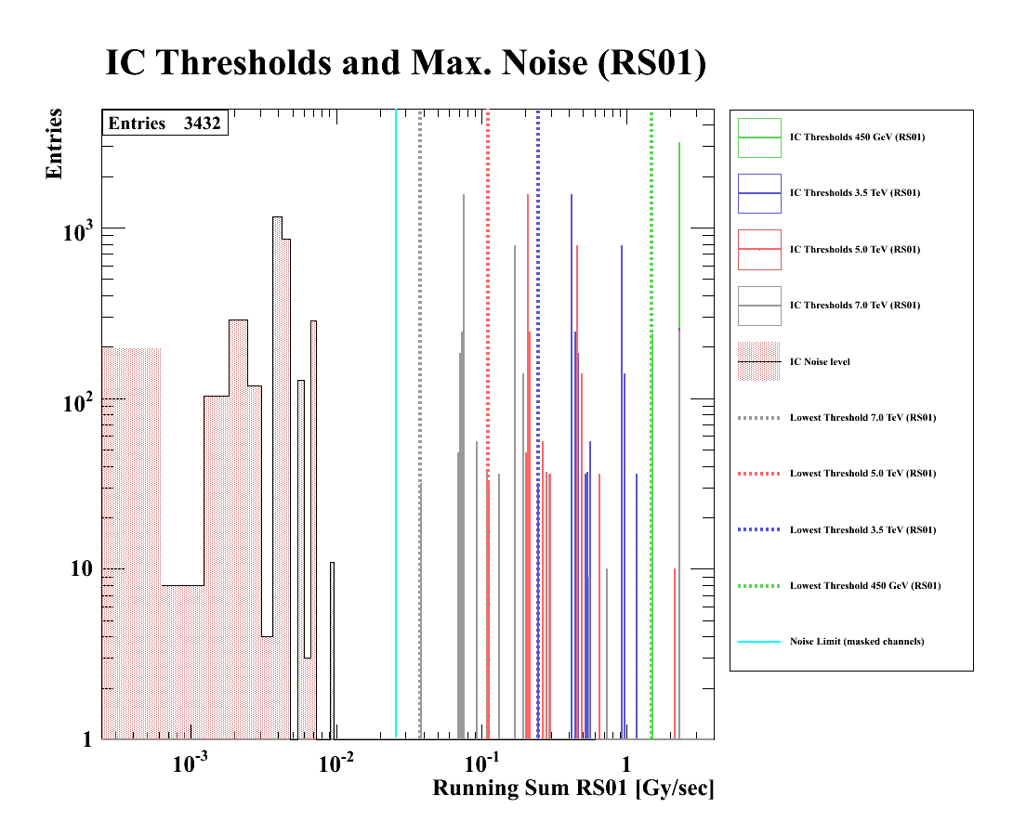
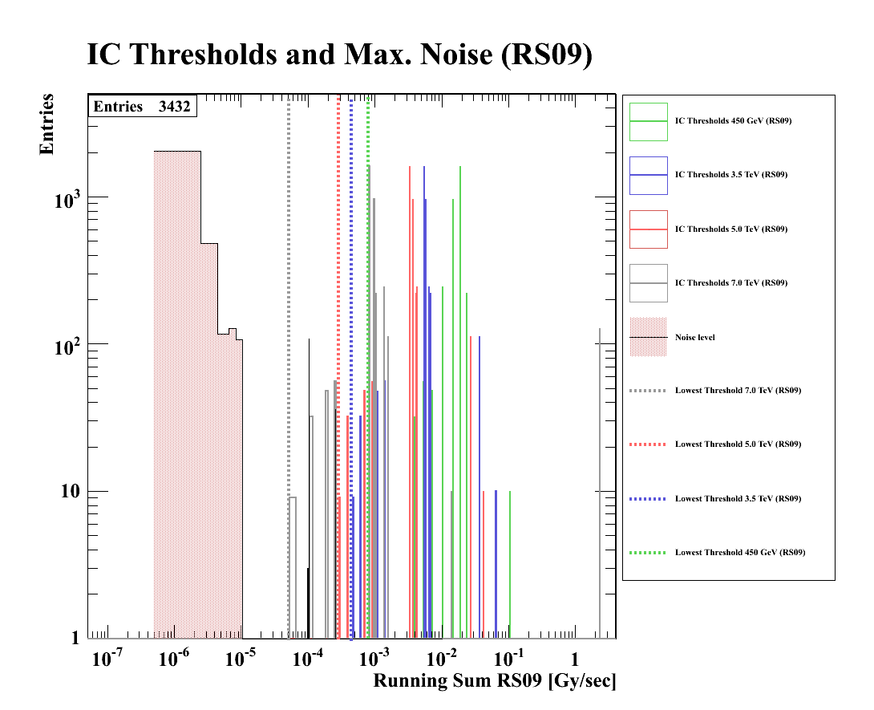
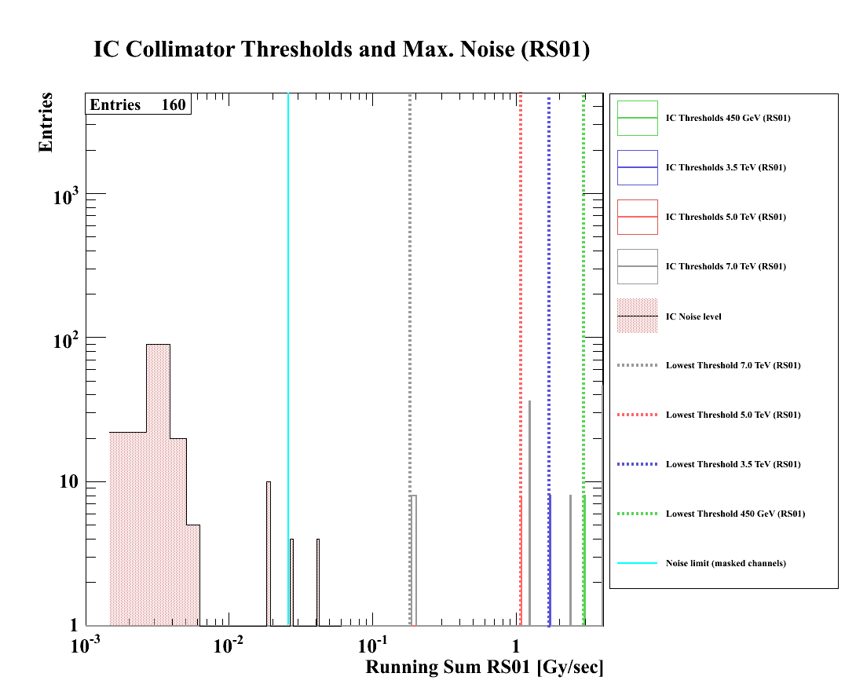
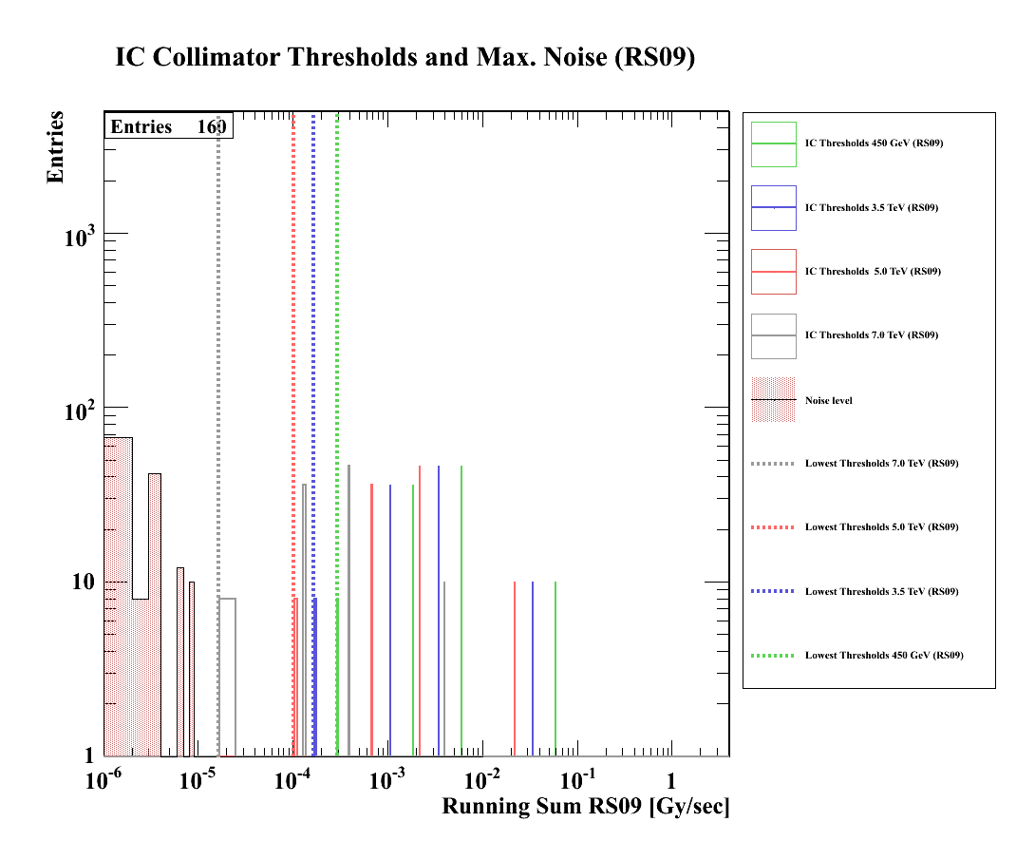
Thresholds & Noise
Frequency distribution of the maximum noise values over 14 days for each channel
(starting from 18-12-2009)
All Ionisation Chamber monitors except on collimators (= 3432)
Threshold values are MASTER * 0.1 (i.e. default monitor coefficient)
No significant problems expected
Some channels to be repaired
Thresholds can be increased with no safety impact.
All Ionisation Chamber monitors on collimators (= 160)
Threshold values are MASTER * 1.0 (i.e. maximum monitor coefficient)
Significantly lower values
Thresholds cannot be increased using the coefficient.
Recalculation of values will be done.

Slide 13
Threshold Values
No threshold values are missing
There are some weak points
Some precise simulations are missing
Tests for verification and fine tuning of the threshold values.
transient losses with special nQPS
steady-state losses with temperature sensors
More on the Chamonix talk.

Slide 14
Processing
Section 3:

Slide 15
System latency
Analysed several Beam Dumps in detail.
Difference in time between the bunch at the MKI and the break of the beam permit loop (by the BLMS) recorded at the BIC was always between 100 and 130 μs.
Time of flight:
MKI => monitor = 10 μs
monitor => acq. electronics (0.5 km cable) = 3 μs
Acq. => processing electronics (1 km fibre) = 3 μs
Detection of change in frequency in the daisy-chain = 5 μs
Integration in the acquisition electronics = 40 μs.
Decision at the BLETC (for fast losses) is taken every 40 μs.
Processing of data to decide < 1 μs.

Slide 16
System Self-Monitoring
Activation of all the self-monitoring processes:
Acquisition operation state monitoring (8 cases)
Configuration cross-check (one case)
Data transmission between the tunnel and the surface installation (14 cases)
Inhibit Beam Dump requests from cards not connected to BIS (2 cases)
Failed cases induce a beam dump
Example: Continuous checks on the data transmission between the tunnel and the surface installation:
Link A | Link B | ERR A | ERR B | Ignore CFC | CHOISE | Comment
0 | 0 | 0 | 0 | x | LK_B | all ok (choice based on PCB properties)
0 | 0 | 0 | 1 | x | LK_A | LK_B has errors
0 | 0 | 1 | 0 | x | LK_B | LK_A has errors
0 | 0 | 1 | 1 | x | Dump & LK_B | LK_A and LK_B have errors
0 | 1 | 0 | x | x | LK_A | LK_B is down
0 | 1 | 1 | x | x | Dump & LK_A | LK_B is down and LK_A has error
1 | 0 | x | 0 | x | LK_B | LK_A is down
1 | 0 | x | 1 | x | Dump & LK_B | LK_A is down and LK_B has error
1 | 1 | x | x | 0 | Dump & LK_B | LK_A and LK_B are both down
1 | 1 | x | x | 1 | LK_B | Both links down but CFC not present

Slide 17
Applications & DB
Section 4:

Slide 18
Storage of Parameters
Restructure of all databases:
MTF – remove BLMS architecture; keep only ref. measurements and components track history [ongoing]
Layout – become the entry point for updating connections or adding new installations [ongoing]
LSA – reorganisation of tables to become more relational [done]
Internal LSA DB Constrains will be reviewed
Internal DB Check for disabled channels [in testing]
Based on monitor criticality and adjacent disabled channels
Each monitors is being tagged on its criticality
Current version only informs on rules violations

Slide 19
Data Concentration
Logging data
Reason for losing packets still uncertain – investigation continues
Modification of CMW settings and Concentrator have improved the situation (positive side effect: FECs have stopped rebooting)
Capture data
Temporary solution with “synchronised GET” seems to work
Will test more and return to 2048 samples
JMS broker – new configuration and tests are foreseen

Slide 20
ALARMS
Warnings for the ALARMS consoles to be added:
System Check is ON-GOING
concentrated from all checks
Timeout from last System Check - TEST MANDATORY
MCS online, Connectivity, Beam Permit, ...
System Check has failed
console should give some details on actions
System has requested a Beam Dump.

Slide 21
Data Displays/Applications
Most applications ready.
Fixed display,
Capture display,
Monitor factor editor, ...
Status application
Main parts ready – still several parts missing
Need usability update for OP
Management application
Only GUI, missing code
Post-Mortem modules update
Adding some more variables (mainly statuses).
Adding more functions and better decoding of data.
Minor to no changes expected
Ongoing
Lower priority
Ongoing

Slide 22
Reliability
Section 5:

Slide 23
Automated checks
MCS Online check
Verify consistency of parameters
Connectivity (HV Modulation) check
Verify monitor connections
Internal Beam Permit check (BLETC -> BLECS)
Verify the ability of each card to trigger a dump
Will activate in the firmware the enforcing of the agreed periodic run of those checks by the Sequencer.
External Beam Permit check (BLMS -> BIS)
Verify connection to BIS
One minor bug pending
Finalising
Completed
Completed

Slide 24
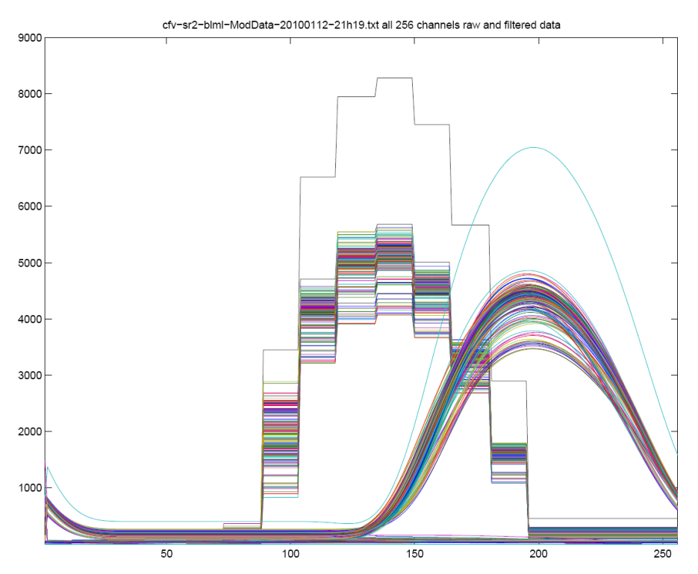
Connectivity check
The high voltage power supply to the monitors is modulated with a 60mHz 30V sinusoidal signal.
View on the LHC BLM system for the connectivity check.
A current on the monitors is generated by the HV modulation and detected by the normal acquisition system of the BLM.
The combiner card uses the running sum (RS_09) from the threshold comparators to determine the amplitude and phase of each monitor (256 per crate).
This results are send to the logging and compared to thresholds to permit or block the next injection if a non conformity is detected.
The signals of each monitors are stored (in the SRAMs) (see right plots) to be read on demand with the diagnostic application (under development).
The thresholds (called internal parameters) are unique for each monitor. They are calculated out of multiple measurements by a script gathering data in the logging.
View of the SRAM data containing the original (stairs) and filtered RS09 data of each channel for one crate.

Slide 25
System Verification Tests
Automatic extraction from DB + human inspection (repeated daily or weekly)
Frequency distribution of channel noise
Optical links degradation
Automatic verification on the Vertical Slice Test system (before releasing new firmware)
Exhaustive Threshold triggering tests (also used in LHC)
Reception and Status tests
Linearity, impulse, and some predefined patterns of input signals check
…
In the future will run inside the DB

Slide 26
Summary

Slide 27
Summary
BLMS removes correctly the BEAM PERMIT signal if measurements are over threshold.
No reliability issues observed.
System is well understood since it has been up and running for more than a year.
Some availability issues (false dumps) at energies higher than the injection are to be expected if thresholds don’t change in some regions.
Continuous monitoring of noise is required.
Sequencer initiated tests will be enforced to be run regularly.
More tests to verify and adjust the threshold values are needed.
Investigation of spurious signals from the SEMs are ongoing and first corrections are being implemented.

Slide 29
Reserved Slides

Slide 30
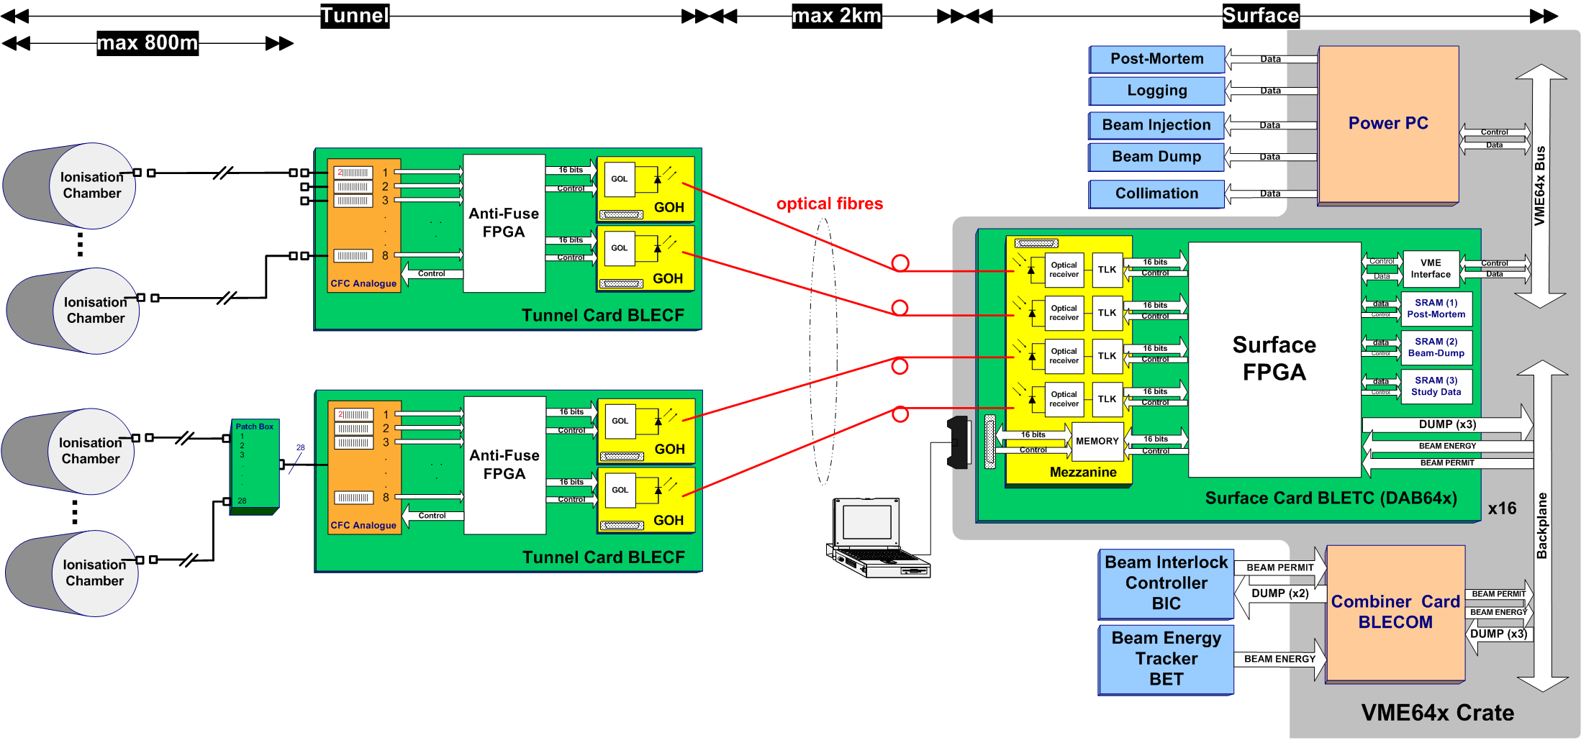
System overview

Slide 31
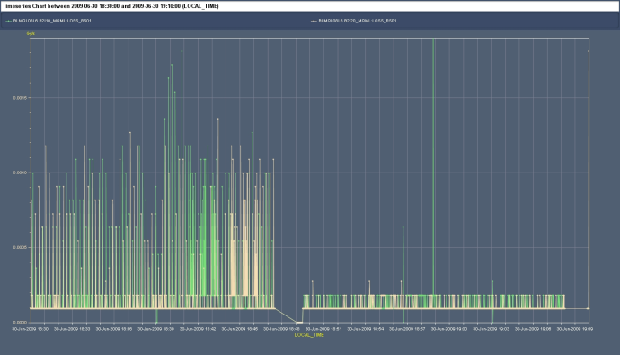
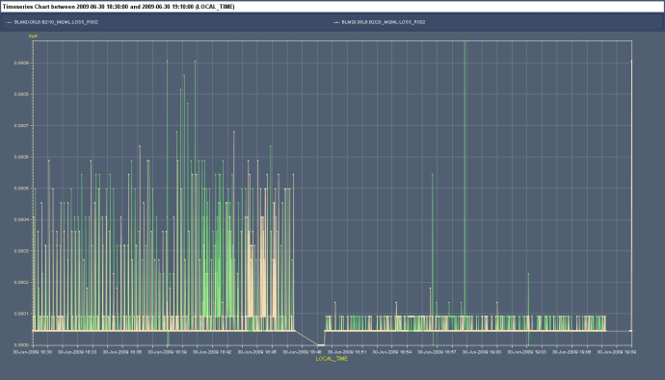
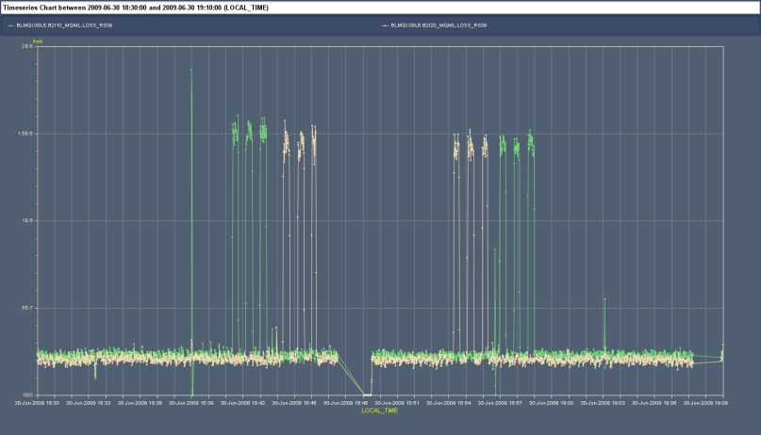
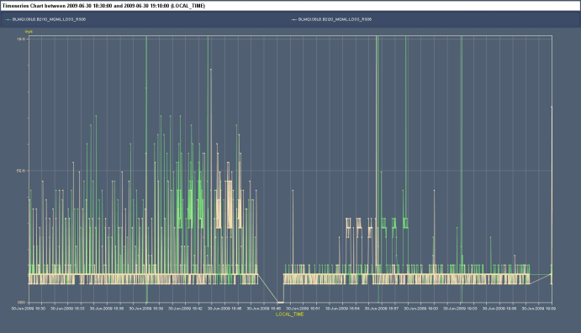
New noise reduction algorithm
Additional digital filter to reduce “noise” from the ADC circuit.
Safe; operates only when losses are very small
Verified to be correct; operational in 2009.
RS01
RS02
Rad Source Measurements with different firmware
OLD
NEW
RS09
RS06

Slide 32
Variables Update
Displays should be driven as much as possible by the electronics.
Avoid wrong information on the displays
Candidates for inclusion:
ChannelMask flag
IsCableConnected flag
IsConnectedtoBIS flag
Provide a bit encoded variable for the reason of the Beam Dump Request.
Final details of request is being discussed

Slide 33
Expert Applications
Management of parameters (Expert Threshold App)
Disabling and masking of channels
Configuration of mobile monitors
Pass complete login info to DB
Connect using LSA DB API
Roll-back on history
Diagnostics of misbehaving channels (for when checks fail)
expert tool initially but later will hand over to OP.
Next weeks
Next months

Slide 34
Other Known Issues:
PM/XPOC data are some times wrongly decoded [Firmware]
PM data channels that have been over threshold remain in history [FESA]
MCS fails always the first time [CO and FESA]
Collimator beam based alignment will not be available for this year [Collimation and BLM]

Slide 35
Beam Permit Lines Check
The internal beam permit check verifies the ability of each BLETC to remove the beam permit.
A timer ensure that this check is done at least every 24 hours (just before the connectivity check)
The external beam permit check verifies that the BIS (CIBUS interface) receives correctly the beam permit signal.
These lines are under the responsibility of the interlock system. A BLM interface is available to control these lines. Regular checks are foreseen.
Daisy chain from TC1 to BLECS
BLM Crate 1
BLETC N°1
U
BLETC N°2
U
BLETC N°16
U
BLECS
M
M
M
BLETC N°1
U
BLETC N°2
U
BLETC N°16
U
Last BLECS
M
M
M
Daisy chain of BLM crates (up to 4) from BLECS1 to CIBUS
BIS network
CIBUS Unmaskable
CIBUS Maskable

