Slide 1
Reliability tests of the lhc beam loss monitoring fpga firmware
Csaba F. Hajdu
09/04/2010

Slide 2
Outline
Introduction
The LHC Beam Loss Monitoring system
The Threshold Comparator firmware
Verification: Motivation
Verification methodology
Simulation
Hardware-based testing
Software-based testing
Procedure for new release
Conclusion

Slide 3
1/1. Introduction The LHC Beam Loss Monitoring system
The LHC Beam Loss Monitoring system
One of the most critical protection systems
Protects magnets from quenches, collider from damage
Provides data for diagnostics and machine tuning
Nearly 4’000 monitors
Ionization Chambers (IC), Secondary Emission Monitors (SEM)
Data acquisition: Current to Frequency Converter (CFC)
Data processing: Threshold Comparator (TC)
FPGA-based
Calculation of integrals over different time windows
Beam abort trigger when necessary

Slide 4
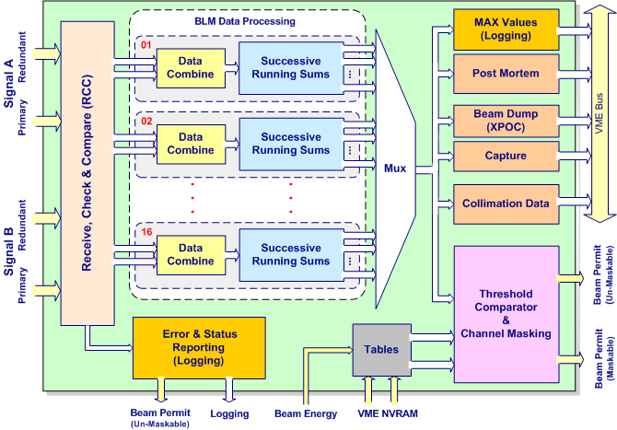
1/2. Introduction The Threshold Comparator firmware

Slide 5
1/3. Introduction Verification: Motivation
Verification of the Threshold Comparator firmware
Verification: about 70% of the design cycle (Doulos)
Sequential digital design of great complexity
Exhaustive verification impractical
Comprehensive verification environment
Different approaches of verification targeting different aspects of design
Functional simulation
Hardware-based approach
Software-based approach

Slide 6
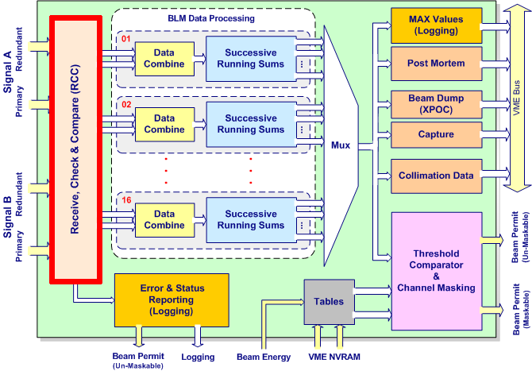
2/1. Simulation Scope

Slide 7
2/2. Simulation The RCC block
The RCC block
Receives the redundant input signals from TLKs
Checks packets for errors
CRC, Card ID, Frame ID, link unavailable
Can issue beam abort triggers as required
Decides which packet to use for further processing

Slide 8
2/3. Simulation Description
Functional simulation
Verify compliance to functional requirements of spec
Testbench (ModelSim)
“Black box” design methodology
Based only on specification
Stimulus read from file
Automatic checking of outputs
Comparison of versions
Regression testing
Detection of new bugs

Slide 9
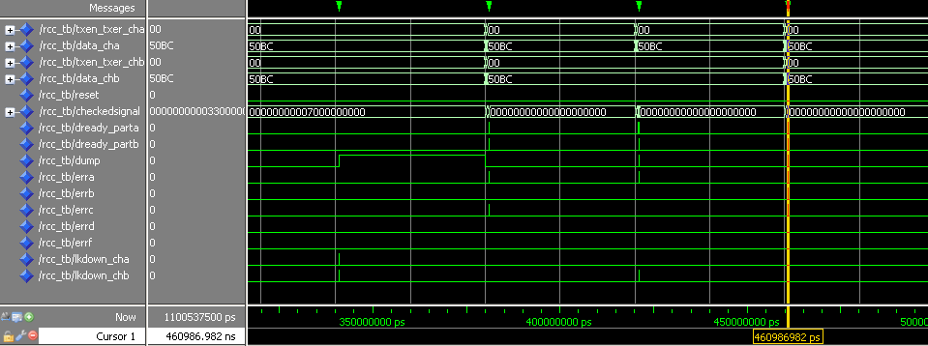
2/4. Simulation Sample output waveforms
I/O signals
Time
Output waveform for optical inspection

Slide 10
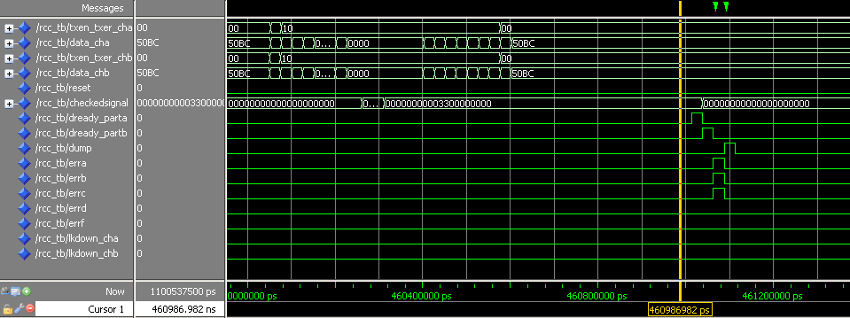
2/5. Simulation Sample output waveforms
Frame transmission
Strobe and error signals
I/O signals
Time

Slide 11
2/6. Simulation Automatic output checker – Description
Automatic output checker
Checks the output of the block vs. the expected output based on stimulus from file
Complements visual inspection
Code snippet of the automatic output checker

Slide 12
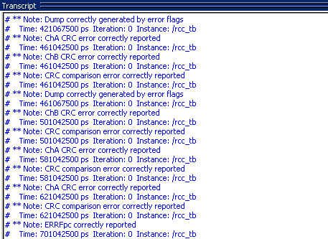
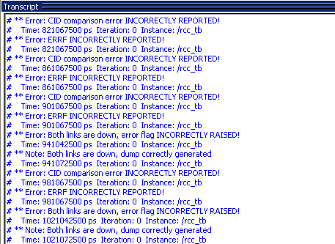
2/7. Simulation Automatic output checker – Sample outputs
Error-free output
Output with errors

Slide 13
3/1. Hardware-based check Scope

Slide 14
3/2. Hardware-based check Motivation
In situ test of the TC in VME crate
Emulation of output signals of CFC
TC architecture
BI standard DAB64x card
Optical receiver mezzanine
4 TLKs, signal from 2 CFCs
FPGA processing firmware

Slide 15
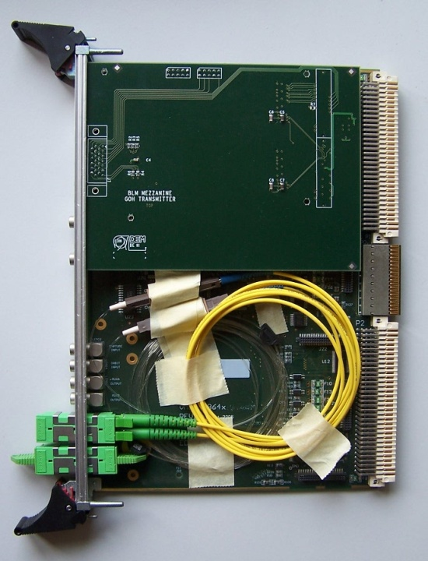
3/3. Hardware-based check The “Vertical Slice” card
New mezzanine for DAB64x card
Two standard Gigabit Optical Hybrid transmitters
Emulation of one CFC; more with optical splitters
Custom FPGA firmware

Slide 16
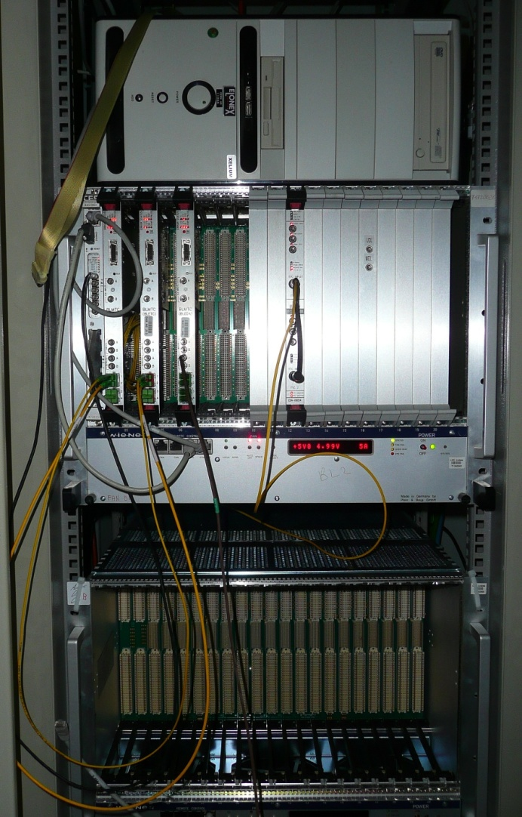
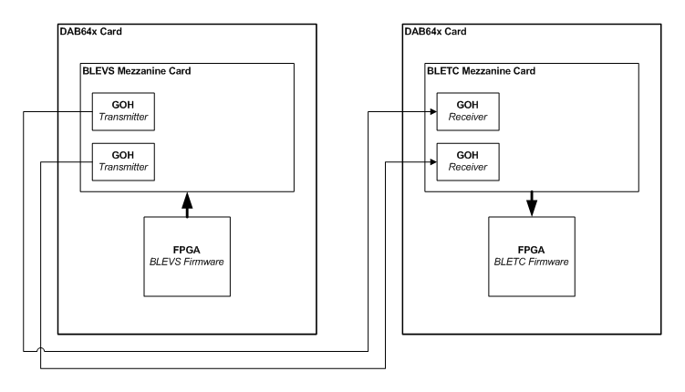
3/4. Hardware-based check Installation

Slide 17
3/5. Hardware-based check Features
Arbitrary Tx data
Comparison of different TC firmware versions
Playback of LHC capture data for analysis
Tx errors
CRC, CID, FID
Wrong configuration
Errors in physical layer
Manual testing procedure
Results read out in Expert application

Slide 18
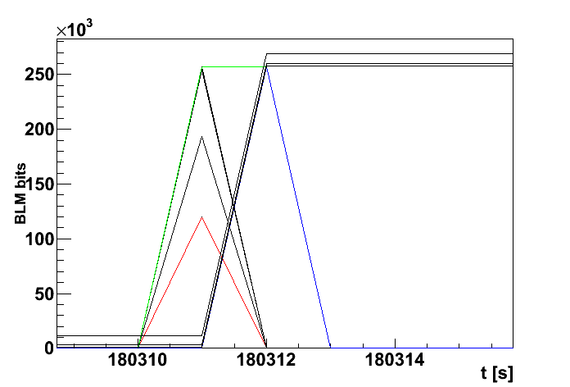
3/6. Hardware-based check Features – Playback of capture data
INPUT
OUTPUT
Samples from an IC in LHC tunnel: loss of a single bunch (40us)
12 Running Sums (integrals)

Slide 19
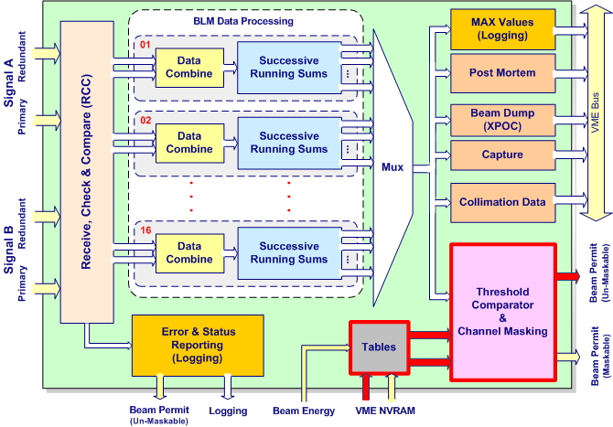
4/1. Software-based check Scope

Slide 20
4/2. Software-based check Description
Exhaustive verification of the behavior of the Threshold Comparator block
Every threshold value has to trigger one by one
16 cards/crate
16 detectors/TC card
12 integration windows/detector
32 beam energy levels
98’304 testcases/crate
VME readout check
The same testcase repeated 500’000 times

Slide 21
4/3. Software-based check The “Exhaustive Threshold Triggering”
VME crates
“Front End Computer” (FEC)
Combiner (CS)
Algorithm running on FEC
Loads threshold maps causing one chosen threshold to trigger a beam abort
Checks the result on TC and CS

Slide 22
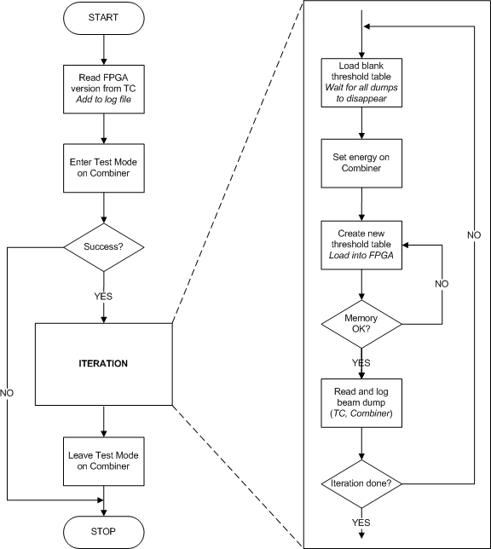
4/4. Software-based check Algorithm

Slide 23
5. New release
Procedure
A few hours of manual testing
Carry out simulation with testbench
If RCC block has been modified
Perform hardware-based test
CRC errors
CID errors
FID errors
Lost frames
24 hours of automatic testing
Execute the software-based “Exhaustive testing”
All tests need to pass!
Inspection of the code changes by the verification engineer
Independent review

Slide 24
6. Conclusion
Numerous bugs identified and fixed
Number of bugs found vs. time converging
Reason for optimism
No bugs found during operation
Sheer good luck?

