Slide 1
Proposal on Threshold Corrections for RC Filters
Eva Barbara Holzer
for the BLM team
LHC MPP
CERN, July 17, 2010

Slide 2
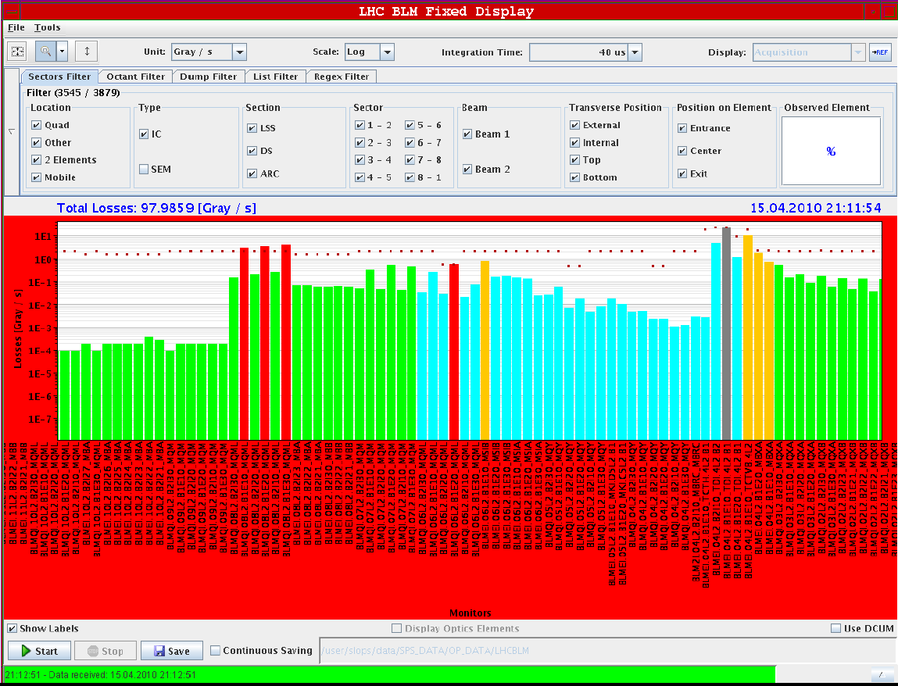

Slide 4
History (April 2010): Injection of higher intensity
RC filter for the monitors requested by the injection team factor 25 (all are external monitors;)
Maximum current will be reduced by a factor of 8.3 by RC filter and additional factor of 3 with (future) thresholds
Factor of ~10 between signal on external and internal monitors
For moment the threshold values not changed!
→For all other energies the thresholds are now too high
A quench could occur
New thresholds to be calculated asap
All these monitors set to maskable
Estimate: Quench of magnet by outside shower if injection intensity 2e13

Slide 5
New Thresholds after filter installation
Allow injection losses
→ 450 GeV thresholds have to be adapted to the shape of instantaneous (delta) losses.
Well defined procedure, which was already done for different magnets (not discussed here).
All other energies: adapt thresholds to ‘cancel’ the effect of the filter
Definition of cancel: same amount of loss leads to beam abort with the same time delay
Correction factor for thresholds depends on the time evolution of the beam loss
100% correction for all possible loss scenarios is not possible
→ need to decide on a reasonable loss evolution

Slide 6
Investigate Dependence on Loss Evolution
Filter response approximated by exponentially decaying signal (rise time = zero).
For bigger filters (rise time 0.3ms) this is not a good approximation
For the filter in question the rise time is between 0.12 ms to 0.2ms (to be confirmed). If confirmed, the thresholds of the first 3 integration times should be reduced further accordingly.
Analytical calculation
Filter response folded with loss evolution
Integrated signal

Slide 7
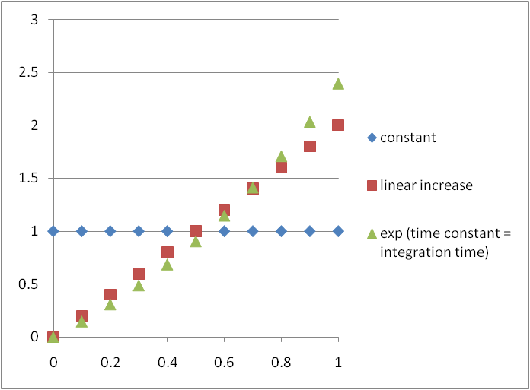
Proton loss distributions
Protons lost in a.u.
δ(t - 0)
δ(t - integration_time)
Time normalized to integration time

Slide 8
Loss distributions: correction effect gets stronger
δ(t - 0)
1-exp(-RS/RC) RS…integration time RC…filter time constant
Constant loss 1-(RC/RS)*(1-exp(-RS/RC))
Linear increasing loss
1+(2*RC*RC/(RS*RS))*(1-exp(-RS/RC))-2*RC/RS
Exponentially increasing with time constant equal to integration time:
The longer the running sum, the slower the development of the loss to protect against
Argument: The running sum RS5 with an integration time of 2.56 ms should protect against losses which develop on that time scale.
The shortest RS has to protect against instantaneous (which are the most dangerous ones for the magnet).
δ(t - integration_time)
not possible to cancel the effect (thresholds go towards zero when delta function approaches the end of the integration window)
When corrections are calculated with δ(t - 0) the maximum time delay of the abort signal is the integration time of the RS

Slide 9
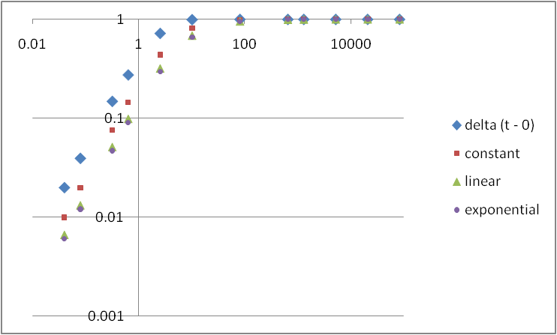
Correction factors for RC time constant of 2ms
Multiplication correction factor for the 12 integration time windows. A factor of 1 means no correction.
Time [s]

Slide 10
Correction factors for RC time constant of 2ms
 | RS [ms] | delta(t-0) 1-exp(-RS/RC) | const | linear | linear | Exp. | Delta/exp.
RS1 | 0.04 | 0.019801 | 0.009934 | 0.006633 | 0.006633 | 0.00604925 | 3.27335
RS2 | 0.08 | 0.039211 | 0.019736 | 0.013201 | 0.013201 | 0.01204168 | 3.256236
RS3 | 0.32 | 0.147856 | 0.075899 | 0.051266 | 0.051266 | 0.0468388 | 3.156704
RS4 | 0.64 | 0.273851 | 0.144216 | 0.098652 | 0.098652 | 0.09031911 | 3.032038
RS5 | 2.56 | 0.721963 | 0.435967 | 0.318802 | 0.318802 | 0.29519402 | 2.445723
RS6 | 10.24 | 0.994024 | 0.805855 | 0.685213 | 0.685213 | 0.65328106 | 1.521587
RS7 | 81.92 | 1 | 0.975586 | 0.952364 | 0.952364 | 0.94379834 | 1.059548
RS8 | 655.36 | 1 | 0.996948 | 0.993915 | 0.993915 | 0.99273469 | 1.007318
RS9 | 1310.72 | 1 | 0.998474 | 0.996953 | 0.996953 | 0.99635857 | 1.003655
RS10 | 5242.88 | 1 | 0.999619 | 0.999237 | 0.999237 | 0.99908799 | 1.000913
RS11 | 20971.52 | 1 | 0.999905 | 0.999809 | 0.999809 | 0.9997719 | 1.000228
RS12 | 83886.08 | 1 | 0.999976 | 0.999952 | 0.999952 | 0.99994297 | 1.000057

Slide 11
Conclusion for RC time constant of 2ms
Maximum difference
between δ(t - 0) and the exponential increase
factor 3.3
Proposal
Apply the least correction: δ(t - 0)
Practical reasons
RS5 is comparatively low already
This type of correction is already applied on all RS1 – RS3 for ion signal effect (ionization chamber does not give delta signal)
Biggest difference seen is only factor 3.3
Do we need to protect against faster losses?
Rise time effect (measured: 0.12 ms to 0.2ms) ?

Slide 12
Some more slides

Slide 13
Over-injection

Slide 14
Over-injection
Thresholds 4 MBX monitors now allow for over-injection onto a ‘fat’ pilot. Requested: Brennan
40us to 10ms (RS1 to RS6 ) changed for 450 GeV
BLMEI.04R8.B2E10_MBXB and BLMEI.04L2.B1E10_MBXA
Up to ‘pilot’ of ~8e9
At the next possibility: increase margin to 1.2e10 (same as MQXA)
Thresholds to be recalculated (unnecessarily low for higher energies)
BLMEI.04R8.B2E20_MBXB and BLMEI.04L2.B1E20_MBXA
Final – to be verified
Threshold on TCT not increased (requested: Ralph) → next in the line to trigger
Two additional corrections:
Swap names: BLMEI.04L2.B1E10_MBXA and BLMEI.04L2.B1E20_MBXA
Past logging data reassigned accordingly – should be transparent
Corrected threshold settings (3 MBX monitors were in wrong family)
ECR to be done once all changes finalized

