Slide 1
Warm Magnet Thresholds

Slide 2
Definition - Master threshold and Applied threshold
Give OP team certain tuning freedom on thresholds
Master thresholds:
Maximum thresholds which can be applied
Safety requirement for cold magnets:
Master thresholds < 10 * ‘damage level’ for integration times ≤ 100ms (integration times > 100ms: also covered by QPS + cryogenic system)
Applied thresholds = Master thresholds * monitor factor (MF)
MF ≤ 1 (enforced in LSA DB)
MF set individually for each monitor
MCS_BLM_expert role (limited number of people) allowed to change MF
Maximum limit of electronics (for IC): 23 Gy/s
→ Master thresholds have to stay below 23 Gy/s
→ Applied thresholds limited to MF * 23 Gy/s

Slide 3
WARM ELEMENT THRESHOLDS
Warm elements: MF = 0.1 (before mid October 2010)
Roman pot thresholds defined by simulations
Verification with beam needed
MSIB simulated, but error found. New results expected soon.
All other warm elements either
same thresholds as MSIB (even though different geometry): MSD, MSIA, MQW, MBWMD, BSRTM (total 94) or
23 Gy/s for all integration times and energies: MBW, MKI, MKD, (absorbers: TAN, TCD, TCAP) – total 34
Short term plan for warm elements – but signal in BLM / lost proton?
 | Transient losses number of protons in 40us | Steady state number of protons in 89s
450 GeV | 1E12 (factor 5 below melting in test measurements, V. Kain PAC’05) | 1E11 protons/second (based on experience)
7 TeV | 1E10 (scaled from 450 GeV) | 1E9 protons/second

Slide 4
Families and Monitors
Family definition: monitors with the same master thresholds
Similar/same:
Elements
Monitor location
Loss scenario
Between 1 and 360 monitors in one family
Local protection strategy
 | # Families | # Monitors
Ionization Chambers (IC): observation and interlock; 99 monitors not connected to BIS (dump line, element not installed, redundant monitor with RC filter for observation) | 122 | 3592
SEM – none connected to BIS; observation only | 22 | 289
Total | 144 | 3881

Slide 5
Safety requirements for warm elements?
Simulation uncertainty: factor of ~5 (2-10)
Before last week (24.10. 2010):
Master thresholds set to estimate of damage level
MF=0.1 → applied thresholds set 10 times below estimated damage limits
BUT: MF could be set to 1 → protection from damage was not guaranteed
Since last week (24.10. 2010):
Master thresholds set to factor 5 below damage estimate
→ safety factor of 5 (~ same as simulation uncertainty)
MQW: MF=1 (applied = 5 times below estimated damage)
Other warm magnets: MF=0.5 (applied = 10 times below estimated damage)

Slide 6
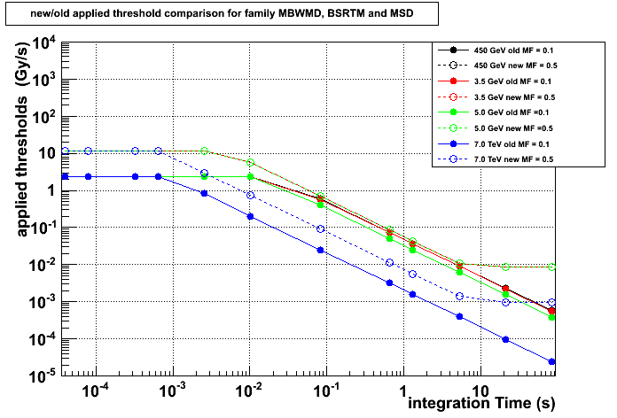
MBWMD, BSRT and MSD families

Slide 7
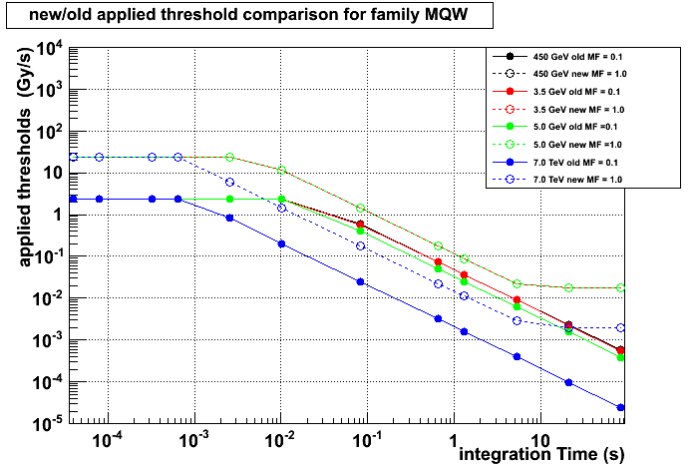
MQW_RC family

Slide 8
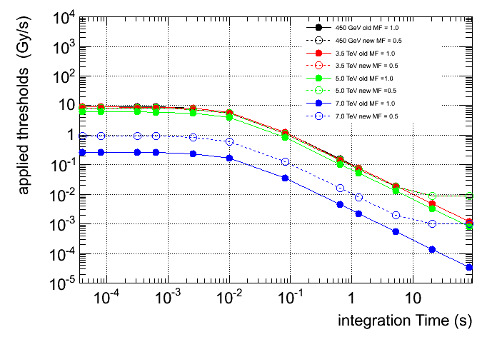
MSD_RC family

Slide 9
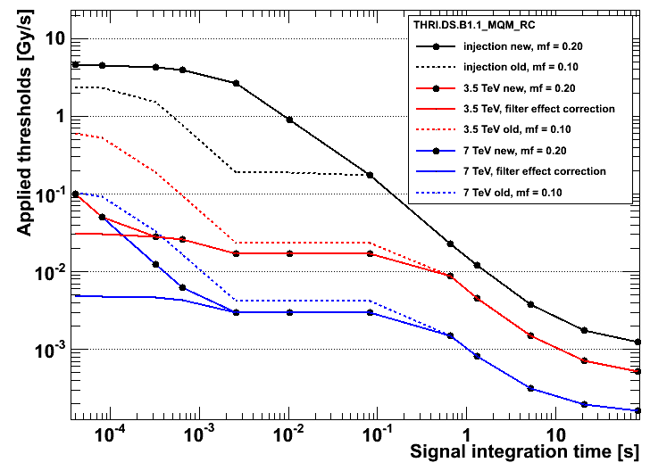
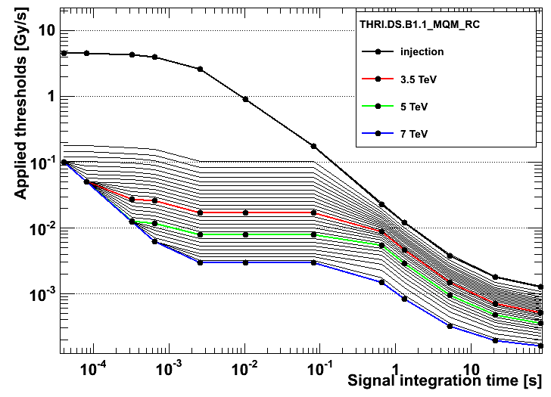
Example Minimum Threshold Values
Minimum threshold set to 4E-6 Gy (independent of RS), which is safely (~ factor 10) above noise level.

Slide 10
Other Slides

Slide 11
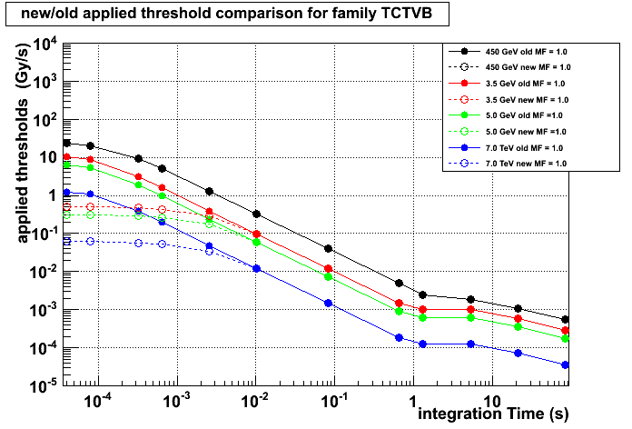
TCTVB_RC8 family

Slide 12
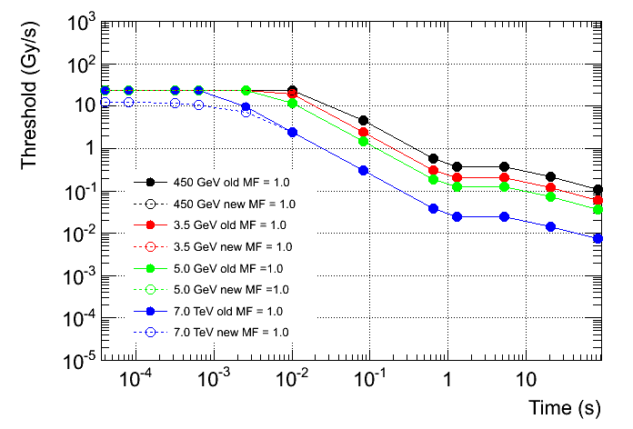
TDI_RC8 family

Slide 13
Collimator Thresholds

Slide 14
COLLIMATOR THRESHOLDS
Standard Collimator thresholds: MF = 1.0 (dynamic range)
95 Ionization Chambers
Extensive simulations (protons → collimator heating and damage)
FLUKA simulations and beam measurements (protons → BLM signal)
Thresholds defined according to operational scenario
Mostly far below damage level (see exception)

Slide 15
Cold Magnet Thresholds

Slide 16
Cold Magnets – Simulations and Measurements
Thresholds set by simulations
Loss shape (geometry, time)
Beam loss → Energy deposition in coil and signal in BLM
Quench margin
Threshold = S_{BLM}(E_{b}) · ΔQ (E_{b},t) / E_{D} (E_{b},t)
BLM signal quench margin energy deposited in coil
and by measurements
Verification with beam only for:
MB transient loss and
ms range MQY (wire scan)
Verification of steady state quench margin with heater inside beam pipe for
MQ, MB and MQM

Slide 17
Cold Magnets
Standard for cold magnets: MF = 0.1
Applied thresholds = 0.3 * ‘best to our knowledge quench levels’
Master thresholds = 3 * ‘best to our knowledge quench levels’
Short losses: about (at least) a factor of 100 between estimated quench and damage levels → safety requirement fulfilled
 | # Monitors | Simulations beam loss → energy deposition magnet and BLM | Beam measurements | Heater test of steady state quench margin
MQ (2361) MB (239) | 2600 | GEANT4 | Yes – transient loss Yes – transient loss | Yes Yes
Triplets: MQXA (80) MQXB (64) | 144 | FLUKA | no
All other cold | 493 | no (scaled by their respective enthalpy for transient loss) | MQY ms range - yes all other - no | MQM – yes All other - no

