Slide 1


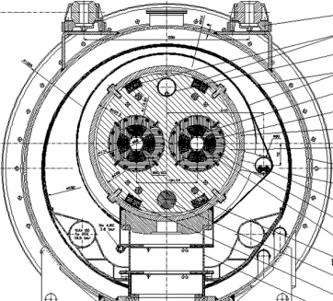
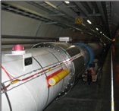
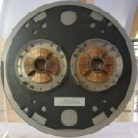
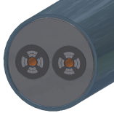
Assessment of BLM thresholds at cold magnets
Agnieszka Priebe, Mariusz Sapinski
CERN
Accelerator and Beams Department
Beam Instrumentation Group
Beam Loss Monitoring Section
10 June 2008

Slide 2
Contents
Introduction and strategy
Main Quadrupole Geometry in Geant4
Loss locations
Energy density in coils
BLM signal
Initial quench level studies
Summary and further development
10 June 2008
A.Priebe, M.Sapinski
2

Slide 3
Introduction and strategy
Geometry and material description
Magnetic field
Loss maps
LHC Design Report
LHC Layouts
edms
ROXIE
Difficult to find the data!
Geant4 simulations
ROOT data analysis
Quench level
Energy deposition
in coils
Fluence
Response function
Critical number
of protons
BLM signal
Threshold
10 June 2008
A.Priebe, M.Sapinski
3

Slide 4
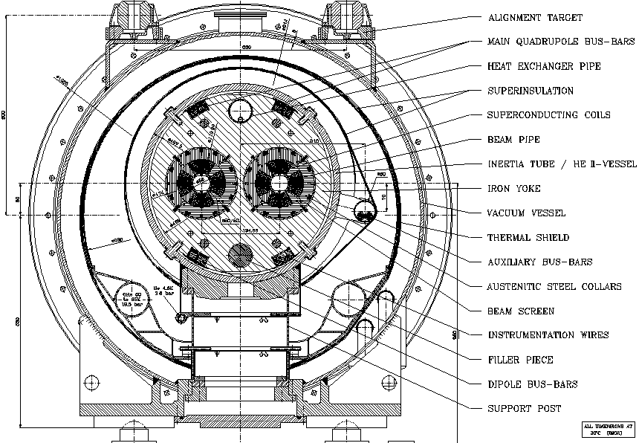
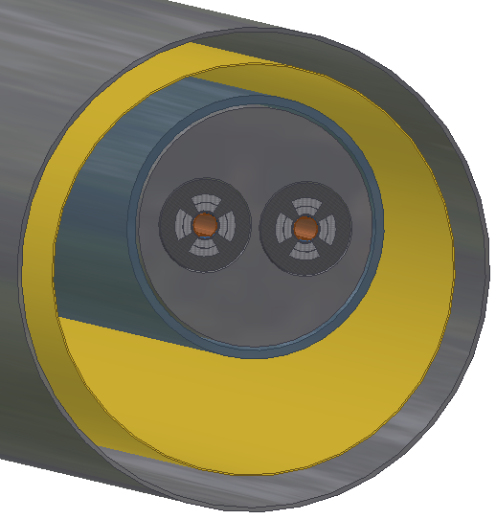
Main Quadrupole Geometry
MQ
10 June 2008
A.Priebe, M.Sapinski
4

Slide 5
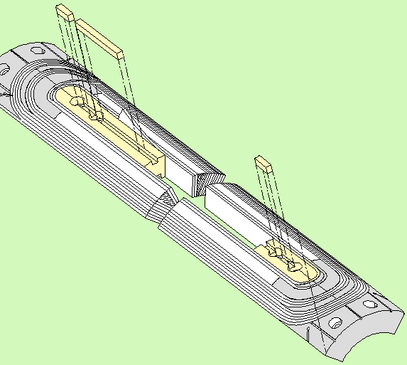
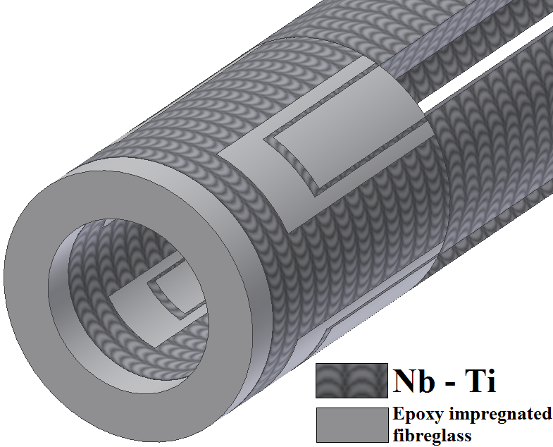
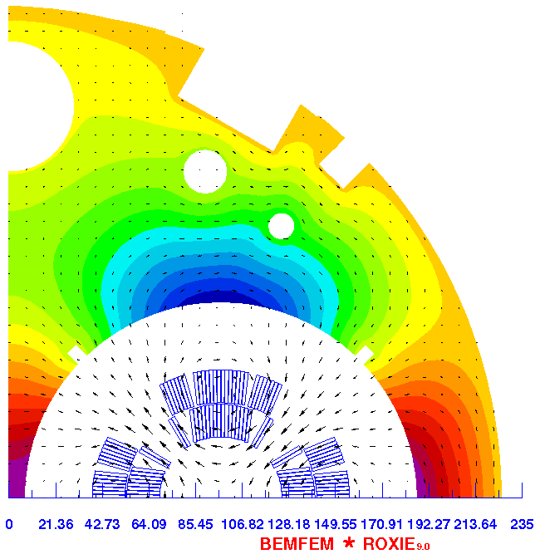
Superconducting Coils
Coil simplifications:
Cu wedges
An angle (displacement respectively to a centre of a coil-creating circle)
Endings
Weighted density ρ: 7.7801 g/cm³
Copper to superconductor ratio: 1.95 ± 0.05
Magnetic field map
10 June 2008
A.Priebe, M.Sapinski
5

Slide 6
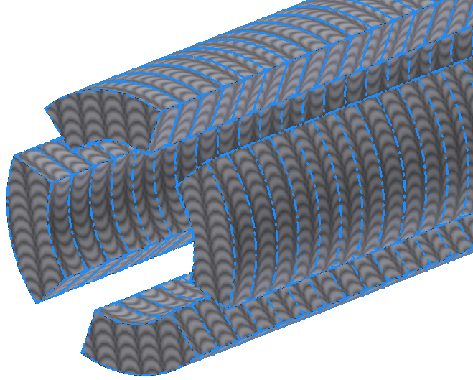
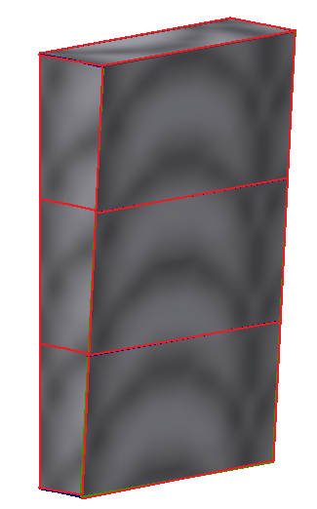
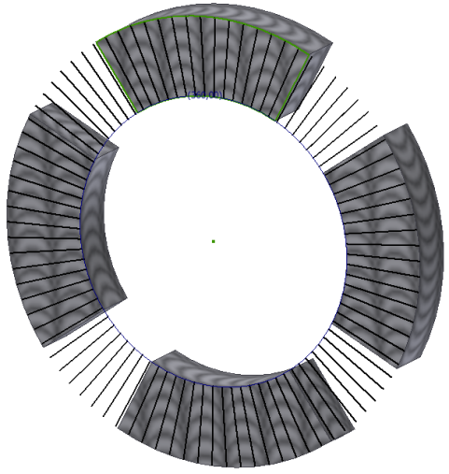
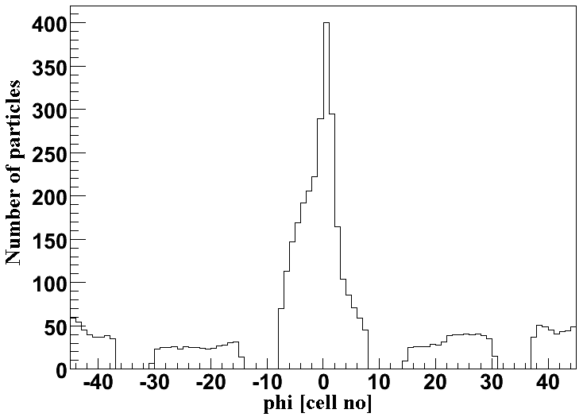
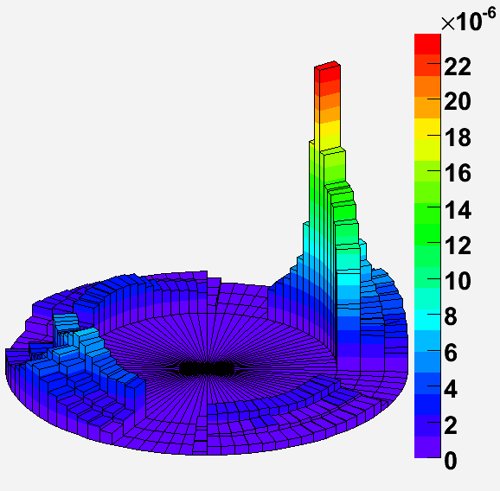
Read-out geometry
r = 2
r = 1
r = 0
Division in z
Division in φ
Division in r
Distortion due to B
2D histogram: (φ, r) weighted by energy density
THE BASIC CELL
Δz = 0, 1, …, 299 →10.53 mm
Δφ = 0, 1, …, 89 →4 °
Δr = 0, 1, 2 →5.12 mm
bin size << shower scale
→ binning is correct
[mJ/cm³]
10 June 2008
A.Priebe, M.Sapinski
6

Slide 7
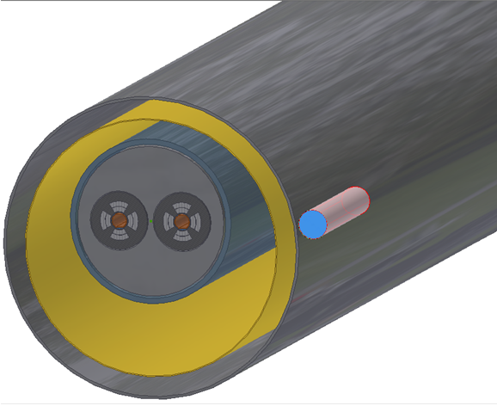
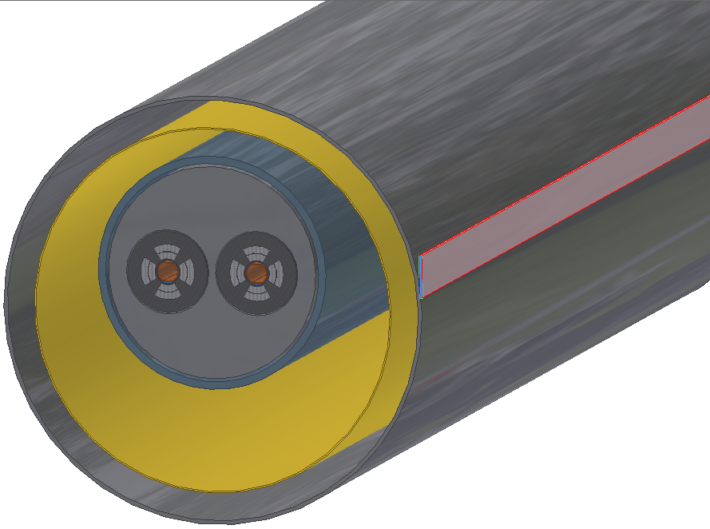
BLMs
Scoring particles
Real situation:
BLM: ø = 87 mm, l = 491 mm
Geant4 simulation:
Plate: a = 5 mm, b = 90 mm, l = l_{sector}
Reasons of use this kind of detector geometry:
Flexibility (different BLM positions on various magnets)
Comparison with previous simulations
10 June 2008
A.Priebe, M.Sapiński
7

Slide 8
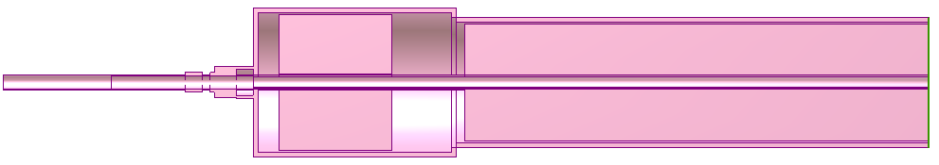
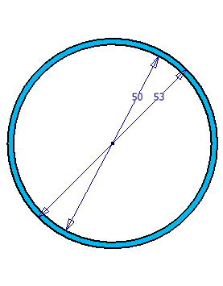
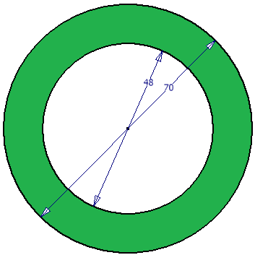
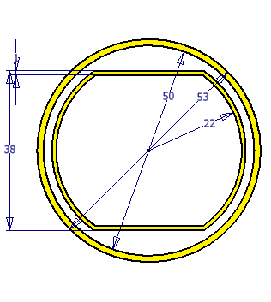
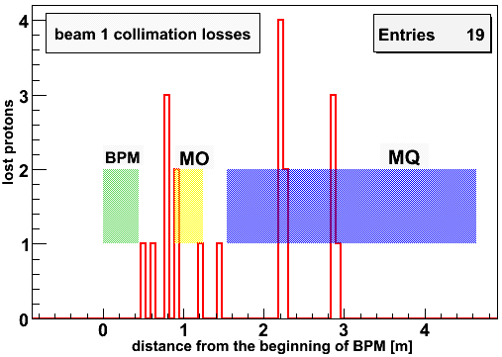
Loss locations
BPM
MO
MQ
Particle: p⁺
Energy: 7 TeV
Angle: 240 μrad
Time: 30min/p⁺
→ use lsf
→ try GRID
loss 1
loss 2
loss 8
loss 3
loss 4
loss 5
loss 6
loss 7
Beam pipe and
Cross - section
Beam pipe
BPM
Beam screen
10 June 2008
A.Priebe, M.Sapinski
8

Slide 9
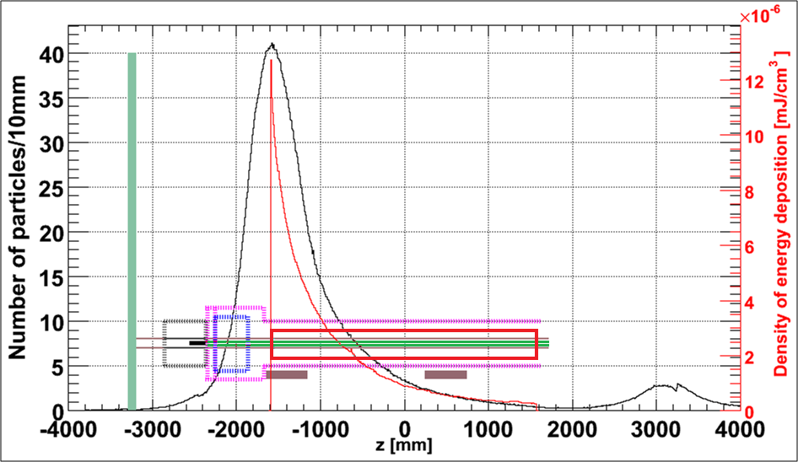
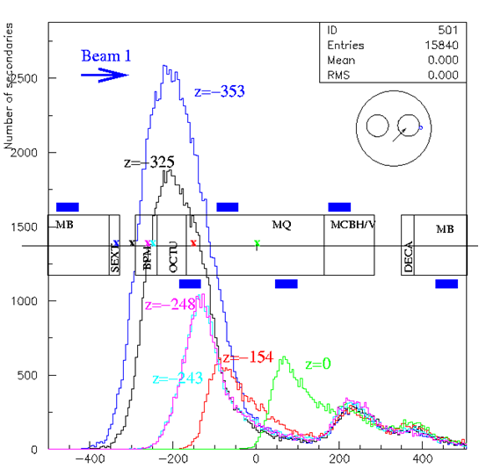
ρ_{Edep} in the coil & BLM signal
Loss8
ParticleGun: (119.69; 80; -2360 ) 1020 events
Quench level = 1.41 mJ/cm³
Geant4
Critical number of protons
≈ 9 · 10⁷
Geant3
Virtual Interconnection Plane
Particle Gun
L.Ponce „Positioning of the LHC BLM”
He-Vessel
MQ Coil
Beam Screen
BPM
MO
BLM1
BLM2
Beam Pipe
Particle number peak ~ 1m after the beam loss → 1st BLM was located correctly !
10 June 2008
A.Priebe, M.Sapinski
9

Slide 10
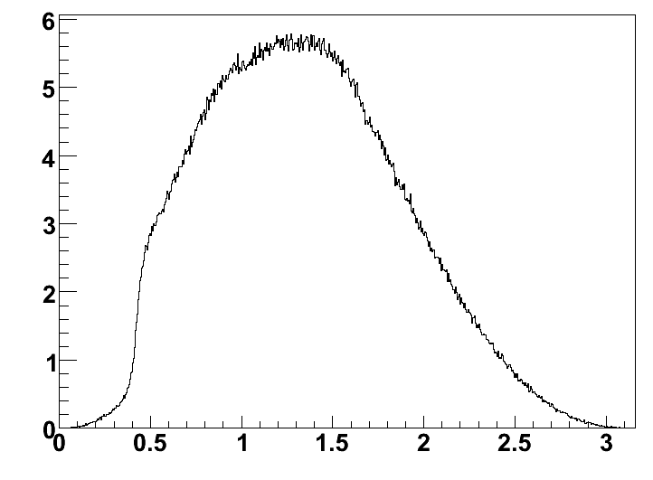
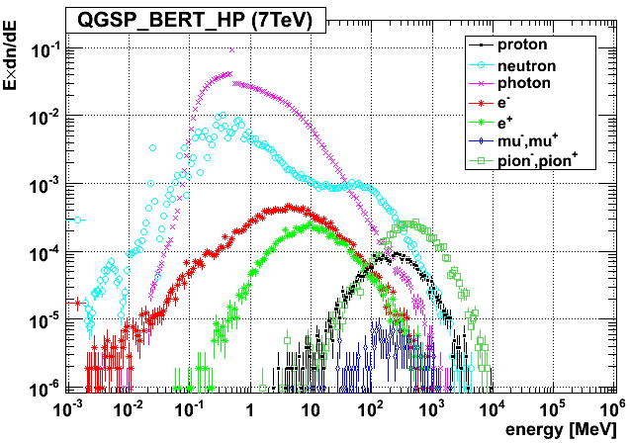
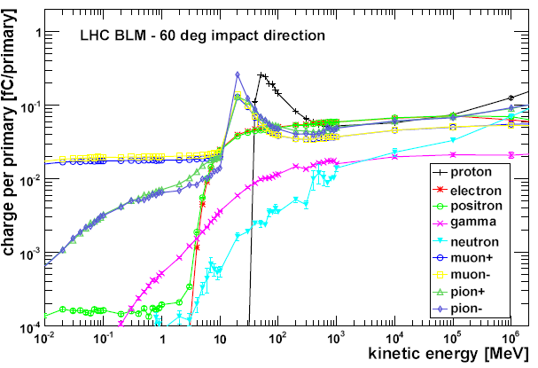
BLM signal
Angular Distribution (in BLM1)
Spectrum of secondary particles
Mean: 1.345
≈ 77°
Number of protons
arccos(p_{z}/p_{tot}) [rad]
LHC response function 60° (M.Stockner)
Signal folding with the response function
R.f. 60°
7 TeV total signal: 2.2 aC/p
R.f. 90°
7 TeV total signal: 2.0 aC/p
10 June 2008
A.Priebe, M.Sapinski
10

Slide 11
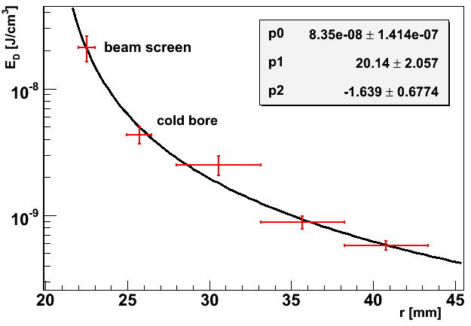

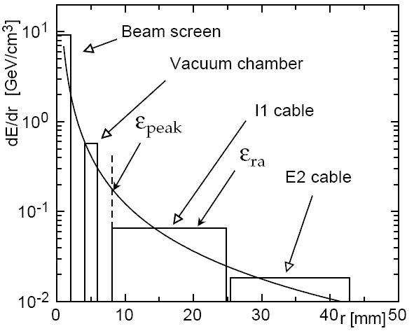
Note 44 vs. Geant4 simulation
Results from Geant4 simulation
E_{D} = p0 · ( r – p1) ^{p2}
Coil
r _{Coil} = 0
r _{Coil} = 1
r _{Coil} = 2
LHC Project Report 44 (CASIM simulations)
„Quench levels and transient beam losses in LHC magnets”
J.B.Jeanneret, D.Leroy, L.Oberli, T.Trenkler
1996
10 June 2008
A.Priebe, M.Sapinski
11

Slide 12
Summary and further aims
SUMMARY
Complex magnet geometry has been implemented in Geant4.
Preliminary threshold for the first BLM on Short Straight Section is about 7.7 ·10 ⁻⁵Gy (fast losses).
Comparison with Geant3 simulations – good agreement.
Comparison with CASIM – similar results.
FURTHER DEVLOPMENTS
Investigations of SSS geometry variations on threshold.
Development of C9R7 (Dispersion Suppressor) region.
Q6 in IP3 (large expected losses).
10 June 2008
A.Priebe, M.Sapinski
12

Slide 13

Thank you for your attention !!!
10 June 2008
A.Priebe, M.Sapinski
13

Slide 14
Comparison with Geant3
L.Ponce „Positioning of the LHC Beam Loss Monitors”
10 June 2008
A.Priebe, M.Sapinski
14

Slide 15
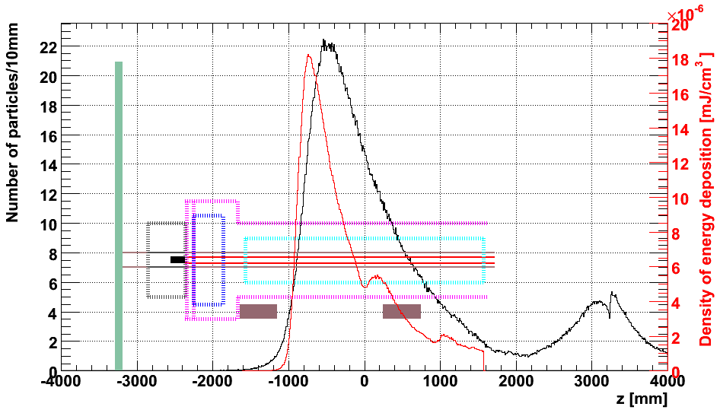
ρ_{Edep} in the coil & BLM signal
Loss5
Geant4
Geant3
Particle Gun
Virtual Interconnection Plane
L.Ponce „Positioning of the LHC BLM”
He-Vessel
BPM
MQ Coil
Beam Screen
MO
BLM1
BLM2
Beam Pipe
ParticleGun: (119.19; 80; -1000 ) 640 events
BLM peak ~ 60 cm after the beam loss
10 June 2008
A.Priebe, M.Sapinski
15

Slide 16
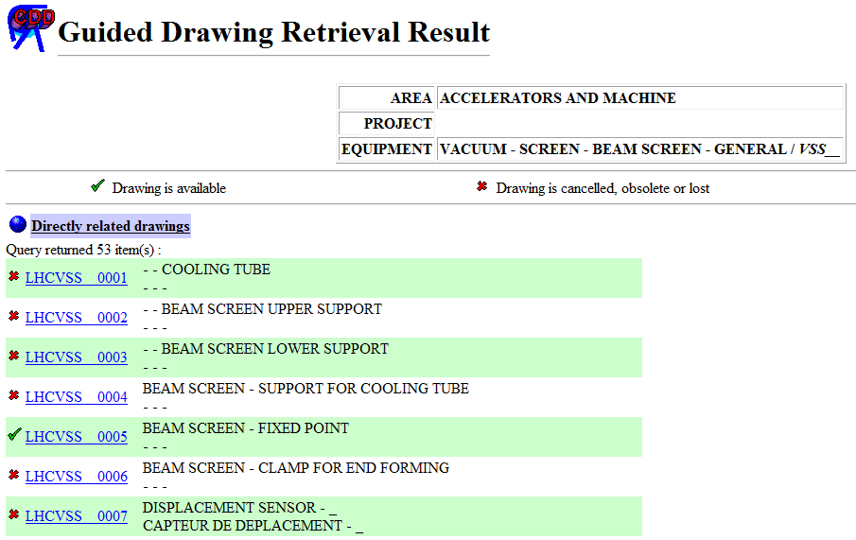
Problems & impediments
10 June 2008
A.Priebe, M.Sapinski
16

Slide 17
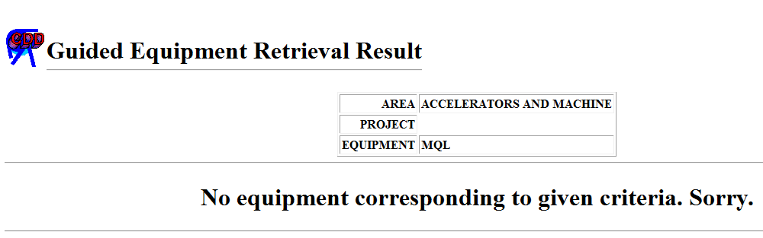
Problems & impediments
10 June 2008
A.Priebe, M.Sapinski
17

Slide 18
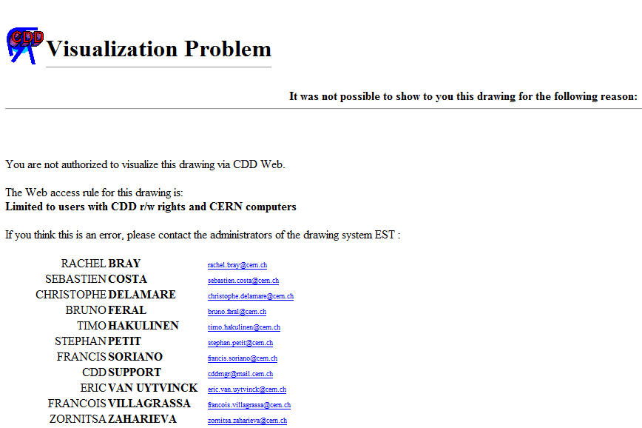
Problems & impediments
10 June 2008
A.Priebe, M.Sapinski
18

Slide 19
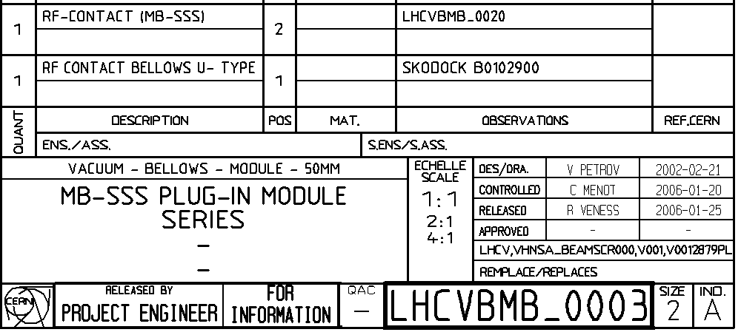

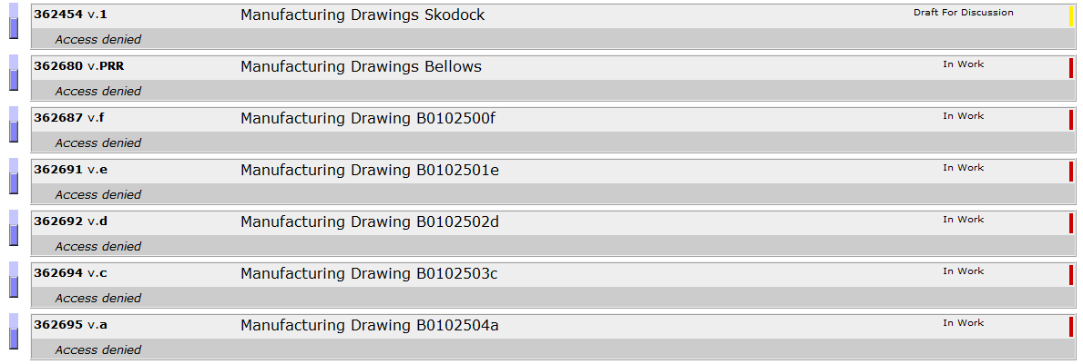
Problems & impediments
10 June 2008
A.Priebe, M.Sapinski
19

Slide 20
Cell volume
r = 0, 1, 2
ρ = 0, 1, …, 90
z = 0, 1, …, 300
r_{Coil,inner} = 28 mm
r_{Coil,outer} = 43.36 mm
r_{Cell,inner} = 28 + r · (r_{Coil,outer}-r_{Coil,inner}) · ⅓
r_{Cell,outer} = 28 + (r+1) · (r_{Coil,outer}-r_{Coil,inner}) · ⅓
V = π · [(r_{Cell,outer})² - (r_{Cell,inner})²] · z ·⅟₃₀₀ ·⅟₉₀
10 June 2008
A.Priebe, M.Sapinski
20

Slide 21
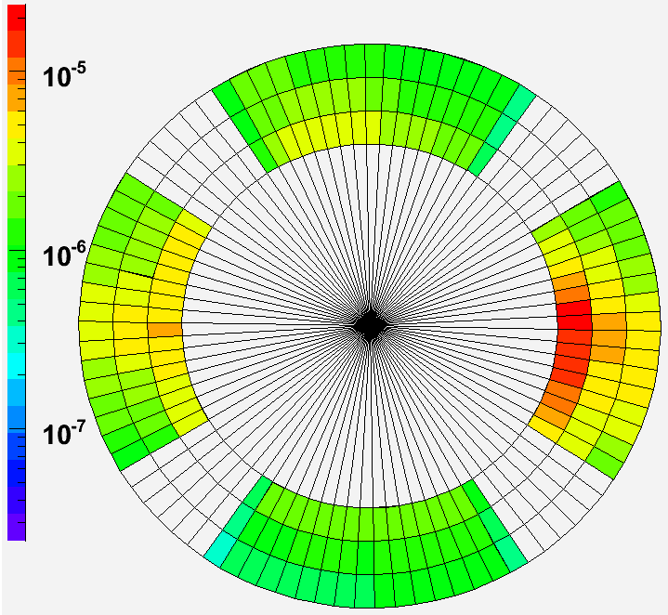
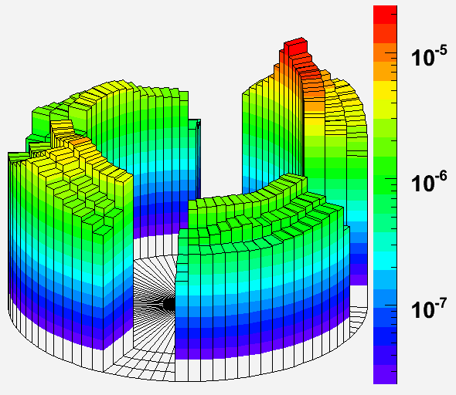
Energy depositions in the coil
[mJ/cm³]
Log (z)
[mJ/cm³]
2D histogram: (φ, r) weighted by energy density
[mJ/cm³]
Log (z)
10 June 2008
A.Priebe, M.Sapinski
21

Slide 22
Cross - section
10 June 2008
A.Priebe, M.Sapinski
22

