Slide 1
CNGS Target with LHC-bunched beams – preliminary
Cesare Maglioni ‹
EN/STI-TCD b
Thanks to :
T. Antonakakis ‹
A. Ferrari ‹
R. Losito ‹
L. Bruno ‹
October 13, 2011

Slide 2
Outline
Actual beam time-structure
Target unit configuration
Material data: Graphite 2020PT
Proposed beams (from E. Gschwendtner)
Some preliminary results
Instantaneous ΔT
Quasi-Static Stresses
Wave propagation and target rod vibration modes
Bunch/batch/pulse – does it matter?
Conclusions & next steps
C. Maglioni CNGS Target - October 18, 2011 2

Slide 3
REMEMBER – Actual Beam Time-structure
2 batches ≡ 2*2100 bunches
1 cycle ≡ 6s
1 bunch
≡ 1E10 p+
…
…
2ns
5ns
5ns
50ms
C. Maglioni CNGS Target - October 18, 2011 3

Slide 4
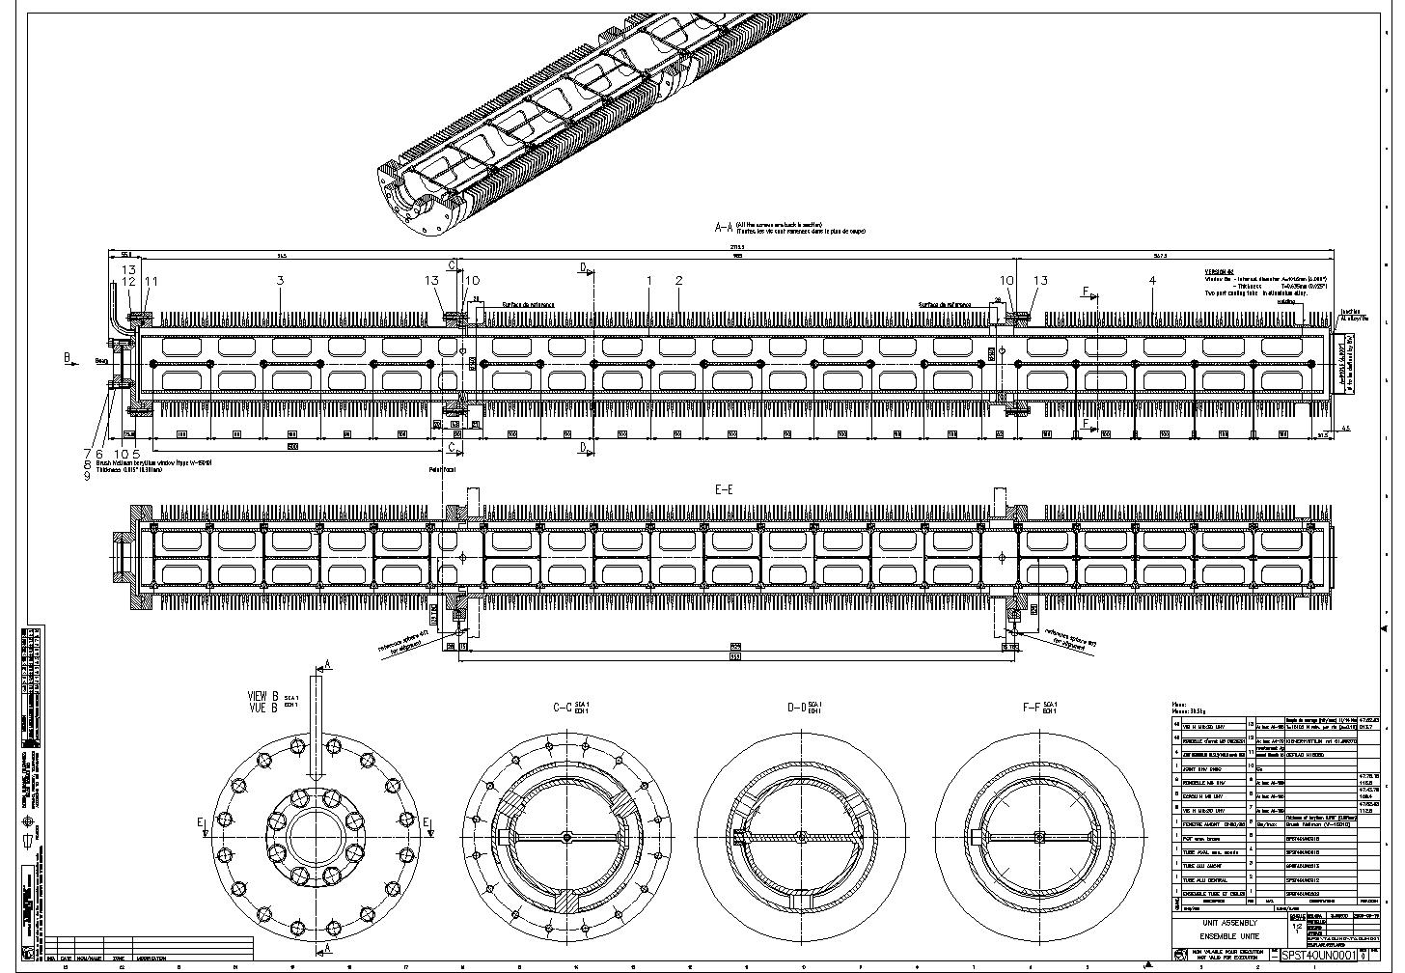
REMEMBER – Target Unit
SPS 400GeV beam
C. Maglioni CNGS Target - October 18, 2011 4

Slide 5
REMEMBER – Graphite 2020PT material data
Courtesy of L. Massidda, CRS4, Italy
REMEMBER: the target was designed to work at ~1000°C steady temperature
C. Maglioni CNGS Target - October 18, 2011 5

Slide 6
Proposed Beams (E. Gschwendtner)
5.0 ns
In respect to the actual beam, in all cases :
bunch intensity is higher
(n bunch)*(n batches) is lower
cycle length is longer → worse or better ??
Proton flux is lower (better for graphite radiation resistance)
C. Maglioni CNGS Target - October 18, 2011 6

Slide 7
Some preliminary results
C. Maglioni CNGS Target - October 18, 2011 7

Slide 8
Instantaneous ΔT & Quasi-Static Stresses
In all cases (ASSUMPTIONS):
bunch spacing is short enough to prevent any thermal diffusion → bunching is “condensed”
minimum batch spacing is 225ns → batching can also be “condensed”
The beam is centered on the target rod (no off-axis beam)
Beam sizes are the same as for the actual beam 0.53 x 0.53 mm²
Beam is “pulsed”, pulse = Σ batches (see later)
C. Maglioni CNGS Target - October 18, 2011 8

Slide 9
Case 1) Beam Time-structure
1 cycle ≡ 7.2s
1 batch ≡ 1*4 bunches = 1pulse
1 bunch ≡ 2.5E11 p+
1.5ns
500ns
500ns
500ns
C. Maglioni CNGS Target - October 18, 2011 9

Slide 10
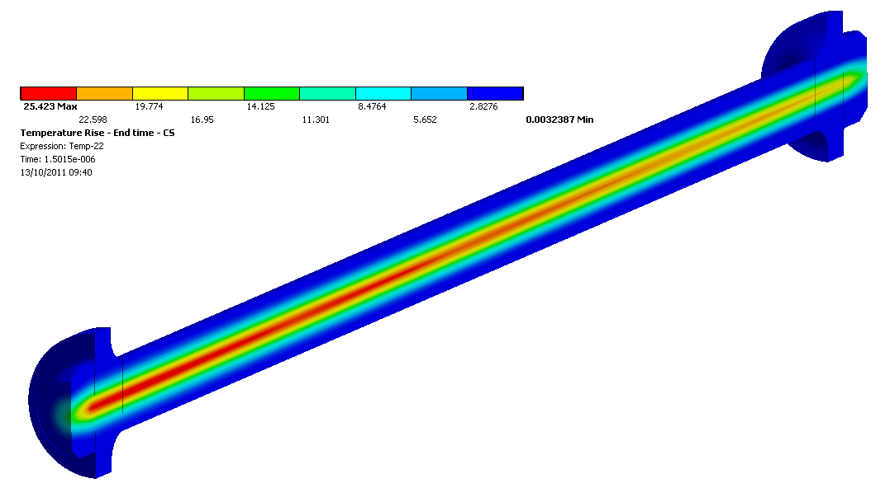
Instantaneous ΔT
Instantaneous temperature increase ΔT in the 2nd graphite rod (T_{initial} = 22°C)
Beam energy : 400 GeV
106.7 mA (1 pulse)
C. Maglioni CNGS Target - October 18, 2011 10

Slide 11
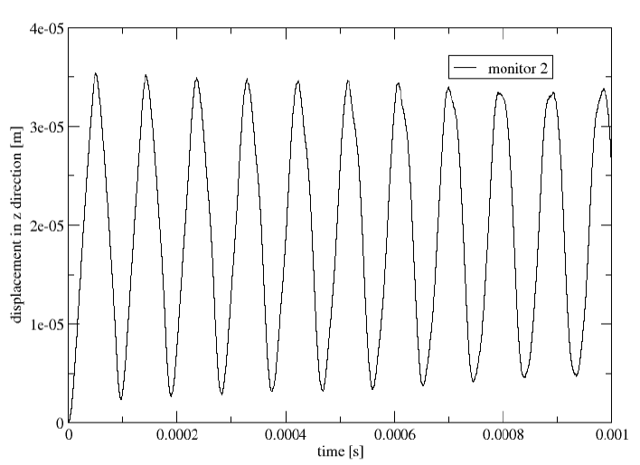
Wave propagation and vibration modes
→ Highest stresses for gauge #4 in tension, #1 and #5 in compression
rod proper vibration frequencies
1st mode | 2.16 kHz
2nd mode | 2.16 kHz
3rd mode | 5.87 kHz
4th mode | 5.87 kHz
5th mode | 11.30 kHz
6th mode | 11.30 kHz
7th mode | 17.50 kHz
8th mode | 18.25 kHz
9th mode | 18.25 kHz
10th mode | 26.60 kHz
11th mode | 26.60 kHz
12th mode | 27.20 kHz
Today’s analysis ~12 kHz
→ The beam excites the 6th vibrating mode @ 12kHz!
~12 kHz
Gauge #5
Past analysis (2004)
~12kHz
Gauge #1
→ Same conclusion
Gauge #4
C. Maglioni CNGS Target - October 18, 2011 11

Slide 12
Bunch/batch/pulse – does it matter?
bunch frequencies
1 | 2 MHz
2a | 7 MHz
2b | 7 MHz
2c | 7 MHz
2d | 7 MHz
3a | 20 MHz
3b | 20 MHz
3c | 20 MHz
3d | 20 MHz
4a | 40 MHz
4b | 40 MHz
4c | 40 MHz
4d | 40 MHz
5 | 40 MHz
batch frequencies
225.0 ns | 4 MHz
500.0 ns | 2 MHz
MHz range
1bunch only
Same result
1bunch + spacing
No influence of bunching and batching structure on the wave propagation analysis
No influence of bunching and batching times (in the “ns” scale) on the quasi-static stresses
→ (at least numerically) it doesn’t matter !!
C. Maglioni CNGS Target - October 18, 2011 12

Slide 13
Conclusions
Results significance :
Results (quasi-static stresses above all) are not absolute statements, rather they are calculated for comparison purposes
Detailed analysis of the finally chosen solution is needed, above all for stress wave propagation : dynamic stresses for case (1) under evaluation, results to be analyzed
Results confidence :
The analyses are done as for a “brand-new” target ! Ageing is not considered!
Beam sizes are the actual ones! The smaller they are, the worse it is (ΔT ↑)
Beam choice guidelines :
Batch spacing does not matter in the “ns scale” : anyhow making it very longer (μs) would help
In general, spread the same number of protons over longer times (uniformly) and over larger beam areas is better
C. Maglioni CNGS Target - October 18, 2011 13

Slide 14
Thank You ☺
Cesare Maglioni ‹
EN/STI-TCD b

