Slide 1
Fluxes and timing in the CNGS muon pits
A. Ferrari
P. Sala

Slide 2
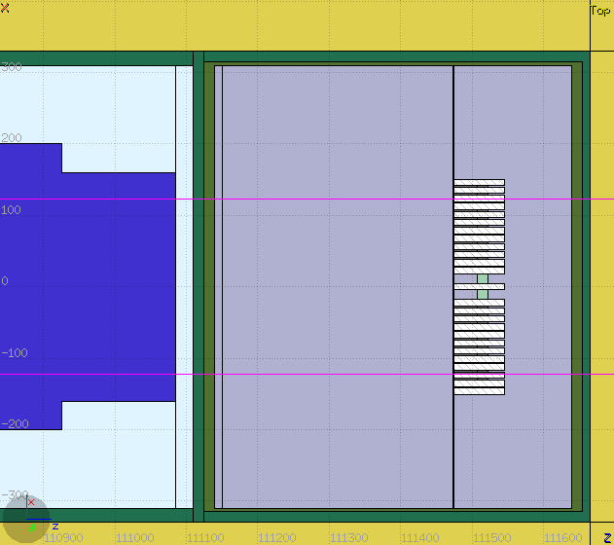
Geometry
BLMs
Here: pit1. (pit2 is the same) . Approximated layout of detectors:
( the timing results are not affected by 2nd order details)
supports: 3 mm Al plates, in front and behind diamonds
Detectors: 100μm C density 3.52
Two positions :
Detector1 at 10 cm from the pit entrance wall,
Detector2 just before the BLMs
Detector 1
Concrete
Detector 2
beam
Beam dump
Air of pit 1
325 cm
5 m

Slide 3
Spectra in 1st pit
Lethargy spectra of muons and background particles
Dominant bg: electrons and photons

Slide 4
Spectra in pit 2
Pit 2, same structure. Backgr. Is regenerated by muons
( hadrons and neutrons via photonuclear reactions)

Slide 5
MUONS spatial distributions
pit1
pit2

Slide 6
Electron spatial distr.
pit1
pit2

Slide 7
Photon spatial distribution
pit1
pit2

Slide 8
Pit 1 (det 1): energy dep. vs time
Log-y scale!
Full range : 250 ns
Position of small secondary peaks consistent with reflections in the pit

Slide 9
Pit 1 (det 2): energy dep. vs time
Log-y scale!
Full range : 250 ns

Slide 10
Pit 1 (det 2): energy dep. vs time
Extended time interval
Full range :5 μ s

Slide 11
Pit 2 (det 1): energy dep. vs time
Log-y scale!
Full range : 250 ns

Slide 12
Pit 2 (det 2): energy dep. vs time
Log-y scale!
Full range : 250 ns

Slide 13
Pit 1: det 1 vs det 2
Each x-axis division is 5 ns long

